Slide 1
Bacterial Genomics
1. Background
  A. Distribution and ubiquity of bacteria
  B. Metagenomics to escape the limits of culturability
  C. Still learning very basic features about bacteria
2. Genome sequence as “parts list”
  Identifying pathways, virulence factors, drug/vaccine targets
  Synthetic chromosomes (minimal cells, new amino acids)
  What are bacterial “species”, and how do they change?
  How big should a bacterial chromosome be?
3. Regulatory architecture as “wiring diagram”
  A. Operon, regulon, stimulon
  B. Regulon mapping
  C. Interpreting genomes of poorly-characterized bacteria
  Is regulatory architecture conserved?
Homework assignment
  Dr. Bob Blumenthal, UTHSC Robert.Blumenthal@utoledo.edu

Slide 2



Background – Distribution and ubiquity of bacteria
Given their ecological, geochemical, agricultural and medical importance, we know surprisingly little about bacteria.
• Great majority of dissolved organic N in seawater is bacterial cell wall material (peptidoglycan).
• Sediments under open ocean contain _______ bacteria/cm³
(Soil has __________ )
• Molecular methods indicate >400 species of bacteria in the human oral cavity. So far, only about 150 of those species have been cultured in laboratories and
identified. Similar situation
for gut.
• Soil microbes are historically the richest source of antibiotics used in human medicine. >99% of soil bacteria are resistant to culturing, and their antibiotics remain inaccessible by traditional means.

Slide 3
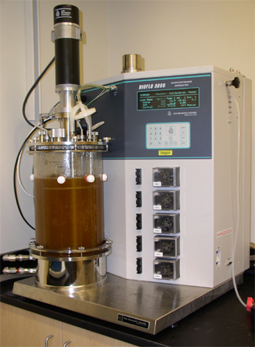
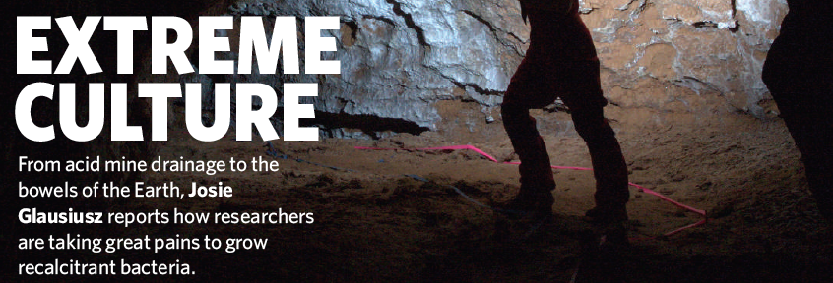
Background – Metagenomics to escape the limits of culturability
Growth parameters commonly dealt with:
pH salinity temperature pO₂
simple nutrients (too many?) light osmolarity
Difficult to accommodate:
obligate partnerships
complex nutrients etc.
The great majority of bacteria have never been grown in the laboratory.

Slide 4
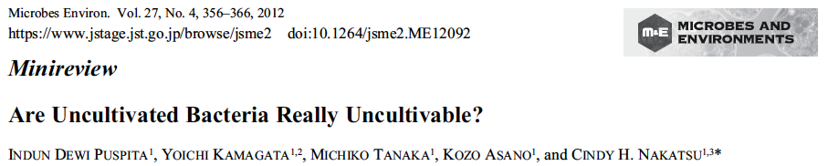
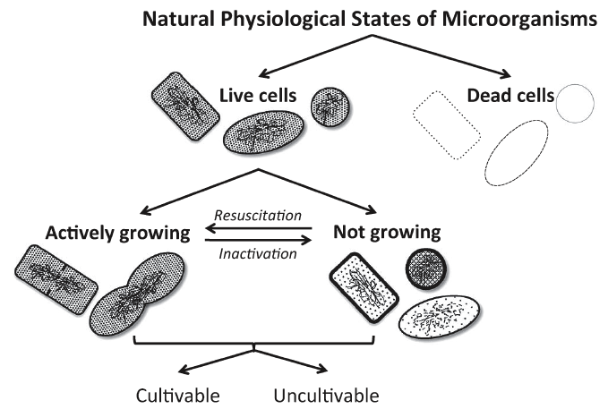
Background – Metagenomics to escape the limits of culturability

Slide 5

Background – Metagenomics to escape the limits of culturability
The finding that certain bacterial species have never been identified by culture may be a simple matter of coincidence: an organism that has a low prevalence or is particularly slow-growing may have been overlooked in cultural analyses. Additionally, many genetically distinct phylotypes are phenotypically indistinguishable and are lumped together if conventional biochemical methods for identification are used. Conversely, some bacteria are genuinely resistant to culture in isolation on conventional media.
An alternative approach for the culture of as-yet-uncultivated organisms is to simulate their natural environment in vitro. Kaeberlein et al. (2002) constructed a diffusion chamber that allowed the passage of substances from the natural environment (intertidal marine sediment) across a membrane and successfully grew bacteria from marine sediment that were previously uncultivated.

Slide 6
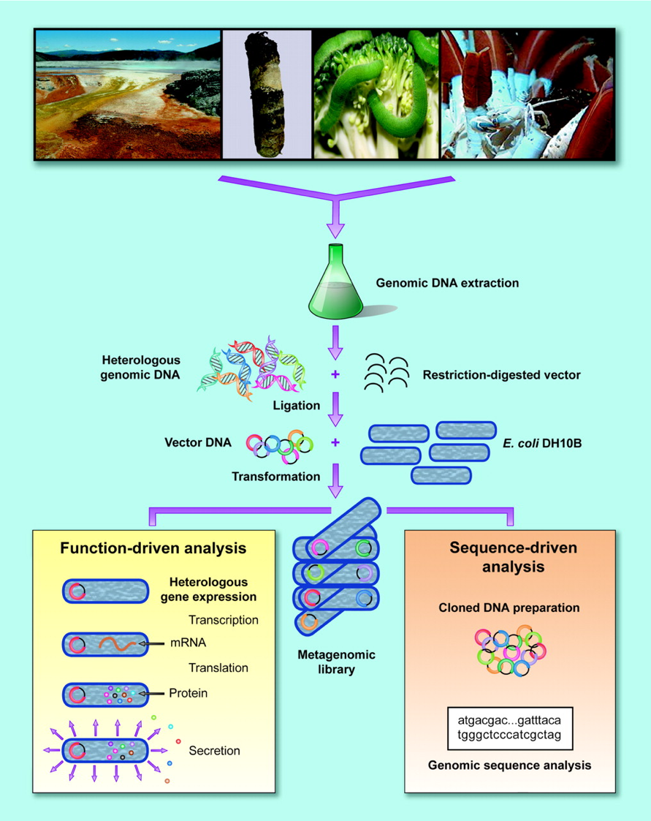

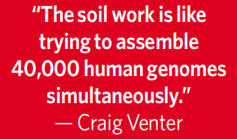
Metagenomics
Jo Handelsman
Microbiol Mol Biol Revs, 2004, 68: 669-685.
Metagenomics: Application of Genomics to Uncultured Microorganisms
V. Gewin
Nature, 2006, 439: 384-386.
Discovery in the Dirt
1g rich soil has ~10,000 species of bacteria

Slide 7

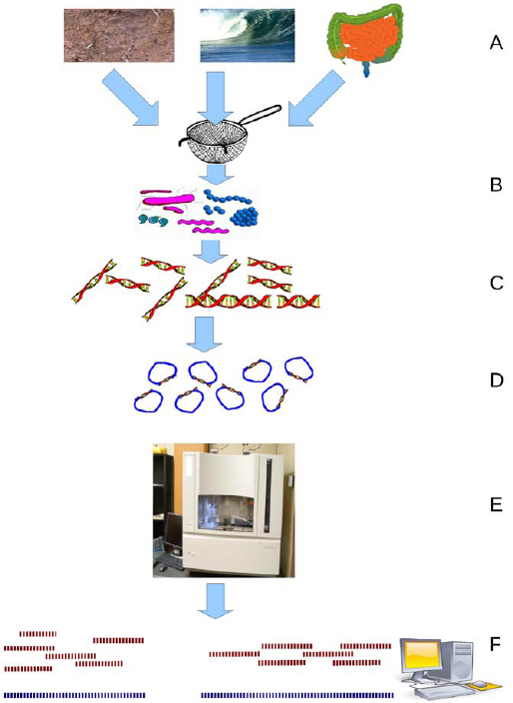
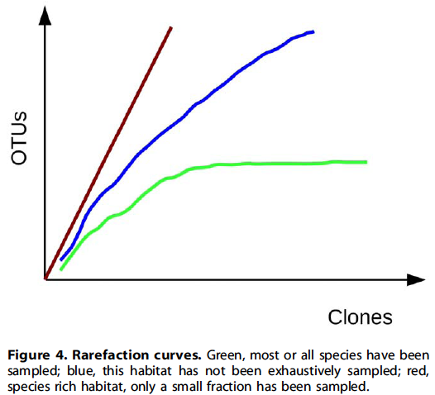
(OTU= Operational Taxonomic Unit)

Slide 8
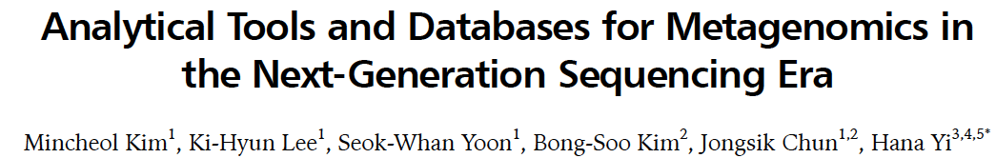
Aside from experimental design and contextual data, metagenomic data have inherent limitations that must be overcome in the future.
  Metagenomic reads commonly show a relatively low genomic coverage compared to that of a single genome
  The short length of sequencing reads makes only fragmented information by the incomplete assembly and annotation processes accessible.
Initiatives are already under way for filling the gap between metagenomic reads by doing
  co-assembly with single-cell genomics
  joint analysis between multiple metagenomes simultaneously, assuming that the same species must exist in different samples and that the co-occurrence helps extract shared information.
The ultimate goal of metagenomics is a comprehensive understanding of our ecosystem.

Slide 9
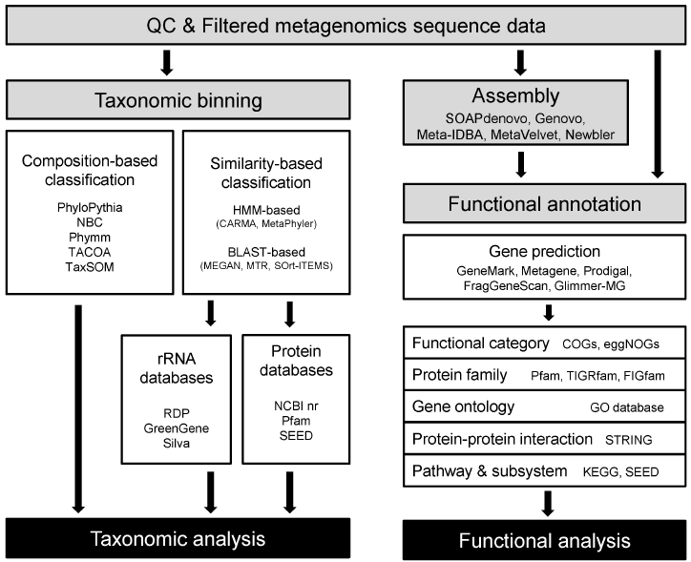

Slide 10


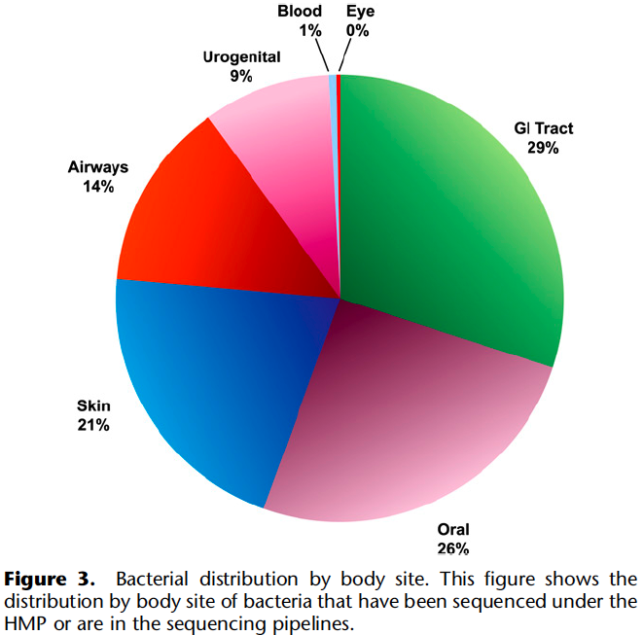
“The HMP is designed to push the frontiers of human microbiology by providing the data, tools, and resources to inform medical science more fully about the role of changes in the resident human microbiome in disease and health. It will provide a database of information that will serve as a reference for future studies.”

Slide 11
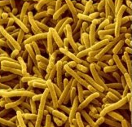
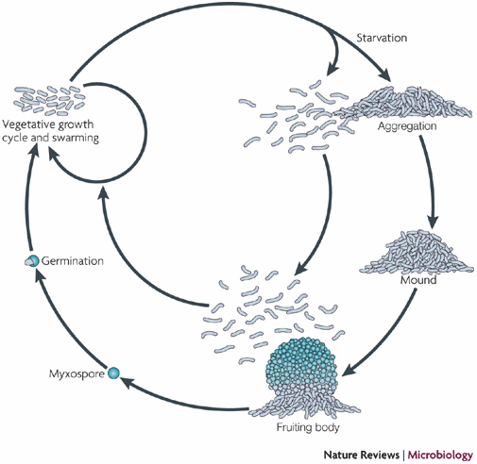
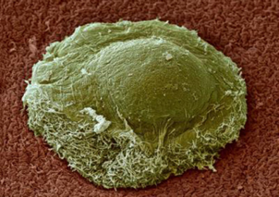
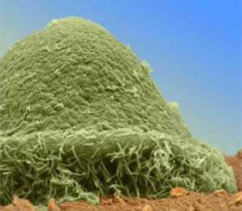
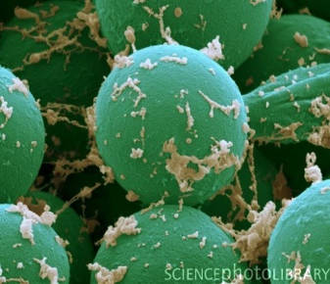
Background – Still learning most basic features about bacteria
Myxococcus

Slide 12

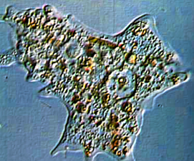
Background – Still learning most basic features about bacteria
Historical assumption:
Bacteria are small enough, and have a high enough surface-to-volume ratio, that no internal cytoplasmic organization is needed…
Surface area of sphere = 4πr² Volume of sphere = ⁴/₃πr³
Radius Surface Area Volume SA:Vol
1 12.57 4.19 3.0
2 50.29 33.52 1.5
4 201.14 268.19 0.75
10 1257.14 4190.47 0.3
…while eukaryotic cells are large enough to require a complex cytoskeleton.

Slide 13
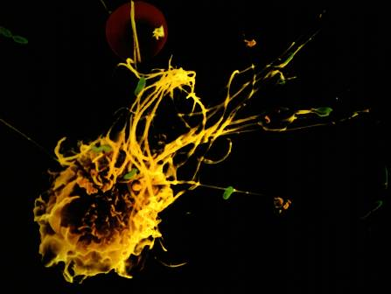
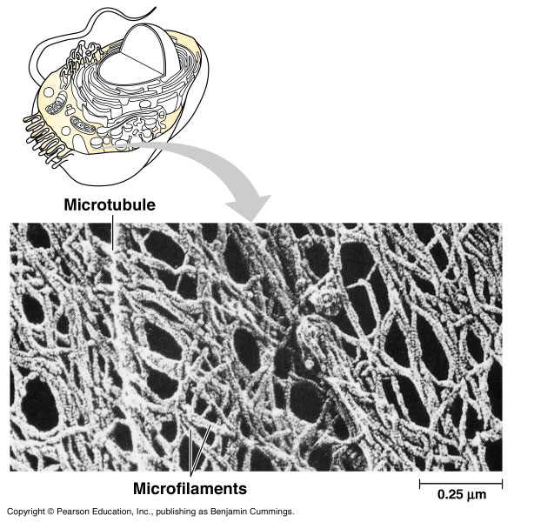
Eukaryotic cells have structurally-organized cytoplasm (cytoskeleton)
Phototake NYC/Dennis Kunkel/CNRI
bacterium
macrophage
Typical bacteria are much smaller; have been believed to lack cytoskeleton.
35.9.122.184/images/ 07-TourOfTheCell/

Slide 14
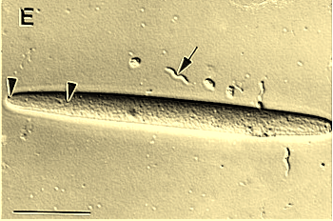
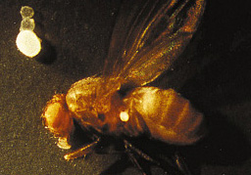
Much larger bacteria are now being discovered,
and may require cytoskeletons
Epulopiscium fishelsoni is a gut symbiont of the brown surgeonfish in the Red Sea (light micrograph, bar = 50 µm). Note the presumed spirillum (arrow) with a length of ~18 µm.
http://jb.asm.org/cgi/content/full/180/21/5601/F1
The colossus among bacteria, ~1 mm diameter, is a single-celled giant that lives in oceanic sulfur-rich sediment off Namibia and is named Thiomargarita namibiensis.
http://www.sciencenews.org/pages/sn_arc99/4_17_99/fob5.htm

Slide 15
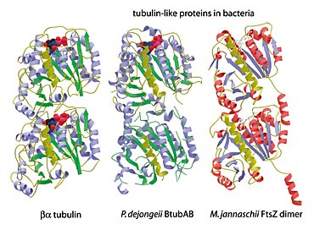
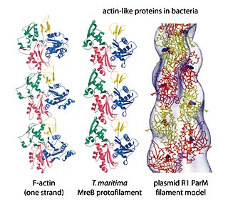
Genomics and Proteomics are Revealing that Bacteria Do Have Cytoskeletons
Bacteria contain both actin and tubulin-like proteins that polymerize in vivo and in vitro into filaments similar to their counterparts in eukaryotes
Tubulin-like proteins in bacteria
Actin-like proteins in bacteria
http://www2.mrc-lmb.cam.ac.uk/SS/Lowe_J/

Slide 16
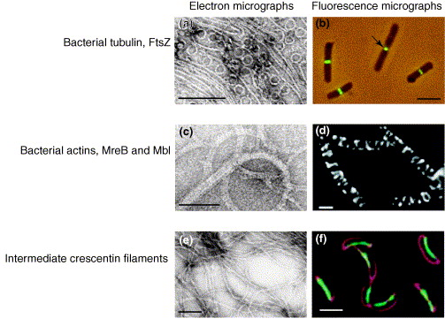
(a) Straight and curved FtsZ protofilaments. (b) Immunofluorescent localization of FtsZ in E. coli. Arrow indicates a constricting Z-ring. (c) MreB filaments and sheets. (d) Helical filaments formed by the MreB-like protein Mbl fused to GFP in Bacillus subtilis. (e) Intermediate filaments formed by crescentin. (f) Crescentin-GFP localisation to the inner cell curvature of Caulobacter crescentus. The cell membrane is stained in red.
Size bars are 100nm in (a, c, e) and 2μm (2000nm) in (b, d, f).

Slide 17
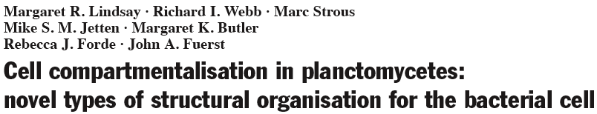
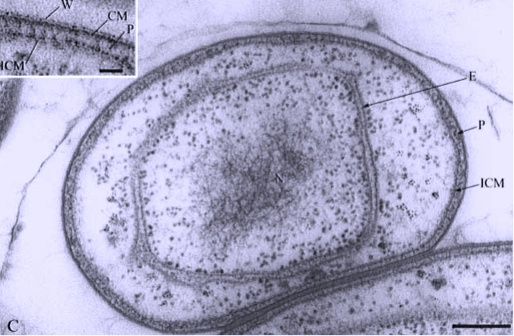

Slide 18
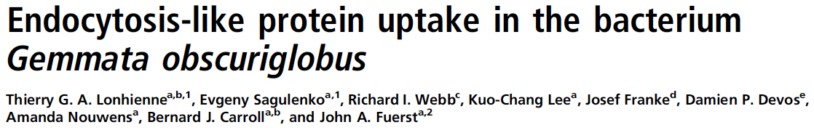
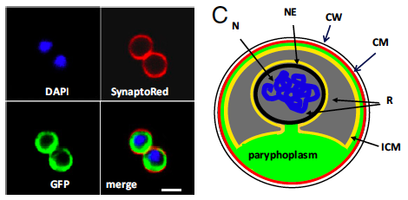
G. obscuriglobus cells were incubated with GFP and then stained with DAPI and SynaptoRed. A GFP-containing region is seen in the cytoplasm bounded by the cytoplasmic membrane as defined by the SynaptoRed staining and is separated from the nuclear body (DAPI staining). N, nucleoid; NE, nuclear envelope; ICM, intracytoplasmic membrane; R, riboplasm; CM, cytoplasmic membrane; CW, cell wall.

Slide 19
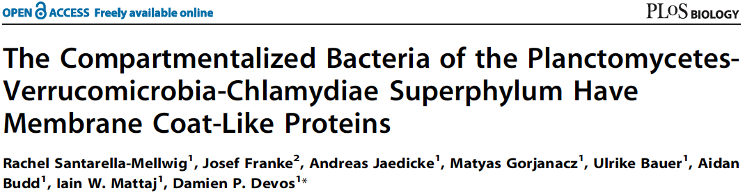
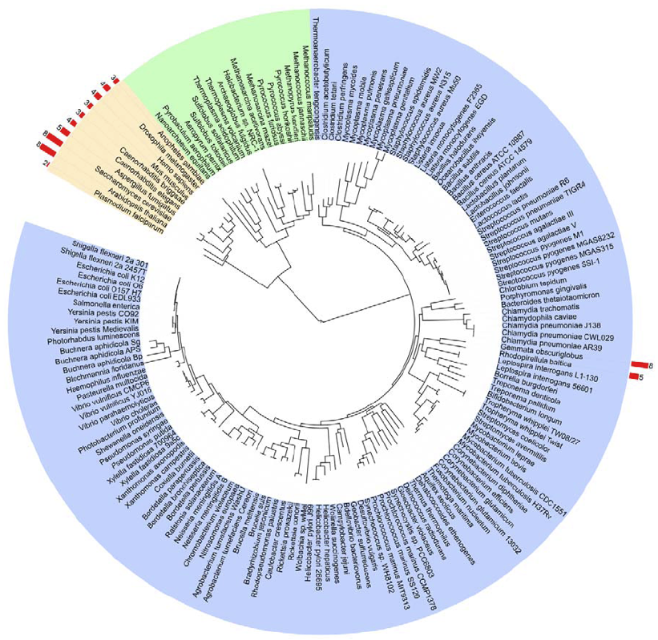
Eukaryotes, archaea, and eubacteria are grouped with orange, green, and blue backgrounds, respectively.
The number of MC proteins found in each proteome is indicated on the external arc with red bars. Note that this tree includes only two members of the PVC superphylum (both are planctomycetes).

Slide 20
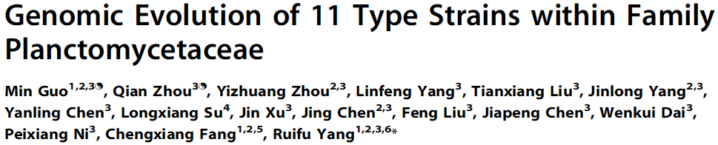
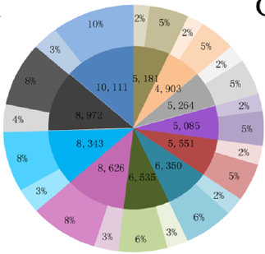
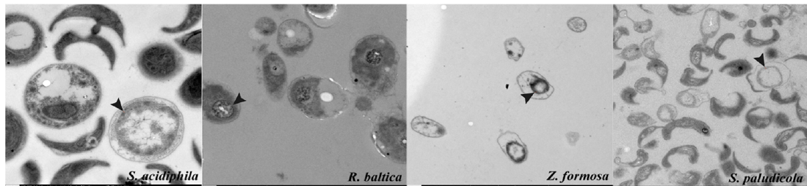
Inner ring: number of genes in the genomes;
Outer ring: characterized/uncharacterized genes.
ICM structure of four Planctomycetaceae species.

Slide 21

Genome sequence as “parts list” – Identifying pathways, virulence factors, drug/vaccine targets
http://www.ncbi.nlm.nih.gov/genomes/static/gpstat.html
• Species count as of March 2014:
 | Complete | Full Draft | In Progress | Total
Archaea | 100 | 5 | 48 | 153
Bacteria | 1017 | 961 | 547 | 2525
Eukarya | 36 | 319 | 294 | 649
Total | 1153 | 1285 | 889 | 3327

Slide 22
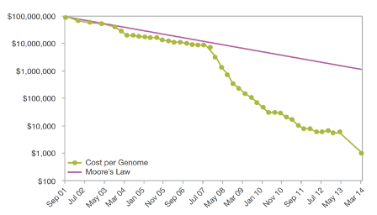

Genome sequence as “parts list” – Identifying pathways, virulence factors, drug/vaccine targets
“The HiSeq X retails for $1 million a unit – and Illumina won’t sell you fewer than ten. Despite the massive upfront costs, the math seems to check out.”
What You Need to Know About Illumina's New Sequencers
http://www.bio-itworld.com/BioIT_Article.aspx?id=133900
By Aaron Krol January 15, 2014

Slide 23

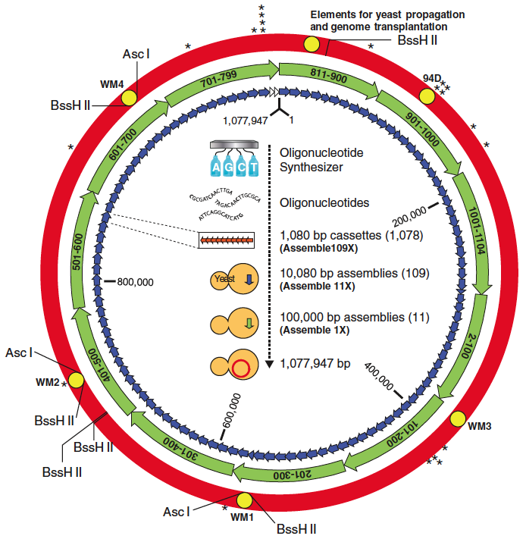
“We report the design, synthesis, and assembly of the 1.08–mega–base pair Mycoplasma mycoides JCVI-syn1.0 genome starting from digitized genome sequence information and its transplantation into a M. capricolum recipient cell to create new M. mycoides cells that are controlled only by the synthetic chromosome. The only DNA in the cells is the designed synthetic DNA sequence, including “watermark” sequences and other designed gene deletions and polymorphisms, and mutations acquired during the building process. The new cells have expected phenotypic properties and are capable of continuous self-replication.”

Slide 24
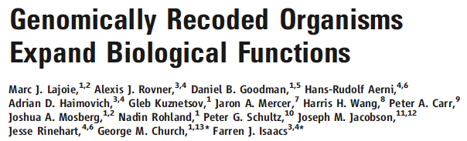

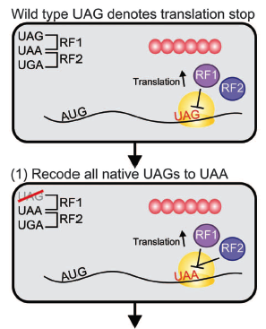
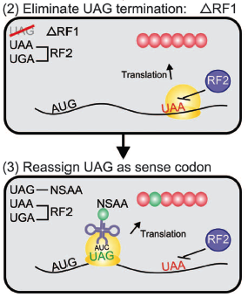
We selected UAG as our first target for genome-wide codon reassignment because:
UAG is the rarest codon in E. coli MG1655 (321 known instances)
prior studies demonstrated the feasibility of amino acid incorporation at UAG
a rich collection of translation machinery capable of incorporating nonstandard amino acids has been developed for UAG. [E.g., phosphoserine, p-acetyl-phenylalanine]

Slide 25
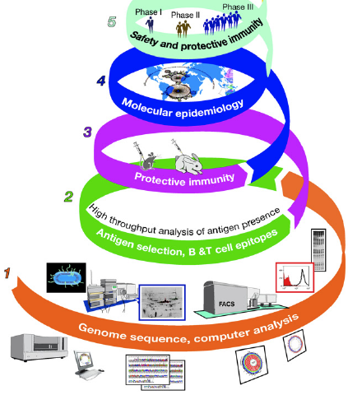

Genome sequence as “parts list” – Identifying pathways, virulence factors, drug/vaccine targets
(1) Computer analysis of the whole genome identifies the genes coding for predicted antigens, and eliminates antigens with homologies to human proteins. (2) Then the identified antigens are screened for expression by the pathogen and for immuno-genicity during infection. (3) The selected antigens are then used to test whether immunization induces a protective response.
(4) Protective antigens are then tested for their presence and conservation across the species (molecular epidemiology). (5) Selected antigens are produced in large scale for clinical trials.

Slide 26
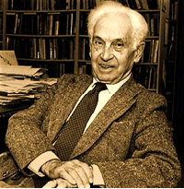
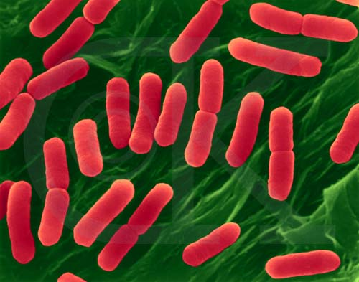
Genome sequence as “parts list” – What are bacterial “species”, and how do they change?
“Species are groups of interbreeding natural populations that are reproductively isolated from other such groups."
Ernst Mayr (1905 - 2005)
Bacteria reproduce asexually (and most have single chromosomes).
image is copyright Dennis Kunkel

Slide 27
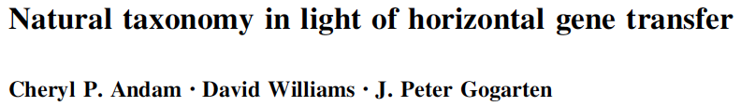
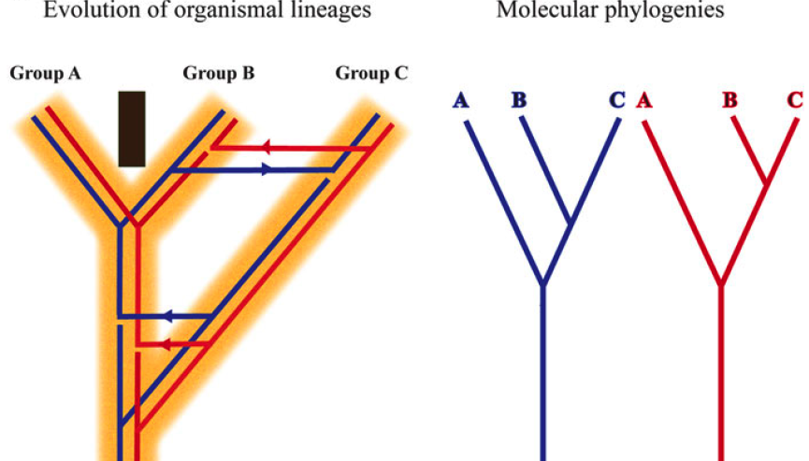
Genome sequence as “parts list” – What are bacterial “species”, and how do they change?

Slide 28
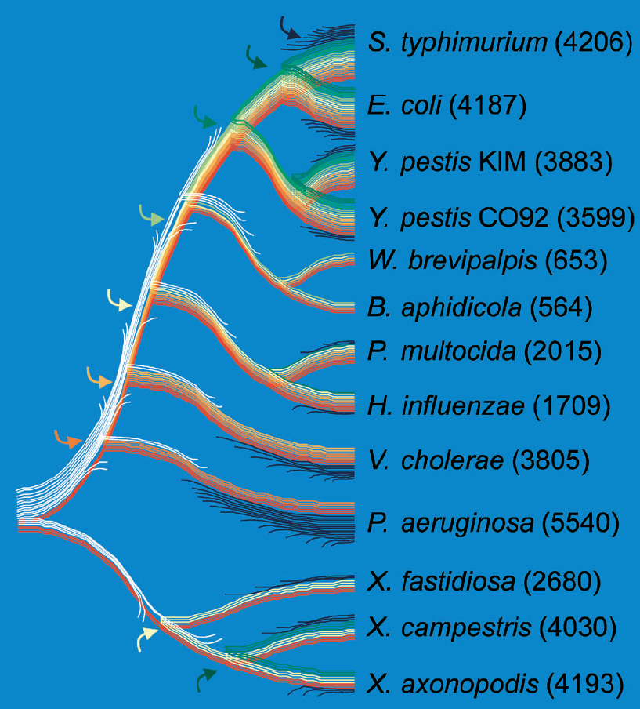
Genome sequence as “parts list” – What are bacterial “species”, and how do they change?
Genome Evolution in γ-Proteo-bacteria
Only a small proportion of genes have been retained since the common ancestor of γ-proteo-bacteria (red). If ancestral and contemporary genome sizes are similar, most genes from this ancestral genome (white) have been replaced by nonhomologous genes (yellow to green), usually via LGT from organisms outside of this clade. The abundance of genes unique to a species (blue) indicates that these bacteria (with the exception of the endosymbionts) constantly acquire new genes, most of which do not persist long-term within lineages. (Numbers of non-IS or -phage ORFs are shown in parentheses).
Lerat et al., 2005. PLoS Biol. 3(5): e130, 1-8

Slide 29
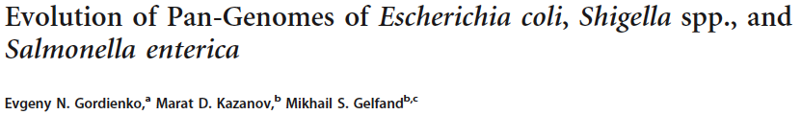
The pan-genome is the total complement of genes from all sequenced strains of the same species, genus, or a larger group.
The pan-genome consists of three parts:
  the universal genome with genes common for all strains
  the unique genome with strain-specific genes (known as ORFans)
  the periphery (genes that are present in a subset of strains).
In most studied bacterial species, the gene content of strains varies widely, and each additional sequenced strain adds new genes to the pan-genome.
  The E. coli pan-genome is open (far from saturation).
The distribution of the OGs by the number of strains in which they are present has a well-known U-shape form.
  The periphery genes tend to be rare (present in just 2-3 strains) or almost universal (absent from only a few strains).
  This holds true for the E. coli-plus-Shigella distribution .
  Overrepresented functions in the unique genome tend to be plasmid related, e.g., “DNA restriction-modification system” or “response to mercury ion.”

Slide 30
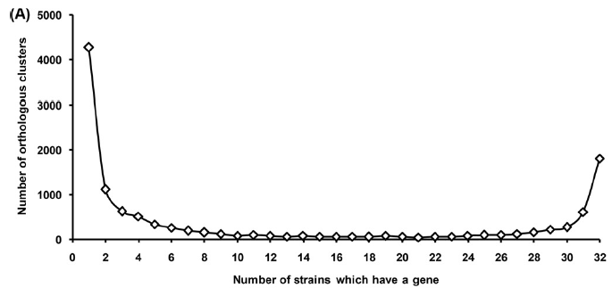
The pan-genome is the total complement of genes from all sequenced strains of the same species, genus, or a larger group.
The pan-genome consists of three parts:
  the universal genome with genes common for all strains
  the unique genome with strain-specific genes (known as ORFans)
  the periphery (genes that are present in a subset of strains).
In most studied bacterial species, the gene content of strains varies widely, and each additional sequenced strain adds new genes to the pan-genome.
  The E. coli pan-genome is open (far from saturation).
The distribution of the OGs by the number of strains in which they are present has a well-known U-shape form.
  The periphery genes tend to be rare (present in just 2-3 strains) or almost universal (absent from only a few strains).
  This holds true for the E. coli-plus-Shigella distribution .
  Overrepresented functions in the unique genome tend to be plasmid related, e.g., “DNA restriction-modification system” or “response to mercury ion.”
unique (ORFans)
universal
periphery

Slide 31
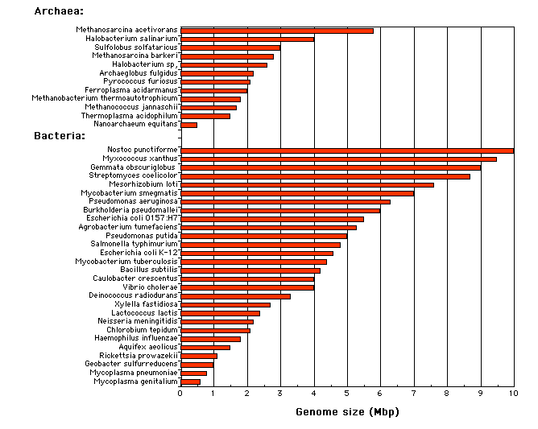
Genome sequence as “parts list” – How big should a bacterial chromosome be?
Microsporidium
Saccharomyces
http://www.sci.sdsu.edu/~smaloy/MicrobialGenetics/topics/chroms-genes-prots/genomes.html

Slide 32
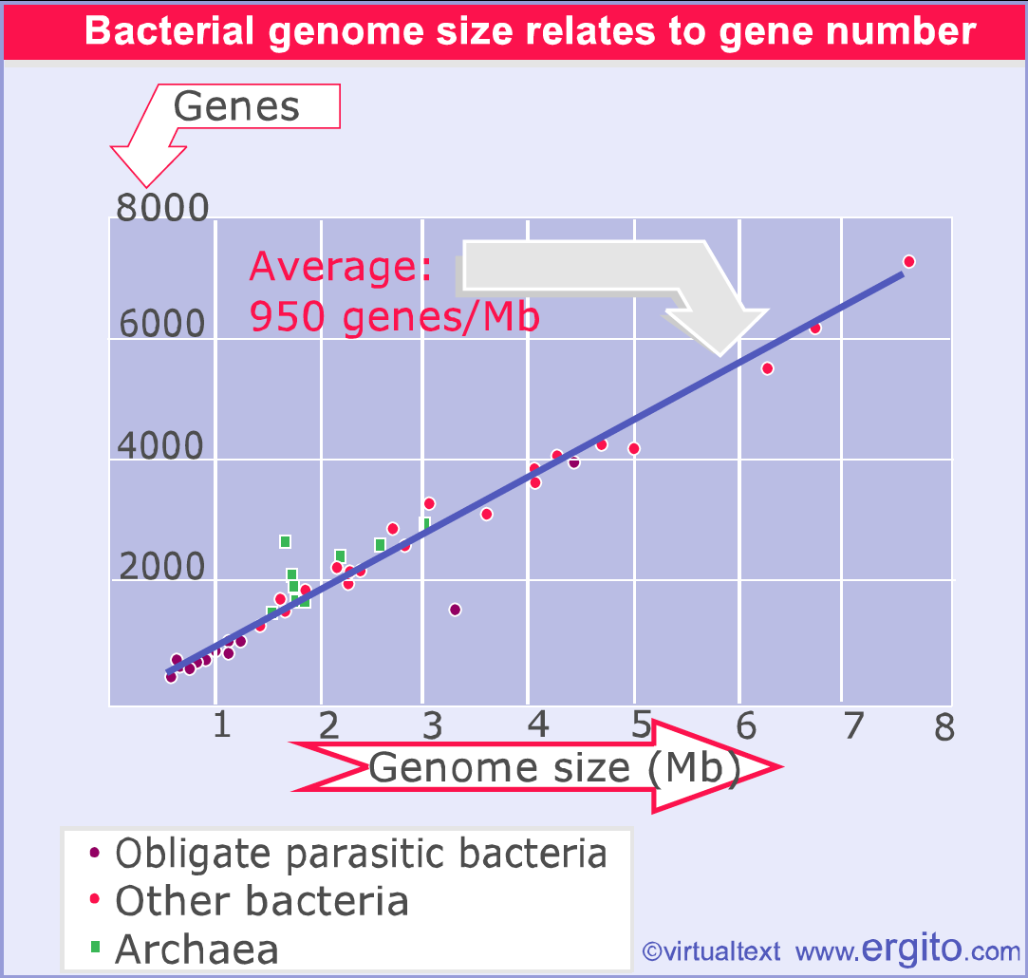
Genome sequence as “parts list” – How big should a bacterial chromosome be?
http://bioscience.jbpub.com/cells/MBIO137.aspx

Slide 33
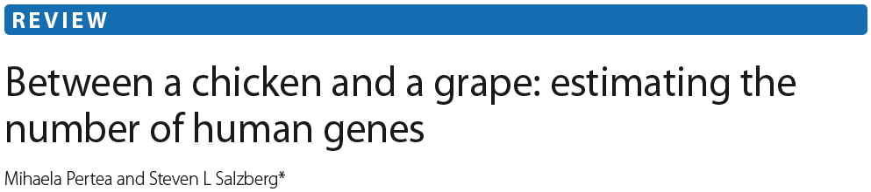
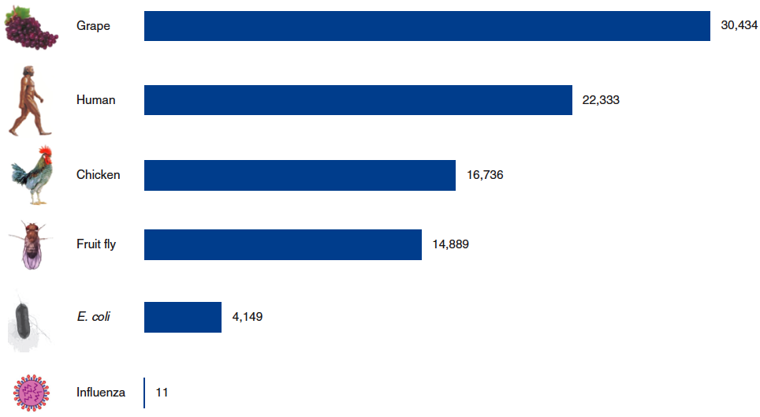

Slide 34



Genome sequence as “parts list” – How big should a bacterial chromosome be?
For 100 complete bacterial genomes, measured NUMBER of genes in various superfamilies in the genome, and plotted vs. size of that genome.
Mostly metabolic gene families.
Mostly regulatory gene families.

Slide 35

Genome sequence as “parts list” – How big should a bacterial chromosome be?

Slide 36


Genome sequence as “parts list” – How big should a bacterial chromosome be?

Slide 37



Genome sequence as “parts list” – How big should a bacterial chromosome be?

Slide 38



We extracted from primary literature 214 minimal generation times (d) of species of bacteria and archaea. We used these data to assess how genomic traits correlate with minimal generation times.
  We started by analyzing its correlation to genome size.
  Historically, microbial genomes have been viewed as short and compact due to selection for rapid replication and fast growth.
  In agreement with previous work, we found no evidence for a positive correlation between minimal generation time and genome size or genome density (Spearman correlations r =20.10 and 20.08, p-value = 0.13 and 0.24).
  Replication can be initiated before the previous rounds have finished (Cooper & Helmstetter, 1968). There is thus no necessity for a direct correlation between genome size and minimal generation time.
[Instead], we found an increase in copy number of rRNA and tRNA genes with decreasing minimal generation times (r=20.59 and r =20.51, all p-value,0.0001).

Slide 39
Regulatory architecture as “wiring diagram”
• Problem: parts list has limited value without wiring diagram

Slide 40


Regulatory architecture as “wiring diagram”
(all you can do with meta-genomics)

Slide 41


Regulatory architecture as “wiring diagram” –
  Operon, regulon, stimulon
http://users.rcn.com/jkimball.ma.ultranet/BiologyPages/
http://cwx.prenhall.com/horton/

Slide 42

Regulatory architecture as “wiring diagram” –
  Operon, regulon, stimulon
Regulon – a group of operons controlled by the same regulator.
Can have a mix of + and – control.
Can have overlapping regulons (multiple regulators).
DtxR^{C102D}• Ni⁺⁺ • tox
(White et al., 1998, Nature 394: 502-6)
E.g., E. coli ArgR regulon includes 18 genes.

Slide 43
Regulatory architecture as “wiring diagram” –
  Operon, regulon, stimulon
Even for best-studied organism on the planet (E. coli), we know relatively little:
• There are about ~320 transcription regulatory proteins; only ~ half have been characterized.
• Some of the uncharacterized 1/2 of regulators could be “global” (subset of key regulators that each control 100s of genes)
• This is a problem, because people are trying to use our RELATIVELY extensive knowledge of E. coli to predict the regulatory architecture of organisms about which we know next to nothing.

Slide 44
Regulatory architecture as “wiring diagram” –
  Operon, regulon, stimulon
Stimulus
(heat, O₂, nutrients, population density, surface attachment, UV, pH, etc.)
“Half of the known and predicted transcriptional regulators in E. coli have predicted domains for the binding of small metabolites, whereas 10% have a CheY-like response regulator receiver domain that are phosphorylated by kinases in two-component signal transduction systems.”
Marinez-Antonio & Collado-Vides, 2003, Curr Opinion Microbiol 6: 482-489.
?
?
Regulator
Regulator
Regulator
Regulator
Regulator
Regulator
Regulator

Slide 45
Regulatory architecture as “wiring diagram” –
  Operon, regulon, stimulon
Problem:
Huge number of poorly-studied bacteria
Laboratory analysis of which genes are expressed under which conditions (where the bacteria can be grown) is accurate, but very labor intensive.
Would like to predict gene regulation via bioinformatics
This is (currently) exceptionally difficult.
Example: predicting promoters

Slide 46





Slide 47

Hard to identify promoters from sequence alone.
Reason #1: Variable distance from ATG initiation codon

Slide 48
RNAP can associate with any of the seven σ factors present in E. coli
  Each σ factor recognizes different consensus promoter motifs
  The majority of genes expressed during exponential growth involve the ‘‘housekeeping’’ σ70 factor.
  The other six ‘‘alternative’’ σ factors have specific roles in stress survival and adaptation to environmental conditions.
Unambiguous determination of which form of RNAP holoenzyme is transcribing a gene is not straightforward.
Hard to identify promoters from sequence alone.
Reason #2: Multiple sigma factors

Slide 49
The canonical model for the σ⁷⁰-DNA promoter sequence:
  –35 hexamer, consensus sequence = TTGACA
  Spacer of 15 to 21 nucleotides
  –10 hexamer, consensus sequence = TATAAT
    –10 element is essential; stabilizes initial RNAP-σ binding to promoter
Other elements can modify the canonical model of the σ⁷⁰ promoters:
  extended –10 region (TG), that is located 1 nucleotide upstream of the –10 element
    Promoters with extended –10 normally have poor –35 element
  UP element, usually positioned 4 nucleotides upstream of the –35 promoter region.
Hard to identify promoters from sequence alone.
Reason #3: Promoters have only short “consensus” sequences

Slide 50
Different combinations of promoter elements vary the basal strength
On average, σ⁷⁰-dependent promoters preserve just 8/12 canonical nucleotides of the –35 and –10 hexamers
~10% of promoters match the consensus in only about half the nucleotides and yet still serve as sites for σ binding.
Activated promoters often poorly match consensus (otherwise they would not need to be activated).
[Also, in bacteria having genomes with low %GC, TATAAT –10 consensus occurs very frequently on a random basis.]
Hard to identify promoters from sequence alone.
Reason #4: Promoters do not always fit “consensus”

Slide 51


sequence logos:
http://weblogo. berkeley. edu/
Also hard to identify regulator binding sites from sequence alone.
Reason #1: Operators do not always fit “consensus”

Slide 52

Also hard to identify regulator binding sites from sequence alone.
Reason #2: If there are multiple cooperative operators, none of them needs to be particularly strong.

Slide 53


Also hard to identify regulator binding sites from sequence alone.
Reason #3: Operator-promoter spacing is variable.

Slide 54

…organisms of the most different sorts are constructed from the very same battery of genes. The diversity of life forms results from small changes in the regulatory systems that govern expression of these genes.
– François Jacob,
Of Flies, Mice, and Men
Also hard to identify regulator binding sites from sequence alone.
Reason #4: Role of conserved regulators is variable between species.

Slide 55

Application: Changing Role of Transcription Factor Lrp
Global
Local
???
(Lost; reduced genome)
Adapted from Price et al., Genome Biol 2008, 9:R4; generated from concatenated alignments of 74 highly-conserved proteins.

Slide 56


Regulatory architecture as “wiring diagram” –
master regulators
middle managers
work-horses
E. coli transcriptional regulatory network follows a power-law distribution.
Seven global regulators:
ArcA Crp
Fis Fnr
Hns Ihf
Lrp

Slide 57


Regulatory architecture as “wiring diagram” –
“(Left) The transcriptional regulatory network of E. coli. (Right) The call graph of the Linux Kernel. Nodes are classified into three categories on the basis of their location in the hierarchy: master regulators (nodes with zero in-degree, Yellow), workhorses (nodes with zero out-degree, Green), and middle managers (nodes with nonzero in- and out-degree, Purple).”

Slide 58

Regulatory architecture as “wiring diagram” –
“The transcriptional regulatory network (1,378 nodes) follows a conventional hierarchical picture, with a few top regulators and many workhorse proteins. The Linux call graph (12,391 nodes), on the other hand, possesses many regulators; the number of workhorse routines is much lower in proportion.”

Slide 59
Regulatory architecture as “wiring diagram” –
“From an engineering point of view, the reuse of common nodes between modules is a cost-effective way to construct a complex system. However, such optimized usage of functions comes at the expense of robustness, because breakdown of a generic function causes problems in many modules.
More importantly, generic functions lead to potential fragility in the sense that modifying any module may require compensating changes in a generic function. As a result, generic functions have to be updated more often…
The low overlap between modules in biological networks, on the other hand, increases robustness. Modules tend to work more independently by recruiting different sets of workhorses from the broad base of the network hierarchy.”

Slide 60


Regulatory architecture as “wiring diagram” –
  Regulon mapping
1. Is the regulator conserved between Bug X and E. coli?
2. Is the target gene conserved between Bug X and E. coli?
3. Is there a putative binding site for the conserved regulator upstream of the target gene in Bug X?
IF {1, 2, AND 3}, “regulation is probably conserved”.

Slide 61
Regulatory architecture as “wiring diagram” –
  Regulon mapping
Additional concerns:
1. Many “Bug X”s live in environments radically different from those inhabited by E. coli, and probably have different regulatory goals.
2. It is genetically easy to alter regulation, EVEN IF regulator, target, and binding site are conserved.
E.g., Hidalgo & Demple, 1997, EMBO J. 16: 1056-1065.
Spacing of promoter elements regulates the basal expression of the soxS gene and converts SoxR from a transcriptional activator to a repressor.
• The assumption that conserved regulator, target, and binding site implies conserved regulation has not been carefully tested.
(We have been using the Lrp regulon to test this assumption.)

Slide 62

Lrp
• Leucine-responsive Regulatory Protein
• Abundant in enteric bacteria (~20,000 monomers/cell)
• Exists as dimers, octamers, and hexadecamers
• As the name implies, leucine is a coregulator
• Depending on the target gene, leucine can be neutral, potentiating or antagonistic for Lrp activity.
• Lrp activates or represses transcription; in some cases switching between activation and repression in response to leucine.
• Lrp controls over 400 genes, >200 of them directly.

Slide 63


Helix-turn-helix

Slide 64




[Reminder: Helix-Turn-Helix motif]
http://swift.cmbi.ru.nl/gv/students/mtom/SUP_1.html

Slide 65


Regulatory architecture as “wiring diagram” –
Okamura et al., 2007. Structure 15: 1325-38.

Slide 66


Testing Lrp equivalence – Substitution test
E. coli
Tn10
lr lrp
lrp
Plac
lrp
pHetero-Lrp
“Assay” is identical set of promoters
Identical nonspecific DNA as well
Same expression sequences for the lrp orthologs
Same coregulator transport and biosynthesis systems

Slide 67
Testing Lrp equivalence – Substitution test
532 genes responsive to EcoLrp
Why are EcoLrp and PmiLrp so different?
Eco+Vch only
(61; 12%)
Eco only
(198; 37%)
Eco+Pmi only
(108; 20%)
Eco+Pmi+Vch
(165; 31%)
False discovery rate <5%
Genes responsive to:
PmiLrp only – 107
VchLrp only – 162
Notes:
67

Slide 68



Testing Lrp equivalence – N-terminal tails
PDB 2GQQ

Slide 69


Testing Lrp equivalence – N-terminal tails
VchEcoLrp M V D S Y K K P S K D L D (EcoLrp K5Y, R7K, G9S)
PmiEcoLrp M I D N K K R P G K D L D (EcoLrp V2I, S4N)
K6QEcoLrp M V D S K Q R P G K D L D (EcoLrp K6Q)
EcoLrp M V D S K K R P G K D L D
λCI (WT) M - S T K K K P L T Q E Q
λCI Actives M - x x B K B x L T Q E Q (x = any AA; B = K or R)
⁺H₃N
NH₃⁺
DNA-binding domains of λCI dimer
PDB 3BDN

Slide 70

Testing Lrp equivalence – N-terminal tails
Vector
Vch
–
lrp
Eco
LacZ Activity (Modified Miller Units)
Plrp-lacZ
+Leu
VchEco
Pmi
(EcoLrp V2I, S4N)
PmiEco
Culture Density (OD_{600nm})

Slide 71
Take-home lessons
• Bacteria typically have several thousand genes, that must be regulated in a coordinated fashion in response to time and to complex environmental changes.
• Very basic questions about bacterial structure and physiology remain to be answered, even in well-studied species such as Escherichia coli. Bioinformatics is helping in this (e.g., the discovery of membrane coat proteins in the Planctomycetes).
• Metagenomic approaches are yielding genome sequences for bacteria that cannot yet be grown in the laboratory, and there is great interest in developing robust methods to predict regulation from the DNA sequences.
• The global regulator Lrp has an unexpectedly broad range of small-molecule coregulators, and appears to modulate its specificity via an unstructured amino-terminal tail.
• Even in E. coli, it is surprising how much remains to be learned about basic regulatory processes.
• Purely bioinformatic approaches to predicting regulation in bacteria will depend on a fuller understanding of transcription factor structure and function than we currently possess.

Slide 72


Homework assignment
Go to the microbial genomes BLAST page: http://blast.ncbi.nlm.nih.gov/Blast.cgi?PAGE_TYPE=BlastSearch&BLAST_SPEC=MicrobialGenomes and then choose the BLASTP tab.
The list of Planctomycetaceae genera with sequenced genomes (you don’t need the species names) can be found in Figure 3 of Guo et al., 2014 (PMID 24489782), but on the specialized BLAST page you can just enter “Planctomycetes” into the “Organism optional” box.
As the search seeds, use the amino acid sequences for any two of the seven global regulators of E. coli (ArcA, Crp, Fis, Fnr, Hns, Ihf, or Lrp) – your choice. [Note: Ihf is a heterodimer so there are two genes for it.]

Slide 73
Homework assignment
If there are no detectable matches, adjust the minimum “expect” score or gap parameters; if you do, be sure to note this in your report.
Prepare a multiple alignment (using single-letter amino acid abbreviations) of the E. coli and 11 Planctomycete sequences. If no good candidate appears, leave that species out, but if you can find NO credible ortholog in the Planctomycetes, try at least one more.
At the end of the alignment, note the % identity of each sequence to the E. coli sequence.
The central question is whether this group of bacteria, unusual in having a nuclear membrane, possesses obvious orthologs of any of the E. coli global regulatory proteins.
Your report should:
  begin with a brief summary of what this protein does in E. coli
  followed by your multiple alignment, including a table of protein name, species names, and accession numbers
  then some justified conclusion about distribution of these regulators

