Slide 1
Applications of Bioinformatics, Proteomics, and Genomics (BIPG 640/840)
Course Director:
Alexei Fedorov, Ph.D.
Office: Room 12 RHC
Associate Professor
Head of Bioinformatics Lab
Department of Medicine
University of Toledo, Health Science Campus
Tel: (419)‑383‑5270
Email: alexei.fedorov@utoledo.edu
http://www.utoledo.edu/med/depts/bioinfo/fedorov.html

Slide 2
Time schedule
Webinar lectures will be twice a week
Tuesdays and Thursdays
Sometimes a lecture could be converted to a three hour lab class (when a special demonstration of programs and tools are desirable). HSC UT, Health Education Building Rm 127
QUESTIONS:
Dr. Fedorov is available every Tuesday 2:30-3:00 via teleconferencing facility or at HSC, Collier Bld. Rm 3107

Slide 3
Grading
Homework (≥ 6 hours) 40%
LABs+ activity 10%
Mid-term Exam 20%
Final Exam 30%
Extra points for outstanding homework and special assignments are possible!
Students receive a waiver to change one homework grade to A

Slide 4
Principles of Student Evaluation.
The course will be taught by several leading scientists from the BPG consortium (MCO, UT and BGSU). Each lecturer will give an assignment covering his/her specific topic and then evaluate student homework. The final grade will be an average of all the grades a student get throughout the course.
Each homework should be returned within 10 days

Slide 5
ABPG Teachers
Dr. Neocles Leontis (BGSU; RNomics)
Dr. Douglas Leaman (UT, Main; Genomics)
Dr. Scott Rogers (BGSU; Bioinformatics)
Dr. Craig Zirbel (BGSU; Bioinformatics)
Dr. John Gray (UT, Main; Genomics)
Dr. Eva Skrzypczak (UT, Medicine; Proteomics)
Dr. Sadik Khuder (UT, Medicine; Bioinformatics)
Dr. Robert Blumenthal (UT, Medicine; Genomics)
Dr. Jerzy Jankun (UT, Medicine; Proteomics)

Slide 6
Objectives
In this core course of the BPG program (normally taken after the other three core courses), students will be made aware of the most advanced computational techniques, programs and databases at the frontiers of biomedical sciences.
The course will cover four major topics (Bioinformatics, Genomics, RNomics, Proteomics) ,focusing in particular (though not exclusively) on the human organism.

Slide 7
In this course much of the materials will not be from a
single textbook but from recently published papers and
Internet resources
Information in textbooks
Information in articles
Unpublished data

Slide 8
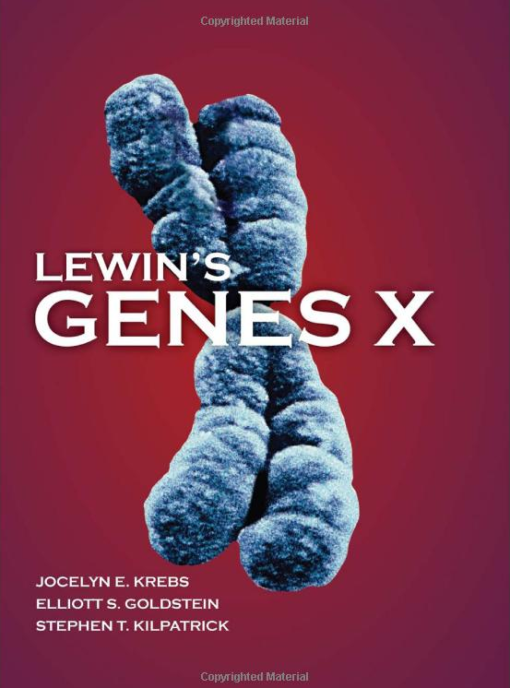
Recommended to read on Genomics and RNomics:
$70-$140

Slide 9
Genome as an unsupervised operating system
ABPG course, January 11th 2011
Alexei Fedorov

Slide 10
Objectives for today: Appreciate fundamental properties of nucleic acids
Take-home questions to think over:
Why does life require two types of nucleic acids (DNA and RNA)?
What aspect of the structure of nucleic acids helped them to maintain life for billions of years?

Slide 11
Quiz on DNA
DNA double helix
Parallel or anti-parallel ?
Left-handed or right-handed ?
What type of non-covalent weak interaction between nucleotides is the most important ?
Do not remember the answers? watch the video http://www.youtube.com/watch?v=ZGHkHMoyC5I&feature=related

Slide 12
Lectures on Advanced Genomics and Rnomics by Alexei Fedorov
Genomics and Rnomics are highly related
DNA constantly produces different types of RNA molecules with the help of RNA polymerases
RNA frequently coverts into a DNA form via reverse transcription and integrates back into the genome (example > 1million of Alu-repeats, and >5,000 pseudogenes in the human genome)

Slide 13
Stacking in supramolecular chemistry
In supramolecular chemistry, an aromatic interaction (or π-π interaction) is a noncovalent interaction between organic compounds containing aromatic moieties. π-π interactions are caused by intermolecular overlapping of p-orbitals in π-conjugated systems, so they become stronger as the number of π-electrons increases. Other noncovalent interactions include hydrogen bonds, van der Waals forces, charge-transfer interactions, and dipole-dipole interactions.
π-π interactions act strongly on flat polycyclic aromatic hydrocarbons such as anthracene, triphenylene, and coronene because of the many delocalized π-electrons. This interaction, which is a bit stronger than other noncovalent interactions, plays an important role in various parts of supramolecular chemistry. For example, π-π interactions have a big influence on molecule-based crystal structures of aromatic compounds.
Stacking in biology
In DNA, pi stacking occurs between adjacent nucleotides and adds to the stability the molecular structure. The nitrogenous bases of the nucleotides are made from either purine or pyrimidine rings, consisting of aromatic rings. Within the DNA molecule, the aromatic rings are positioned nearly perpendicular to the length of the DNA strands. Thus, the faces of the aromatic rings are arranged parallel to each other, allowing the bases to participate in aromatic interactions. Through aromatic interactions, the pi bonds, extending from atoms participating in double bonds, overlap with pi bonds of adjacent bases. This is a type of non-covalent chemical bond. Though a non-covalent bond is weaker than a covalent bond, the sum of all pi stacking interactions within the double-stranded DNA molecule creates a strong net stabilizing effect.

Slide 14
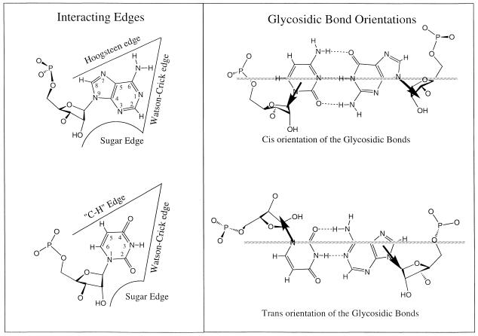
The non-Watson–Crick base pairs and their associated isostericity
matrices by Neocles Leontis, Jesse Stombaugh, Eric Westhof

Slide 15
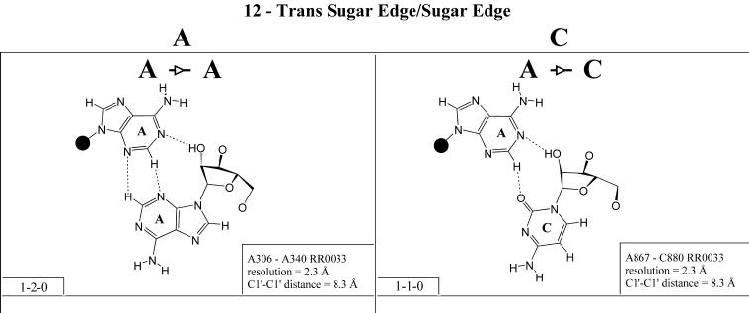
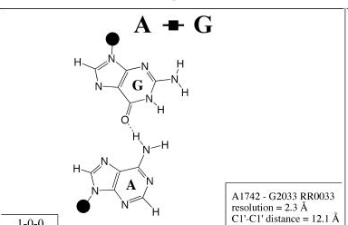
Hoogsteen-Hoogsteen
Nucleic Acids Res 2002
30(16): 3497–3531

Slide 16
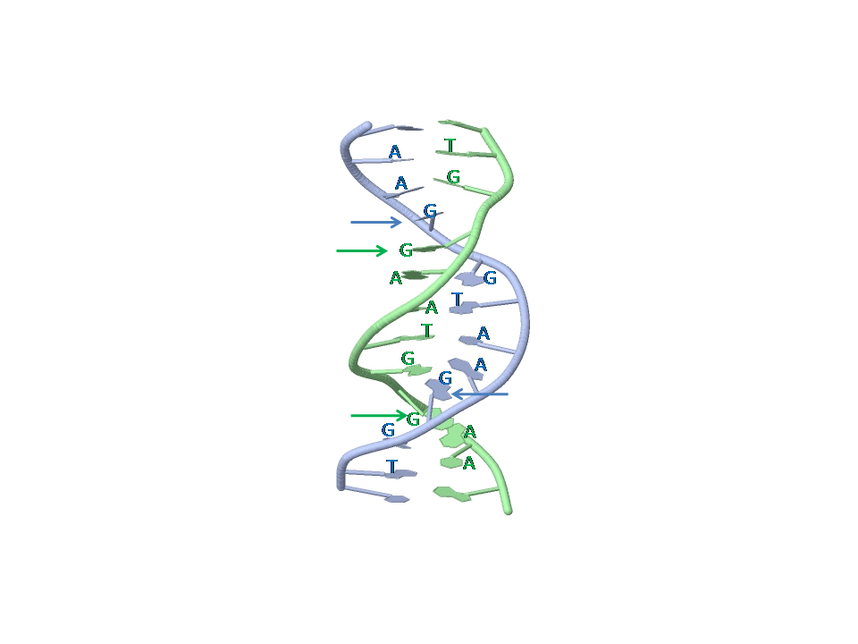
DNA duplex 5`TGGAATGGAA:TGGAATGGAA3` formed by two copies of TGGAA pentamer repeat
PDB identifier:
103D
Four arrows point to unpaired guanosine residues stacked between Hoogsteen G-A pairs.

Slide 17
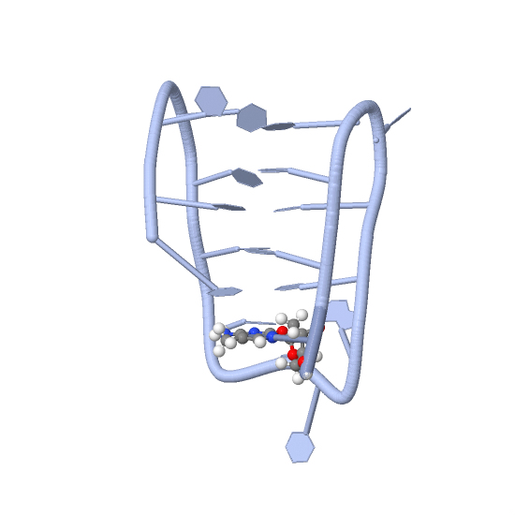
C-rich strand fragment of the human centromeric satellite III
(CCATTCCATTCCTTTCC) that forms intra-molecurlar i-motif structure
with C.C(+) pairs from parallel strands intercalated head-to-tail.
1G22
parallel stranded DNA duplex see 1R2L

Slide 18
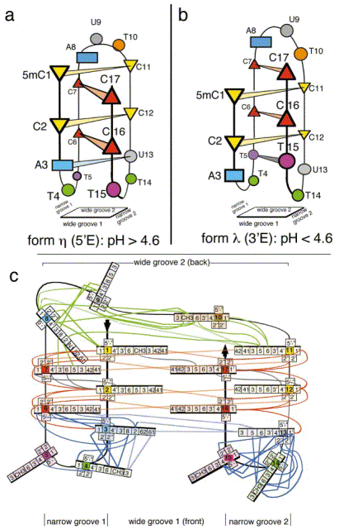
Nonin-Lecomte & Leroy
JMB 2001, 309:491-506

Slide 19
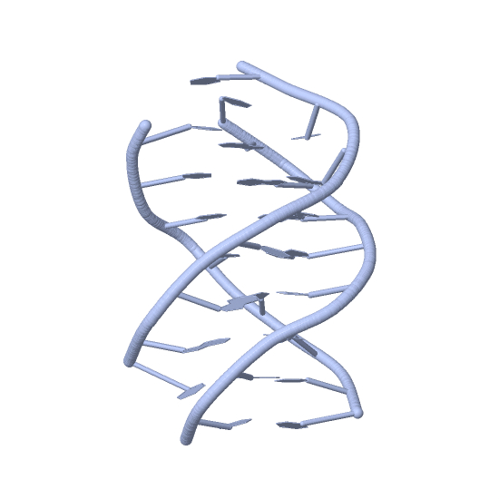
DNA triplex
134D
Third strand interacts via
Hoogsteen base pairing with
Watson-Crick DNA duplex
along its major groove

Slide 20
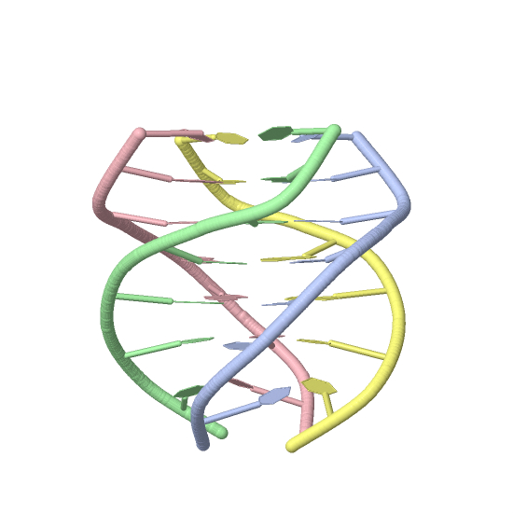
G-quadruplex, G-quartet, or G4, is formed
by guanine-rich strands of the repeats
TTAGGG
GGA and CGG
Quadruplexes are arranged in
four-stranded structures with
stands connected to each other
via Hoogsteen hydrogen bonding.
There are several alternative
conformations of G-quadruplexes.
Among them are anti-parallel,
parallel, and parallel/anti-parallel
hybrids

Slide 21
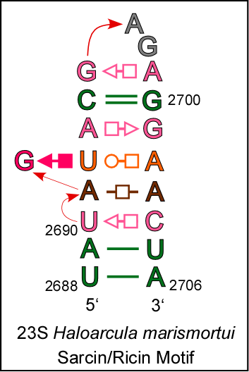
EXAMPLE: Sarcin/ricin stem-loop motif from 23S ribosomal RNA of Haloarcula marismortui.
Sequence:UAUAGUACGAGAGGAACUA
Annotation:((.....(....)....))

Slide 22
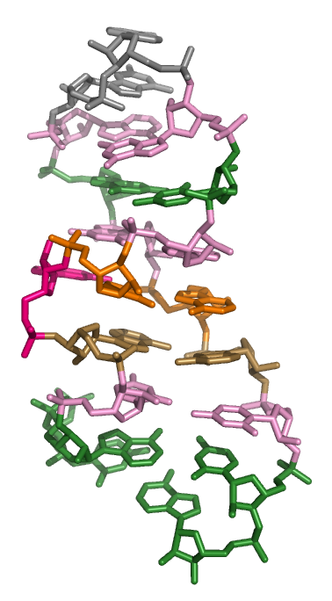
See also rat sarcin loop
1Q93 28S rRNA

Slide 23
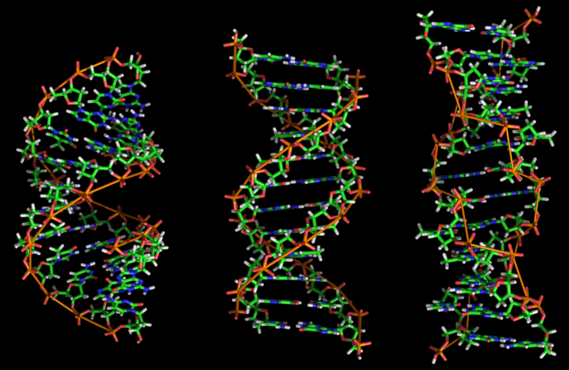
A-, B-, and Z- DNA

Slide 24
Assignment
I. Read two reviews on DNA conformations
a) Zhao et al. 2010,
b) Fedorov & Fedorova 2010
Create a list of all unusual (non-B) DNA structures described in these reviews.
II. Read tutorials and learn how to work with Jmol viewer in PDB. Open a subset of PDB, so-called, Nucleic Acids Database (NDB). Find a section inside NDB that lists all unusual DNA structures. View all these unusual conformations using Jmol. Create a list of all unusual structures presented in NDB, which are missed in the reviews

Slide 25
DNA and RNA can move!
non-B DNA conformations likely do not exist permanently, but only under specific conditions. Their formation can be facilitated by negative supercoiling during transcription or by binding with transcription factors (Mirkin 2008)
THE PROBLEM: DNA is so small, that it is still impossible to us to view it alive!

Slide 26
What do we know about the movement of nucleic acids?
We cannot see DNA or RNA!!
Typical magnification of a light microscope, assuming visible range light, is up to 1500x with a theoretical resolution limit of around 0.2 microns or 200 nanometers. Specialized techniques (e.g., scanning confocal microscopy) may exceed this magnification but the resolution is diffraction limited.
http://en.wikipedia.org/wiki/Microscope

Slide 27
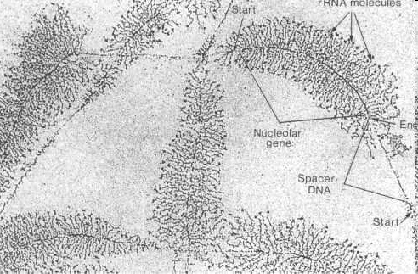
Electron microscopy of nucleic acids http://www.cytochemistry.net/Cell-biology/nucleus3.htm

Slide 28
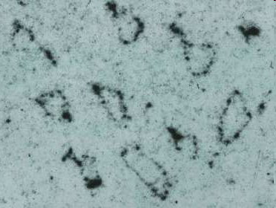
Electron microscopic picture of potato spindle tuber viroid http://www.biologie.uni-hamburg.de/bzf/mppg/agviroid.htm
http://www.biologie.uni-hamburg.de/bzf/mppg/agviro2.jpg

Slide 29
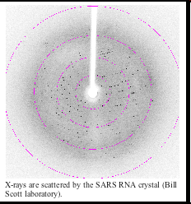
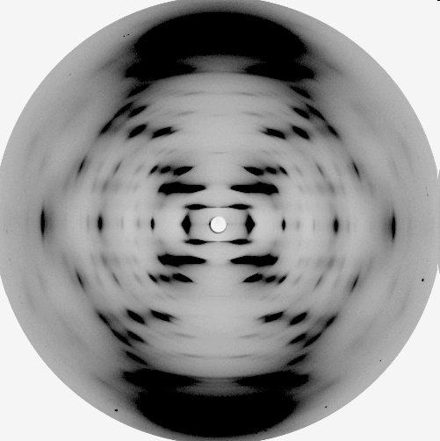
X-ray analysis of nucleic acids http://ribonode.ucsc.edu/learn/RNAvirus.html
The diffraction pattern obtained from the
B form of DNA obtained by Wilkins, Franklin
and colleagues at King's College, London

Slide 30
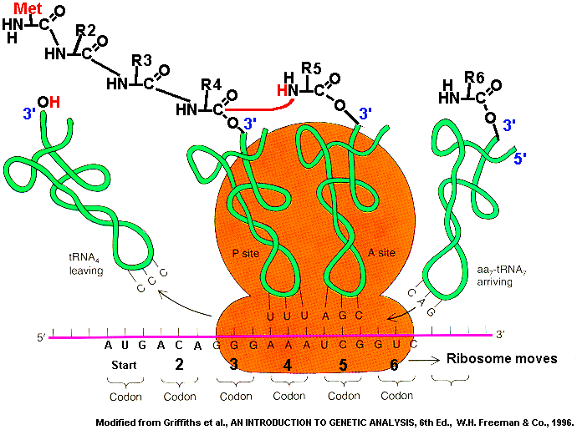
Ribosome machinery

Slide 31
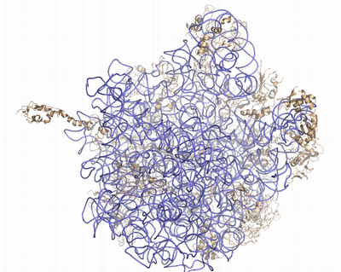
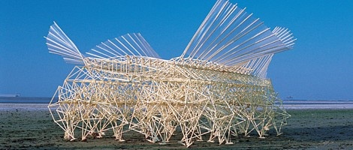
We are unable to see the complex behavior of nucleic acids because of their ultra-small size
Let’s compare nucleic acids with the autonomous, wind-powered machines.
The machines are composed mainly of plastic tubes and lemonade bottles.
http://www.youtube.com/watch?v=a7Ny5BYc-Fs video2
http://www.youtube.com/watch?v=b694exl_oZo video3
http://www.youtube.com/watch?v=pZ3_JAPpH3U

Slide 32
Important properties of the wind-powered beach creatures
Flexibility
Coordinated movement
Mechanisms for energy transformation for motion (wind -> movement)
What we still do not know about nucleic acids

Slide 33
'Telepathic' Genes Recognize Similarities In Each Other
ScienceDaily (Jan. 26, 2008) http://www.sciencedaily.com/releases/2008/01/080124103151.htm
Genes have the ability to recognise similarities in each other from a distance, without any proteins or other biological molecules aiding the process, according to new research. This discovery could explain how similar genes find each other and group together in order to perform key processes involved in the evolution of species.
Although the capacity for single complementary strands of DNA to attract each other is probably the best-known and most fundamental property of DNA, no-one knew until now that intact, double-stranded DNA could do this too.
The phenomenon might explain how identical paired DNA strands align themselves ready for repairs, copying, and alteration through a process called homologous recombination.
DNA double helices recognize mutual sequence homology in a protein free environment. Baldwin et al. J Phys Chem B. 2008;112(4):1060-4.

Slide 34

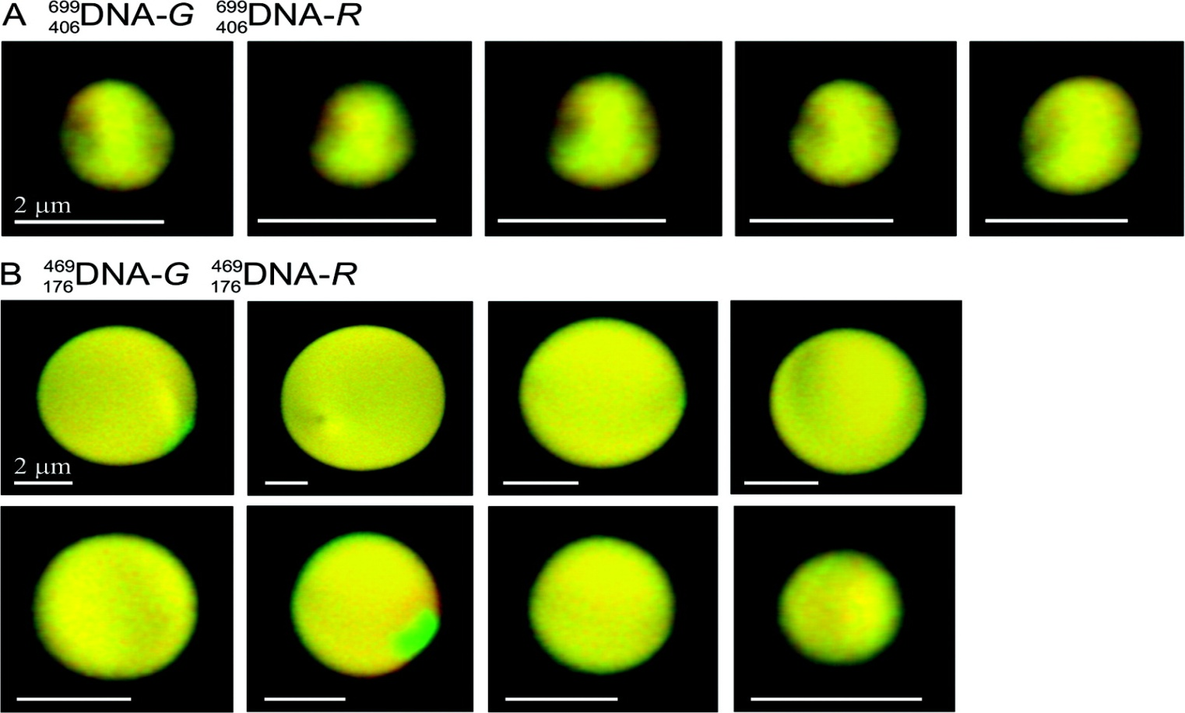
Figure 2 Confocal imaging of single DNA sequences in spherulites demonstrates that fluorescent dyes do not affect the localization of DNA within the spherulite. Typical confocal microscopy sections of spherulites condensed as described in Figure 1 from equal mixtures of (A)DNA-G withDNA-R and (B)DNA-G withDNA-R. The two color channels were normalized for intensity and corrected for chromatic aberration.
Published in: Geoff S. Baldwin; Nicholas J. Brooks; Rebecca E. Robson; Aaron Wynveen; Arach Goldar; Sergey Leikin; John M. Seddon; Alexei A. Kornyshev; J. Phys. Chem. B 2008, 112, 1060-1064.
DOI: 10.1021/jp7112297
Copyright © 2008 American Chemical Society

Slide 35
Crick’s unpairing hypothesis (1971)
Meiotic division is characterized by the union (or "conjugation" as the early cytologists called it) of your parental chromosomes. How parental duplex DNA molecules would be able to recognize each other?
In helical duplex DNA the bases were inward-looking. How could inward-looking bases in one duplex look outwards to recognize homologous bases in another DNA duplex?

Slide 36
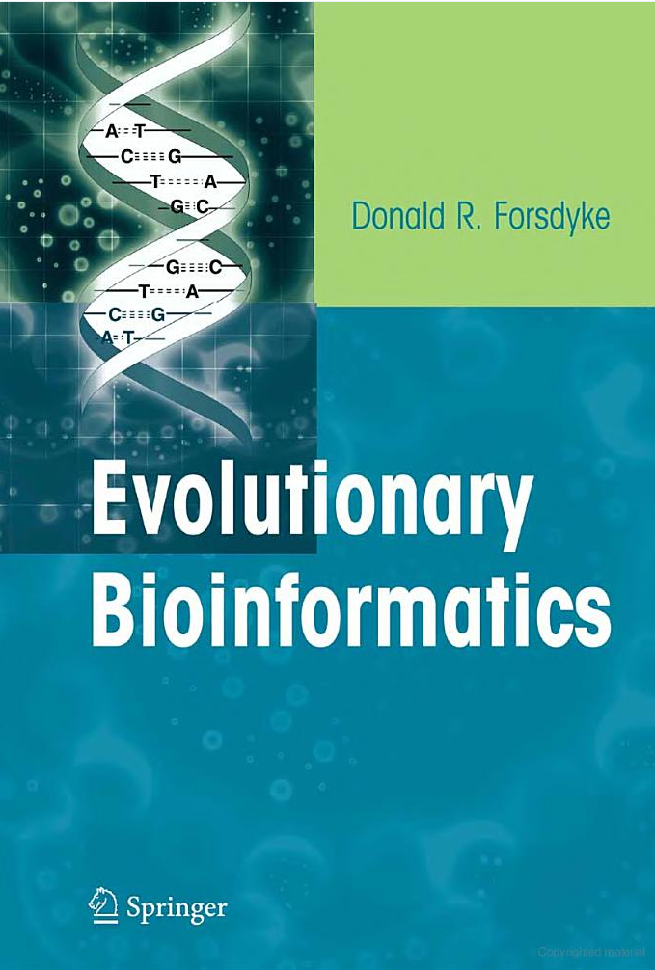
Kissing loops
Homepage of Dr. Donald Forsdyke http://post.queensu.ca/~forsdyke/index.htm
http://post.queensu.ca/~forsdyke/homepage.htm#Homepage
“Molecular sex” paper http://post.queensu.ca/~forsdyke/speciat4.htm

Slide 37
Nucleic acids might possess unknown and very strange properties described by quantum physics and we are only at the very beginning of this appreciation.
Rieper E, Anders J, and Vedral V. 2010. The relevance of continuous variable entanglement in DNA. arXiv:1006.4053v1
SUMMARY We consider a chain of harmonic oscillators with dipole-dipole interaction between nearest neighbours resulting in a van der Waals type bonding. The binding energies between entangled and classically correlated states are compared. We apply our model to DNA. By comparing our model with numerical simulations we conclude that entanglement may play a crucial role in explaining the stability of the DNA double helix.

Slide 38
Conclusions
Nucleic acids are not just a simple set of instructions (texts)! They are dynamic and complex creatures.
We still do not know much about DNA and RNA!

Slide 39
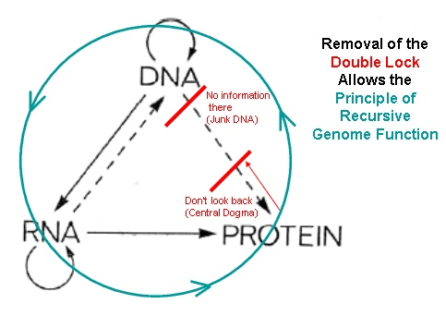
Andras Pellionisz
The principle of recursive genome function
Figure reference: http://www.junkdna.com/

Slide 40
Assignment
I. Read two reviews on DNA conformations
a) Zhao et al. 2010,
b) Fedorov & Fedorova 2010
Create a list of all unusual (non-B) DNA structures described in these reviews.
II. Read tutorials and learn how to work with Jmol viewer in PDB. Open a subset of PDB, so-called, Nucleic Acids Database (NDB). Find a section inside NDB that lists all unusual DNA structures. View all these unusual conformations using Jmol. Create a list of all unusual structures presented in NDB, which are missed in the reviews

