Slide 1
ABPG: RNomics, lecture #2
microRNA
siRNA
piwiRNA

Slide 2
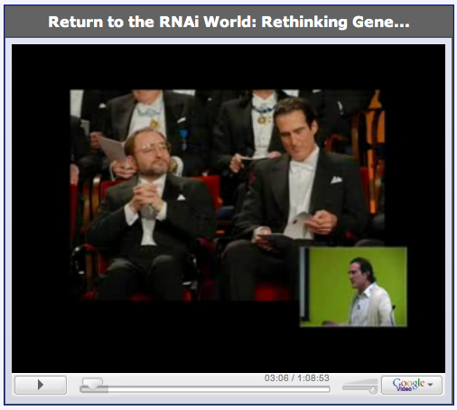
Homework (part 1, watching assignment)
www.massachusetts.edu/mello/index.html
https://www.youtube.com/watch?v=5ZE7o_bRekk (Video for HW#1)
Write down all important and interesting facts on RNAi from the movie
The content of this film will be in your final exam!

Slide 3
Public educational resources
http://www.youtube.com/watch?v=oANi7PRqalM&feature=fvwrel
Famous scientists who made groundbreaking discoveries on RNAi
Victor Ambros, Gary Ruvkun and David Baulcombe
Great educational web-site for small ncRNAs http://www.gene-quantification.de/micro-rna.html
RNA interference in Proteopedia
http://www.proteopedia.org/wiki/index.php/RNA_Interference http://www.proteopedia.org/wiki/index.php/2f8s
HHMI Biointeractive resource
http://www.hhmi.org/biointeractive/click/index.html
Wikipedia

Slide 4
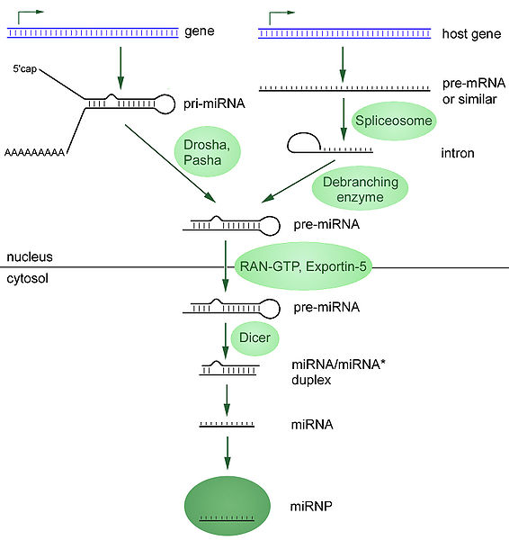

Slide 5
What is the difference between miRNA and siRNA ?
siRNA - small interfering RNA
miRNA - microRNA
Different functions!!!
Associated with different proteins

Slide 6
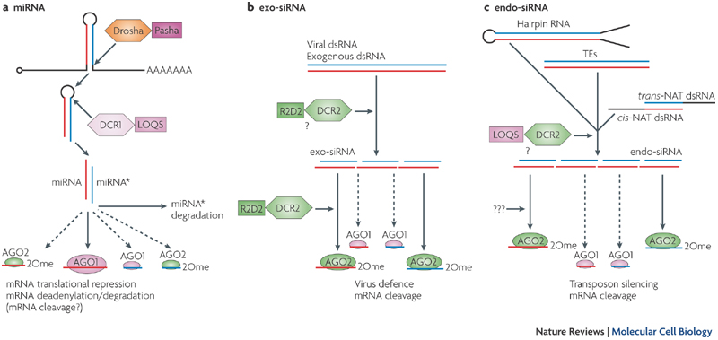
Okamura & Lai, Endogenous small interfering RNA in animals. 2008
2Ome, 2'-O-methyl group. Three main protein families are denoted with RNase III enzymes
(Drosha, Dicer-1 (DCR1) and DCR2; shown as hexagons), their dsRNA-binding domain (dsRBD)
partners (Pasha, Loquacious (LOQS) and R2D2; shown as squares) and Argonaute proteins
(AGO1 and AGO2; shown as ovals).

Slide 7
In Drosophila melanogaster:
Micro (mi)RNAs are 22 nucleotides (nt) long, have free hydroxy groups at their 3' ends, and associate primarily with the Argonaute protein AGO1.
Small interfering (si)RNAs are 21 nt, are methylated at their 3' ends, and associate primarily with AGO2.
miRNA pathway. Endogenous transcripts that contain short inverted repeats are processed into 21–22 nt RNAs that mostly function to repress endogenous targets by translational repression and deadenylation by AGO1. miRNA* is the species on the other side of the hairpin to the miRNA.
exogenous siRNA pathway viral dsRNA or artificial dsRNA produce exogenous siRNAs (exo-siRNAs) that are mostly sorted to AGO2 and restrict viral replication or cleave designed targets.
endogenous dsRNA pathway — transposable elements (TEs), cis-natural antisense transcripts (cis-NATs), trans-NATs and hairpin RNA transcripts — that are processed into endo-siRNAs that load mostly AGO2. These repress transposon transcripts or endogenous mRNAs. Note that a minority of miRNAs programme AGO2 and a small fraction of exo- and endo-siRNAs associate with AGO1, but the functional significance of this is currently unknown..

Slide 8
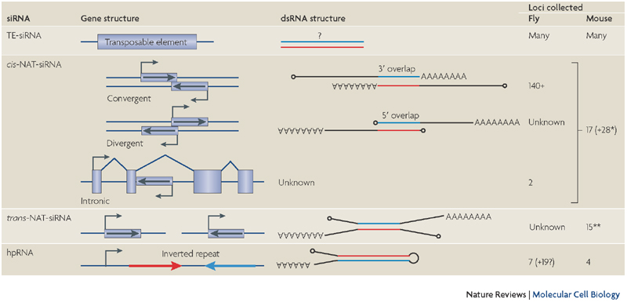
Okamura & Lai, Endogenous small interfering RNA in animals. 2008
Endogenous siRNA in animals

Slide 9
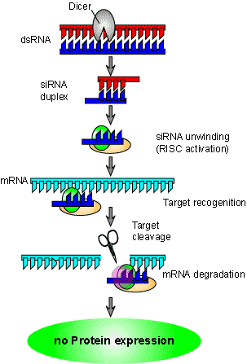
Human AGO2 slicing activity (endonuclease)

Slide 10
Web animations
http://www.rnaiweb.com/RNAi/RNAi_Web_Resources/RNAi_Animations___Images/
http://www.nature.com/focus/rnai/animations/animation/animation.htm
http://www.youtube.com/watch?v=_-9pROnSD-A (miRNA)

Slide 11
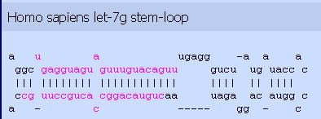
microRNA and introns
miRBase: http://microrna.sanger.ac.uk/sequences/

Slide 12
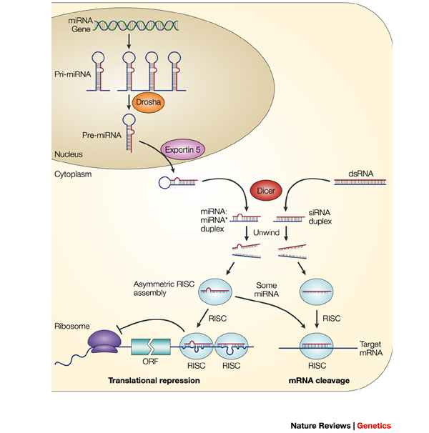
He L and Hannon GJ
Nature Rev Genet
5:522-531, 2004
MicroRNAs: small RNAs
with a big role in gene
regulation

Slide 13
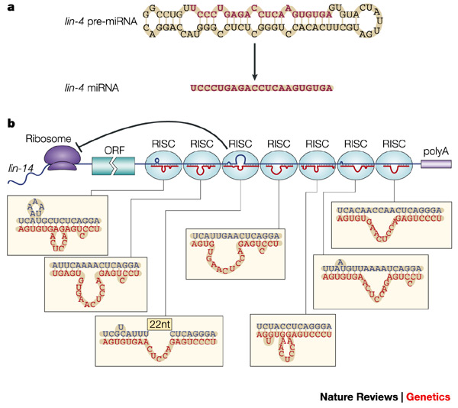

Slide 14
5 miRNAs within intronless Retrotransposon-like (RTL1) gene
mir431
mir433
mir127
mir434
mir434
(-)
(+)
RTL1
Antisense location (perfect match with mRNA)
Clustering
Unique case: the same sequence represents both CDS and miRNA
Likely function – imprinting
Uncommon case – miRNA works inside nucleus rather than cytoplasm

Slide 15
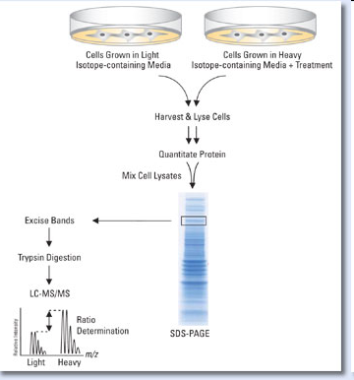
miRNA functioning
Individual miRNA suppresses the production of hundred of proteins.
Reduction of protein level by miRNA is modest (1.5-2 fold).
Nature 2008, Sept 04
Selbach et al., pp. 58-63.
Baek et al., pp. 64-71.
Mourelatos pp. 44-45.
SILAC mass spectrometry

Slide 16
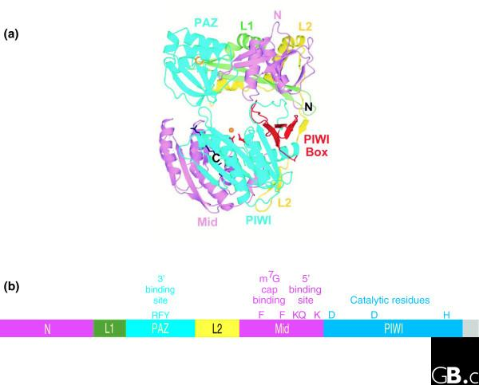
Argonaute protein family – are the key players in gene-silencing pathways guided by small RNAs
Review: Hock and Meister, Genome Biology, 2008 9:210

Slide 17
Two subfamilies of Argonaute: AGO and PIWI

Slide 18
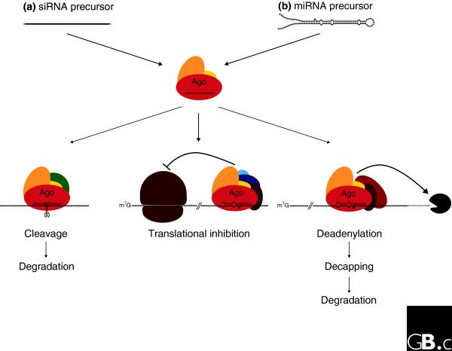
Höck and Meister Genome Biology 2008 9:210

Slide 19
Functions of microRNAs
Nakahara K and Carthew R.
Curr Opin Cell Biol 16:127-133, 2004
Expanding roles for miRNAs and siRNAs in cell regulation
The role of small RNAs as key regulators of mRNA turnover and translation has been well established. Recent advances indicate that the small RNAs termed microRNAs play important roles in cell proliferation, apoptosis and differentiation. Moreover, the microRNA mechanism is an efficient means to regulate production of a diverse range of proteins. As new microRNAs and their mRNA targets rapidly emerge, it is becoming apparent that RNA-based regulation of mRNAs may rival ubiquitination as a mechanism to control protein levels.

Slide 20
J. Hall 2004 Nature Rev. Genet 5:552-557.
Unravelling the general properties of siRNAs: strength in numbers and lessons from the past.
“RNAi represents one of the most powerful biological tools ever to be introduced. It provides a simple, rapid, inexpensive, selective method of gene inhibition with high success rate. Gene-specific RNAi screens in cells or model organisms generate data that link a specific gene to a given biological process. Moreover, genome-wide screens that use a library of individual oligoribonucleotides to knock down each gene return massive amounts of biological information.”

Slide 21
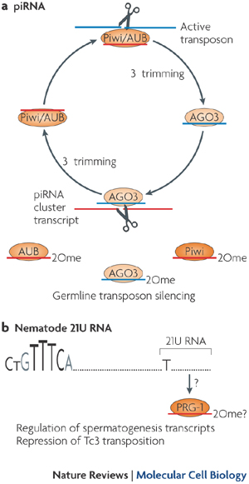
piRNA – 24-32 nts
Processed by PIWI argonaute
the expression of which is
restricted to the germ line.
piRNA facilitates silencing of
mobile genetic elements ??

Slide 22
Characteristics of piRNA from Wikipedia
piRNAs have been identified in both vertebrates and invertebrates.
piRNAs have no clear secondary structure motifs.
the length of a piRNA is, by definition, between 26 and 31 nucleotides, and the presence of a 5’ uridine is common to piRNAs in both vertebrates and invertebrates.
piRNAs in Caenorhabditis elegans have a 5’ monophosphate and a 3’ modification that acts to block either the 2’ or 3’ oxygen, and this has also been confirmed to exist in Drosophila melanogaster, zebrafish, mice, and rats. This 3’ modification is likely to be a 2’-O-methylation, but the reason for this modification is not known.
There are many hundreds of thousands of different piRNA species found in mammals. Thus far, over 50,000 unique piRNA sequences have been discovered in mice and more than 13,000 in D. melanogaster.

Slide 23
Characteristics of piRNA from Wikipedia
LOCATION: In mammals, piRNAs are found only within the testes, with an estimated one million copies per cell in spermatocytes and spermatids. In invertebrates, piRNAs have been detected in both the male and female germlines, but in no other cell types.
FUNCTION: Like other small RNAs, piRNAs are thought to be involved in gene silencing, specifically the silencing of transposons. The majority of piRNAs are antisense to transposon sequences, suggesting that transposons are the piRNA target. In mammals it appears that the activity of piRNAs in transposon silencing is most important during the development of the embryo, and in both C. elegans and humans, piRNAs are necessary for spermatogenesis.

Slide 24
Homework
Assignment #1 (see slide #2)
Assignment #2 (see file L24_HW2.doc)

