Slide 1
Recombination of nucleic acids
Lecture 9th
Alexei Fedorov, 2014

Slide 2
Origin of Chess http://www.expert-chess-strategies.com/who-invented-chess.html http://www.ponderabout.com/archives/972/mind-boggling-exponential-growth.aspx
--"You are allowed to choose what you want!” the king said to the man who invented chess. "I will give it to you!"
--"My wish is to get some wheat! Please put one grain of wheat on to the first chess square and two on to the second and keep doubling up the wheat until the last square!"
Soon the servants were flabbergasted and frightened. „All the wheat of your kingdom and all the wheat of other kingdoms is not enough to fulfill this wish.” They told to the king

Slide 3
Power of geometric progression!
2⁶⁴⁻¹ equals to 18,446,744,073,709,551,615
grains of wheat -a quantity far greater than
a thousand years of U.S. wheat production
In Gentetics:
2 – parents
4 – grand parents
8 -- great-grand parents
…

Slide 4
Human genetics
(~5 generations/100 years)
200 years ago (10 generations) – 1024 direct ancestors
400 years ago (20 generations) – 1.0 x10⁶ direct ancestors
600 years ago (30 generations) – 1.1x10⁹ direct ancestors
800 years ago (40 generations) – 1.1x10¹² direct ancestors
1000 years ago (50 generations) – 1.1x10¹⁵ direct ancestors
Time of Jesus Christ - ?
Time of pyramids - ?

Slide 5
Mice genetics
6 generations/year (laboratory)
3 generations/year (wild life)
In about 90 years
2²⁵⁶ ~1.16 ×10⁷⁷ direct ancestors
^{=116 trillion viginitillion!}

Slide 6
Homologous recombination during meiosis
Homologous
chromosomes
gametogenesis
Father’s
Mother’s
Gametes consist of pieces of
Mother’s and father’s
chromosomes

Slide 7

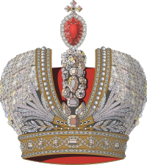
QUIZ
One of my direct ancestors from the 30-th generation was a king (~600 years ago). How much genomic DNA has passed from the king to myself?

Slide 8
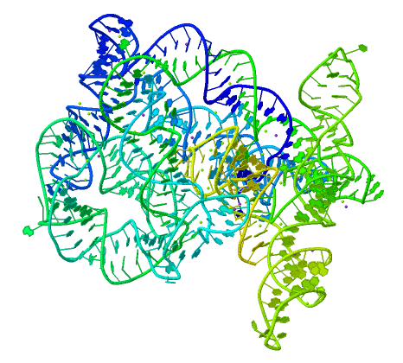
recombination is a fundamental intrinsic property of nucleic acids vital for every living organism.
RNA molecule can join its ends itself!
PDB: 3IGI
Mg⁺² and GTP
Tertiary architecture of the Oceanobacillus iheyensis group II intron
Toor et al. RNA 2010, 16:57-69.

Slide 9
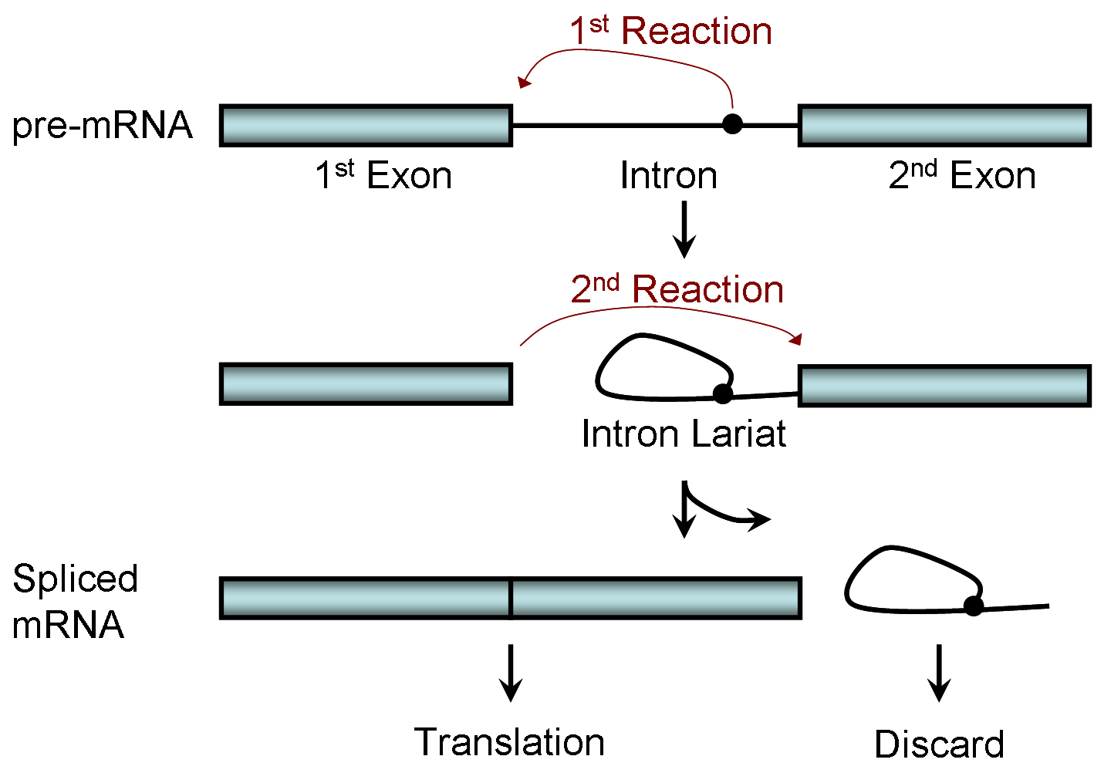
Splicing of nuclear and group II introns http://en.wikipedia.org/wiki/Intron_splicing
GT
AG

Slide 10
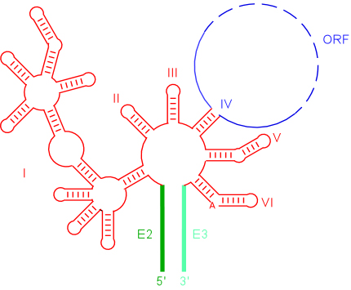
Group II introns in bacterial world
F. Martinez-Abarca and N. Toro
Molecular Microbiology 2000, 38:917-926
http://www.fp.ucalgary.ca/group2introns/wherefound.htm

Slide 11
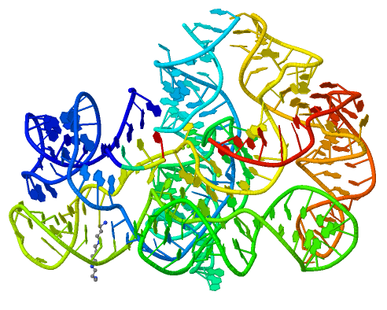
Crystal structure of a phage Twort group I ribozyme-product complex.
Golden, B.L., Kim, H., Chase, E. (2005) Nat.Struct.Mol.Biol. 12: 82-89
1Y0Q

Slide 12

Splicing of Group I introns http://en.wikipedia.org/wiki/Group_I_catalytic_intron
Splicing of group I introns is processed by two sequential ester-transfer reactions.[3]
The exogenous guanosine or guanosine nucleotide (exoG) first docks onto the active
G-binding site located in P7, and its 3'-OH is aligned to attack the phosphodiester
bond at the 5' splice site located in P1, resulting in a free 3'-OH group at the upstream
exon and the exoG being attached to the 5' end of the intron. Then the terminal G
(omega G) of the intron swaps the exoG and occupies the G-binding site to organize
the second ester-transfer reaction, the 3'-OH group of the upstream exon in P1 is
aligned to attacks the 3' splice site in P10, leading to the ligation of the adjacent
upstream and downstream exons and free of the catalytic intron.

Slide 13
'Telepathic' Genes Recognize Similarities In Each Other
ScienceDaily (Jan. 26, 2008) http://www.sciencedaily.com/releases/2008/01/080124103151.htm
Genes have the ability to recognise similarities in each other from a distance, without any proteins or other biological molecules aiding the process, according to new research. This discovery could explain how similar genes find each other and group together in order to perform key processes involved in the evolution of species.
Although the capacity for single complementary strands of DNA to attract each other is probably the best-known and most fundamental property of DNA, no-one knew until now that intact, double-stranded DNA could do this too.
The phenomenon might explain how identical paired DNA strands align themselves ready for repairs, copying, and alteration through a process called homologous recombination.
DNA double helices recognize mutual sequence homology in a protein free environment. Baldwin et al. J Phys Chem B. 2008;112(4):1060-4.

Slide 14
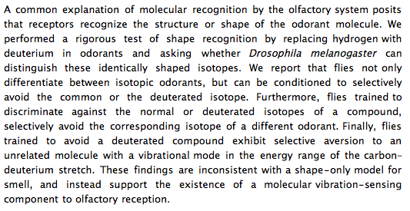
Molecular vibration-sensing component in D. melanogaster olfaction. Franco et al., 2011, PNAS.

Slide 15
DNA Recombination is vital to all organisms!
Repair of DNA double-strand breaks
Sexual reproduction
Genome evolution and creation on novel genes

Slide 16
Major types of DNA recombination from textbooks
Homologous recombination -- between two homologous DNA molecules.
Site-specific recombination -- at a specific DNA sequence which is present in both non-homologous DNA molecules that may have the recombination.
Transposition – occurs when a mobile element is inserted into a target DNA.
Non-homologous end joining (NHEJ) is a pathway that repairs double-strand breaks in DNA.

Slide 17
Dickson et al. “Retrotransposition of a yeast group II intron occures by reverse splicing directly into ectopic DNA sites”. PNAS 2001, 98:13207-13212
Reverse splicing of intronic RNA directly into DNA target sites
Retrotransposition mechanisms using DNA targets. The COXI gene of strain 1+t20 (top) contains both the donor aI1 intron (hatched) and the 5 848 ectopic site in intron 5 (open rectangle) The mechanism on the left begins with reverse splicing into the ectopic site in double-stranded DNA. Inefficient nicking of the antisense strand forms the primer for full-length cDNA synthesis by the RT with completion of intron insertion by DNA repair. The mechanism on the right begins with reverse splicing into the ectopic site at a replication fork. cDNA synthesis is initiated either de novo or by using the 3' end of the newly made leading strand with further replication and repair needed to complete intron insertion

Slide 18
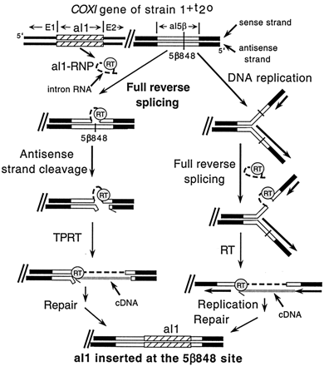

Slide 19
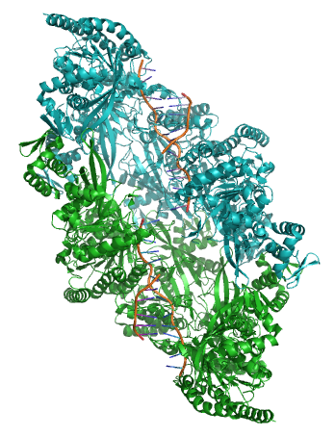
Crystal structure of two chains of the RecA protein bound to DNA. A double-strand break and two adjacent 3' overhangs are visible. http://en.wikipedia.org/wiki/Homologous_recombination

Slide 20
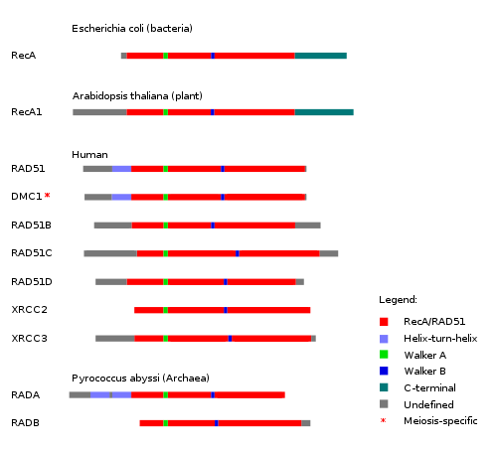
Human proteins homologous to E. coli RecA http://en.wikipedia.org/wiki/Homologous_recombination

Slide 21

Hot and cold spots for homologous recombination http://hapmap.ncbi.nlm.nih.gov/downloads/recombination/
Physical map (position in nucleotides) | Ratio [ cM / Mb] | Genetic map Position in centiMorgans
1640705 1.2602869151 1.0447704391
1643532 1.1823811803 1.0483332702
0.002827 Mb
0.003563 cM
2,108,219 11.3590716646 1.873665397
1,021,403 0.2587157271 0.4358957457

Slide 22
Site-specific recombination
×
×

Slide 23
Site-specific recombination
×
×

Slide 24
Partial exon repetition
100 bp
GENE: ribosomal protein L7a
4
5
6
7
EST: CF127429
3
4
5
6
7
8
6
5
Exons 5 and 6, pieces of which are repeated within the EST, are shown in color.
Short direct repeated sequence CACCAC inside exon 5 and 6 is shown as a gray bar with an arrow above it. This repeat lies precisely in the junction of partial exon
repetition in the EST clone.

Slide 25
Partial exon scrambling
A
Gene: hypoxia-inducible factor-3 alpha isoform b
2
3
4
5
6
100 bp
EST AU118844
1
2
4
5
6
3
4
5

Slide 26
Site-specific recombination with inversion
a
b
a
×
b
b
a

Slide 27
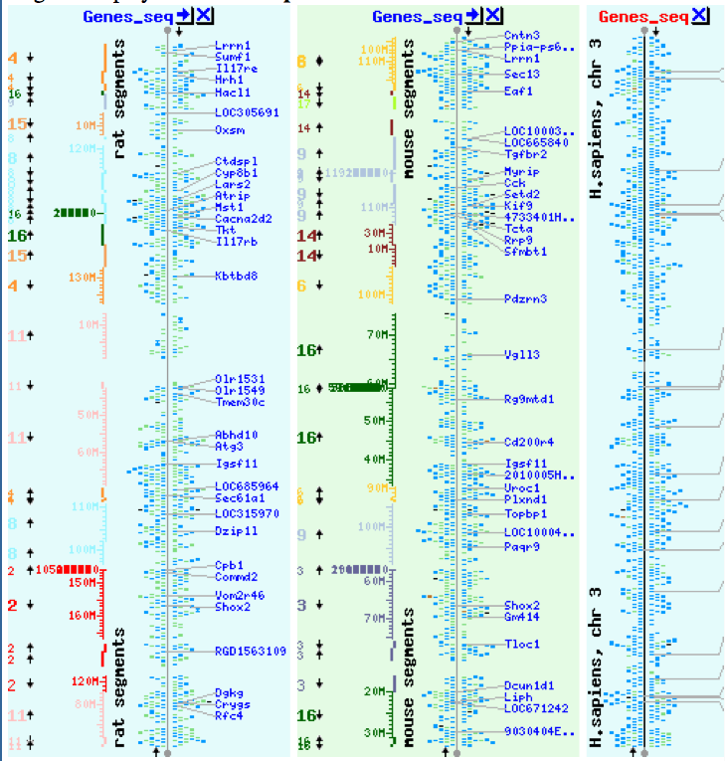
NCBI Homology maps http://www.ncbi.nlm.nih.gov/projects/homology/maps/

Slide 28
Mammalian chromosomes are mosaic and resulted from numerous recombinations
Genomic maps of human and mouse at NCBI
http://www.ncbi.nlm.nih.gov/projects/homology/maps/

Slide 29
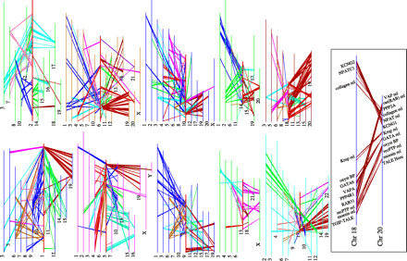
Segmental duplications between chromosomes in the human genome. The 24 panels show the 1077 duplicated blocks of genes, containing 10,310 pairs of genes in total.

Slide 30
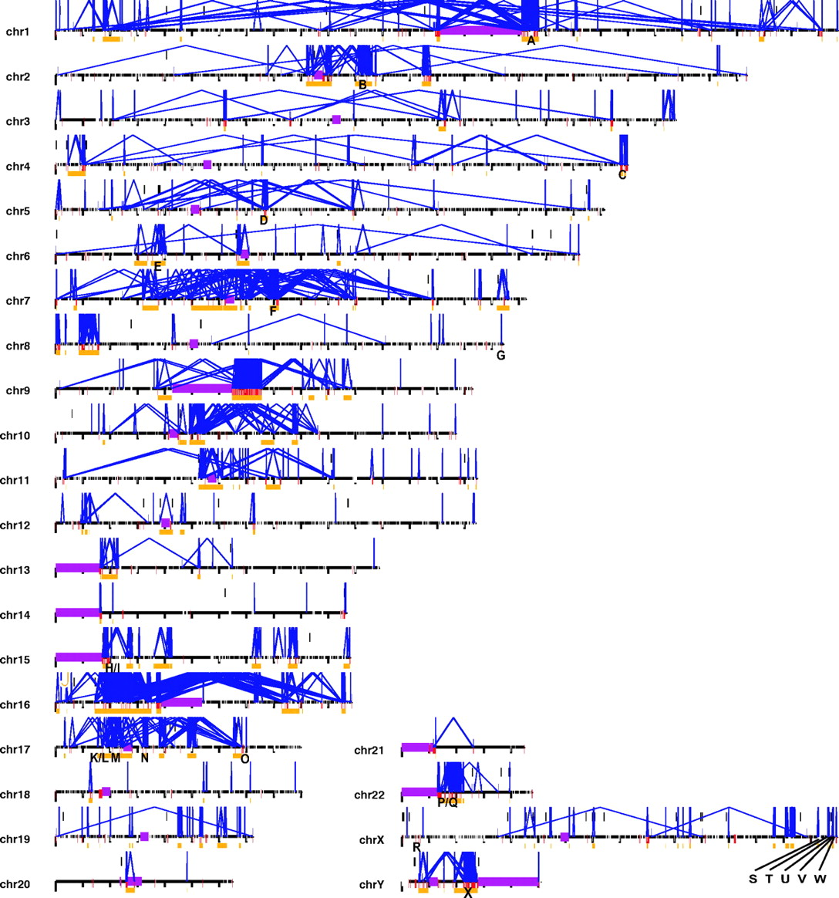

Figure 2 Patterns of intrachromosomal and interchromosomal duplication (≥10 kb; ≥95%).
J A Bailey et al. Science 2002;297:1003-1007
Published by AAAS
Notes:
Patterns of intrachromosomal and interchromosomal duplication (≥10 kb; ≥95%). The graphic shows a genome-wide view of intrachromosomal (blue, with connecting lines) and interchromosomal (red bars) segmental duplications. Purple bars represent areas (acrocentric chromosomal arms, heterochromatin satellite DNA, and centromeres) not targeted as part of the Human Genome Project. Unique regions (≥50 kb and <10 Mb) of the genome encompassed by intrachromosomal duplications (≥95% sequence identity and ≥10 kb) are shown as gold bars. Such regions are typically associated with recurrent chromosomal structural rearrangements associated with genetic disease. A total of 169 regions (∼298 Mb of sequence) were identified as potential hot spots for genomic rearrangement. Twenty-four of these regions (labeled A to X) correspond to known genomic disorders: (A) Gaucher disease, (B) familial juvenile nephronophthisis, (C) fascioscapulo- humeral muscular dystrophy, (D) spinal muscular atrophy, (E) congenital adrenal hyperplasia III, (F) Williams-Beuren syndrome, (G) glucocorticoid-remediable aldosteronism, (H) Prader-Willi syndrome, (I) Angelman syndrome, (J) polycystic kidney disease, (K) Charcot-Marie-Tooth disease type 1A, (L) hereditary neuropathy with liability to pressure palsies, (M) Smith-Magenis syndrome, (N) neurofibromatosis, (O) pituitary dwarfism, (P) cat eye syndrome, (Q) DiGeorge/velocardiofacial syndrome, (R) ichthyosis, (S) Hunter syndrome (mucopolysaccharidosis type II), (T) red-green color blindness, (U) Emery-Dreifuss muscular dystrophy, (V) incontinentia pigmenti, (W) hemophilia A, and (X) azoospermia (AZFc region). Specific regions corresponding to each region can be found athttp://humanparalogy.cwru.edu/SDD/hotspots.htm. For details about patterns of interchromosomal duplications, see fig. S4.

Slide 31
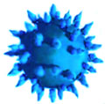
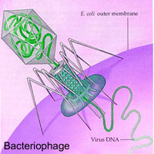
Viruses and host cells
HIV virus integrase

Slide 32
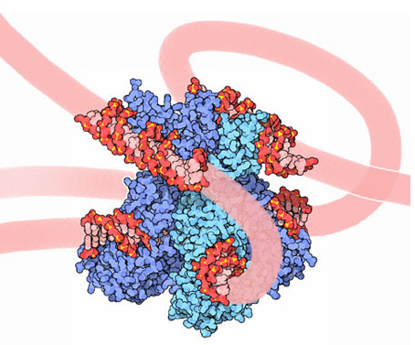
Site-specific recombination is used by bacteriophage λ to integrate or excise its genome into and out of the host chromosome. λ recombination is carried out by the bacteriophage-encoded integrase protein (λ -int). Nature 2005, 435:1059-66.
PDB: Molecule of the month: TRANSPOSASE
Lambda integrase from a bacteriophage (PDB entry 1z1g). This structure catches the Enzyme in the middle of its reaction, which involves an elaborate looping of DNA in and around the enzyme. http://www.pdb.org/pdb/static.do?p=education_discussion/molecule_of_the_month/pdb84_2.html

Slide 33
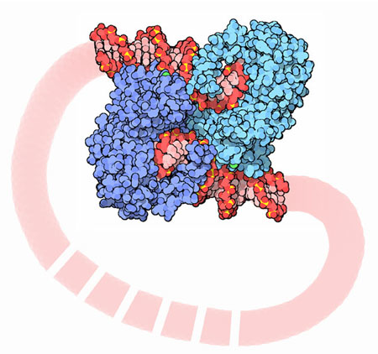
PDB: Molecule of the Month Transposase by David S. Goodsell http://www.pdb.org/pdb/static.do?p=education_discussion/molecule_of_the_month/pdb84_1.html
Bacterial transposase (PDB entry 1muh) that moves a transposon called Tn5. The transposition starts when two copies of enzyme bind to the DNA at the two ends of the transposon. Then, the two ends are brought together, closing the transposon into a big loop, and the transposase cuts the DNA at both ends.

Slide 34
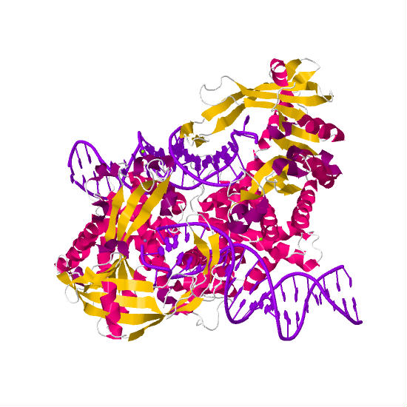
1muh

Slide 35
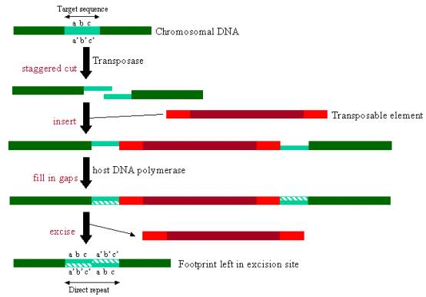
InterPro: Transposase By Jennifer McDowall http://www.ebi.ac.uk/interpro/potm/2006_12/Page1.htm

Slide 36
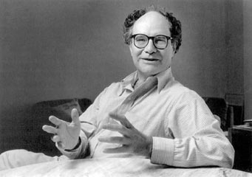
Origin of novel genes by DNA recombination
Walter Gilbert
The inventor of DNA sequencing technique ( Nobel Prize 1982)
Exon shuffling theory 1978

Slide 37
Exon shuffling
Short ancient genes
Modern gene
Common case

Slide 38
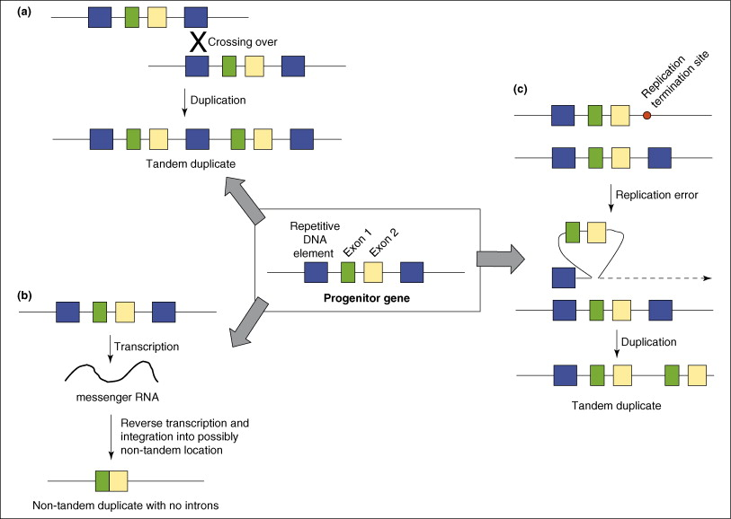
Protein subcellular relocalization:a new perspective on the origin of novel genes. Byun-McKay S A. and Geeta R. 2007, TEE 22:338-344.

Slide 39
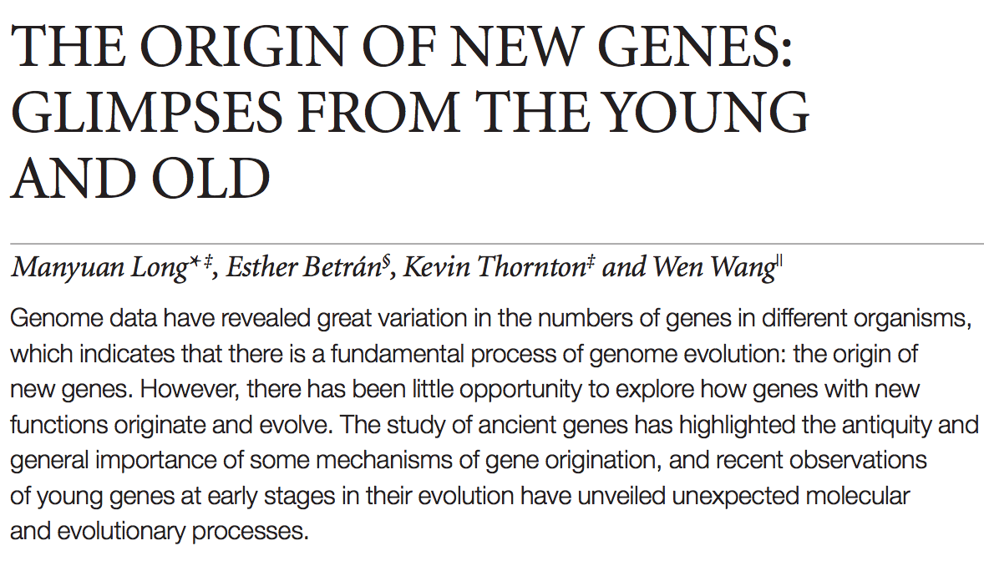
The origin of new genes: glimpses from the young and old.
Long M, Betrán E, Thornton K, Wang W. Nat Rev Genet. 2003;4:865-75.

Slide 40
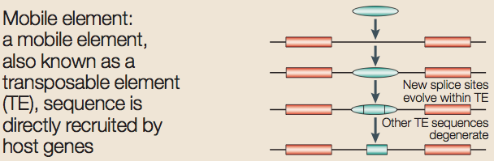

Slide 41
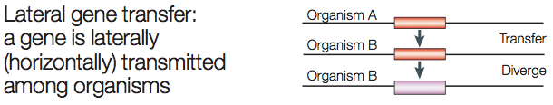
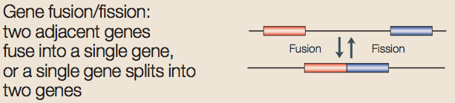
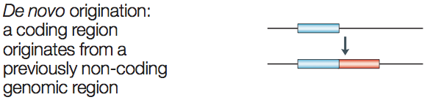

Slide 42
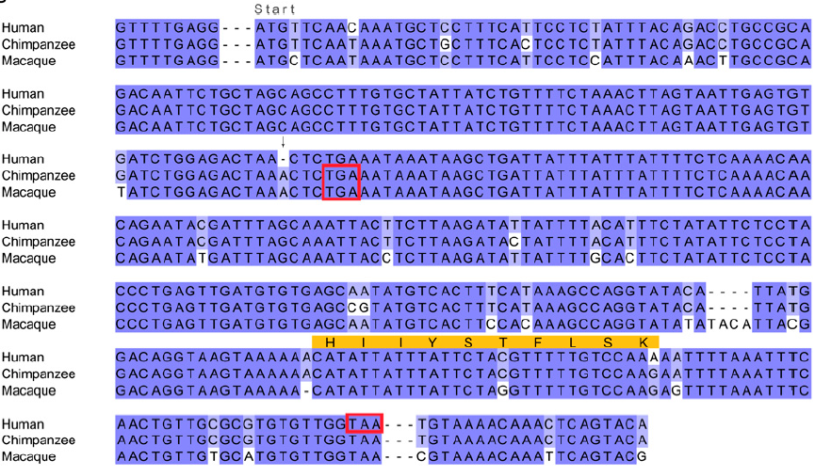
Recent de novo origin of human protein-coding genes. Knowles DG, McLysaght A. Genome Res. 2009;19:1752-9.

Slide 43
CONCLUSIONS
DNA recombination is a enormously important process for all species from viruses to humans.
Recombination is an intrinsic property of nucleic acids and these molecules are susceptible to joining their ends. In addition, evolution invented thousands of proteins that assist DNA recombination and became crucial for cell functioning.
Recombination is a major engine of evolution.

Slide 44
Homework assignment
Find the hottest and the coldest spot for recombination in the human genome. Specify the chromosome, the position, and recombination rate. (see slide 21)
Compare the structure of the EST with the structure of its gene. Describe the difference between the EST and the expected mRNA transcript of the gene and the reason for it. SEQUENCES: BP214078 and CO245739 (second character is “ou”, not zero)
(see slide 24-25)
(To get the sequence (e.g. BP214078) from NCBI web choose “Nucleotide” option)

