Slide 1
DNA vs Human Language
What is common between these two informational structures? Where are the differences?
DNA
1 gaattcaaaa aagaaagaca atgacttgta gctgaagcta tgatcaggaa aagatggggt
61 ggacggcatt tgagaaaatc aggacagtgg tgtacttatc aaataagaag atctgggcag
121 aagattgttg aaaaagcaga cacagcactg agtagcagca tggagcagaa aagcataagg
181 aacaagtagt gcagtgtgcc tgaacatagg atgggaaatt aggaaagata aatggaggct
ENGLISH
The current genome sequence (Build 35) contains 2.85 billion nucleotides interrupted by only 341 gaps. It covers ~99% of the euchromatic genome and is accurate to an error rate of ~1 event per 100,000 bases. … Notably, the human genome seems to encode only 20,000-25,000 protein-coding genes.” Nature Oct 21, 2004, 431:931-945
EXPERIMENT
????????????????????????????????????????????????????????????????????????????????????????????????????????????????????????????????????????????????????????????????????????????????????????????????????????????????????????????????????????????????????????????????????????????????????????????????????????????????????????????????????????????????????????????????????????????????????????????????????

Slide 2
?
…????????????????????????????????...
ENGLISH LANGUAGE
Frequent letters: E, A, T, S …etc
Rare letters Q, X, J
Human DNA language
Frequent letters: A, T
Rare letters G, C
Our guess is ? = A

Slide 3
Short-range non-randomness
Our guess was ? = A
a
?
…????????????????????????????????...
What happens with your bet if I open to you neighboring letters?
It should! Because “aa” is a very rear combination of characters in English. Actually many
letters have preferences to be in combination with some other ones (“qu”, “th”, etc.) and
at the same time try to avoid to be together with other letters (“qa”, “ht”, etc.)
The same is true with DNA sequences. For instance, in humans
rare dinucleotides are “cg” and “at” and abundant are “ag” and “ca”

Slide 4
Mid-range non-randomness??
Our guess was ? = A
a
?
q
…????????????????????????????????...
What happens with your bet if I open to you more distant letters?
Not informative for English!
The same is true with DNA sequences!

Slide 5
There are negative and positive correlations between neighboring letters both in English and DNA
…XY… - strong correlation
…X.Y… - weaker correlation
…X..Y… -very weak correlation
…X…Y… - correlation is neglectful
δ > 1 letter pair is overabundant
δ < 1 letter pair is under-abundant
δ = 1 no preference

Slide 6
Combination of letters are limited!
biology
liobogy boilogy gioloby yioligb logbioy etc
Words represent only a small fraction of all possible combinations of letters
As we saw last week genomic DNA has favorable “words” – PYKNONS

Slide 7
Rigoutsos at al. 2006
Pyknons in the 3′ UTRs of the apoptosis inhibitor birc4 (shown above the horizontal line) and nine other genes.

Slide 8
English has a larger scale of non-randomness – in the order of words
He went home
Went he home
Home went he
He home went
Home he went
Went home he
What combinations make sense?

Slide 9
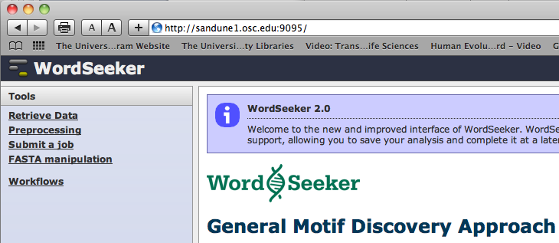
WordSeeker Our colleagues from Ohio University Lonnie Welsh and his team
2008 Interpretations?

Slide 10
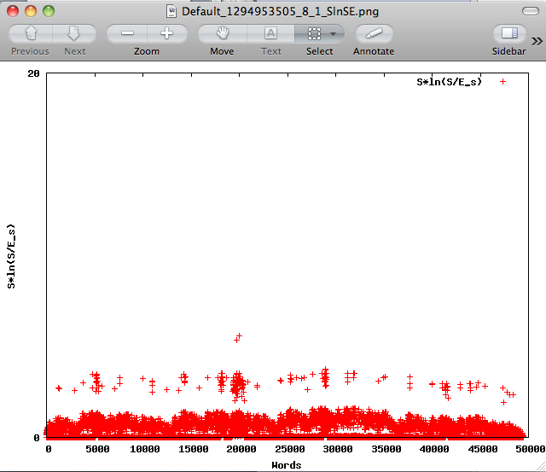
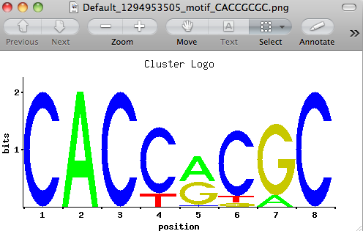

Slide 11
Mid-range scale of non-randomness in English
galactosidase
???????????????????????????????????????????????????????????????????????????????????????????????????????????????????????????????????????????????????????????????????????????????????????????????????????????????????????????????????????????????????????????????????????????????????????????????????????????????????????????????????????????????????????????????????????????????????????????????????????????????????????????????????????????????
Lactose, Glycoproteins Wilderness, tormenting, pleasantness

Slide 12
Mid-range inhomogeneity in genomic DNA
30-10,000 nucleotide range
Non-randomness in nucleotide composition within 50 nts, 200 nts, 1000 nts windows
Major topic for today

Slide 13
English Long-range inhomogeneity
Chapters in books
written by a boy and old man
Conversations vs descriptions
Covered different topics (War and Peace)

Slide 14
Genomic long-range inhomogeneity
Also well recognized are long-range interdependencies in nucleotide frequencies on a scale of up to millions of bases, known as genomic isochores. It has been shown that isochores can be generally categorized according to their level of G+C content. Isochores defined by G+C content correspond to many other genomic phenomena.

Slide 15
HUMAN
GENOME:
GC-content
green
#Alu-repeats
# transcripts (EST)
G+C percentage
# genes

Slide 16
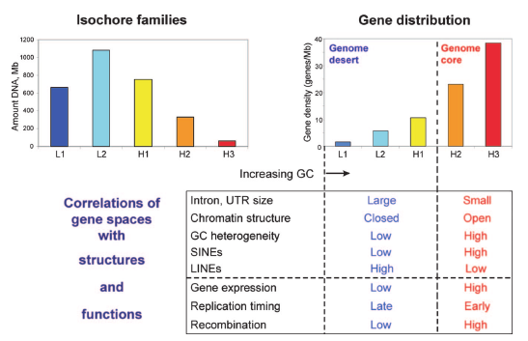
What are isochores?
DNA and gene distribution in the human isochore families
Bernardi. The neoselectionist theory of genome evolution. PNAS. May, 2007. 104(20):8385-90.
Notes:
DNA regions of fairly homogeneous base composition (esp. GC), which can be further grouped into discrete "levels" corresponding to frequency (number in the genome), gene density (and intron size), gene expression, replication timing, and recombination frequency.
o ~1% sd. of GC internally (85% of genome); the rest ~2%
o ~3,200 in humans, grouped into 5 familes (L1/2, H1/2/3)‏
o ~1Mb, on average
o cover a wide range of G+C content (34-59% in humans)‏

Slide 17
Isochore origins
Plausible origins
Homeothermy
Advent of CpG methylation
repair/replication machinery bias
+ microchromosomes
Invasion of very active mobile elements

Slide 18
Isochore evolution
Evolution
"Transitional mode"
Mutational bias hypothesis
Selection hypothesis
Biased Gene Conversion theory
G+C content in decline?
"Regression mode"
A new "conservation mode"

Slide 19
Difference in DNA chains in prokaryotes
Skew(AT) = (f(A)-f(T)) /(f(A)+f(T))
GenSkew http://genskew.csb.univie.ac.at/

Slide 21
Trifonov’s periodicities
http://research.haifa.ac.il/~genom/topics_pages/codes/codes.html

Slide 22
Assignment #1
Http://www.springerlink.com/content/g74u87880k58w001/
From this website download PDF (140.4 KB), on the left side in the middle of the webpage.
Read this review and write about all genomic codes. Rank these codes according to their importance, starting from the most valuable one. Present this ranking table with your arguments.

Slide 23
Genomic mid-range inhomogeneity correlates with an abundance of RNA secondary structures
Bechtel JM, Wittenschlaeger T, Dwyer T, Song J, Arunachalam S, Ramakrishnan SK, Shepard S, Fedorov A
BMC Genomics 2008, 9:284
Genomic MRI
http://bpg.utoledo.edu/gmri
http://mco321125.meduohio.edu/~jbechtel/gmri/
Web resource for analysis of genomic sequences

Slide 24
Nucleotide Composition of intron 3 of Heparanase2
rel. freq
A 0.290
T 0.336
C 0.185
G 0.189
AA 0.0935
AT 0.0867
AC 0.0455
AG 0.0641
TA 0.0756
TT 0.1232
TC 0.0611
TG 0.0759
CA 0.0654
CT 0.0711
CC 0.0434
CG 0.0056
GA 0.0552
GT 0.0549
GC 0.0355
GG 0.0434
What is interesting
in this CpG composition?

Slide 25
Under-representation of CG dinucleotides in the human genome due to methylation
Frequency of C 0.185
Frequency of G 0.189
Frequency of CG 0.0056 (on average 5-6 CG in 1000 nt sequence)
Genomic signatures:

Slide 26
Why there is a shortage of CG dinucleotides in the human genome?

Slide 27
5`-CpG- 3` specific sites for methylation in humans
5`- AGTCGTTCAATCACGGGGATC-3`
3`- TCAGCAAGTTAGTGCCCCTAG-5`
5`- AGTCGTTCAATCACGGGGATC-3`
3`- TCAGCAAGTTAGTGCCCCTAG-5`
5me
5me
5me

Slide 28
^{5me}C deamination -> T

Slide 29
Short-range inhomogeneity
It is well established that the particular base (A, G, C, or T) that appears in a given position of a genomic sequence significantly depends upon the nearest bases surrounding its position. The highest interdependence of base frequencies is always observed for adjacent nucleotides. The interdependence of base frequencies sharply drops with increasing distance. When the distance between nucleotides X and Y is more than six bases apart, their occurrence interdependency becomes negligible.

Slide 30
There are hundreds of intercellular molecular processes that cause mutations or selection of mutations at specific sites
Hot spots for mutations
DNA conformations (A-, B-, Z- forms)
Transcriptional activity (unwinding of DNA double strands)
Covering by chromosomal proteins
Reasons for majority of mutational hot-spots are unknown

Slide 31
Table of genomic signatures in humans
AA 1.16 GA 0.98
AC 0.80 GC 0.98
AG 1.19 GG 1.26
AT 0.85 GT 0.79
CA 1.15 TA 0.72
CC 1.27 TC 0.97
CG 0.36 TG 1.17
CT 1.19 TT 1.16

Slide 32
Genome signature comparisons among prokaryote, plasmid and mitochondrial DNA Campbell A., Mrazek J., Karlin S. PNAS 1999, 96:9184-9189
Our basic observation is that each genome has a characteristic "signature" defined as the ratios between the observed dinucleotide frequencies and the frequencies expected if neighbors were chosen at random (dinucleotide relative abundances). The remarkable fact is that the signature is relatively constant throughout the genome; i.e., the patterns and levels of dinucleotide relative abundances of every 50-kb segment of the genome are about the same. Comparison of the signatures of different genomes provides a measure of similarity which has the advantage that it looks at all the DNA of an organism and does not depend on the ability to align homologous sequences of specific genes.
Table
Genome signature (dinucleotide relative abundances) of complete genomes and large DNA sequence samples (>500 kb).

Slide 34
Generation of random sequence
A
T
G
C
Let’s assume you have 40 A, 30 T, 15 G, 15 C

Slide 35
Two approaches for generating random sequence
Every time you draw the ball from a random lottery machine you:
1) put it back into lottery machine
2) keep it with you
QUIZ
Let’s assume you have 40 A, 30 T, 15 G, 15 C
and you should generate 100 nt-long sequence
What is the most frequent random sequence output for case 1 and case 2?

Slide 36
Perl program to generate random sequence
#!/usr/bin/perl
@sum=(); @n = ('A', 'T', 'C', 'G'); $count = 0; $randseq='';
$A =231878; $T =268788; $C =148462; $G =151234;
$sum[0]=$A; $sum[1]=$sum[0]+$T; $sum[2]=$sum[1]+$C; $sum[3]=$sum[2]+$G;
print "Please enter the name of the output file \n";
$output = <STDIN>; chomp ($output);
for $w (0..$sum[3]) {
$r2 =int(rand($sum[3]))+1;
for $x (0..3) {if ($sum[$x] >= $r2) {$new = $n[$x]; last;}}
$randseq .=$new;
}
open (OUTPUT, ">$output") || die "Can't open $output : $!\n";
print OUTPUT '> ', "random sequence\n", $randseq , "\n";

Slide 37
SRI generator
Generation of random sequence with the real composition of N-mers (let’s say 4-mers: ATTA, GCCT, GGGA, etc.
Approach 1
Approach 2

Slide 38
Markov Models to generate random sequences with specific compositions
CTGGACTGAAATCG
A
C
A
T
?
CATA 0.004613
CATC 0.003341
CATG 0.004720
CATT 0.006889
23.6%
17.1%
24.1%
35.2%
A
C
G
T
4- mer TABLE

Slide 40
Mid-range inhomogeneity
The compositional non-randomness between the two extremes described above we call mid-range inhomogeneity or MRI. MRI has yet to be thoroughly investigated. The only well-known manifestation of mid-range inhomogeneity is CpG islands.
Here we demonstrate that MRI can be observed for regions from 30-1000 bp and is significant not only for G+C content but for other nucleotide pairings (A+G and G+T) as well as for the individual bases.

Slide 41
MRI-analyzer (Mid-Range Inhomogeneity)
MRI-analyzer program scans input sequences with a mid-range window size (the default, utilized for the results presented, is a 50 nt window). When the GC-content of the sequence in this window reaches the upper threshold, MRI-analyzer generates a blue top spike on the output graph (Figure 3). Similarly, when the GC-content of the window reaches the lower threshold, MRI-analyzer generates a purple bottom spike. The upper and lower thresholds are flexible parameters defined by the user. MRI-analyzer output for natural and SRI-generated 3'-UTR and intron sequences is shown in the next figure.

Slide 42
Looking for MRI in English language

Slide 43
Conversion of English to the genomic (AGTC) language
$decode{'d'}=['ACG', 'ACT'];
$decode{'e'}=['AGA', 'AGC'];
$decode{'f'}=['AGG', 'AGT'];
$decode{'g'}=['ATA', 'ATC'];
$decode{'h'}=['ATG', 'ATT'];
$decode{'i'}=['CAA', 'CAC'];
$decode{'j'}=['CAG', 'CAT'];
$decode{'k'}=['CCA', 'CCC'];
$decode{'l'}=['CCG', 'CCT'];
$decode{'m'}=['CGA', 'CGC'];
$decode{'n'}=['CGG', 'CGT'];

Slide 44
English language does not show profound MRI pattern

Slide 46
Assignment #2
repeat all my Genomic MRI demonstration steps with your 70 thousand nucleotide –long promoter sequence of globin gene.
Does it enriched with
G+C-rich and –poor regions?
G+T-rich and –poor regions?
G+A-rich and –poor regions?
Optional question for extra points to improve your grades:
Repeat the same protocol with your masked promoter sequence (which you obtained
after RepeatMasking last week). Note, that SRI-generator program recognizes all N-s in
the masked sequence and keep the same number and order of N-s in the randomized
sequence.
Do repetitive elements influence on the genomic MRI effect? How?

Slide 47
2 envelops paradox
Think it over
???

Slide 48
Optional assignment #3 to improve your grades
Think over and investigate the two letters paradox
Whether similar problems exist in biology and physics?
Write 1-2 pages report on your research

Slide 49
Assignment #1
Http://www.springerlink.com/content/g74u87880k58w001/
From this website download Trifonov’s review form “The codes of life” 2008 PDF (140.4 KB), on the left side in the middle of the webpage.
Read this review and write about all genomic codes. Rank these codes according to their importance, starting from the most valuable one. Present this ranking table with your arguments.

Slide 50
Assignment #2
repeat all my Genomic MRI demonstration steps with your 50 thousand nucleotide –long promoter sequence from lecture #6 (L6). Use online GMRI recourse http://bpg.utoledo.edu/~jbechtel/gmri/
IF YOU WANT TO EARN EXTRA POINTS TRY TO RUN Perl GMRI PROGRAMS YOURSELF FROM A COMMAND LINE (Follow the instructions on MRI_demoABPG2014.m4v and L4_HOMEWORKdemo.doc). [Extra assignment for additional credits]
After you have finished #1 answer the following questions: contrast with your randomized sequence, Does your promoter enriched with:
G+C-rich and –poor regions?
G+T-rich and –poor regions?
G+A-rich and –poor regions?

