Slide 1
quiz
What is the GC-content of the entire human genome?
What are two most rare dinucleotides in the human genome? Please specify their genomic signatures
~ 42%
δ_{cg}= 0.25
δ_{ta}= 0.74

Slide 2
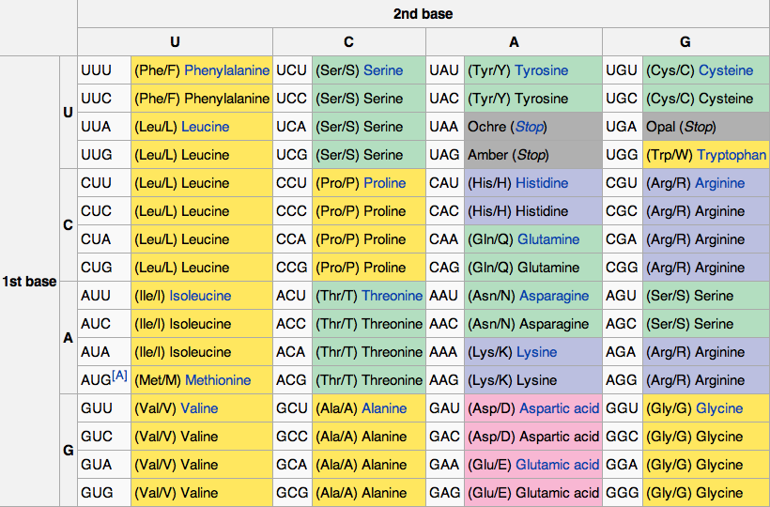

Slide 4
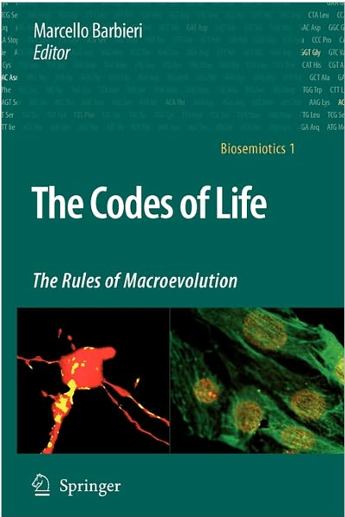
Why there is such profound non-symmetry in the genetic code?
Many interesting hypotheses and ideas

Slide 5
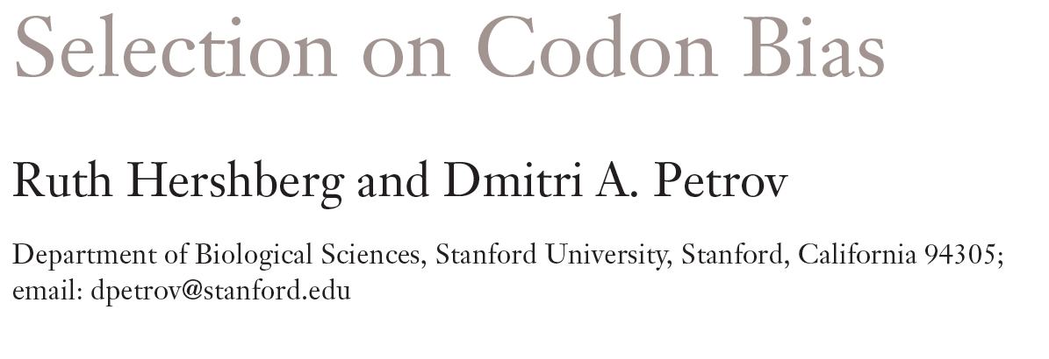
Understanding codon bias

Slide 6
Wobbling positions:
G and C over A and T
C->T plus strand
G->A minus strand

Slide 7
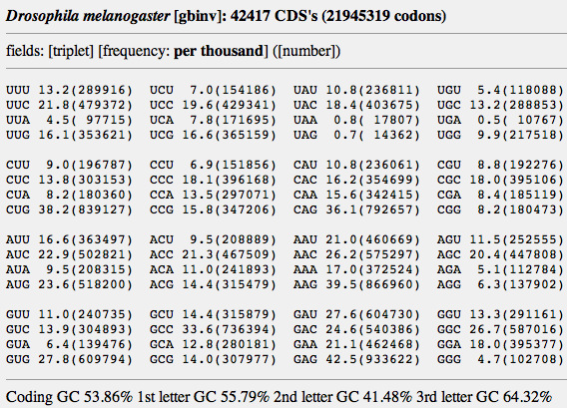
Do we see the same rules in Drosophila?

Slide 8
Analysis of genome-wide codon bias shows that only two parameters effectively differentiate the genome-wide codon bias of 100 eubacterial and archaeal organisms. The first parameter correlates with genome GC content, and the second parameter correlates with context-dependent nucleotide bias. Both of these parameters may be calculated from intergenic sequences. Therefore, genome-wide codon bias in eubacteria and archaea may be predicted from intergenic sequences that are not translated. When these two parameters are calculated for genes from nonmammalian eukaryotic organisms, genes from the same organism again have similar values, and genome-wide codon bias may also be predicted from intergenic sequences. In mammals, genes from the same organism are similar only in the second parameter, because GC content varies widely among isochores. Our results suggest that, in general, genome-wide codon bias is determined primarily by mutational processes that act throughout the genome, and only secondarily by selective forces acting on translated sequences.
http://www.ncbi.nlm.nih.gov/pmc/articles/PMC373487/?tool=pubmed

Slide 9
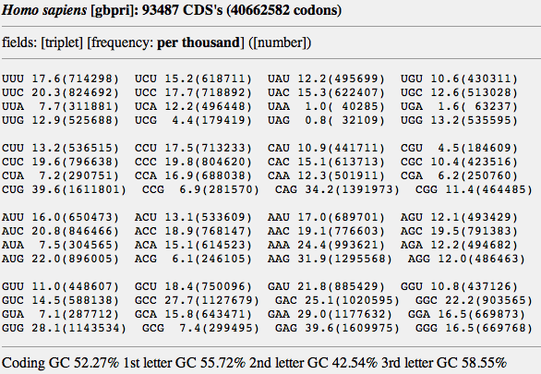

Slide 10
….Under the mutation-selection-drift balance model, codon bias is the result of positive selection for mutations that increase the frequency of major codons (preferred mutations) and purifying selection against mutations that decrease the frequency of major codons (unpreferred mutations).
…. However, the exact relative contribution of selection for efficiency and for accuracy of translation remains unclear. Although most genes seem to be under selection to increase the use of preferred codons, some have been found to be under selection in the opposite direction. What drives selection in these genes has not been determined.
CONCLUSION: While it is now clear that changes to synonymous sites are not neutral and that codon usage is affected by selection, many questions remain regarding the relationship between selection and codon bias.

Slide 11
Codon bias in individual genes
Codon Adaptaion Index (CAI) : Measurement of the relative adaptedness of codon usage of a gene towards the codon usage of highly expressed genes. CAI = exp(1/L ln Wk )
( John Peden,1997)
Frequency of Optimal Codon (FOP) = Ratio of the optimal codons to the non-optimal codons (regardless of their encoded amino acids) within a sequence. FOP = # Optimal_Codons/#Non-optimal_Codons
(Ikemura, 1985 and Peden, 1997)

Slide 12
Codon Bias Index (CBI)
CBI = (N_{opt} – N_{rand} )/ (N_{tot} – N_{rand} )
(Bennetzen and Hall, 1982)
N_{opt} = Number of optimal codons in the sequence
N_{tot} = Total number of codons
N_{rand} = Number of optimal codons under random choice
CODON_{rand} = 1/2 (for groups with 2 synonymous codons)
CODON_{rand} = 1/4 (for groups with 4 synonymous codons)
CODON_{rand} = 1/6 (for groups with 6 synonymous codons)

Slide 13
For Example:
UUC UUU AGC AAU GGG UGG
Phe Phe Ser Asn Gly Trp
CBI = (2 – (0.5 + 0.5 + 0.15 + 0.5 + 0.25))/(5 - (0.5 + 0.5 + 0.15 + 0.5 + 0.25))
CBI = 0.03
Optimal Codon
Corresponding Amino Acid
Excluded
CBI Range (-1…0…+1)➔ (mostly Rare codon …. Random.. .…mostly Optimal Codon)

Slide 14
CBI varied in our real sequences!
> EXON_30 3016_NT_005403 protein_id:NP_005867.3;
CBI value: 0.39
CGCTCCCAGATCAGCTACAAATGCCACCTGGTGCTGGCCCCATCCCCGAGCTGCTGCGGGCCCCCCCA…
> EXON_4 13299_NT_026437 protein_id:NP_473365.3;
CBI value: -0.34
GAATCTGACTTTCTTTGTCTTCTTGGAGTAAGTTACACATTTGACAATGAAGAT…

Slide 15
CBI value

Slide 16
… Still unclear is what determines which of the synonymous codons will be used as major and minor codons. In some cases, the choice of major codons appears to be strongly nonrandom and thus hard to explain. For example, in Drosophila and in C. elegans most major codons end in either a cytosine or a guanine even though both genomes are AT rich (14). No theories have been proposed, to our knowledge, to explain this fact.
Note that in Drosophila and C. elegans almost all of the
optimal codons contain a cytosine or a guanine in the third
position. Laurent Duret 2002

Slide 17
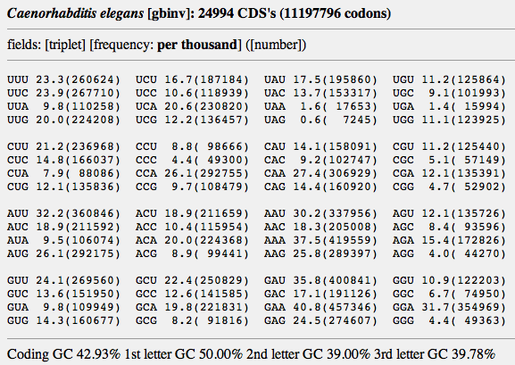
Inverse preference of A and T over G and C

Slide 18
Genomic GC-content and codon bias

Slide 19
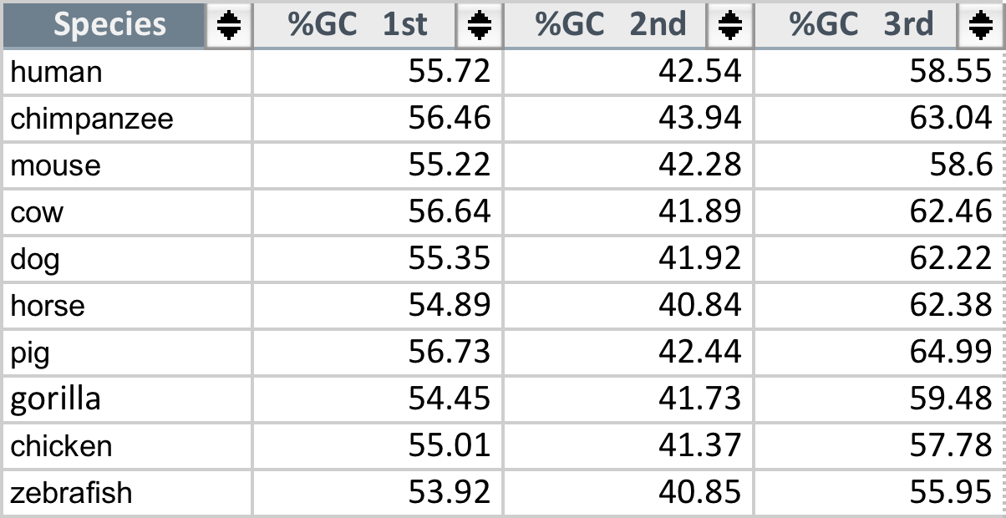
GC-content in codons of mammals and vertebrates

Slide 20
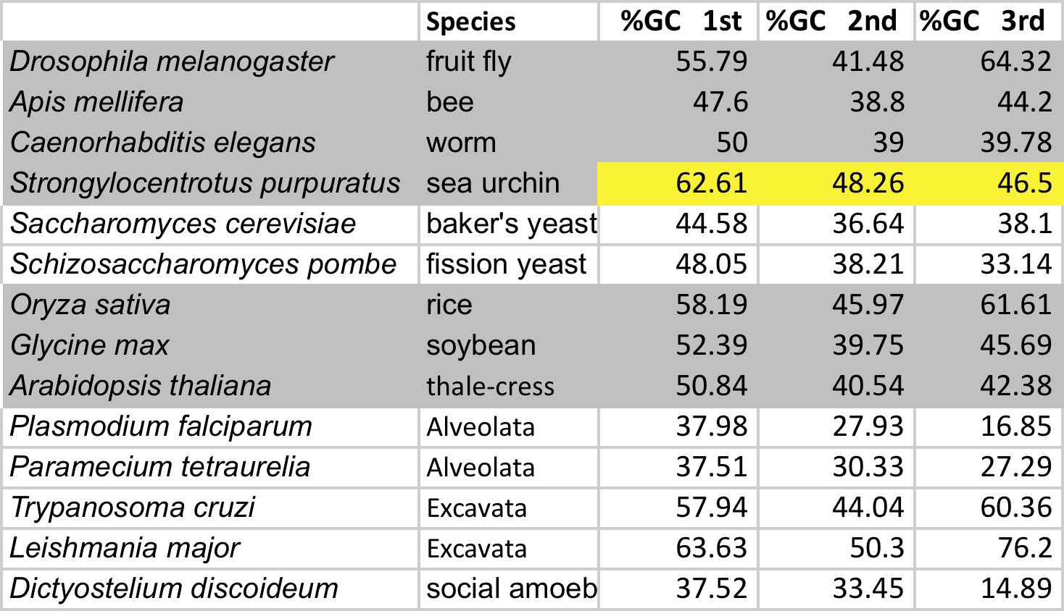
GC-content in codons across eukaryotes

Slide 21
GC-content in the 1st vs 2nd codon position in prokaryotes

Slide 22
GC-content in the 1st vs 3rd codon position in prokaryotes

Slide 23
GC-content in the 2nd vs 3rd codon position in prokaryotes

Slide 24
CONCLUSIONS
A
INPUT: GC-content
for the 1st letter in
codons
Prediction of Codon Bias
With ~75% accuracy
Prediction of Codon Bias
With ~95% accuracy
INPUT: genomic
signatures
GC%
GC%
B
Constant evolutionary waives
In GC-content up and down

Slide 25
GC-content in the 1st vs 2nd codon position in eukaryotes

Slide 26
GC-content in the 1st vs 3rd codon position in eukaryotes

Slide 27
GC-content in the 2nd vs 3rd codon position in eukaryotes

Slide 28
GC-content in codons of mammals and vertebrates

Slide 29
2010
FROM THE ABSTRACT:
…(In humans) fixation had strong bias towards increasing the rarest codons but
decreasing the most frequently used codons, suggesting that codon equilibrium
has not been reached yet.
Therefore, our ancestors have even higher CG-composition in 3rd position of codons.
How could mammals have GC-content in the third codon position above 60%?
Human GC-rich isochors: H1 (44 < GC% ≤ 47), H2 (47 < GC% ≤ 52) and H3 (GC% > 52).

Slide 30
Homework assignment
Read 3 additional papers on codon bias (CB_paper1, CB_paper2, and CB_paper3)
What forces have predominantly created codon bias in mammals? (selection or mutations?)
How could mammals have the GC-content in the third codon position above 60%?

Slide 31
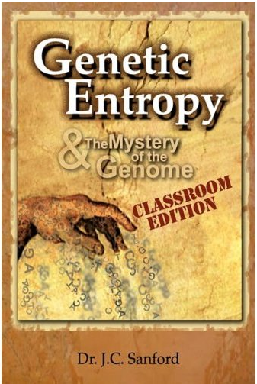
This book explores the weaknesses of Darwinian theory from the perspective of someone who has been at the cutting-edge of genetic research.

Slide 32
Genetic Entropy & the Mystery of the Genome (2005)
The book claims that the genome is deteriorating and therefore could not have evolved in the way specified by the Modern evolutionary synthesis.
Sanford is a prolific inventor with more than 30 patents. At Cornell Sanford and colleagues developed the "Biolistic Particle Delivery System" or so-called "gene gun”. He is the co-inventor of the Pathogen-derived Resistance process and the co-inventor of the genetic vaccination process. He was given the "Distinguished Inventor Award" by the Central New York Patent Law Association in 1990 and 1995. He has founded two biotechnology companies, Sanford Scientific and Biolistics. In 1998 he retired on the proceeds from the sale of his biotech companies, and continued at Cornell as a courtesy associate professor. http://www.youtube.com/watch?v=0-rx_lS3ZwI

Slide 33
Special assignment to get extra credits and earn extra “A+”!
YOUR TASK: Find in the literature an alternative SCIENTIFIC theory for the origin of new gene
Rapid mutations
And acquisition of
a new function
duplication
Gene A1
Gene new
Gene A
Gene A2
Gene A2
Preservation an
original function

Slide 34
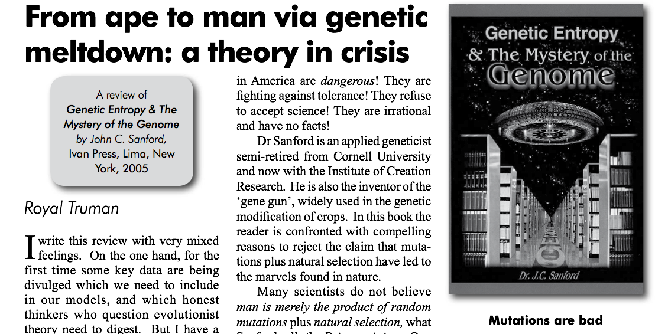
http://creation.com/images/pdfs/tj/j21_1/j21_1_43-47.pdf

Slide 35
Homework assignments for L5
Major assignment – See slide 30
Optional assignment – See slide 33.

