Slide 1
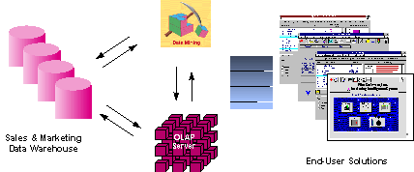
Data Mining in Bioinformatics
Sadik A. Khuder, Ph.D.,
College of Medicine
University of Toledo

Slide 2
Introduction
Bioinformatics is the science of managing, mining, and interpreting information from biological data.
Various genome projects have contributed to an exponential growth in DNA and protein sequence databases.
Rapid advances in high-throughput technologies, such as microarrays, mass spectrometry and new/next-generation sequencing, can monitor quantitatively the presence or activity of thousands of genes, RNAs, proteins, metabolites, and compounds in a given biological state.
The ongoing influx of these data, the pressing need to address complex biomedical challenge, and the gap between the two have collectively created exciting opportunities for data mining researchers.

Slide 3
What is Data Mining?
Data mining (or knowledge discovery) is the process of analyzing data and summarizing it into useful information
Information are used to develop new biomarkers, or find a new line of treatment etc..
Data mining aims at the extraction of hidden predictive information from large databases
Data mining software is one of a number of analytical tools for analyzing data. It allows users to analyze data from many different dimensions or angles, categorize it, and summarize the relationships identified.
Technically, data mining is the process of finding correlations or patterns among dozens of fields in large relational databases.

Slide 4
The challenge
Researchers in bioinformatics are estimated to produce 10,000,000,000,000,000 bytes of data each year ( 16 billion of CD-roms).
How do we learn something from this data?
Commonly many relevant variables in the data
  E.g. one chip ~30000 variables
  Typically many cross tabulations
Data mining can help summarize the data
Also reduce the chance of obtaining spurious results

Slide 5
Some Examples
Microarray gene expression data analysis
Identification of regulatory binding sites
Identification of splice junction sites & translation start sites
Experimental technique for inference of protein complexes
Phylogenetic analysis
Protein domain identification
Identification of structural motifs
Prediction reliability assessment of protein structures
Predicting protein functional classes such as localization sites and modifications

Slide 6
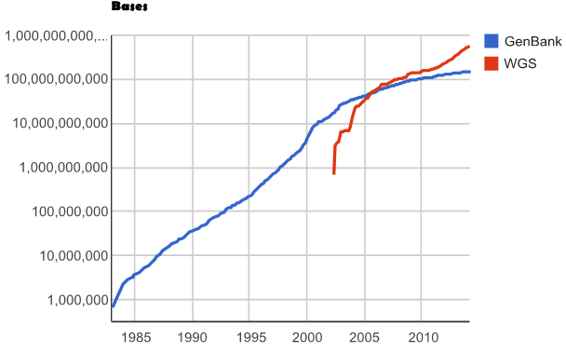
Growth of GenBank and WGS

Slide 7
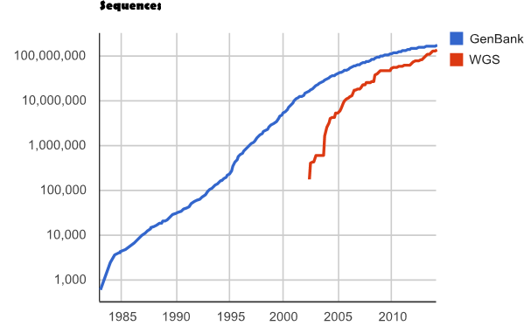
Growth of GenBank and WGS

Slide 8
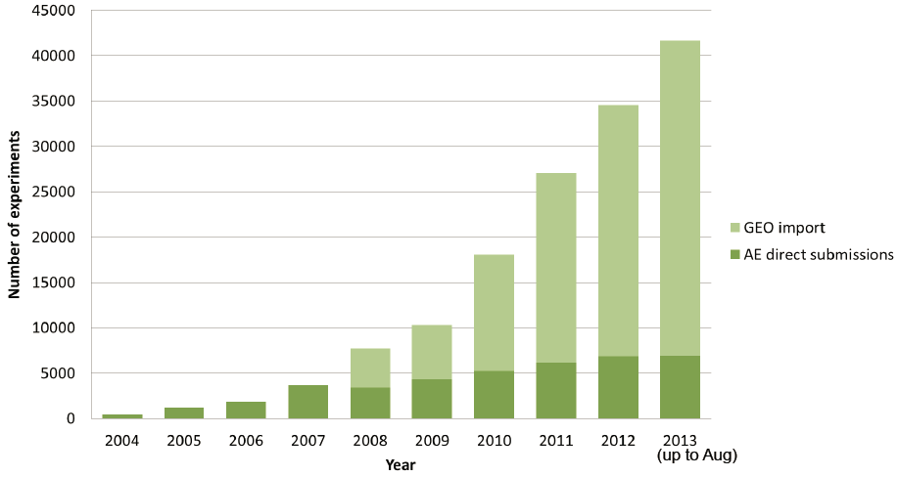
Data in ArrayExpress

Slide 9
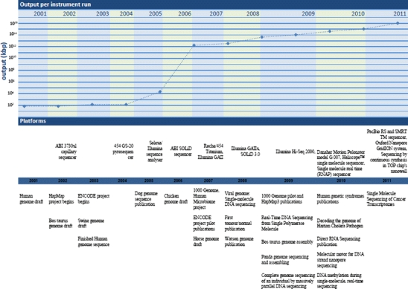
NGS technology evolution
Pareek at al, 2011. J Appl Genet. 2011 Nov;52(4):413-35

Slide 10
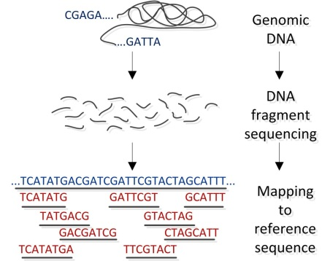
NGS technology evolution
Pavlopoulos et al. BioData Mining 2013, 6:13

Slide 11
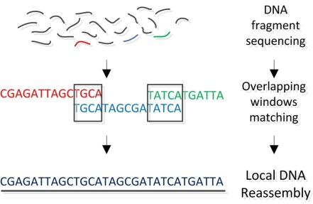
NGS technology evolution
Pavlopoulos et al. BioData Mining 2013, 6:13

Slide 12
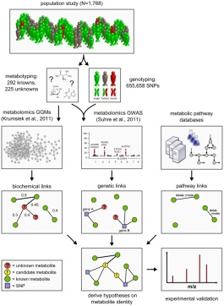
Metabolomic
Data integration workflow for the systematic classification of unknown metabolites.
PLoS Genet. Oct 2012; 8(10):

Slide 13
Data Mining
Pre-Processing
&
Representation
Knowledge
discovery
Feedback
Intermediate
representation
Data
Background Knowledge

Slide 14
Supervised vs. Unsupervised Learning
Imagine an organism or machine which experiences a series of sensory inputs: x1, x2, x3, x4, . . .
Supervised learning: The machine is also given desired outputs y1, y2, . . ., and its goal is to learn to produce the correct output given a new input.
Unsupervised learning: The goal of the machine is to build representations of x that can be used for reasoning, decision making, predicting things, communicating etc.

Slide 15
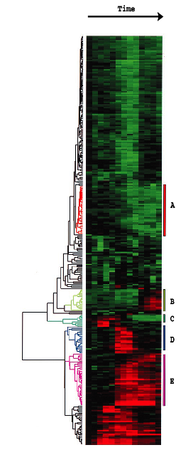
Supervised vs. Unsupervised Learning
Unsupervised learning: The classes are unknown a priori and need to be “discovered” from the data, e.g. cluster analysis, class discovery, unsupervised pattern recognition
Supervised learning- The classes are predefined and the task is to understand the basis for the classification from a set of labeled objects. This information is then used to classify future observations, e.g. classification, discriminant analysis, class prediction, supervised, pattern recognition
Eisen MB, Spellman PT, Brown PO and Botstein D. (1998)

Slide 16
Multivariate Analysis Methods
  Analysis of interdependence (Unsupervised)
    No variables thought of as “dependent”
    Look at the relationships among variables, objects or cases
  Analysis of dependence (Supervised)
    Where one (or more) variables are dependent variables, to be explained or predicted by others

Slide 17
Unsupervised Learning
Raw Data
Dimensionality Reduction
Graphical
Representation
Distance or
Similarity Matrix
Validation
Internal
Extermal
Clustering

Slide 18
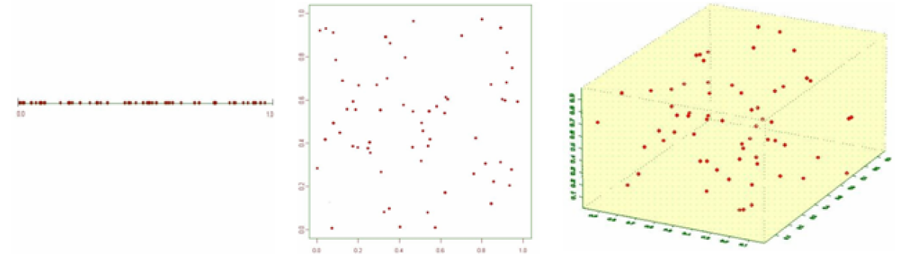
The Dimensionality Problem
Caused by the rapid increase in volume associated with adding extra dimensions to a (mathematical) space.
It is a significant obstacle in high dimension data analysis.
The sparsity increases exponentially given a fixed amount of data points.
64 data points are simulated form a uniform (0 , 1) distribution.
Points are clustered together
more sparse
more sparse

Slide 19
N<<p problem
Dimensionality problem when N is not >>>p.
In bioinformatics, usually N<100, and p > 1000.
How to deal with this N <<p issue?
Dramatically reduce p before model-building.

Slide 20
Dimensionality Reduction
What is Dimensionality Reduction?
  Simplifying complex data.
  Can be used as a data mining tool.
  Useful for both data modeling and data analysis.
Linear Dimensionality Reduction Methods
  Principal Component Analysis (PCA)
  Multi-Dimensional Scaling (MDS)
  Correspondence Analysis

Slide 21
Principal components analysis (PCA)
An exploratory technique used to reduce the
dimensionality of the data set to 2D or 3D
For a matrix of m variables x n samples, create a new covariance matrix of size n x n
Thus transform some large number of variables into a smaller number of uncorrelated variables called principal components (PCs).
Page 211

Slide 22
Principal Components
The first principal component is identified as the vector (or equivalently the linear combination of variables) on which the most data variation can be projected
The 2nd principal component is a vector perpendicular to the first, chosen so that it contains as much of the remaining variation as possible
And so on for the 3rd principal component, the 4th, the 5th etc.

Slide 23
PCA : objectives
•to reduce dimensionality
to determine the linear combination of variables
to choose the most useful variables (features)
to visualize multidimensional data
to identify groups of objects (e.g. genes/samples)
to identify outliers
Page 211

Slide 24
Principal Components
C1 C2 C3 C4 C5 C6
Similarity
Criterion:
Correlations
1
2
3
4
5
Correlations
6×6
1
Calculate eigenvectors with greatest eigenvalues
Linear combinations
Orthogonal
Project data
points onto
new axes
(eigenvectors)
2

Slide 25
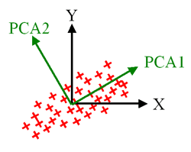
Principal Components

Slide 26
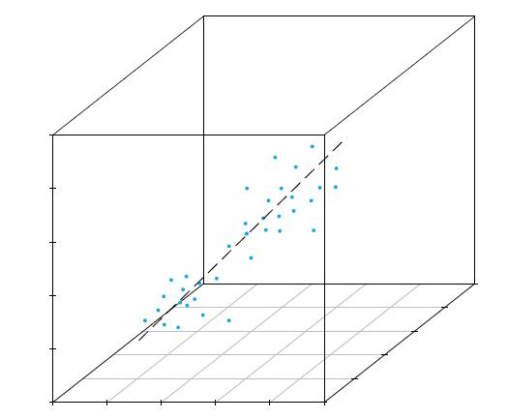
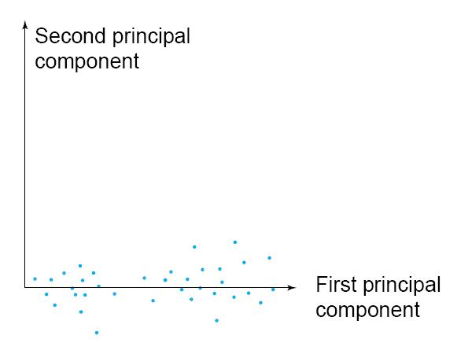
Principal components

Slide 27
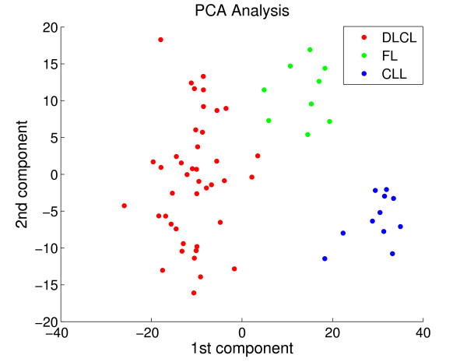
Principal Components-example
PCA plot for Alizadeh-V2. A scatter plot with the two first largest components of a PCA for Alizadeh-V2. Colors indicate the three classes in the data: diffuse large B-cell lymphoma in red (DLBCL), follicular lymphoma in green (FL) and chronic lymphocytic leukemia in blue(CLL).
BMC Bioinformatics. 2008 Nov 27;9:497.

Slide 28
Scree plot
A scree plot displays eigenvalues versus factors.
Used to estimate the number of factors that usefully capture the variance in the data.
Look for where the plot levels off and exclude those factors.
Typically, we hope to find as few factors as possible to explain the original data.
Eigenvalue
Components

Slide 29
Multidimensional Scaling
Multidimensional scaling (MDS) is a dimension reduction technique that can be considered as
an alternative to PC
MDS uses distances in the calculation
It attempts to arrange "objects" in a space with a particular number of dimensions so as to reproduce the observed distances.
As a result, we can "explain" the distances in terms of underlying dimensions

Slide 30
Multidimensional Scaling (MDS)
Displays (transformed) multivariate data in low-dimensional space
Different from plots based on PC
  Primary objective is to “fit” the original data into low-dimensional system
  Distortion caused by reduction of dimensionality is minimized
Distortion
  Similarities or dissimilarities among data

Slide 31
Multidimensional Scaling
Given a set of similarities (or distances) between every pair of N items
Find a representation of the items in few dimensions
Inter-item proximities “nearly” match the original similarities (or distances)

Slide 32
Non-metric and Metric MDS
Non-metric MDS
  Uses only the rank orders of the N(N-1)/2 original similarities and not their magnitudes
Metric MDS
  Actual magnitudes of original similarities are used
  Also known as principal coordinate analysis

Slide 33
Measures of goodness-of-fit: Stress
N items, M = N(N-1) / 2 similarities.
Assume no ties, and arrange
Find a q-dimensional configuration such that
Kruskal’s Stress
are numbers known to satisfy the ordering.
Takane’s Stress

Slide 34
Basic Algorithm
Obtain and order the M pairs of similarities
Try a configuration in q dimensions
  Determine inter-item distances and reference numbers
  Minimize Kruskal’s or Takane’s stress
Move the points around to obtain an improved configuration
Repeat until minimum stress is obtained

Slide 35
Example 1
Identification of a molecular signature in human type 1 diabetes mellitus using serum and functional genomics.
In MDS analysis, each sample is plotted in a three-dimensional space where the similar samples are plotted in closer proximity compared with the dissimilar ones.
RO samples are shown as red circles and HC samples are shown as black squares.
J Immunol. 2008 Feb 1;180(3):1929-37

Slide 36
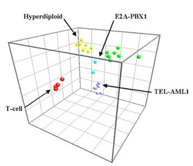
Example 2
Different cell types are multi-dimensionally scaled. The color codes indicate clear clustering.

Slide 37
Correspondence Analysis (CA)
Special case of PCA — transforms a table of numerical data into a graphic summary
A simplified, more interpretable display leads to deeper understanding of the fundamental relationships/structure inherent in the data
A map of basic relationships, with much of the “noise” eliminated and usually reduces the dimensionality of the data

Slide 38
CA – basic ideas
Derived from methods of contingency table analysis
Most suited for analysis of categorical data: counts, presence-absence data
possibly better to use PCA for continuous (i.e., ratio) data
CA makes no assumptions about the distribution of the input variables

Slide 39
Interpretation
Correspondence analysis plots should be interpreted by looking at points relative to the origin
  Points that are in similar directions are positively associated
  Points that are on opposite sides of the origin are negatively associated
  Points that are far from the origin exhibit the strongest associations
Also the results reflect relative associations, not just which rows are highest or lowest overall

Slide 40
Correspondence Analysis
Distance between two species, i and j, over sites k=1,…,p is
  r_{i} species totals
  c_{k} site totals
Difference in proportions of each species at each site
Then do Principal Coordinates Analysis

Slide 41
Example
Reg Short 4-plus
#1 48 28 2
#2 8 27 11
#3 9 26 0
#4 0 0 3
#5 1 2 1
#6 1 0 5
#7 4 0 0
#8 0 4 1
#9 0 2 0
#11 3 0 0
#12 0 1 0
#13 4 1 0
#14 1 0 0
#15 1 0 0
mtDNA haplotype
Eigenvalue 0.205
Eigenvalue 0.394

Slide 42
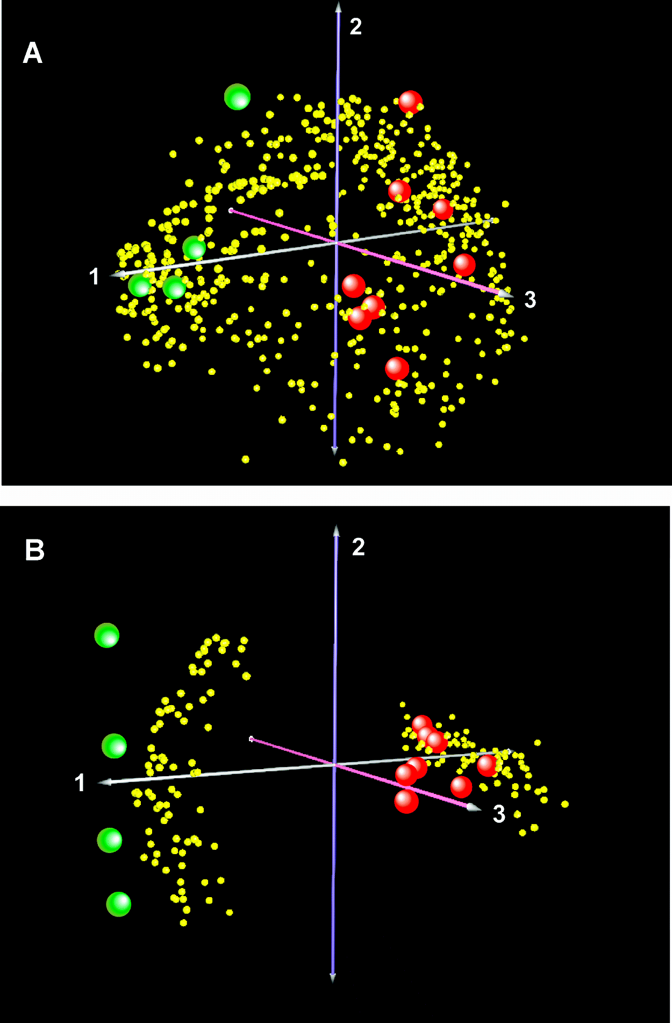
CA of proteomics data
Correspondence analysis on all 641 proteins identified by shotgun proteomics in the BAL fluid of control and/or cystic fibrosis subjects.
Correspondence analysis of the subset of 154 differentially enriched proteins identified by an SpI ≥ 0.75 or SpI ≤ –0.75. Yellow spheres, individual proteins; red spheres, cystic fibrosis subjects; green spheres, control subjects.
Journal of Proteome Research 2008, 7, 845–854 845

Slide 43
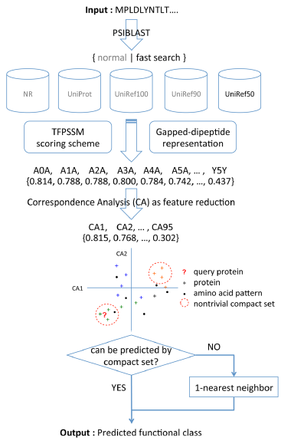
Prediction of Protein Functional Classes by Correspondence Analysis
Homology extension is performed against a compact non-redundant database using a fast search model to reduce running time.
Correspondence analysis (CA) is incorporated as an efficient feature reduction to generate a clear visual separation of different protein classes.
Functional classes are predicted by a combination of accurate compact set (CS) relation and interpretable one-nearest neighbor (1-NN) algorithm.
CA can not only efficiently identify discriminative features but also provide a clear visualization of different functional classes.
PLOS ONE October 2013 | Volume 8 | Issue 10 |

Slide 44
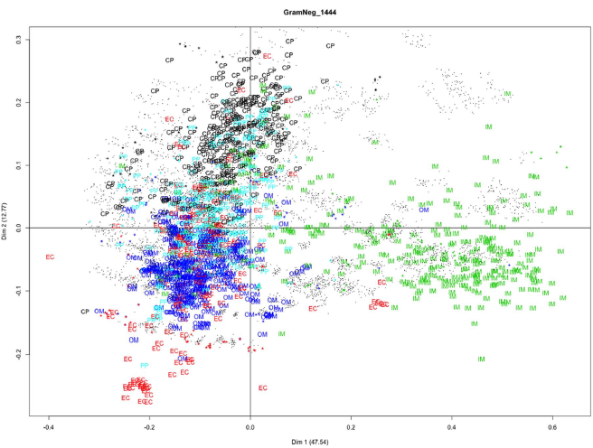
Figure 4. Correspondence analysis of the GramNeg_1444 data set. The figure shows Gram-negative bacteria proteins with localization labels, gapped-dipeptides (black circle) and gapped-dipeptide signatures (stars with corresponding color) projected in top two major CA dimensions whose percentage of variance is shown in parentheses.
PLOS ONE October 2013 | Volume 8 | Issue 10 |

Slide 45
Microarray Data Mining
Pre-Processing
&
Representation
Knowledge
discovery
Feedback
Intermediate
representation
Microarray Data
Background Knowledge

Slide 46
PCA for Microarray Data
Thousands of variables (genes) and a very small number of (biological) replicates, so multivariate regression analysis is difficult in practice.
The extremely high dimensional space of gene expression measurements obtained by microarrays impedes the detection of underlying patterns in gene expression data and the identification of discriminatory genes.

Slide 47
Data Format
attribute
object 1 2 3 ... m
1 4.7 3.8 5.9 ... 1.3
2 5.2 6.9 3.8 ... 2.9
3 5.8 4.2 3.9 ... 4.4
. . . . . .
. . . . . .
. . . . . .
n 6.3 1.6 4.7 ... 2.0

Slide 48
Microarray Data
time points
attribute
object 1 2 3 ... m
1 4.7 3.8 5.9 ... 1.3
2 5.2 6.9 3.8 ... 2.9
3 5.8 4.2 3.9 ... 4.4
. . . . . .
. . . . . .
. . . . . .
n 6.3 1.6 4.7 ... 2.0
genes
estimated expression levels

Slide 49
Microarray Data
tissue types
attribute
object 1 2 3 ... m
1 4.7 3.8 5.9 ... 1.3
2 5.2 6.9 3.8 ... 2.9
3 5.8 4.2 3.9 ... 4.4
. . . . . .
. . . . . .
. . . . . .
n 6.3 1.6 4.7 ... 2.0
genes
estimated expression levels

Slide 50
Microarray Data
treatment
conditions
attribute
object 1 2 3 ... m
1 4.7 3.8 5.9 ... 1.3
2 5.2 6.9 3.8 ... 2.9
3 5.8 4.2 3.9 ... 4.4
. . . . . .
. . . . . .
. . . . . .
n 6.3 1.6 4.7 ... 2.0
genes
estimated expression levels

Slide 51
Example 1
Pat_N1 Pat_N2 Pat_A1 Pat_A2 Pat_B1 Pat_B2
gene_a 90 110 190 210 290 310
gene_b 190 210 390 410 590 610
gene_c 90 110 110 90 120 80
gene_d 200 100 400 90 600 200

Slide 52
Covariance Matrix
gene_a gene_b gene_c gene_d
gene_a 8120 16120 -80 8380
gene_b 16120 32120 -80 18380
gene_c -80 -80 240 2020
gene_d 8380 18380 2020 39350

Slide 53
Eigen Values & Eigen Vectors
Eigen values
[1] 6.000824e+04 1.972570e+04 9.566785e+01 3.899597e-01
Eigen vectors
[,1] [,2] [,3] [,4]
[1,] -0.31240722 0.33844158 -0.19322348 0.86632772
[2,] -0.64183253 0.61246043 0.05781972 -0.45782105
[3,] -0.02237963 -0.07752419 -0.97732560 -0.19576472
[4,] -0.69996564 -0.71016866 0.06446891 0.03939986

Slide 54
Singular Value Decomposition
D
[1] 6.000824e+04 1.972570e+04 9.566785e+01 3.899597e-01
U
[,1] [,2] [,3] [,4]
[1,] -0.31240722 -0.33844158 -0.19322348 -0.86632772
[2,] -0.64183253 -0.61246043 0.05781972 0.45782105
[3,] -0.02237963 0.07752419 -0.97732560 0.19576472
[4,] -0.69996564 0.71016866 0.06446891 -0.03939986
V
[,1] [,2] [,3] [,4]
[1,] -0.31240722 -0.33844158 -0.19322348 -0.86632772
[2,] -0.64183253 -0.61246043 0.05781972 0.45782105
[3,] -0.02237963 0.07752419 -0.97732560 0.19576472
[4,] -0.69996564 0.71016866 0.06446891 -0.03939986

Slide 55
R Code for Example 1
dataf = read.table("example1.txt")
dataf1 = t(dataf)
pca =princomp(dataf1,cor=F,scores=TRUE)
plot(pca)biplot(pca)

Slide 56
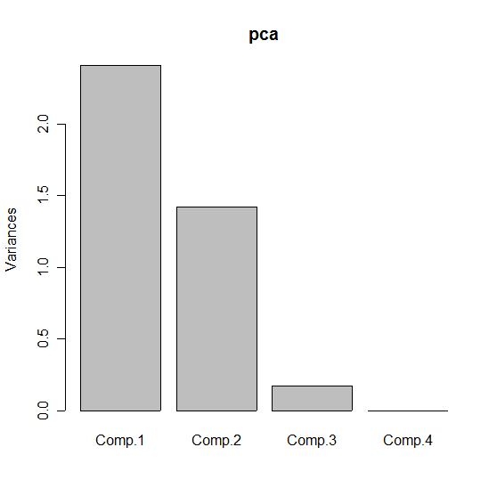
PCA for Example 1

Slide 57
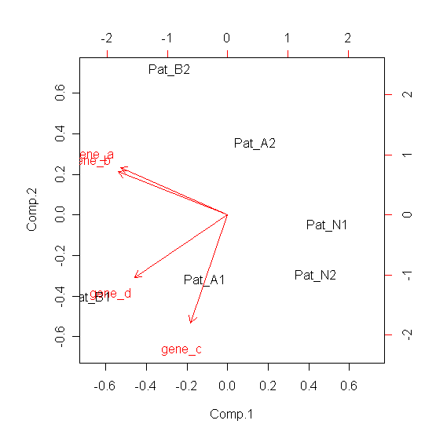
Biplot for Example 1

Slide 58
R Code for Example 2
data1=read.table("example2.txt")
pc.c1=princomp(data1)
summary(pc.c1)
summary(pc.c1 <- princomp(data1, cor=TRUE))
print(summary(princomp(data1, cor=TRUE),
loadings = TRUE, cutoff = 0.2), digits = 2)
screeplot(pc.c1)
screeplot(pc.c1, npcs=8, type="lines")
biplot(princomp(data1))
biplot(pc.c1, choices = 1:2, scale = .2, pc.biplot = T)
c1=cov(data1)
eigen(c1)
c2=svd(c1)

Slide 59
PCA for Example 2
Importance of components:
Comp.1 Comp.2 Comp.3 Comp.4 Comp.5
Standard deviation 17.0440506 9.9498858 7.8672439 7.01213985 6.71861146
Proportion of Variance 0.4734996 0.1613653 0.1008833 0.08014475 0.07357547
Cumulative Proportion 0.4734996 0.6348649 0.7357482 0.81589292 0.88946838
Comp.6 Comp.7 Comp.8 Comp.9
Standard deviation 4.66546927 4.53155163 3.91057506 3.19668232
Proportion of Variance 0.03547845 0.03347093 0.02492615 0.01665608
Cumulative Proportion 0.92494683 0.95841776 0.98334392 1.00000000

Slide 60
PCA for Example 2
Loadings:
Comp.1 Comp.2 Comp.3 Comp.4 Comp.5 Comp.6 Comp.7 Comp.8 Comp.9
x1 -0.45 -0.36 0.78 0.21
x2 -0.37 0.40 0.29 0.46 -0.42 0.44
x3 -0.42 0.21 -0.21 0.50 0.49 -0.48
X4 -0.30 0.24 -0.24 -0.53 -0.50 -0.27 -0.33 -0.23
X5 -0.31 -0.54 0.36 -0.45 -0.51
x6 -0.42 0.27 -0.49 0.40 -0.55
x7 -0.32 0.69 -0.49 0.24
x8 -0.57 -0.57 -0.22 0.46
x9 -0.24 -0.20 0.79 -0.45 -0.25

Slide 61
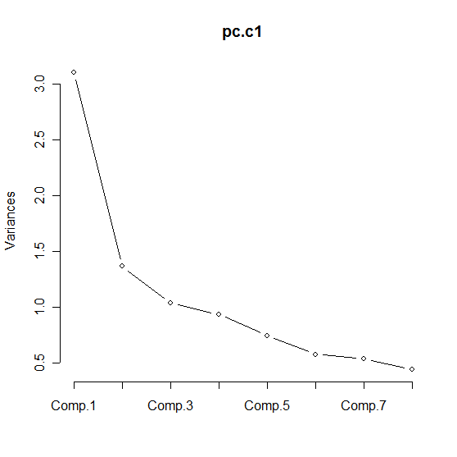
Screeplot for Example 2

Slide 62
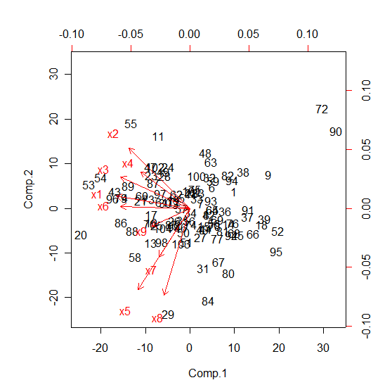
Biplot for Example 2

Slide 63
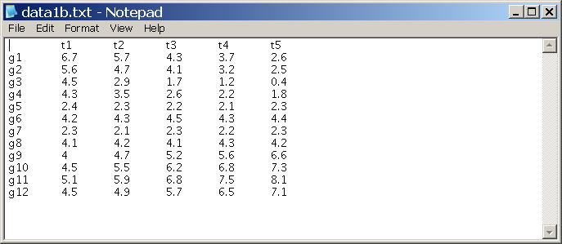
Example 2

Slide 64
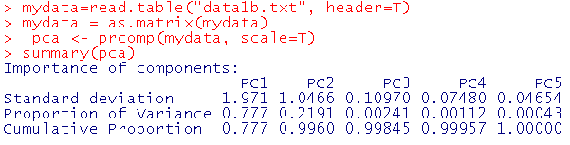
Importance of Components

Slide 65
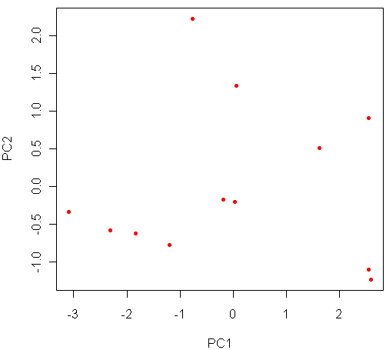
Plot of Samples

Slide 66
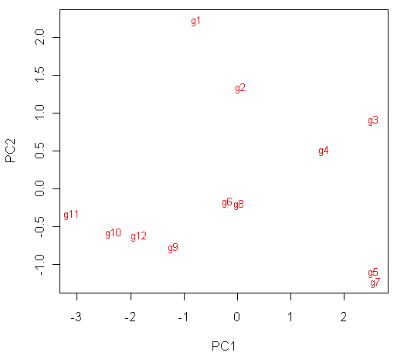
Plot of Genes

Slide 67
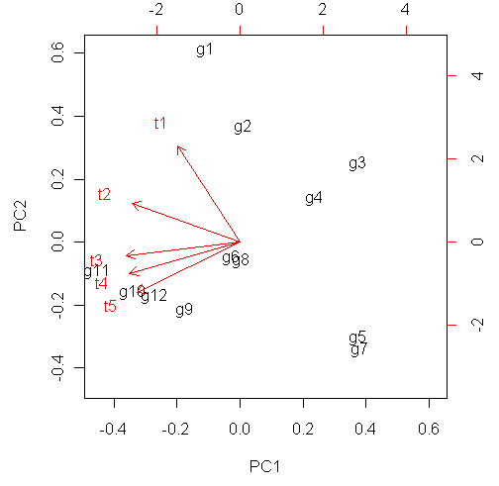
Biplot of Samples and Genes

Slide 68
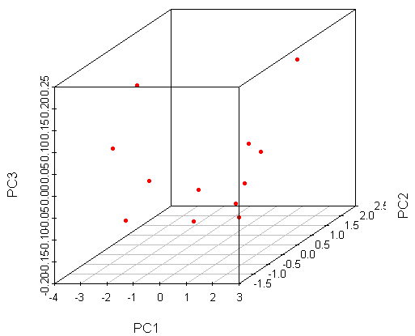
Three dimensional plot

Slide 69
