Slide 1
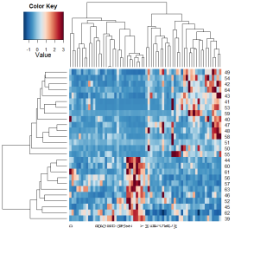
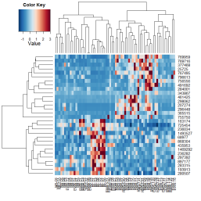
Cluster Analysis in Bioinformatics
Sadik A. Khuder, Ph.D.,
College of Medicine
University of Toledo

Slide 2
Cluster analysis
Is the process of grouping several objects into a number of groups, or clusters.
Objects in the same cluster are more similar to one another than they are to objects in other clusters.

Slide 3
What is clustering?
A way of grouping together data samples that are similar in some way - according to some criteria that you pick
A form of unsupervised learning – you generally don’t have examples demonstrating how the data should be grouped together
It is a method of data exploration – a way of looking for patterns or structure in the data that are of interest

Slide 4
What is a cluster?
A cluster is a group that has homogeneity (internal cohesion) and separation (external isolation).
The relationships between objects being studied are assessed by similarity or dissimilarity measures.

Slide 5
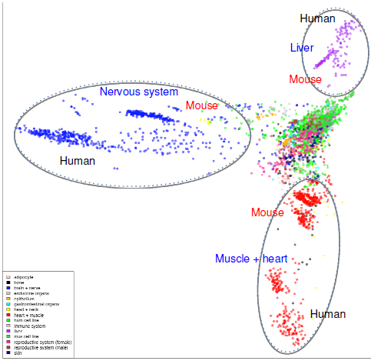
What is a cluster?
Genome Biol 2010, 11:R124

Slide 6
The Goals of Clustering
Identify patterns in the data
Reduce complexity in data sets
Allow “visualization” of complex data
Data reduction
  “natural clusters”
  “useful” clusters
  outlier detection

Slide 7
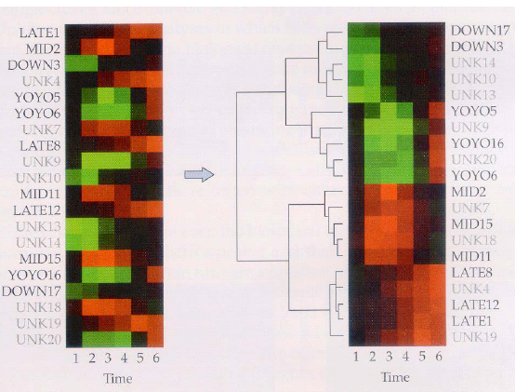
The Need for Clustering
Cluster variables (rows)
  Measure expression at multiple time-points, different conditions, etc.
  Similar expression patterns may suggest similar functions of genes

Slide 8
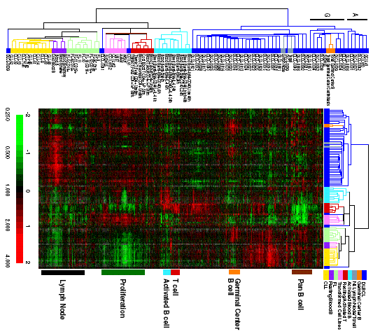
The Need for Clustering
Cluster samples (columns)
  Expression levels of thousands of genes for each tumor sample
  Similar expression patterns may suggest biological relationship among samples
Alizadeh et al., Nature 403:503-11, 2000

Slide 9
Similarity Measures
The goal of cluster analysis is to group together “similar” data
This depends on what we want to find or emphasize in the data
The similarity measure is often more important than the clustering algorithm used
The similarity measures are often replaced by dissimilarity measures

Slide 10
Distance Measures
Given vectors x = (x₁, …, x_{n}), y = (y₁, …, y_{n})
Euclidean distance:
Manhattan distance:

Slide 11
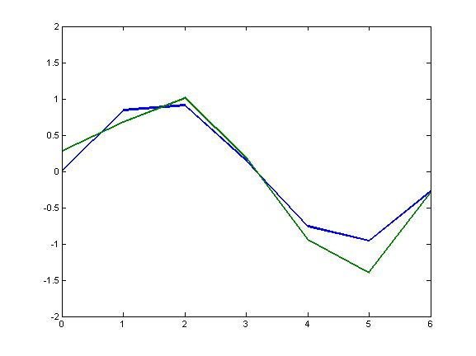
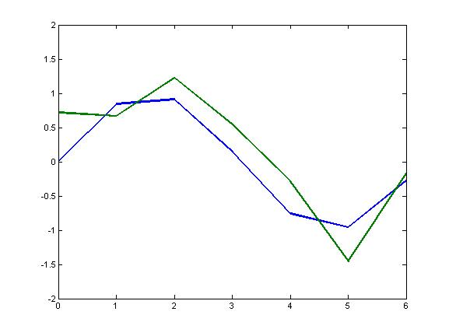
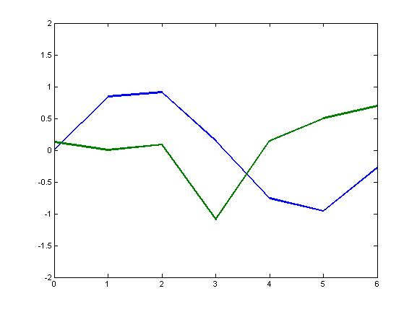
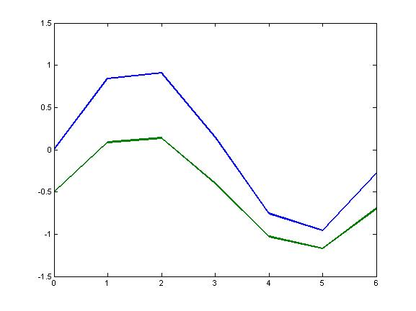
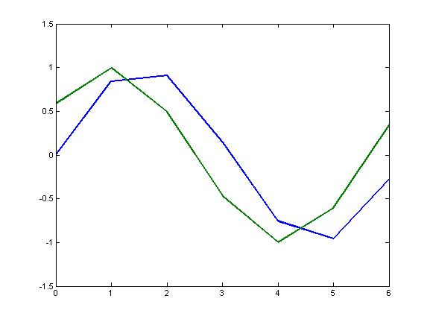
Euclidean distance
d_{euc}=0.5846
d_{euc}=1.1345
d_{euc}=2.6115
d_{euc}=1.41
d_{euc}=1.22

Slide 12
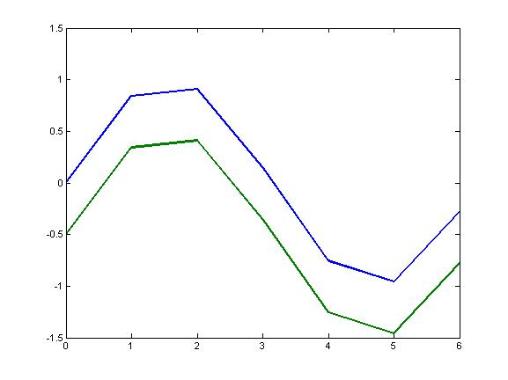
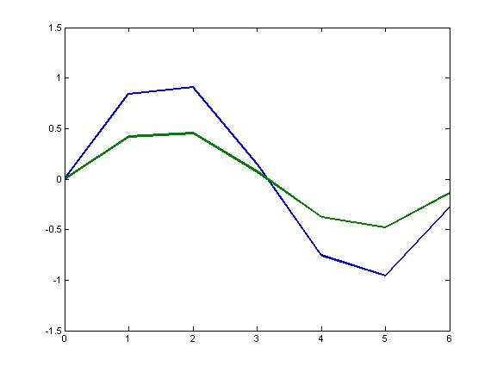
Correlation Coefficient
The overall shape of expression profiles may be more important than the actual magnitudes
Genes may be considered similar when they are “up” and “down” together
The correlation coefficient may be more appropriate in these situations

Slide 13
Pearson Correlation Coefficient
We’re shifting the expression profiles down (subtracting the means) and scaling by the standard deviations (i.e., making the data have mean = 0 and std = 1)

Slide 14
Similarity: Jaccard’s coefficient
Jaccard coefficient is used with binary data such as recording gene expression as on (1) or off (0)
The coefficient (S_{ij}) is defined as
This is the ratio of positive matches to the total number of characters minus the number of negative matches.
 | Genei
Genej |  | 1 | 0
 | 1 | a | b
 | 0 | c | d

Slide 15
Clustering methods
Partitioning
Hierarchical

Slide 16
Hierarchical Method
Hierarchical clustering Method produce a tree or dendogram
They avoid specifying how many clusters are appropriate by providing a partition for each k obtained from cutting the tree at some level
The tree can be built in two distinct ways
  Bottom-up: agglomerative clustering
  Top-down: divisive clustering

Slide 17
Dendogram
A dendrogram shows how the clusters are merged hierarchically

Slide 18
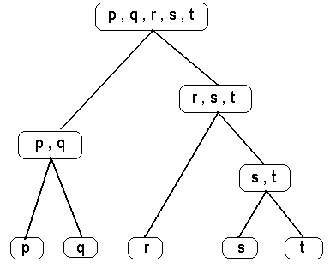
Hierarchical Clustering
Agglomerative
Divisive
Agglomerative clustering treats each object as a singleton cluster, and then successively merges clusters until all objects have been merged into a single remaining cluster.
Divisive clustering works the other way around.

Slide 19
Agglomerative clustering
0
1
2
3
4
a
a,b
b
c
d
e
Kaufman and Rousseeuw (1990)

Slide 20
Agglomerative clustering
0
1
2
3
4
a
a,b
b
c
d
d,e
e
Kaufman and Rousseeuw (1990)

Slide 21
Agglomerative clustering
0
1
2
3
4
a
a,b
b
c
c,d,e
d
d,e
e
Kaufman and Rousseeuw (1990)

Slide 22
Agglomerative clustering
0
1
2
3
4
a
a,b
b
a,b,c,d,e
c
c,d,e
d
d,e
e
…tree is constructed
Kaufman and Rousseeuw (1990)

Slide 23
Divisive clustering
a,b,c,d,e
4
3
2
1
0
Kaufman and Rousseeuw (1990)

Slide 24
Divisive clustering
Divisive clustering
a,b,c,d,e
c,d,e
4
3
2
1
0
Kaufman and Rousseeuw (1990)

Slide 25
Divisive clustering
Divisive clustering
a,b,c,d,e
c,d,e
d,e
4
3
2
1
0
Kaufman and Rousseeuw (1990)

Slide 26
Divisive clustering
Divisive clustering
a,b
a,b,c,d,e
c,d,e
d,e
4
3
2
1
0

Slide 27
Divisive clustering
Divisive clustering
a
a,b
b
a,b,c,d,e
c
c,d,e
d
d,e
e
4
3
2
1
0
…tree is constructed
Kaufman and Rousseeuw (1990)

Slide 28
Agglomerative Method
Start with n sample clusters
At each step, merge the two closet clusters using a measure of between-cluster dissimilarity which reflects the shape of the clusters
The distance between clusters is defined by the method used

Slide 29
Cluster Linkage Methods
Single linkage
Complete linkage
Centroid (Average linkage)

Slide 30
Example – Single Linkage
M
T
F
A
R
N
 | A | F | M | N | R | T
A | 0 | 662 | 877 | 255 | 412 | 996
F | 662 | 0 | 295 | 468 | 268 | 400
M | 877 | 295 | 0 | 754 | 564 | 138
N | 255 | 468 | 754 | 0 | 219 | 869
R | 412 | 268 | 564 | 219 | 0 | 669
T | 996 | 400 | 138 | 869 | 669 | 0

Slide 31
Example – Single Linkage
M
T
F
A
R
N
 | A | F | M | N | R | T
A | 0 | 662 | 877 | 255 | 412 | 996
F | 662 | 0 | 295 | 468 | 268 | 400
M | 877 | 295 | 0 | 754 | 564 | 138
N | 255 | 468 | 754 | 0 | 219 | 869
R | 412 | 268 | 564 | 219 | 0 | 669
T | 996 | 400 | 138 | 869 | 669 | 0

Slide 32
Example – Single Linkage
M
T
F
A
R
N
 | A | F | M | N | R | T
A | 0 | 662 | 877 | 255 | 412 | 996
F | 662 | 0 | 295 | 468 | 268 | 400
M | 877 | 295 | 0 | 754 | 564 | 138
N | 255 | 468 | 754 | 0 | 219 | 869
R | 412 | 268 | 564 | 219 | 0 | 669
T | 996 | 400 | 138 | 869 | 669 | 0

Slide 33
Example – Single Linkage
M
T
F
A
R
N
 | A | F | M | N | R | T
A | 0 | 662 | 877 | 255 | 412 | 996
F | 662 | 0 | 295 | 468 | 268 | 400
M | 877 | 295 | 0 | 754 | 564 | 138
N | 255 | 468 | 754 | 0 | 219 | 869
R | 412 | 268 | 564 | 219 | 0 | 669
T | 996 | 400 | 138 | 869 | 669 | 0

Slide 34
Example – Single Linkage
M
T
F
A
R
N
 | A | F | M | N | R | T
A | 0 | 662 | 877 | 255 | 412 | 996
F | 662 | 0 | 295 | 468 | 268 | 400
M | 877 | 295 | 0 | 754 | 564 | 138
N | 255 | 468 | 754 | 0 | 219 | 869
R | 412 | 268 | 564 | 219 | 0 | 669
T | 996 | 400 | 138 | 869 | 669 | 0

Slide 35
K-means clustering
Step 0: Start with a random partition into K clusters
Step 1: Generate a new partition by assigning each object to its closest cluster center
Step 2: Compute new cluster centers as the centroids of the clusters. Reassign objects to the closest centroids.
Step 3: Steps 1 and 2 are repeated until there is no change in the membership (also cluster centers remain the same)

Slide 36
K-means clustering

Slide 37
K-Means Method
Strength
  Relatively efficient
  Often terminates at a local optimum. The global optimum may be found using techniques such as: deterministic annealing and genetic algorithms
Weakness
  Applicable only when mean is defined
  Need to specify k, the number of clusters, in advance
  Unable to handle noisy data and outliers
  Not suitable to discover clusters with non-convex shapes

Slide 38
Determining the number of clusters
We calculate a measure of cluster quality Q and then try different values of k until we get an optimal value for Q
There are different choices of Q and our decision will depend on what dissimilarity measure we’re using and what types of clusters we want
Jagota suggests a measure that emphasizes cluster tightness or homogeneity:
|C_{i} | is the number of data points in cluster I
Q will be small if (on average) the data points in each cluster are close

Slide 39
Self-Organizing Maps (SOM)
Based on work of Kohonen on learning/memory in the human brain
As with k-means, we specify the number of clusters
We also specify a topology – a 2D grid that gives the geometric relationships between the clusters (i.e., which clusters should be near or distant from each other)
The algorithm learns a mapping from the high dimensional space of the data points onto the points of the 2D grid (there is one grid point for each cluster)

Slide 40
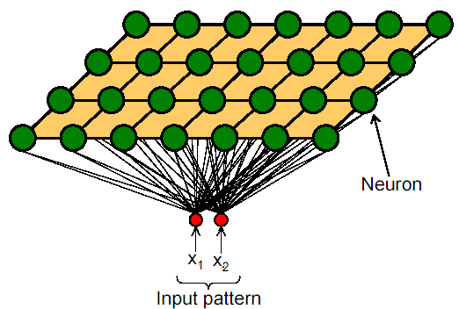
Kohonen SOM’s
The Self-Organizing Map (SOM) is an unsupervised artificial neural network algorithm. It is a compromise between biological modeling and statistical data processing
Each weight is representative of a certain input.
Input patterns are shown to all neurons simultaneously.
Competitive learning: the neuron with the largest response is chosen.

Slide 41
SOM

Slide 42
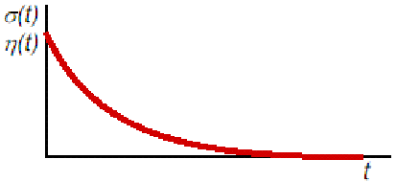
Kohonen SOM’s
Initialize weights
Repeat until convergence
  Select next input pattern
  Find Best Matching Unit
  Update weights of winner and neighbours
  Decrease learning rate & neighbourhood size
Learning rate & neighbourhood size

Slide 43
Example 1: clustering genes
P. Tamayo et al., Interpreting patterns of gene expression with self-organizing maps: methods and application to hematopoietic differentiation, PNAS 96: 2907-12, 1999.
Treatment of HL-60 cells (myeloid leukemia cell line) with PMA leads to differentiation into macrophages
Measured expression of genes at 0, 0.5, 4 and 24 hours after PMA treatment

Slide 44
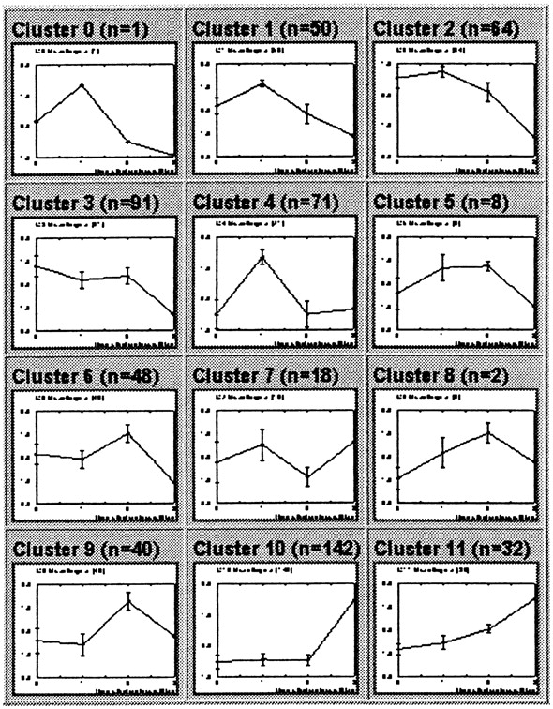
Example 1: clustering genes
Used SOM technique; shown are cluster averages
Clusters contain a number of known related genes involved in macrophage differentiation
e.g., late induction cytokines, cell-cycle genes (down-regulated since PMA induces terminal differentiation), etc.

Slide 45
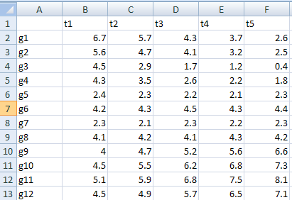
Example 2

Slide 46
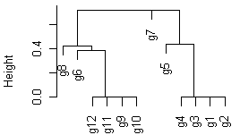
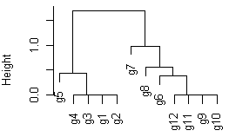
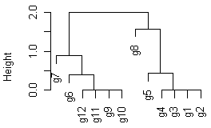
Example 2
Single linkage
Average linkage
Complete linkage

Slide 47
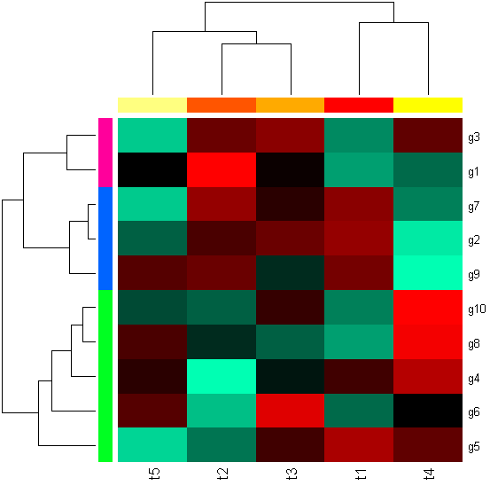
Example 2

Slide 48
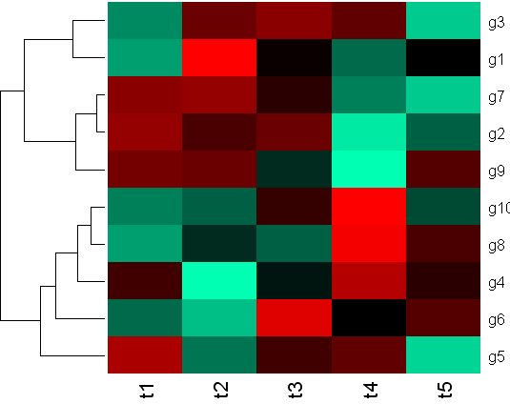
Example 2

Slide 49
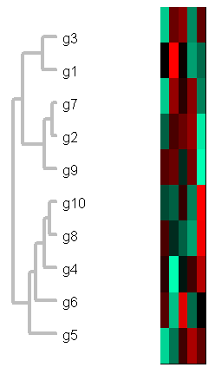
Example 2

Slide 50
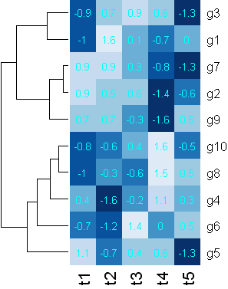
Example 2

Slide 51
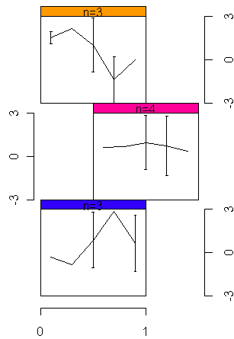
Example 2

Slide 52
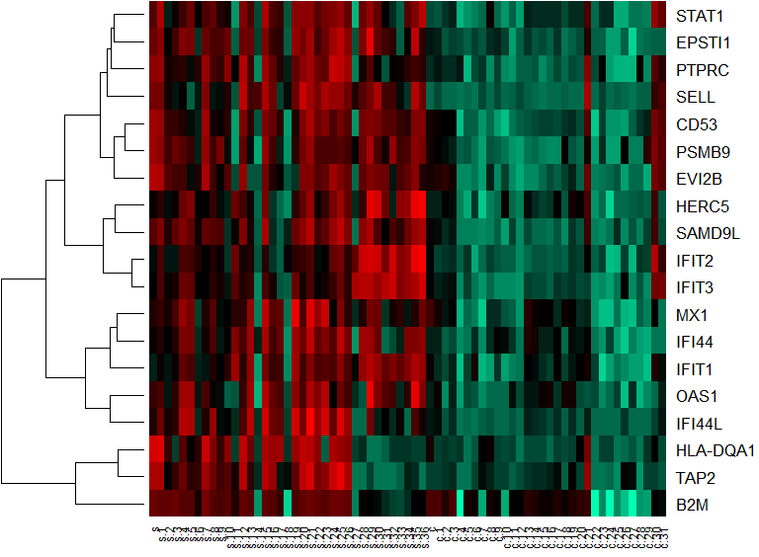
Example 3
Genomic Biomarkers for Sjögren's syndrome
Figure 1. Heat map visualization of the optimal gene set discriminating between SS patients and healthy control in the training set.

Slide 53
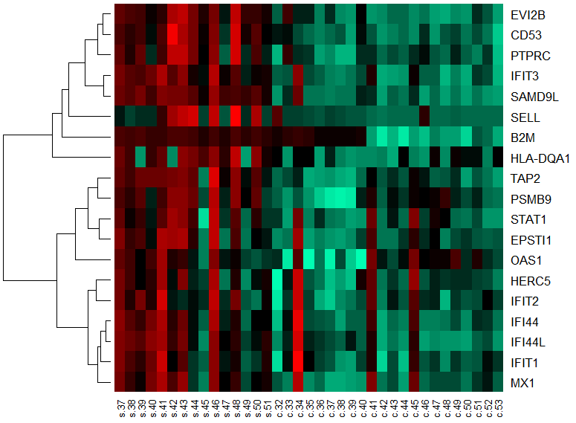
Example 3
Figure 2. Heat map visualization of the optimal gene set discriminating between SS patients and healthy control in the testing set.

Slide 54
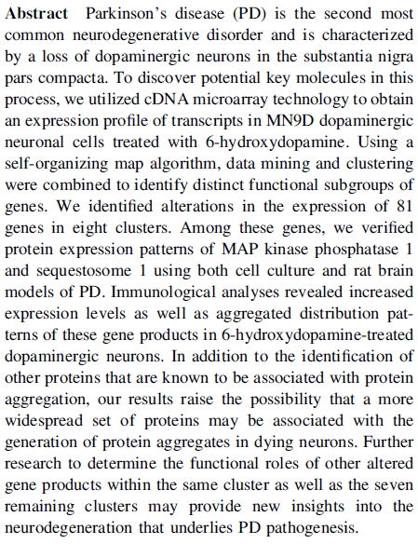
Example 4
J Neural Transm (2011) 118:1585–1598

Slide 55
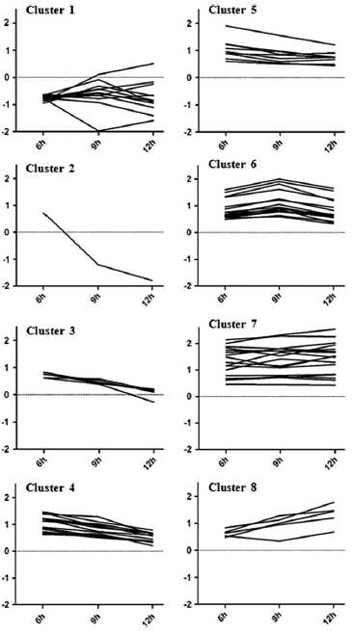
Time-course profiles of eight distinct gene clusters
To examine the profiles of altered gene expression after microarray analysis, the SAM algorithm was first applied with q values (q ≤ 0.1).
The 81 selected genes were then further analyzed using GeneCluster 2.0 after SOM clustering to distinguish between differences in the expression changes.
The baselines depicted as dotted lines represent the untreated control levels of each clustered genes
J Neural Transm (2011) 118:1585–1598

Slide 56

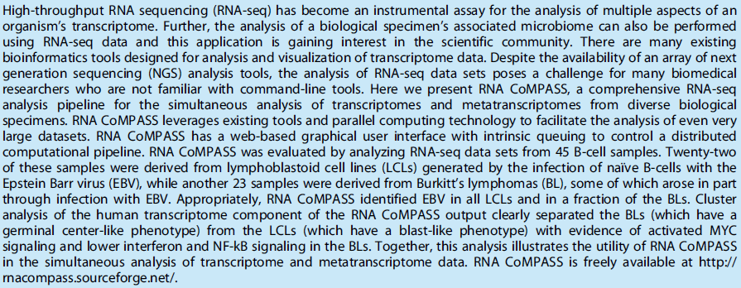
Example 5

Slide 57
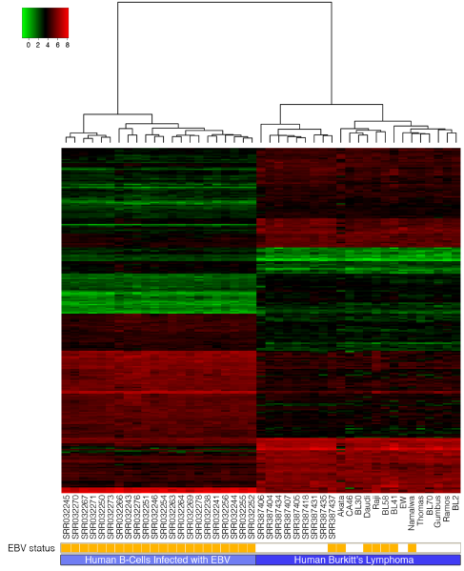
Heat Map representing Human B-Cells analyzed using RNA CoMPASS.

