Slide 1
BIPG 6400/8400
Applications of Bioinformatics and Proteomics/Genomics
1. Background
  A. Distribution and ubiquity of bacteria
  Still learning very basic features about bacteria
  Determining sequences
  Metagenomics to escape the limits of culturability
2. Genome sequence as “parts list”
  Determining evolutionary relationships and history
  How big should a bacterial chromosome be?
  One use: synthetic chromosomes
3. Regulatory architecture as “wiring diagram”
  A. Operon, regulon, stimulon
  Regulon mapping
Homework assignment
  Dr. Bob Blumenthal, UTHSC Robert.Blumenthal@utoledo.edu

Slide 2
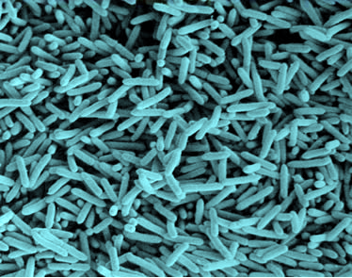

1. Background – A. Distribution and ubiquity of bacteria
Given their ecological, geochemical, agricultural and medical importance, we know surprisingly little about bacteria.
• Great majority of dissolved organic N in seawater is bacterial cell wall material (peptidoglycan).
• Sediments under open ocean contain _______ bacteria/cm³
(Soil has ~10⁹/g, ~2000 spp.)
• Molecular methods indicate >400 species of bacteria in the human oral cavity. So far, only about 150 of those species have been cultured in laboratories and
identified. Similar situation
for gut.
• Soil microbes are historically the richest source of antibiotics used in human medicine. >99% of soil bacteria are resistant to culturing, and their antibiotics remain inaccessible by traditional means.

Slide 3

1. Background – A. Distribution and ubiquity of bacteria
• The great majority of infectious agents are not pathogenic to humans.
  Molecular methods indicate >400 species of bacteria in the human oral cavity. Only ~150 of those species have been cultured in laboratories and identified.
  Similar situation for human colon.
  Total estimated number
  of bacteria on Earth:
  ______
10–100 trillion (10¹³-10¹⁴) symbiotic microbial cells harbored by each person, primarily bacteria in the gut

Slide 4

1. Background – A. Distribution and ubiquity of bacteria
http://apps.who.int/gho/data/view.main.1430?lang=en
Most bacteria do not cause human disease,
but they cause a lot of death and disease.
Accidents
Over 17 million people die annually from
infectious diseases, equivalent to nearly the combined populations of Chicago, Los Angeles and New York City.
[ > 45,000 each day, ~ one every two seconds ]
Infectious diseases
Noninfectious diseases

Slide 5
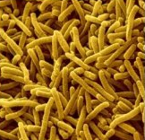
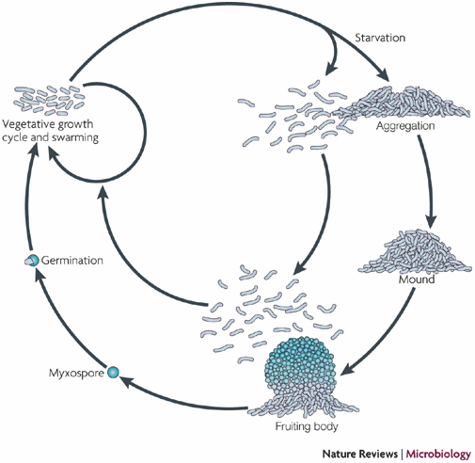
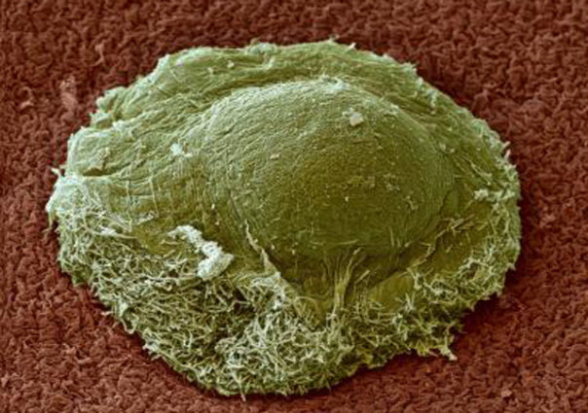
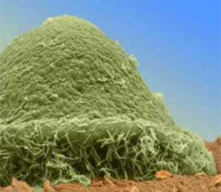
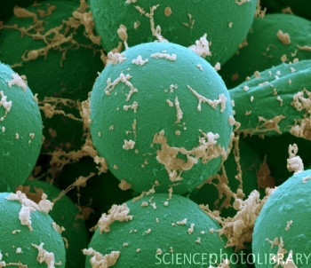
1. Background – B. Still learning very basic features about bacteria
Myxococcus
PMID: 17922045

Slide 6
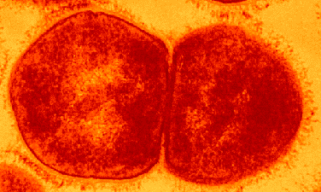
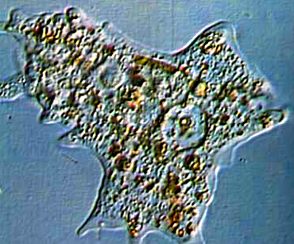
1. Background – B. Still learning very basic features about bacteria
Historical assumption:
Bacteria are small enough, and have a high enough surface-to-volume ratio, that no internal cytoplasmic organization is needed…
Surface area of sphere = 4πr² Volume of sphere = ⁴/₃πr³
Radius Surface Area Volume SA:Vol
1 12.57 4.19 3.0
2 50.29 33.52 1.5
4 201.14 268.19 0.75
10 1257.14 4190.47 0.3
µm
µm
…while eukaryotic cells are large enough to require a complex cytoskeleton.

Slide 7
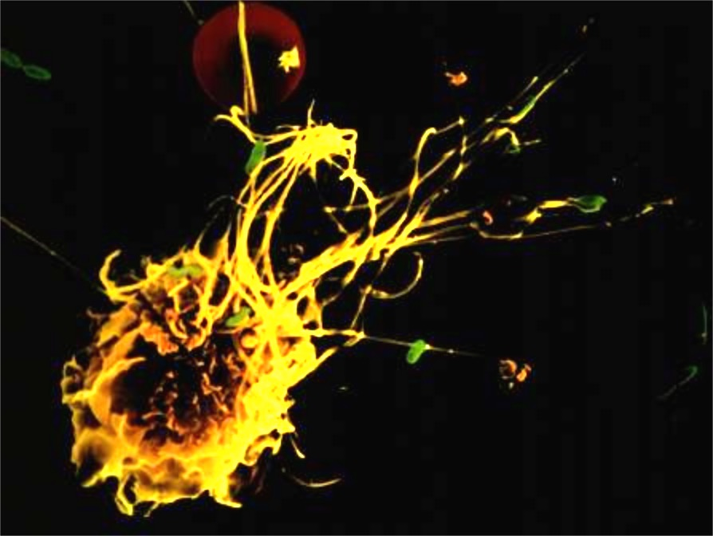
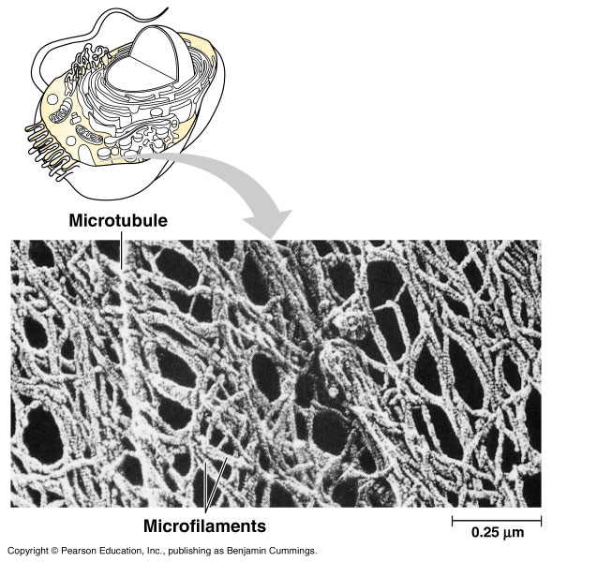
Eukaryotic cells have structurally-organized cytoplasm (cytoskeleton)
Phototake NYC/Dennis Kunkel/CNRI
bacterium
macrophage
Typical bacteria are much smaller; have been believed to lack cytoskeleton.
35.9.122.184/images/ 07-TourOfTheCell/

Slide 8
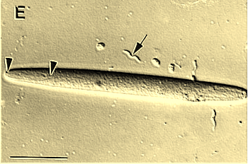
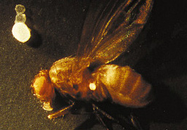
1. Background – B. Still learning very basic features about bacteria
Much larger bacteria are now being discovered,
and may require cytoskeletons
Epulopiscium fishelsoni is a gut symbiont of the brown surgeonfish in the Red Sea (light micrograph, bar = 50 µm). Note the presumed spirillum (arrow) with a length of ~18 µm.
http://jb.asm.org/cgi/content/full/180/21/5601/F1
The colossus among bacteria, ~1 mm diameter, is a single-celled giant that lives in oceanic sulfur-rich sediment off Namibia and is named Thiomargarita namibiensis.
http://www.sciencenews.org/pages/sn_arc99/4_17_99/fob5.htm

Slide 9
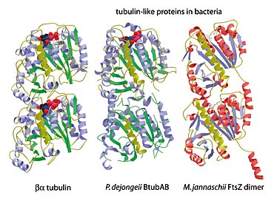
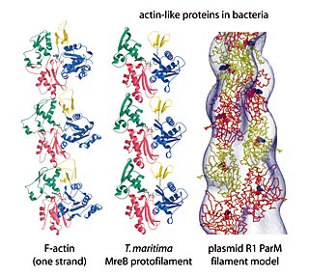
1. Background – B. Still learning very basic features about bacteria
Bacteria contain both actin and tubulin-like proteins that polymerize in vivo and in vitro into filaments similar to their counterparts in eukaryotes
Tubulin-like proteins in bacteria
Actin-like proteins in bacteria
http://www2.mrc-lmb.cam.ac.uk/SS/Lowe_J/

Slide 10
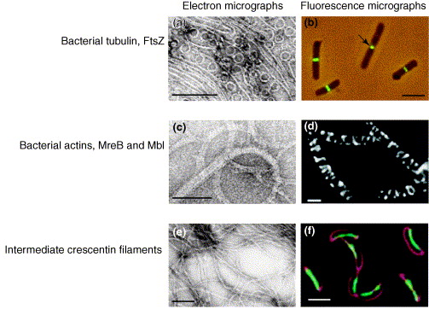
1. Background – B. Still learning very basic features about bacteria
PMID: 15661522
(a) Straight and curved FtsZ protofilaments. (b) Immunofluorescent localization of FtsZ in E. coli. Arrow indicates a constricting Z-ring. (c) MreB filaments and sheets. (d) Helical filaments formed by the MreB-like protein Mbl fused to GFP in Bacillus subtilis. (e) Intermediate filaments formed by crescentin. (f) Crescentin-GFP localisation to the inner cell curvature of Caulobacter crescentus. The cell membrane is stained in red.
Size bars are 100nm in (a, c, e) and 2μm (2000nm) in (b, d, f).

Slide 11
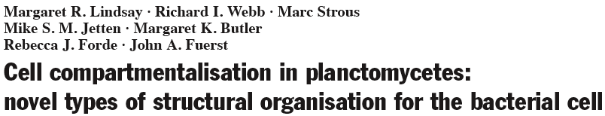
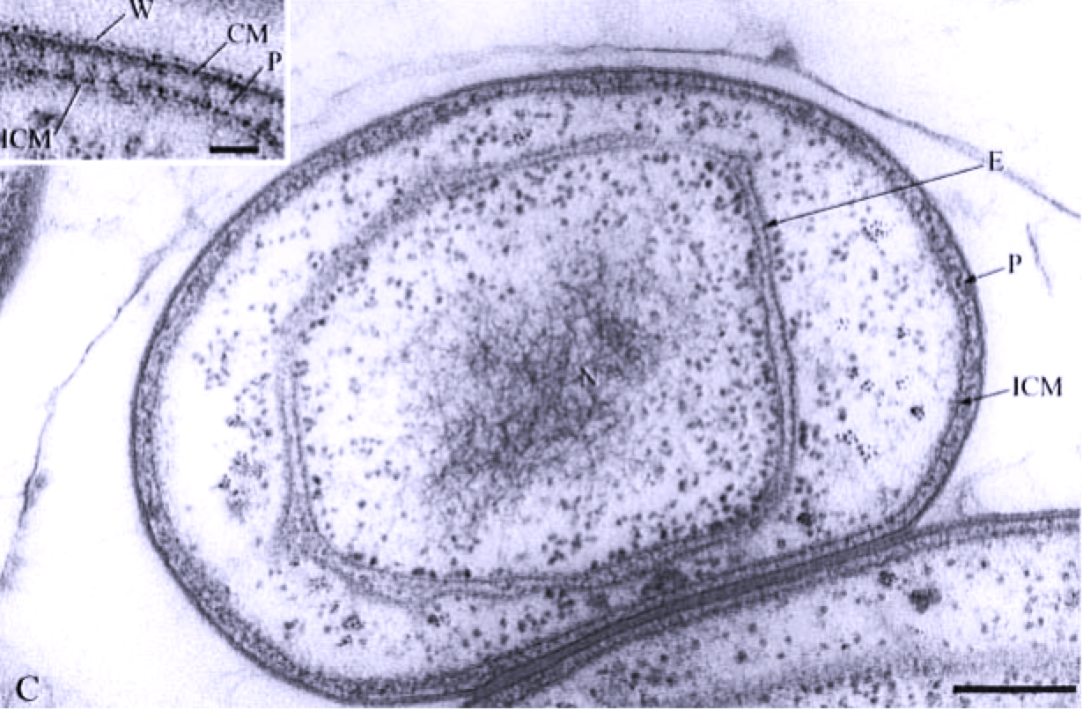

Slide 12
2013
PMID: 23700385
“Importantly, our findings show that chromosomal DNA is not enclosed by a single membrane in G. obscuriglobus. Combined with the genomic evidence, this strongly supports the suggestion that the membrane organization of the PVC superphylum is not different from that of a Gram-negative bacterium, but an extension of it based on numerous invaginations of the IM.”
2014
PMID: 24632833
“3-D models built upon the results of reconstructions unambiguously confirm the membrane- enclosed nature of both NB and riboplasm ‘vesicles’. Nucleoid DNA has never been observed in paryphoplasm, and our recent tomographic examinations also confirmed that nucleoid DNA is associated only with the NB compartment.”

Slide 13
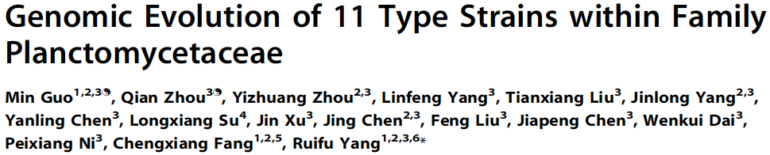
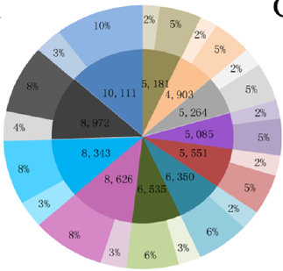
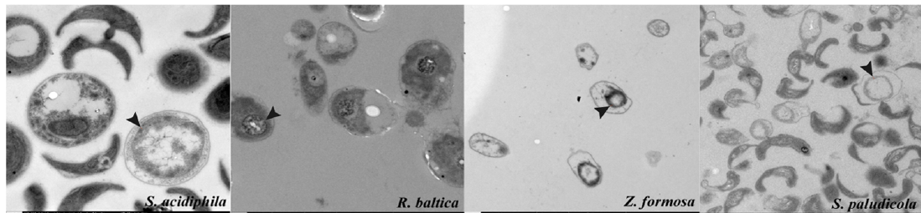
So we still have a lot to learn about bacteria.
What can [meta] genomics and bioinformatics
teach us?
Inner ring: number of genes in the genomes;
Outer ring: characterized/uncharacterized genes.
ICM structure of four Planctomycetaceae species.
Notes:
Just example of recent study, and how little we know about them (note low % of characterized genes).

Slide 14

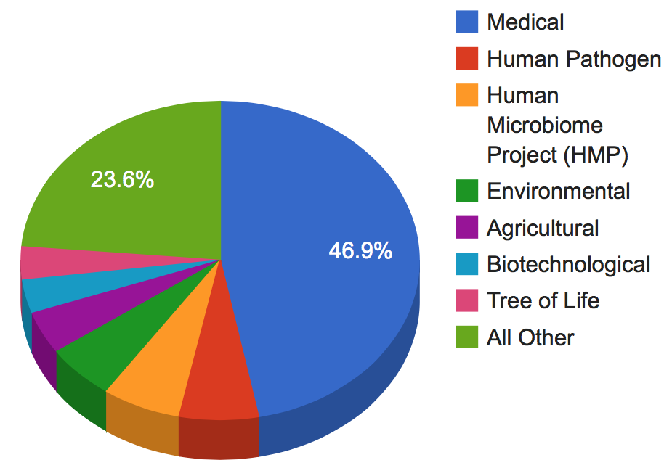
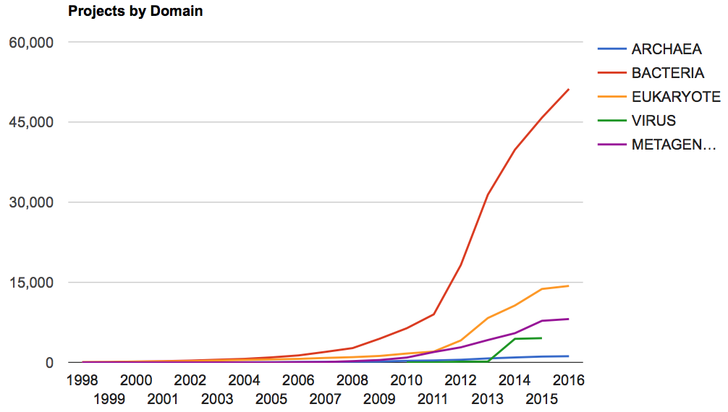
1. Background – C. Determining Genome Sequences
http://www.ncbi.nlm.nih.gov/genomes/static/gpstat.html

Slide 15
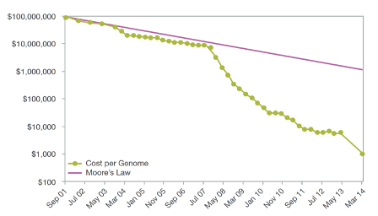

1. Background – C. Determining Genome Sequences
“The HiSeq X retails for $1 million a unit – and Illumina won’t sell you fewer than ten. Despite the massive upfront costs, the math seems to check out.”
What You Need to Know About Illumina's New Sequencers
http://www.bio-itworld.com/BioIT_Article.aspx?id=133900
By Aaron Krol January 15, 2014
Notes:
Of course, bioinformatics costs still arount $20K/human genome.

Slide 16
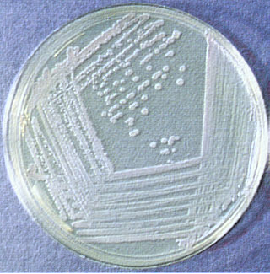
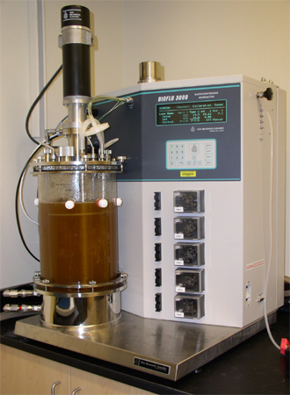
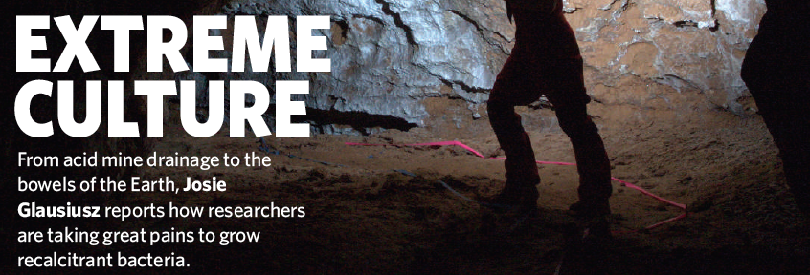
1. Background – D. Metagenomics to escape the limits of culturability
Growth parameters commonly dealt with:
pH salinity temperature pO₂
simple nutrients (too many?) light osmolarity
Difficult to accommodate:
obligate partnerships
complex nutrients etc.
The great majority of bacteria (>>95%) have never been grown in the laboratory.

Slide 17
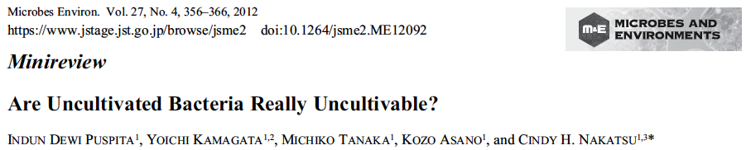
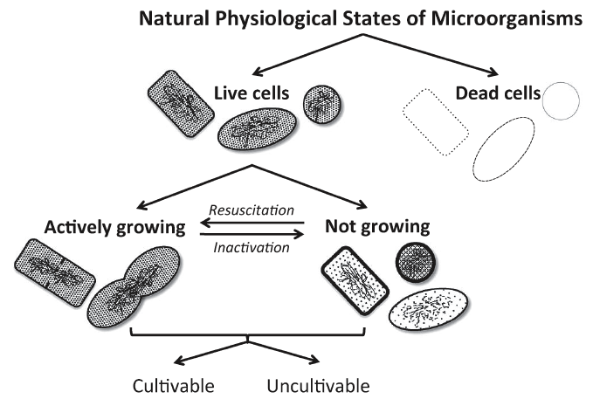
1. Background – D. Metagenomics to escape the limits of culturability

Slide 18

1. Background – D. Metagenomics to escape the limits of culturability
The finding that certain bacterial species have never been identified by culture may be a simple matter of coincidence: an organism that has a low prevalence or is particularly slow-growing may have been overlooked in cultural analyses. Additionally, many genetically distinct phylotypes are phenotypically indistinguishable and are lumped together if conventional biochemical methods for identification are used. Conversely, some bacteria are genuinely resistant to culture in isolation on conventional media.
An alternative approach for the culture of as-yet-uncultivated organisms is to simulate their natural environment in vitro. Kaeberlein et al. (2002) constructed a diffusion chamber that allowed the passage of substances from the natural environment (intertidal marine sediment) across a membrane and successfully grew bacteria from marine sediment that were previously uncultivated.

Slide 19
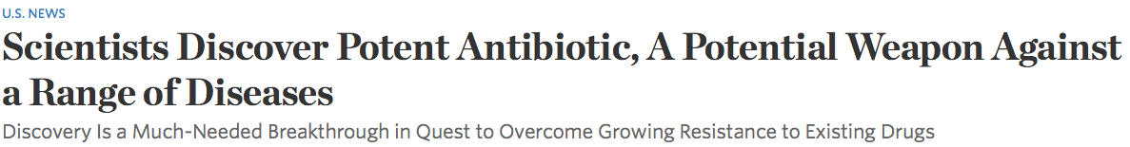

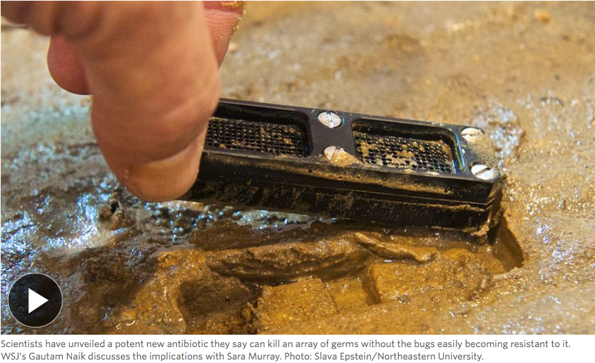
1. Background – D. Metagenomics to escape the limits of culturability
http://www.wsj.com/articles/scientists-discover-new-antibiotic-a-potential-weapon-against-a-range-of-diseases-1420654892
Even if one could culture 1000s of individual species,
would that be the best approach?

Slide 20
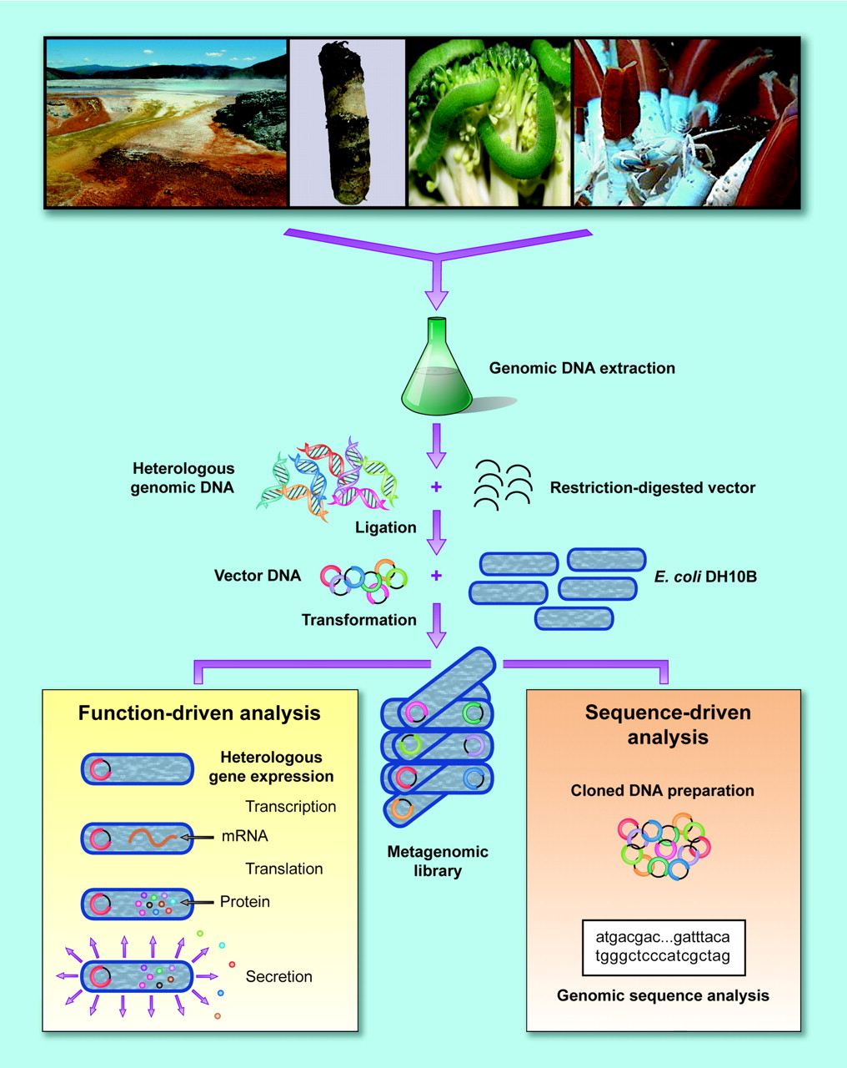
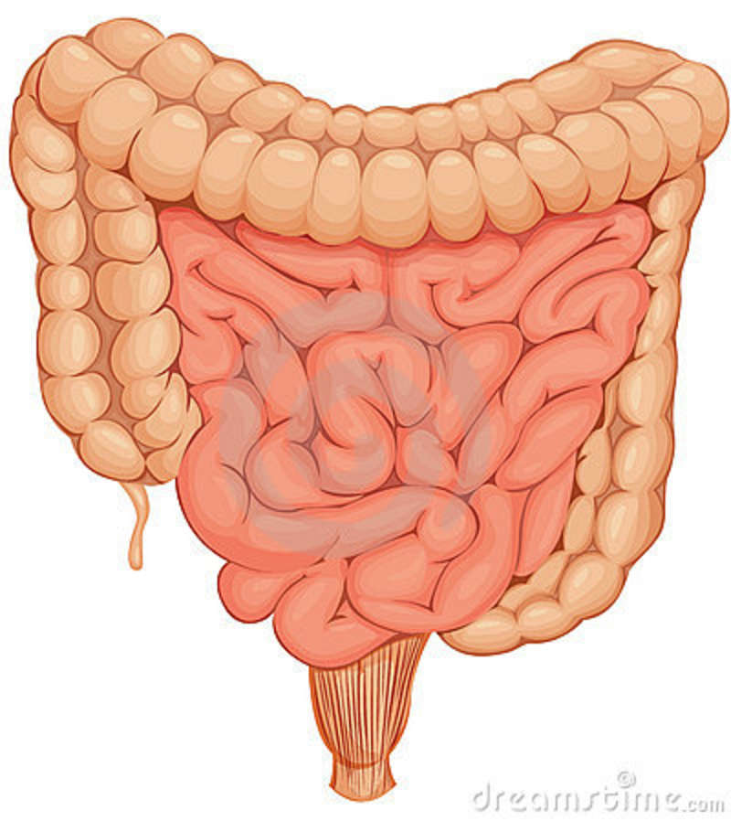


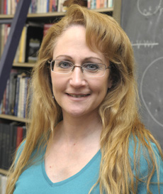
Metagenomics
Jo Handelsman
Microbiol Mol Biol Revs, 2004, 68: 669-685.
Metagenomics: Application of Genomics to Uncultured Microorganisms
Notes:
http://thumbs.dreamstime.com/z/intestines-19281976.jpg Jo Handlesman, Wisc→Yale, associate director for science at the Office of Science and Technology Policy, help advise President on the impact of science on both international and domestic affairs. Confirmed June 2014.

Slide 21
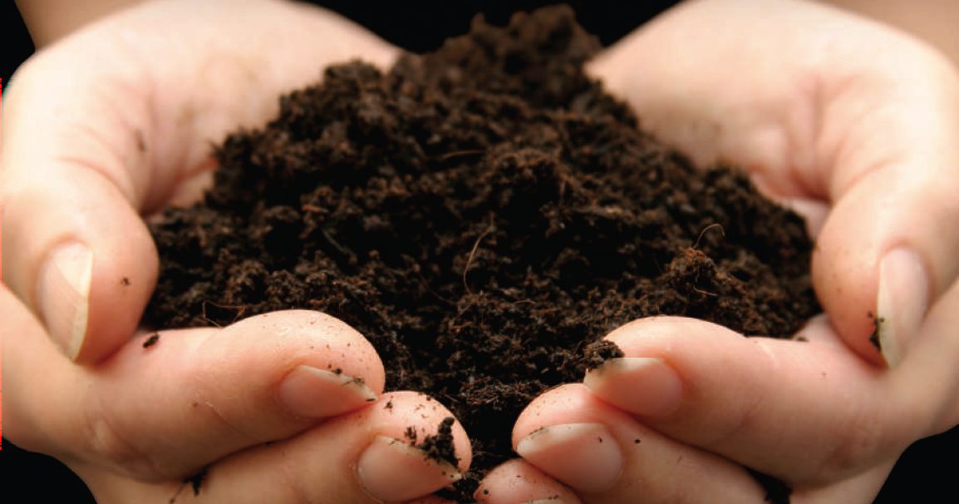
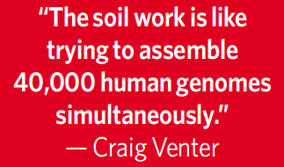
Metagenomics
Jo Handelsman
Microbiol Mol Biol Revs, 2004, 68: 669-685.
Metagenomics: Application of Genomics to Uncultured Microorganisms
V. Gewin
Nature, 2006, 439: 384-386.
Discovery in the Dirt
1g rich soil has ~10,000 species of bacteria
Notes:
http://thumbs.dreamstime.com/z/intestines-19281976.jpg Jo Handlesman, Wisc→Yale, associate director for science at the Office of Science and Technology Policy, help advise President on the impact of science on both international and domestic affairs. Confirmed June 2014.

Slide 22

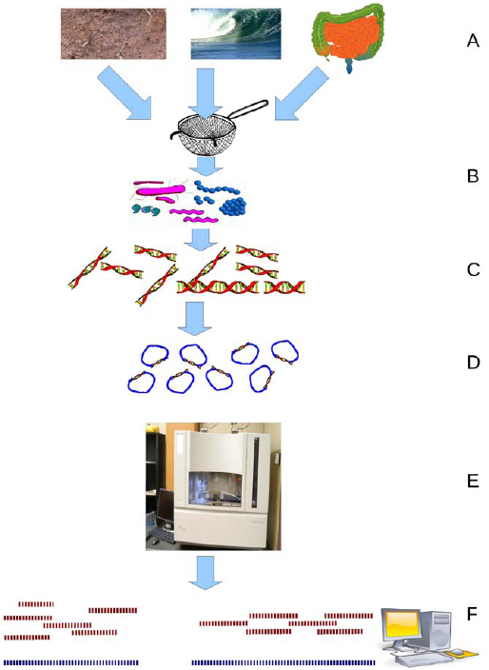
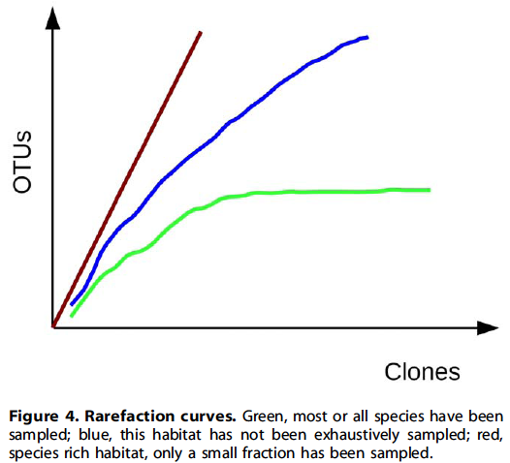
(OTU= Operational Taxonomic Unit)
Notes:
52 cards in deck

Slide 23
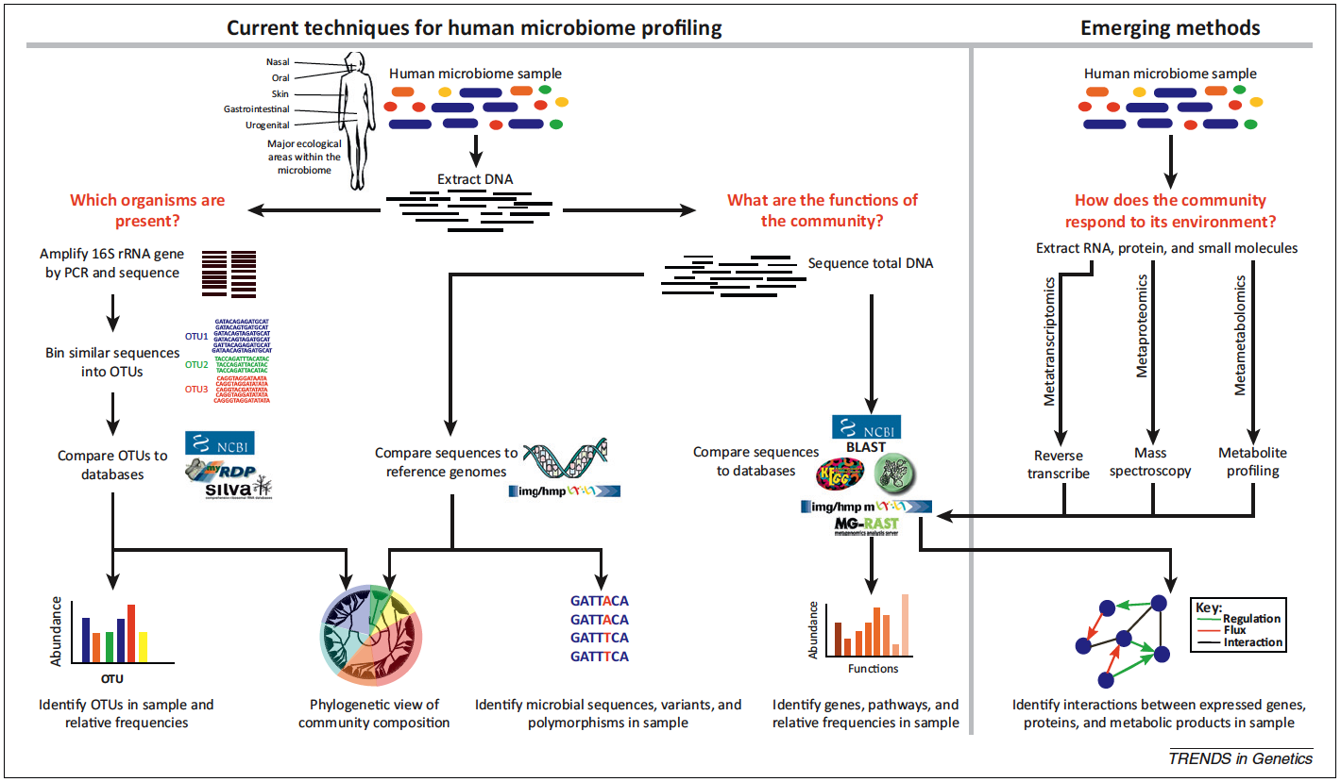
1. Background – D. Metagenomics to escape the limits of culturability (16SrRNA)
(Morgan et al., 2013; PMID: 23140990; Fig 1)
Notes:
Figure 1. Overview of bioinformatic methods for functional metagenomics. Microbial community samples typically contain many species of bacteria and other microorganisms, here indicated by different colors. After total DNA has been extracted, the composition of the community is determined by amplifying and sequencing the 16S rRNA gene. Highly similar sequences are grouped into operational taxonomic units (OTUs), and these OTUs are labeled by comparison with databases of recognized organisms. OTUs can then be analyzed in terms of presence/absence, abundance, or phylogenetic diversity. To determine biomolecular and metabolic functions present in the community, the total metagenomic DNA may be sequenced and compared with function-oriented databases. Alternatively, sequenced community DNA can be compared to reference genomes. This allows identification of microbial sequence variants and polymorphisms, as well as providing an alternative means for detecting the presence and abundance of specific organisms. In the future, the emerging fields of metatranscriptomics, metaproteomics, and metametabolomics will help to build an integrated picture of gene expression and interactions in microbial communities.

Slide 24
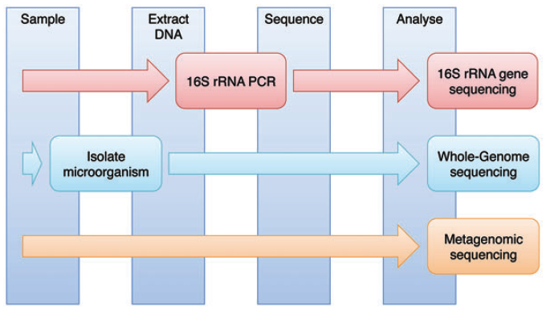
1. Background – D. Metagenomics to escape the limits of culturability (16SrRNA)
  (Cox et al., 2013; PMID: 23943792; Fig. 1)
Notes:
Figure 1. A schematic demonstrating the processes for 16S rRNA gene sequencing, Whole-Genome Sequencing and metagenomics. Sample collection, DNA extraction, sequencing and sequence analysis are required in all three techniques. 16S rRNA gene sequencing and WGS involve additional steps.

Slide 25
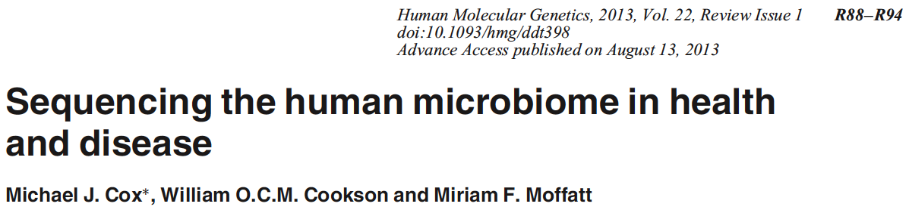
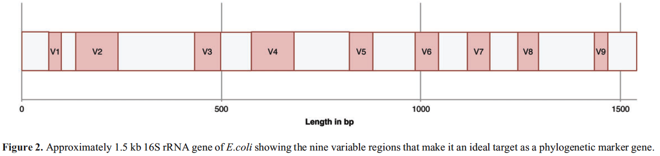
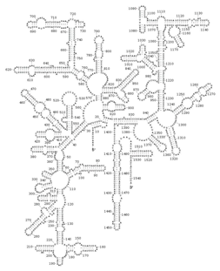
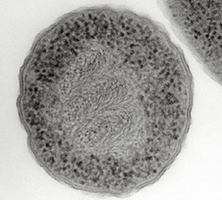
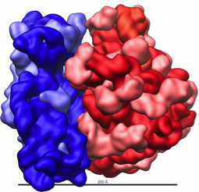
1. Background – D. Metagenomics to escape the limits of culturability (16SrRNA)
Clusters of similar sequences = “operational taxonomic units” (OTUs)
97% rRNA sequence identity → same species
93% rRNA sequence identity → same genus
Warning: up to 5% of 16S rRNA sequences in GenBank may be erroneous (Ashelford et al., 2005; PMID 16332745)
WARNING #2: 16S variable regions are not inert barcodes
PMID: 23943792
Notes:
http://www.nature.com/scitable/content/an-electron-micrograph-of-a-prokaryote-escherichia-14708319 ; http://en.wikipedia.org/wiki/Ribosome ; http://rna.ucsc.edu/rnacenter/xrna/xrna_gallery.html

Slide 26
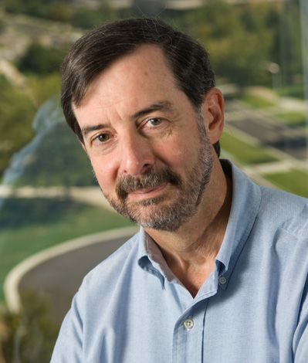
WARNING #3
PMID 24306768
“There still is widespread misconception that if a new isolate has <97 % 16S rRNA gene similarity with the closest named (and preferentially cultivated) relative, description of a new species is warranted, while a value above this 97 % cutoff value indicates that the isolate belongs to a known species. It cannot be stressed sufficiently that the 16S rRNA gene sequence similarity alone cannot be used to reliably delineate species.”
“Naming a species is stating a hypothesis”,
in part due to mosaicism.

Slide 27
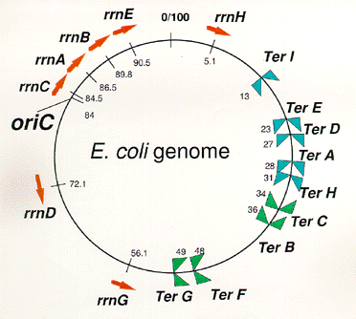
1. Background – D. Metagenomics to escape the limits of culturability (16SrRNA)
WARNING #4: MANY species have >1 16S rRNA gene

Slide 28
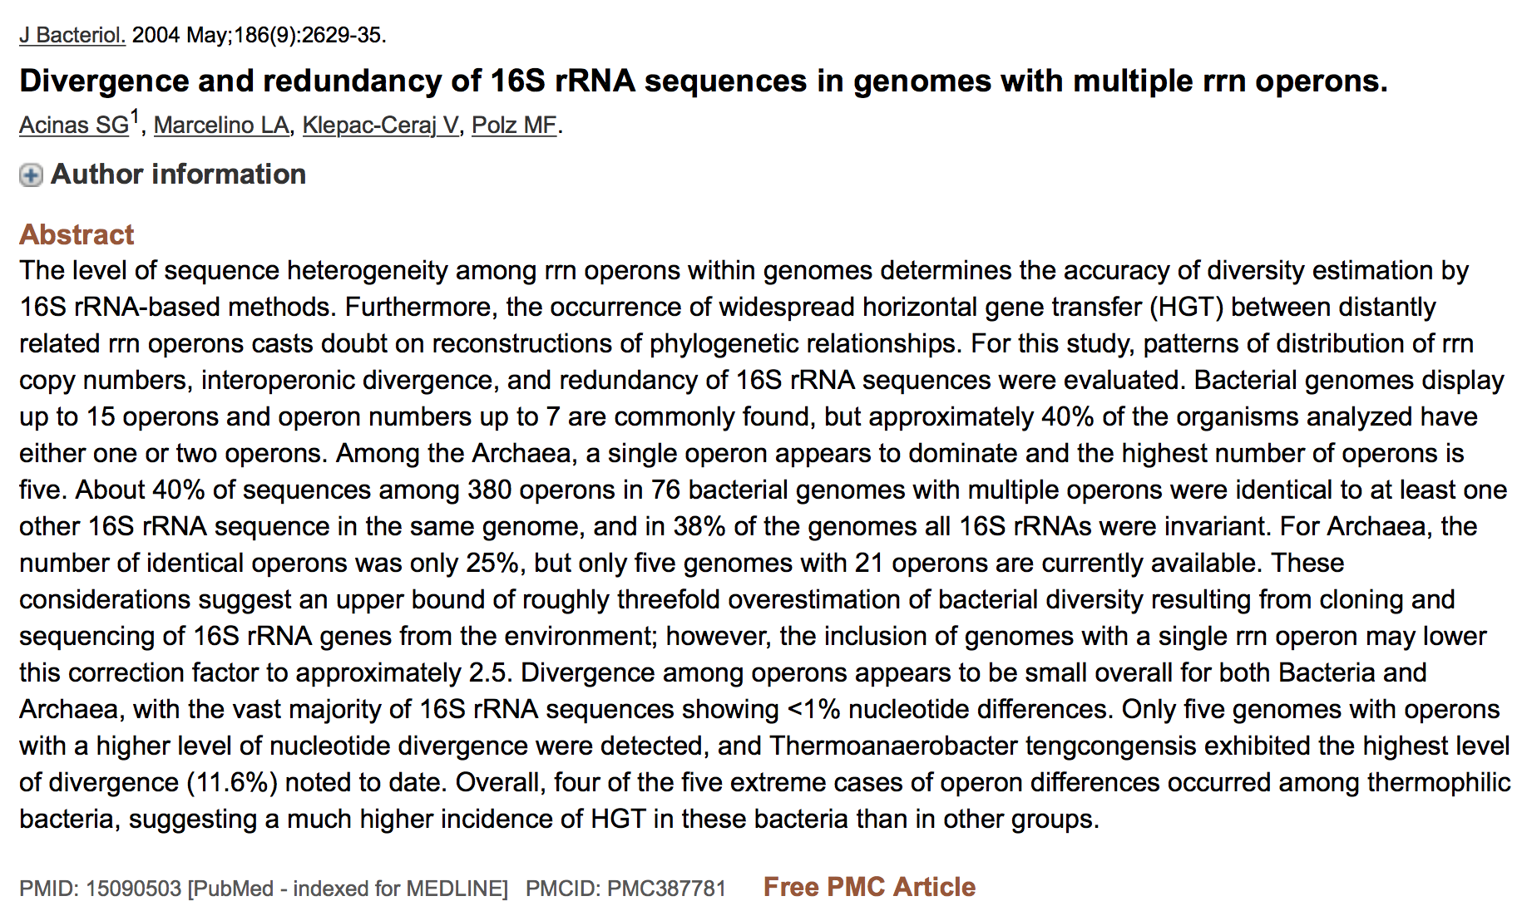
WARNING #4: MANY species have >1 16S rRNA gene

Slide 29
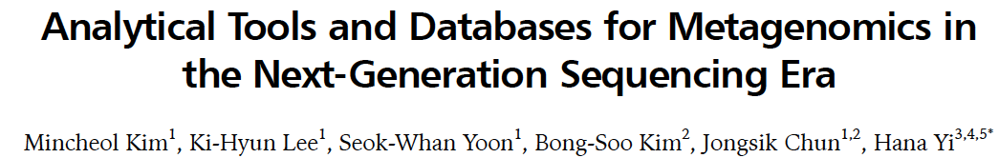
PMID: 24124405
Aside from experimental design and contextual data, metagenomic data have inherent limitations that must be overcome in the future.
  Metagenomic reads commonly show a relatively low genomic coverage compared to that of a single genome
  The short length of sequencing reads makes only fragmented information by the incomplete assembly and annotation processes accessible.
Initiatives are already under way for filling the gap between metagenomic reads by doing
  co-assembly with single-cell genomics
  joint analysis between multiple metagenomes simultaneously, assuming that the same species must exist in different samples and that the co-occurrence helps extract shared information.
The ultimate goal of metagenomics is a comprehensive understanding of our ecosystem.

Slide 30
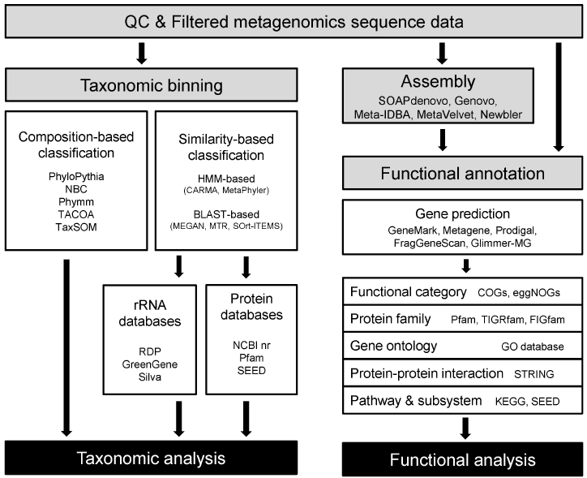
PMID: 24124405

Slide 31
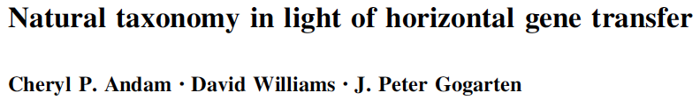


2. Genome as “Parts List” – A. Use to Determine Evolutionary Relationships and History
Notes:
Even a single gene can be a fusion of domains with distinct evolutionary histories.

Slide 32

The pan-genome is the total complement of genes from all sequenced strains of the same species, genus, or a larger group.
The pan-genome consists of three parts:
  the universal genome with genes common for all strains
  the unique genome with strain-specific genes (known as ORFans)
  the periphery (genes that are present in a subset of strains).
In most studied bacterial species, the gene content of strains varies widely, and each additional sequenced strain adds new genes to the pan-genome.
  The E. coli pan-genome is open (far from saturation).
The distribution of the OGs by the number of strains in which they are present has a well-known U-shape form.
  The periphery genes tend to be rare (present in just 2-3 strains) or almost universal (absent from only a few strains).
  This holds true for the E. coli-plus-Shigella distribution .
  Overrepresented functions in the unique genome tend to be plasmid related, e.g., “DNA restriction-modification system” or “response to mercury ion.”
Notes:
OGs = Ortholog Groups 100s of Eco whole genomes

Slide 33

The pan-genome is the total complement of genes from all sequenced strains of the same species, genus, or a larger group.
The pan-genome consists of three parts:
  the universal genome with genes common for all strains
  the unique genome with strain-specific genes (known as ORFans)
  the periphery (genes that are present in a subset of strains).
In most studied bacterial species, the gene content of strains varies widely, and each additional sequenced strain adds new genes to the pan-genome.
  The E. coli pan-genome is open (far from saturation).
The distribution of the OGs by the number of strains in which they are present has a well-known U-shape form.
  The periphery genes tend to be rare (present in just 2-3 strains) or almost universal (absent from only a few strains).
  This holds true for the E. coli-plus-Shigella distribution .
  Overrepresented functions in the unique genome tend to be plasmid related, e.g., “DNA restriction-modification system” or “response to mercury ion.”
unique (ORFans)
universal
periphery

Slide 34


2. Genome as “Parts List” –
B. How Big Does a Genome Need to Be?
Ktedonobacter 13,000
yeast 8,000
Mycoplasma 500
Notes:
Ktedonobacter = green non-sulfur (cyano) bacterium

Slide 35

2. Genome as “Parts List” – B. How Big Does a Genome Need to Be?
Approximately 45% of the human genome is currently recognized as being derived from transposable elements.
~1.5% codes for proteins.

Slide 36

2. Genome as “Parts List” – B. How Big Does a Genome Need to Be?
Ktedonobacter
Microsporidium
Saccharomyces
http://www.sci.sdsu.edu/~smaloy/MicrobialGenetics/topics/chroms-genes-prots/genomes.html

Slide 37

2. Genome as “Parts List” – B. How Big Does a Genome Need to Be?
http://bioscience.jbpub.com/cells/MBIO137.aspx

Slide 38



2. Genome as “Parts List” – B. How Big Does a Genome Need to Be?
PMID: 15680509
For 100 complete bacterial genomes, measured NUMBER of genes in various superfamilies in the genome, and plotted vs. size of that genome.
Mostly metabolic gene families.
Mostly regulatory gene families.

Slide 39

2. Genome as “Parts List” – B. How Big Does a Genome Need to Be?
PMID: 15680509

Slide 40


2. Genome as “Parts List” – B. How Big Does a Genome Need to Be?
PMID: 21937509
Notes:
More recent data backs this up, using larger # of sequenced genomes. “Domains” here refer to gene families.

Slide 41



2. Genome as “Parts List” – B. How Big Does a Genome Need to Be?
PMID: 18445653

Slide 42



PMID: 20090831
We extracted from primary literature 214 minimal generation times (d) of species of bacteria and archaea. We used these data to assess how genomic traits correlate with minimal generation times.
  We started by analyzing its correlation to genome size.
  Historically, microbial genomes have been viewed as short and compact due to selection for rapid replication and fast growth.
  In agreement with previous work, we found no evidence for a positive correlation between minimal generation time and genome size or genome density (Spearman correlations r =20.10 and 20.08, p-value = 0.13 and 0.24).
  Replication can be initiated before the previous rounds have finished (Cooper & Helmstetter, 1968). There is thus no necessity for a direct correlation between genome size and minimal generation time.
[Instead], we found an increase in copy number of rRNA and tRNA genes with decreasing minimal generation times (r=20.59 and r =20.51, all p-value,0.0001).
Notes:
Here’s what is NOT a driving force for determining genome size.

Slide 43
Cooper S, Helmstetter C 1968. J Mol Biol. 31: 519-40.
Chromosome replication and the division cycle of Escherichia coli B/r.
PMID: 4866337
C-time (chrom rep) ~40 min
D-time (crosswall) ~20 min

Slide 44


2. Genome as “Parts List” – C. Uses
PMID: 20488990
“We report the design, synthesis, and assembly of the 1.08–mega–base pair Mycoplasma mycoides JCVI-syn1.0 genome:
starting from digitized genome sequence information
transplantation into a M. capricolum recipient cell to create new M. mycoides cells that are controlled only by the synthetic chromosome.
The only DNA in the cells is the designed synthetic DNA sequence, including “watermark” sequences and other designed gene deletions and polymorphisms, and mutations acquired during the building process.”

Slide 45




2. Genome as “Parts List” – C. Uses
PMID: 24136966
We selected UAG as our first target for genome-wide codon reassignment because:
UAG is the rarest codon in E. coli MG1655 (321 known instances)
prior studies demonstrated the feasibility of amino acid incorporation at UAG
a rich collection of translation machinery capable of incorporating nonstandard amino acids has been developed for UAG. [E.g., phosphoserine, p-acetyl-phenylalanine]

Slide 46


3. Regulatory architecture as “wiring diagram”
PMID: 17040488
Notes:
Hard to do some of these with metagenomics.

Slide 47


3. Regulatory architecture as “wiring diagram” –
  A. Operon, regulon, stimulon
http://users.rcn.com/jkimball.ma.ultranet/BiologyPages/
http://cwx.prenhall.com/horton/

Slide 48

3. Regulatory architecture as “wiring diagram” –
  A. Operon, regulon, stimulon
Regulon – a group of operons controlled by the same regulator.
Can have a mix of + and – control.
Can have overlapping regulons (multiple regulators).
DtxR^{C102D}• Ni⁺⁺ • tox
(White et al., 1998, Nature 394: 502-6)
E.g., E. coli ArgR regulon includes 18 genes.

Slide 49
3. Regulatory architecture as “wiring diagram” –
  A. Operon, regulon, stimulon
Even for best-studied organism on the planet (E. coli), we know relatively little:
• There are about ~320 transcription regulatory proteins; only ~ half have been characterized.
• Some of the uncharacterized 1/2 of regulators could be “global” (subset of key regulators that each control 100s of genes)
• This is a problem, because people are trying to use our RELATIVELY extensive knowledge of E. coli to predict the regulatory architecture of organisms about which we know next to nothing.

Slide 50
3. Regulatory architecture as “wiring diagram” –
  A. Operon, regulon, stimulon
Stimulus
(heat, O₂, nutrients, population density, surface attachment, UV, pH, etc.)
“Half of the known and predicted transcriptional regulators in E. coli have predicted domains for the binding of small metabolites, whereas 10% have a CheY-like response regulator receiver domain that are phosphorylated by kinases in two-component signal transduction systems.”
Marinez-Antonio & Collado-Vides, 2003, Curr Opinion Microbiol 6: 482-489.
?
?
Regulator
Regulator
Regulator
Regulator
Regulator
Regulator
Regulator

Slide 51
3. Regulatory architecture as “wiring diagram” –
  B. Predicting regulation from genome sequences
Problem:
Huge number of poorly-studied bacteria
Laboratory analysis of which genes are expressed under which conditions (where the bacteria can be grown) is accurate, but very labor intensive.
Would like to predict gene regulation via bioinformatics
This is (currently) exceptionally difficult.
Example: predicting promoters

Slide 52




PMID: 19838305
3’
5’
3’

Slide 53

PMID: 19838305
Hard to identify promoters from sequence alone.
Reason #1: Variable distance from ATG initiation codon

Slide 54
PMID: 19838305
RNAP can associate with any of the seven σ factors present in E. coli
  Each σ factor recognizes different consensus promoter motifs
  The majority of genes expressed during exponential growth involve the ‘‘housekeeping’’ σ70 factor.
  The other six ‘‘alternative’’ σ factors have specific roles in stress survival and adaptation to environmental conditions.
Unambiguous determination of which form of RNAP holoenzyme is transcribing a gene is not straightforward.
Hard to identify promoters from sequence alone.
Reason #2: Multiple sigma factors

Slide 55
PMID: 19838305
The canonical model for the σ⁷⁰-DNA promoter sequence:
  –35 hexamer, consensus sequence = TTGACA
  Spacer of 15 to 21 nucleotides
  –10 hexamer, consensus sequence = TATAAT
    –10 element is essential; stabilizes initial RNAP-σ binding to promoter
Other elements can modify the canonical model of the σ⁷⁰ promoters:
  extended –10 region (TG), that is located 1 nucleotide upstream of the –10 element
    Promoters with extended –10 normally have poor –35 element
  UP element, usually positioned 4 nucleotides upstream of the –35 promoter region.
Hard to identify promoters from sequence alone.
Reason #3: Promoters have only short “consensus” sequences

Slide 56
PMID: 19838305
Different combinations of promoter elements vary the basal strength
On average, σ⁷⁰-dependent promoters preserve just 8/12 canonical nucleotides of the –35 and –10 hexamers
~10% of promoters match the consensus in only about half the nucleotides and yet still serve as sites for σ binding.
Activated promoters often poorly match consensus (otherwise they would not need to be activated).
[Also, in bacteria having genomes with low %GC, TATAAT –10 consensus occurs very frequently on a random basis.]
Hard to identify promoters from sequence alone.
Reason #4: Promoters do not always fit “consensus”

Slide 57


PMID: 24146625
sequence logos:
http://weblogo. berkeley. edu/
Also hard to identify regulator binding sites from sequence alone.
Reason #1: Operators do not always fit “consensus”

Slide 58

PMID: 24146625
Also hard to identify regulator binding sites from sequence alone.
Reason #2: If there are multiple cooperative operators, none of them needs to be particularly strong.

Slide 59


PMID: 19632175
Also hard to identify regulator binding sites from sequence alone.
Reason #3: Operator-promoter spacing is variable.

Slide 60

PMID: 19632175
…organisms of the most different sorts are constructed from the very same battery of genes. The diversity of life forms results from small changes in the regulatory systems that govern expression of these genes.
– François Jacob,
Of Flies, Mice, and Men
Also hard to identify regulator binding sites from sequence alone.
Reason #4: Role of conserved regulators is variable between species.

Slide 61

3. Regulatory architecture as “wiring diagram” –
  B. Predicting regulation from genome sequences
transcriptomics
PMID: 21668997

Slide 62


3. Regulatory architecture as “wiring diagram” –
  B. Predicting regulation from genome sequences
PMID: 11934610
1. Is the regulator conserved between Bug X and E. coli?
2. Is the target gene conserved between Bug X and E. coli?
3. Is there a putative binding site for the conserved regulator upstream of the target gene in Bug X?
IF {1, 2, AND 3}, “regulation is probably conserved”.

Slide 63


PMID 20439753
Nodes are classified into three categories:
master regulators (zero in-degree, Yellow),
middle managers (nonzero in- and out-degree, Purple)
workhorses (zero out-degree, Green).
The low overlap between modules in biological networks… increases robustness. Modules tend to work more independently by recruiting different sets of workhorses from the broad base of the network hierarchy.”

Slide 64
PMID 20439753
“From an engineering point of view, the reuse of common nodes between modules is a cost-effective way to construct a complex system. However, such optimized usage of functions comes at the expense of robustness, because breakdown of a generic function causes problems in many modules.”
“More importantly, generic functions lead to potential fragility in the sense that modifying any module may require compensating changes in a generic function. As a result, generic functions have to be updated more often…”

Slide 65

PMID 20439753
But bacteria still have SOME “master regulators”, presumably to help coordinate expression of the thousands of genes.

Slide 66


E. coli transcriptional regulatory network follows a power-law distribution
master / global regulators
middle managers
work-horses
Master ≠ Global
Master regulator defined as having no regulatory inputs (may not have a large number of outputs)
Global regulator defined as having > 100 outputs (generally does have regulatory inputs)
PMID 14572541
Seven global regulators:
ArcA Crp
Fis Fnr
Hns Ihf
Lrp
Notes:
One key question is why THESE proteins are the global regulators. Do they have properties that made them particularly adept at fine-tuning.

Slide 67

Leucine-responsive Regulatory Protein (Lrp)
Helix-Turn-Helix
HTH
RAM
PDB 1RI7
Regulation of Amino acid Metabolism
PDB 2GQQ
Leu, etc.
PMID 11575919
Notes:
Monomer from Pyrococcus; orthologs conserved across Bacteria and Archaea. But acting as global regulator only found (so far) in limited subset of gammaproteobacteria.

Slide 68

3. Regulatory architecture as “wiring diagram” –
  B. Predicting regulation from genome sequences
1. Is the regulator conserved between Bug X and E. coli?
2. Is the target gene conserved between Bug X and E. coli?
3. Is there a putative binding site for the conserved regulator upstream of the target gene in Bug X?
IF {1, 2, AND 3}, “regulation is probably conserved”.

Slide 69




PMID: 15173120
[Reminder: Helix-Turn-Helix motif]
http://swift.cmbi.ru.nl/gv/students/mtom/SUP_1.html

Slide 70
3. Regulatory architecture as “wiring diagram” –
  B. Predicting regulation from genome sequences
Additional concerns:
1. Many “Bug X”s live in environments radically different from those inhabited by E. coli, and probably have different regulatory goals.
2. It is genetically easy to alter regulation, EVEN IF regulator, target, and binding site are conserved.
E.g., Hidalgo & Demple, 1997, EMBO J. 16: 1056-1065.
Spacing of promoter elements regulates the basal expression of the soxS gene and converts SoxR from a transcriptional activator to a repressor.
PMID: 9118944
• The assumption that conserved regulator, target, and binding site implies conserved regulation has not been carefully tested.
(We have been using the Lrp regulon to test this assumption.)

Slide 71
3. Regulatory architecture as “wiring diagram” –
  B. Predicting regulation from genome sequences
PMID: 11934610
1. Is the regulator conserved between Bug X and E. coli?
Proteus mirabilis
lrp
lrp
Escherichia coli
2. Is the target gene conserved between Bug X and E. coli?
3. Is there a putative binding site for the conserved regulator upstream of the target gene in Bug X?
All target genes and binding sites are identical in the two strains being compared;
the only difference is the Lrp ortholog
IF {1, 2, AND 3}, “regulation is probably conserved”.
Is it?

Slide 72

3. Regulatory architecture as “wiring diagram” –
  B. Predicting regulation from genome sequences
Ecoli/Pmira differ at only four positions

Slide 73

3. Regulatory architecture as “wiring diagram” –
  B. Predicting regulation from genome sequences
Testing Lrp equivalence – Substitution test
E. coli
Tn10
lr lrp
lrp
“Assay” is identical set of promoters
Identical nonspecific DNA as well
Same expression sequences for the lrp orthologs
Same coregulator transport and biosynthesis systems
Plac
lrp
pHetero-Lrp
PMID 18405378
Notes:
In SOME expts we had a reporter fusion and measured beta-gal activity. In others, there was no fusion and we used microarrays to measure mRNA levels.

Slide 74
532 genes responsive to EcoLrp
Why are EcoLrp and PmiLrp so different?
Eco+Vch only
(61; 12%)
Eco only
(198; 37%)
Eco+Pmi only
(108; 20%)
Eco+Pmi+Vch
(165; 31%)
False discovery rate <5%
Genes responsive to:
PmiLrp only – 107
VchLrp only – 162
Notes:
74
About a third respond to all three, about a third to Eco only, and about a third only to one of the other two Lrp orthologs. Given the 5% FDR, this is clearly different from the expectation if the three Lrps are equivalent.
FDR is a statistical method used to correct for multiple comparisons. Instead of using significance levels, FDR allows for a certain fraction (defined by a q value) of the tests declared positive by the statistics to be truly negative. The FDR of a set of statistical tests is the expected percentage of false positives in the set of tests.

Slide 75




PMID 21642464
PDB 2GQQ

Slide 76

Testing Lrp equivalence – N-terminal tails
VchEcoLrp M V D S Y K K P S K D L D (EcoLrp K5Y, R7K, G9S)
PmiEcoLrp M I D N K K R P G K D L D (EcoLrp V2I, S4N)
K6QEcoLrp M V D S K Q R P G K D L D (EcoLrp K6Q)
EcoLrp M V D S K K R P G K D L D
λCI (WT) M - S T K K K P L T Q E Q
λCI Actives M - x x B K B x L T Q E Q (x = any AA; B = K or R)
⁺H₃N
NH₃⁺
DNA-binding domains of λCI dimer
PDB 3BDN

Slide 77
Testing Lrp equivalence – N-terminal tails
Vector
Vch
–
lrp
Eco
LacZ Activity (Modified Miller Units)
Plrp-lacZ
+Leu
VchEco
Pmi
(EcoLrp V2I, S4N)
PmiEco
Culture Density (OD_{600nm})
Notes:
In the case of Plrp, we’re looking at feedback repression by Lrp of its own gene’s promoter. Focusing on Eco and Pmi, Pmi hyper-represses (which we’d noticed before). Important point is that the hybrid Lrp, with two AA changes in N-term tail to match PmiLrp, ALSO hyperrepresses.

Slide 78
Take-home lessons
• Bacteria typically have several thousand genes, that must be regulated in a coordinated fashion in response to time and to complex environmental changes.
• Very basic questions about bacterial structure and physiology remain to be answered, even in well-studied species such as Escherichia coli. Bioinformatics is helping in this (e.g., the discovery of membrane coat proteins in the Planctomycetes).
• Metagenomic approaches are yielding genome sequences for bacteria that cannot yet be grown in the laboratory, and there is great interest in developing robust methods to predict regulation from the DNA sequences.
• Even in E. coli, it is surprising how much remains to be learned about basic regulatory processes. So for the rest of the [huge] microbial world…
• Purely bioinformatic approaches to predicting regulation in bacteria will depend on a fuller understanding of transcription factor structure and function than we currently possess.

Slide 79

BIPG 6400/8400 4.
B i o m a r k e r s
Read the following paper and address
the questions in a paragraph each.
  Kerepesi et al. 2016; PMID 26831696
  What is meant by “genome length bias”, and how is it significant for metagenomic studies?
  What metagenomic biases did we discuss for use of 16S rRNA?
  Based on the above, justify your choice of which approach (genomic or 16S rRNA) is more reliable for metagenomic studies.
Read the following paper and compare to the paper above.
  Cho et al., 2014; PMID 25251678
  What is meant by “mapping bias” and how is it significant for transcriptomic studies?
  Given the existence of genome length bias, is there an equivalent such that the amounts of longer mRNAs are overestimated relative to total mRNA? Why or why not?
Warnings
  I will compare homework from different students.
  I will look to see if you’re simply quoting from the abstract.
  I will only grade homework that has been submitted by email as .rtf, .doc, or .docx
  Be sure to put your name in the document itself, not just the file title.

