Slide 1
Pros and cones of genomic mutations
Alexei Fedorov
Bioinformatics Program, University of Toledo

Slide 2
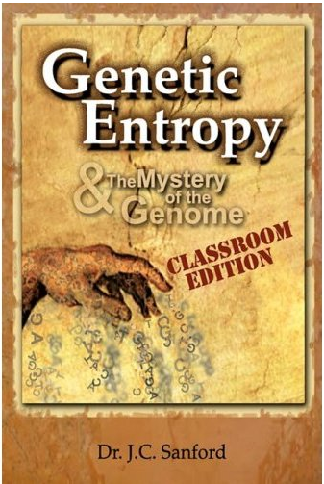
This book explores the weaknesses of Darwinian theory from the perspective of someone who has been at the cutting-edge of genetic research.

Slide 3
Genetic Entropy & the Mystery of the Genome (2005)
The book claims that the genome is deteriorating and therefore could not have evolved in the way specified by the Modern evolutionary synthesis.
Sanford is a prolific inventor with more than 30 patents. At Cornell Sanford and colleagues developed the "Biolistic Particle Delivery System" or so-called "gene gun”. He is the co-inventor of the Pathogen-derived Resistance process and the co-inventor of the genetic vaccination process. He was given the "Distinguished Inventor Award" by the Central New York Patent Law Association in 1990 and 1995. He has founded two biotechnology companies, Sanford Scientific and Biolistics. In 1998 he retired on the proceeds from the sale of his biotech companies, and continued at Cornell as a courtesy associate professor. http://www.youtube.com/watch?v=0-rx_lS3ZwI

Slide 4
From Dr. Sanford’s presentation http://www.youtube.com/watch?v=0-rx_lS3ZwI

Slide 5
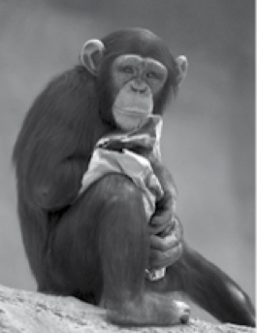
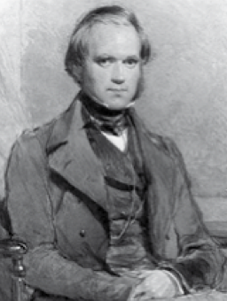
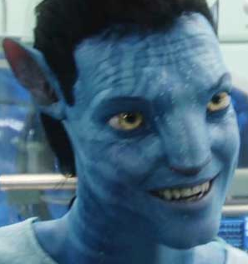
Because of multiple mutations per generation, we are fated to change but not degradation
10 million years ago
PRESENT TIME
10 million years ahead

Slide 6
Special assignment to get extra credits and earn “A+” for the course!
YOUR TASK: Find in the literature an alternative SCIENTIFIC theory for the origin of new gene
Rapid mutations
And acquisition of
a new function
duplication
Gene A1
Gene new
Gene A
Gene A2
Gene A2
Preservation an
original function

Slide 7
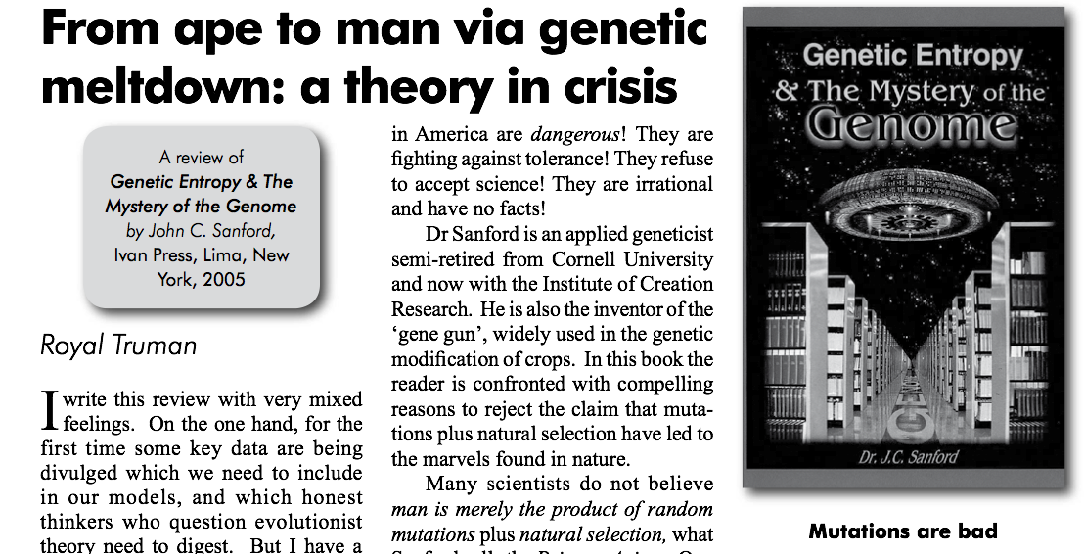
http://creation.com/images/pdfs/tj/j21_1/j21_1_43-47.pdf

Slide 8
ORIGIN OF NEW GENES
Gene duplication ->
Mutation acquisition ->
New function gain
Other theories?

Slide 9
Ambiguities in biology
CODON BIAS (mutation bias or selection?)
INTRON ORIGIN (early or late?)
GENOME EVOLUTION (neutralism vs selectionism )
Almost all topics have controversies even –
the chicken or the egg?
ORIGIN OF GENES
How bad are gene mutations?

Slide 10
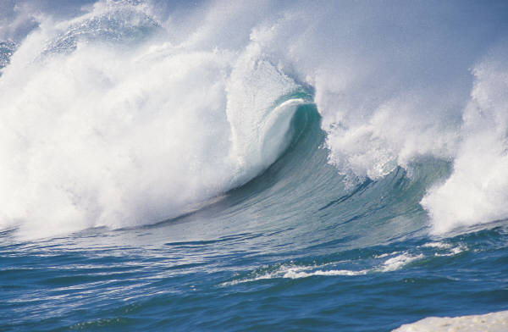
Astronomical amount of information in Biology
Impossible to find, read, and appreciate all pieces of published data.
Professionals may not know essential things even in the very narrow field they are working in.
Frequently scientists do not discover something new but reinvent the wheel.

Slide 11
Lecture 5 special assignment results: 3 students got A+ for listing the following theories for the origin of novel genes:
Exon shuffling
Transposable element domestification
Lateral gene transfer
Gene fusion
Gene fission
De novo gene synthesis from non-coding DNA
Retroposition of mRNA copies

Slide 12
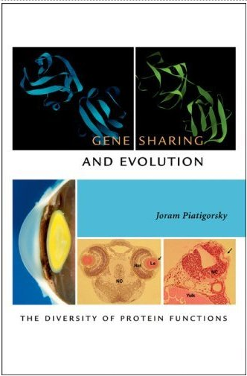
2007
Harvard University Press
Contains 1165 citations!

Slide 13
From the book Editorial reviews:
It has been a dogma of evolutionary biology that gene duplication precedes the evolution of new gene and protein function. Joram Piatigorsky stands this scenario on its head by showing that, in the case of lens crystallins and probably other protein families, functional diversity can precede gene duplication. His revolutionary perspective provides unexpected insight into how biological systems evolve.
--Austin Hughes, Professor of Biological Sciences, University of South Carolina

Slide 14
MULTIPLE NAMES: Moonlighting proteins “Hijacking”³¹ and “co-option”³² proteins
Reviews on moonlighting proteins: Jeffrey 1999; Copley 2003.
From Piatigorsky book: … As early as 70es..
(17) Orgel, L.E. Gene-duplication and the origin of proteins with novel functions. J. Theor. Biol. 67, 773, 1977.
(13) Jensen R.A. Enzyme recruitment in evolution of new function. Annu Rev Micorbiol 30, 409-425, 1976.

Slide 15
Origin of new of new genes according to gene sharing theory
Acquisition of a new function (B)
Gene duplication
Gene duplicates specialize on different functions
mutations
duplication
Gene A,B
Gene B
Gene A
Gene A,B
specialization
Gene A,B
Gene A

Slide 16
Famous examples of gene sharing: Crystallins –structural proteins in eye lenses
δ-2 crystallin is argininosuccinate lyase (chicken)
ε crystallin is a lactate dehydrogenase B4 (duck)
λ crystallin is a L-gulonate-3-dehydrogenase (rabit)
Τ crystallin is a alpha-enolase (turtle, Lamprey)
…(12 examples; see p 62. Piatigorsky)

Slide 17
COMMON SCHEME
Rapid mutations
And acquisition of
a new function
duplication
Gene A1
Gene new
Gene A
Gene A2
Gene A2
Preservation an
original function
GENE SHARING SCHEME
duplication
Gene A,B
Gene B
Gene A,B
specialization
Gene A,B
Gene A

Slide 18
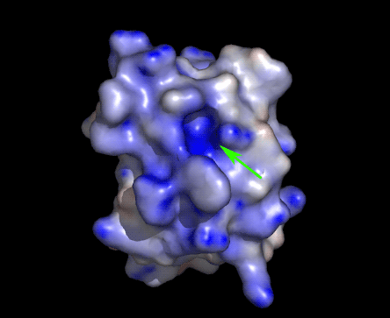
Large proteins have small active sites
Plenty of room for a new function to arrive !!!

Slide 19
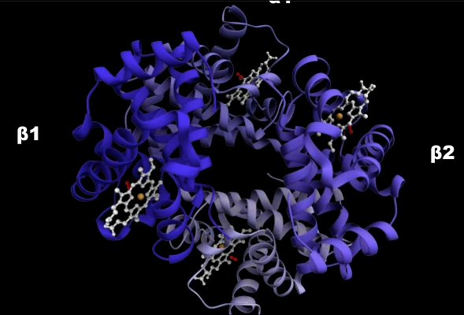
Hemoglobin binds oxygen molecules Acknowledgement to Janet Iwasa https://iwasa.hms.harvard.edu/project_pages/hemoglobin/hemoglobin.html

Slide 20
Old Doctrine in Protein Biology: Proteins are dozens of times larger than their active sites in order to keep their shapes despite thermal motion
http://www.ks.uiuc.edu/Gallery/Movies/
http://www.youtube.com/watch?v=ManrtvnpiI0
http://www.youtube.com/watch?v=J8-C9SaPeIY
http://www.youtube.com/watch?v=meNEUTn9Atg&feature=related

Slide 21
Topic 2: Often proteins are multi-functional molecules
HEMOGLOBINS:
Transport O₂
Transport CO₂
Transport NO
etc. (see Wikipedia)

Slide 22
Hemoglobin movements Acknowledgement to Janet Iwasa https://iwasa.hms.harvard.edu/project_pages/hemoglobin/hemoglobin.html

Slide 23
Hemoglobin movement from Wikipedia http://en.wikipedia.org/wiki/Hemoglobin

Slide 24
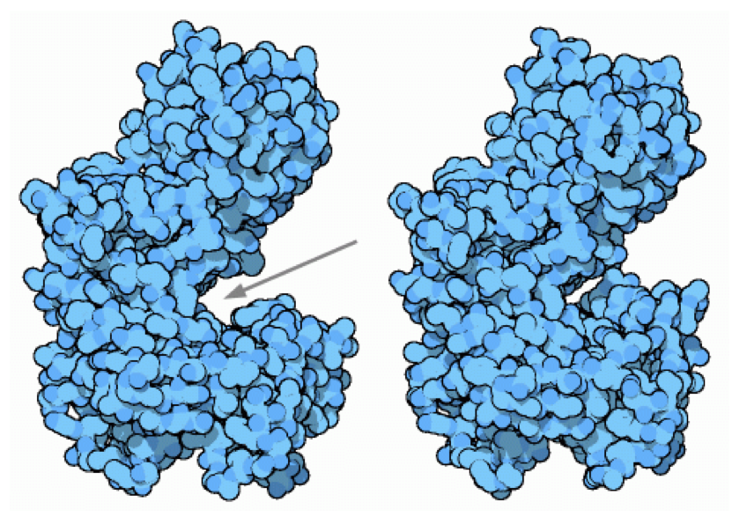
From PDB educational pages “molecule of the month” The Glycolytic Enzymes. Hexokinase http://www.pdb.org/pdb/static.do?p=education_discussion/molecule_of_the_month/pdb50_2.html

Slide 25
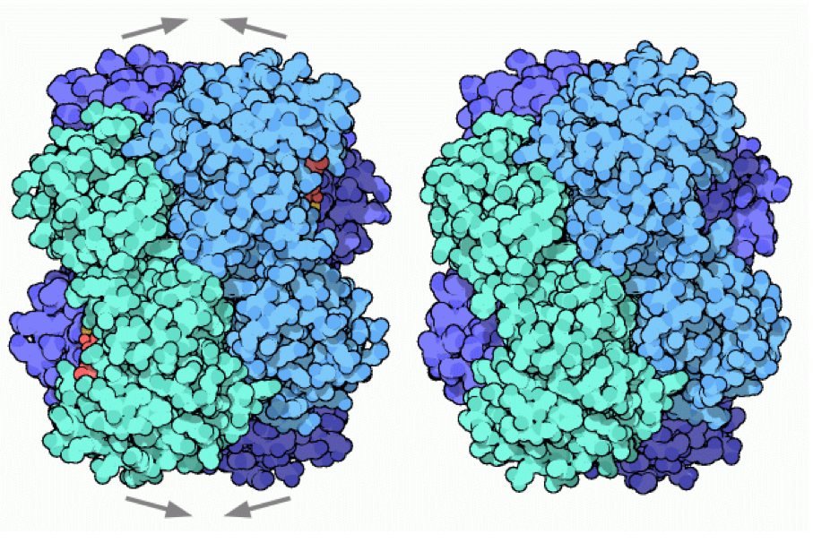
From PDB educational pages “molecule of the month” The Glycolytic Enzymes. http://www.pdb.org/pdb/static.do?p=education_discussion/molecule_of_the_month/pdb50_1.html
…Phosphofructokinase is like a miniature molecular computer that senses the levels of different molecules and decides if the time is right for breakdown of sugar. For instance, when ADP and AMP are common, the cell needs to make ATP, so the enzyme turns on. Phosphfructokinase is a mechanical computer, with moving parts.

Slide 26
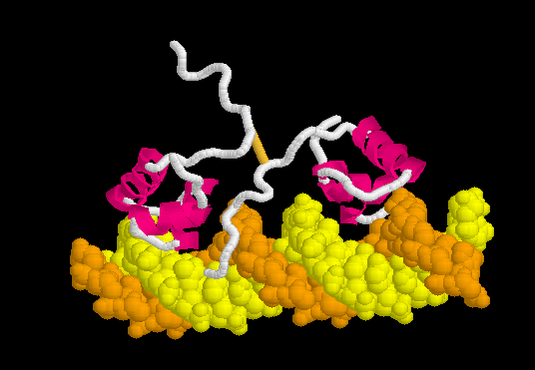
TOPIC 3: Proteins are flexible moving molecules
PROTEOPEDIA http://www.proteopedia.org/wiki/index.php/Lac_repressor

Slide 27
CONCLUSIONS
Protein ability to alter conformations is essential for its function.
Transitions between several alternative conformations of a protein should be precisely regulated and should withstand constant pressure from thermal motion. Therefore, proteins should be pretty large macromolecules to possess such flexibility and precision of their actions.

Slide 28
Part II How bad are mutations to macromolecule structures?

Slide 29
TOPIC 4: Proteins are very flexible and often can absorb many types of mutations slightly changing neighboring amino acid positions
Protein folding is due to WEAK interactions between AA residues
Hydrogen bonds
Dipole-dipole (van der Waals interactions)
Electrostatic interactions of ions
Hydrophobic interactions in aquatic solutions
Aromatic rings stacking
Rare exception inside cells: Disulfide cysteine bonds

Slide 30
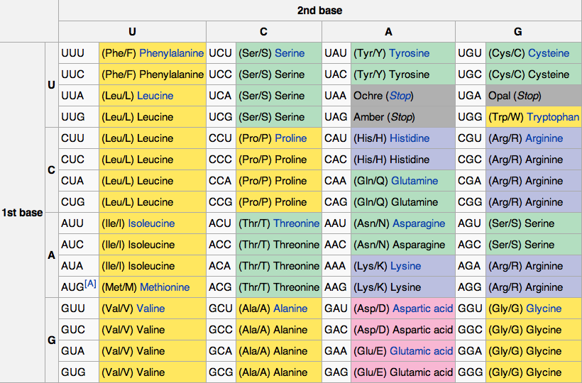

Slide 31
From PDB educational pages “molecule of the month” The Glycolytic Enzymes. Hexokinase http://www.pdb.org/pdb/static.do?p=education_discussion/molecule_of_the_month/pdb50_2.html
WATCH YOURSELF ON THE WEB: Hydorphobic core of globular proteins

Slide 32
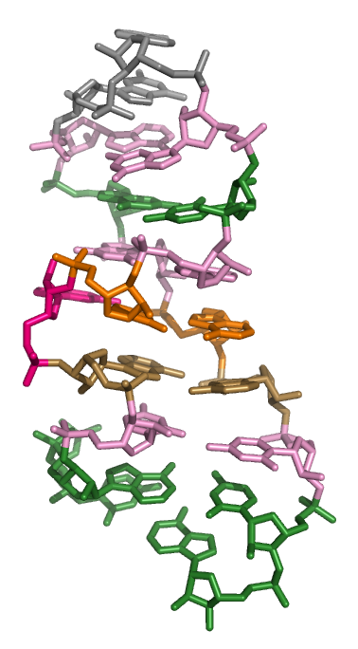
Flexibility of macromolecules
See also rat sarcin loop
1Q93 28S rRNA

Slide 33
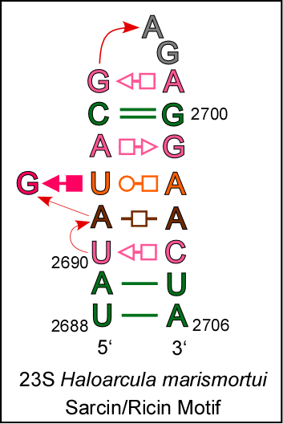
EXAMPLE: Sarcin/ricin stem-loop motif from 23S ribosomal RNA of Haloarcula marismortui.
Sequence:UAUAGUACGAGAGGAACUA
Annotation:((.....(....)....))

Slide 34
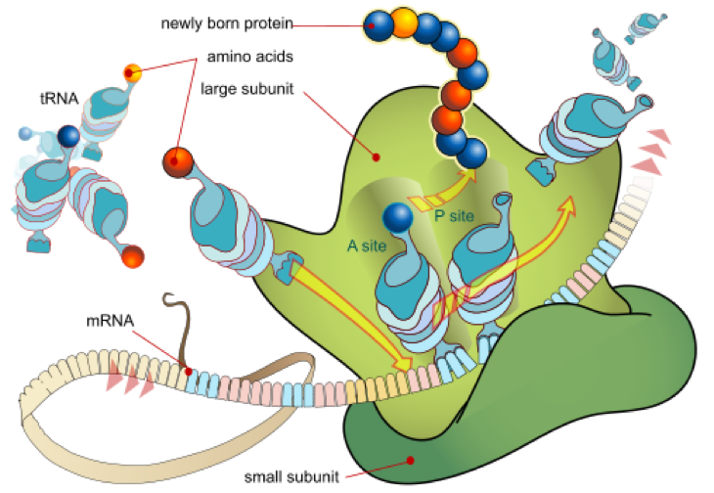
TOPIC 5: Translational errors are not rare! Substantial safety factor presumably is imbedded into proteins to withstand these errors.
Translation error rate
~2×10⁻⁴ per codon
This work has been released into the Wikipedia public domain by its author, LadyofHats.

Slide 35
The frequency of translational misreading errors in E. coli is largely determined by tRNA competition. Kramer EB, Farabaugh PJ. RNA. 2007;13(1):87-96.
Estimates of missense error rates (misreading) during protein synthesis vary from 10⁻³ to 10⁻⁴ per codon. The experiments reporting these rates have measured several distinct errors using several methods and reporter systems. Variation in reported rates may reflect real differences in rates among the errors tested or in sensitivity of the reporter systems.

Slide 36
Take home exam, March 1st, 2011
Write a minimum of 3 pages and describe the best experiment you can think of or find in the literature for the estimation of the rate of translational errors.

Slide 37
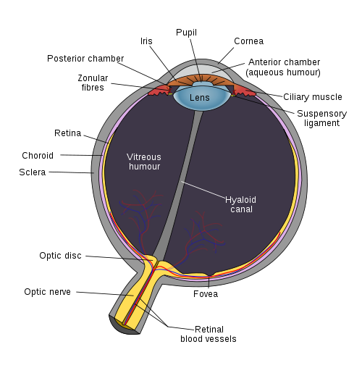
human keratoepithelin is a primary component of cornea composing nearly 20% of its protein mass. It performs a structural function in organization of this tissue.
http://en.wikipedia.org/wiki/Cornea

Slide 38
Conclusions: Mutations are ambivalent
Mutations are potentially dangerous because they may disrupt important gene functions.
About 2-3% of newborns have genetic disorders.
Currently about 6000 human genetic diseases have been described.
Mutations are a major driving force of evolution. They create novel genes and allow a population to adapt quickly to changing environment.
A majority of mutations do not have a pronounced effect on the organism.

Slide 39
FINAL PART OF THE LECTURE
Can we distinguish between good and bad mutations?

Slide 40
Two reviews on Selectionism versus Neutralism
“The Neutral Theory of Molecular Evolution in the Genomic Era” 2010, by Masatoshi Nei, Yoshiyuki Suzuki, and Masafumi Nozawa.
“Neutralism and selectionism: a network-based reconciliation” 2008 by Andreas Wagner

Slide 41
From Andreas Wagner paper 2008
“The tension between neutralism and selectionism is at least as old as the field of molecular evolution^{1”.}
“…To neutralism, beneficial mutations are rare and are fixed less frequently than neutral or slightly deleterious mutations². By contrast, according to selectionism, beneficial mutations are abundant: most mutations that go to fixation in a population would be beneficial, or are at least linked to abundantly occurring beneficial mutations.”

Slide 42
Recommended book with balanced view.
Chapters 5 and 7

Slide 43
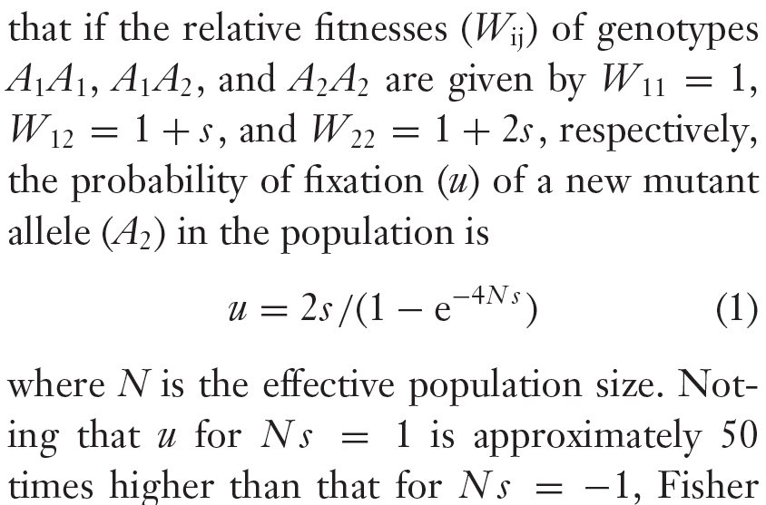
Each mutation can be characterized by a scalar: selection coefficient (s)
From Nei et al. 2010

Slide 44
PROBLEM !!! It is absolutely impossible to measure the selection coefficient S for a given mutation in experiments
… unless this mutation is deleterious
Therefore, the crucial parameter (S) for each theory
is totally elusive and the dispute between
Selectionism versus Neutralism cannot be resolved!

Slide 45
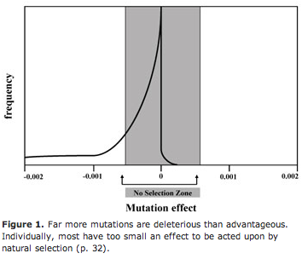
Sanford’s book criticized this distribution of S-values, which is popular among Neutralists

Slide 46
Homework assignment
Read two reviews by Nei et al. 2010 and Wagner 2008.
List all arguments presented in these papers that support Neutralism.
List all arguments presented in these papers that support Selectionism.

