Slide 1
ABPG 2016 Lecture 6, January 29th
DNA structure and mobility

Slide 2
PART 1
Visualization of DNA

Slide 3

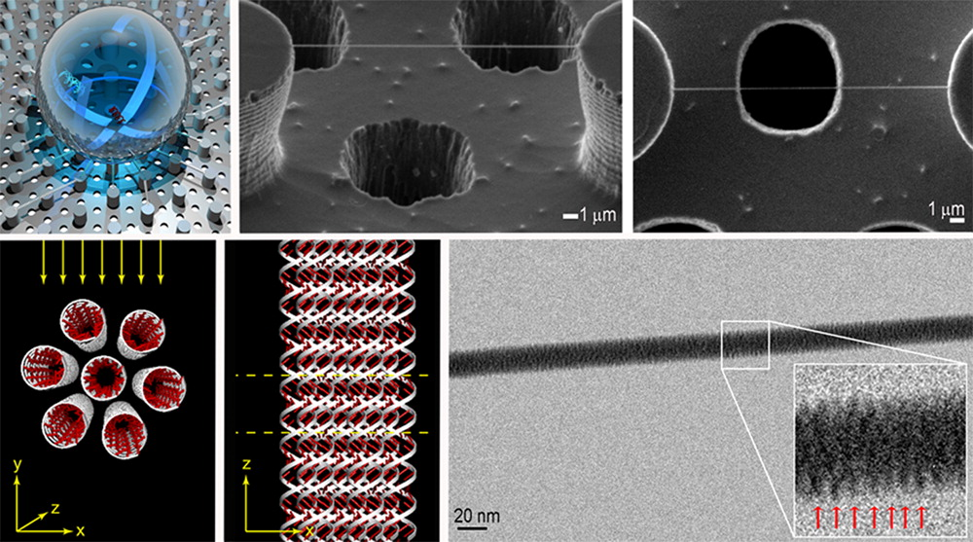
Published in: Francesco Gentile; Manola Moretti; Tania Limongi; Andrea Falqui; Giovanni Bertoni; Alice Scarpellini; Stefania Santoriello; Luca Maragliano; Remo Proietti Zaccaria; Enzo di Fabrizio; Nano Lett. 2012, 12, 6453-6458.
DOI: 10.1021/nl3039162
Copyright © 2012 American Chemical Society

Slide 4
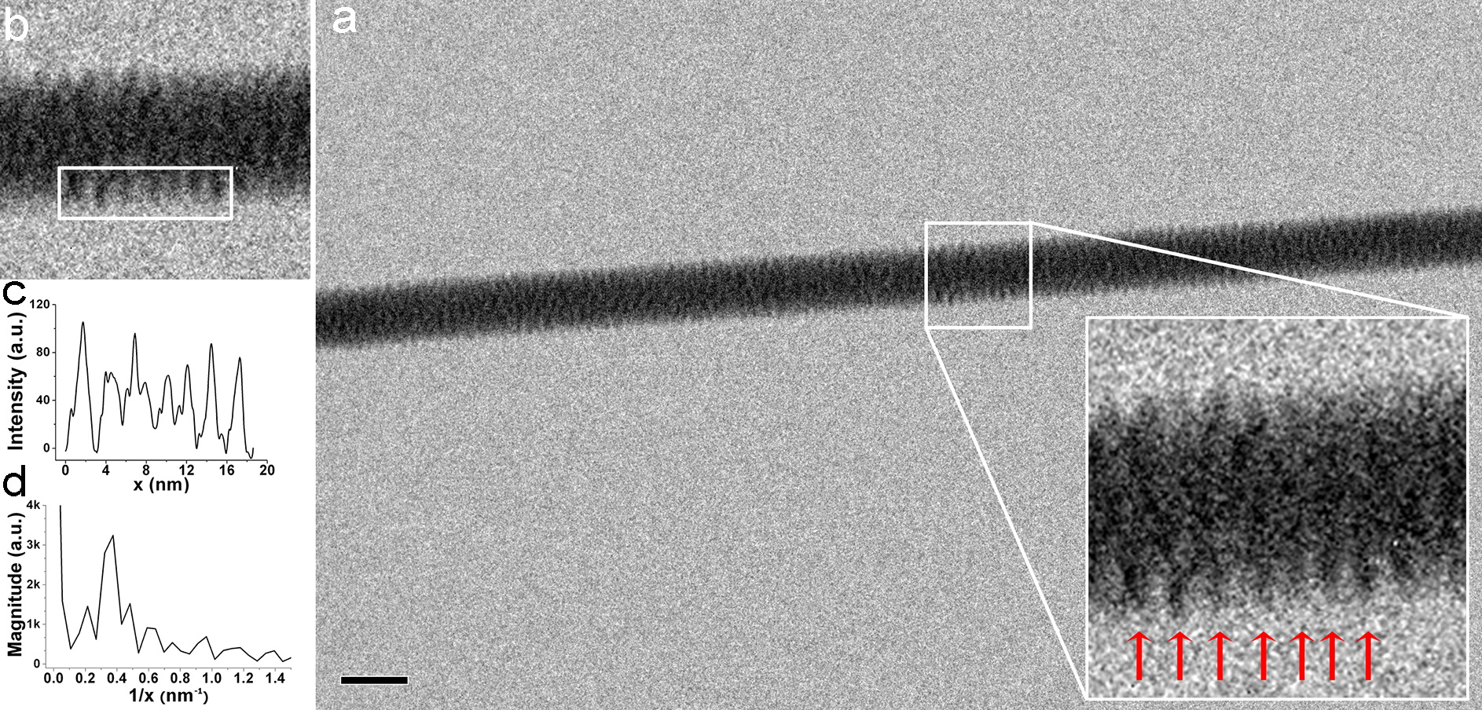
TEM image with intensity profile and corresponding FFT pitch calculation of λ-DNA fibers. (a) DNA fiber TEM image. The inset shows higher magnification DNA fiber details; the red arrows point out the 2.7 nm pitch of A double helix. The scale bar corresponds to a length of 20 nm. In panel b, a white rectangle is superimposed, showing where the intensity profile was measured. The peaks in plot c correspond to the alternation of bright and dark bands in the original image (b): plot c displays a two-dimensional graph where the Y-axis reports the pixel intensity integrated along the height of the rectangle and the X-axis represents the distance measured on the rectangle. Plot d shows the FFT of the signal displayed in plot c: a well-defined maximum is observed at 0.37 ± 0.02 1/nm, corresponding to a frequency of 2.7 ± 0.2 nm.
Published in: Francesco Gentile; Manola Moretti; Tania Limongi; Andrea Falqui; Giovanni Bertoni; Alice Scarpellini; Stefania Santoriello; Luca Maragliano; Remo Proietti Zaccaria; Enzo di Fabrizio; Nano Lett. 2012, 12, 6453-6458.
DOI: 10.1021/nl3039162
Copyright © 2012 American Chemical Society

Slide 5
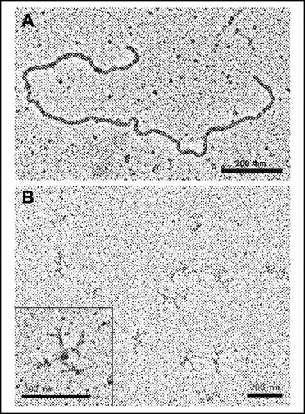

Electron microscopy of RdgC-DNA complexes.
Drees J C et al. J. Biol. Chem. 2006;281:4708-4717
©2006 by American Society for Biochemistry and Molecular Biology
Notes:
Electron microscopy of RdgC-DNA complexes. RdgC (1 μm) was incubated with 8 μm ϕX174 ldsDNA (A) or 4 μm M13 cssDNA (B) for 10 min at 37 °C before being diluted 6.6-fold (A) or 3.3-fold (B) and adhered to electron microscopy grids.

Slide 6
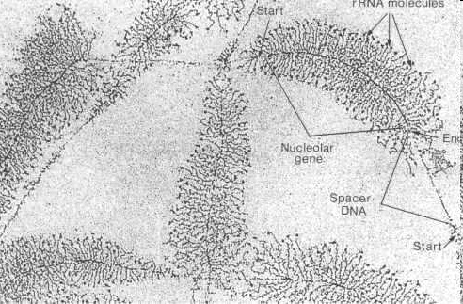
Electron microscopy of nucleic acids http://www.cytochemistry.net/Cell-biology/nucleus3.htm

Slide 7
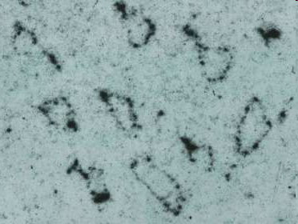
Electron microscopic picture of potato spindle tuber viroid http://www.biologie.uni-hamburg.de/bzf/mppg/agviroid.htm
http://www.biologie.uni-hamburg.de/bzf/mppg/agviro2.jpg

Slide 8
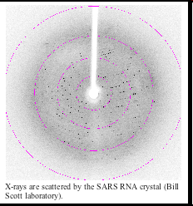
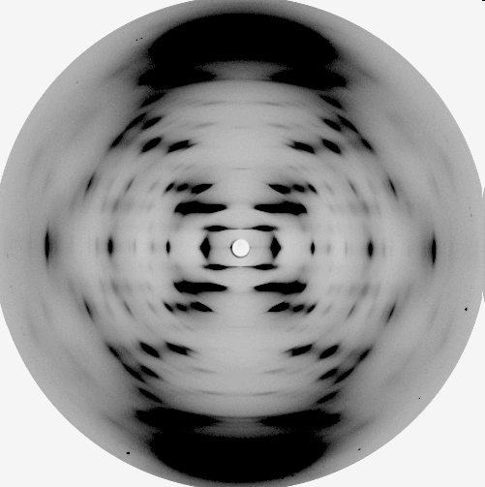
X-ray analysis of nucleic acids http://ribonode.ucsc.edu/learn/RNAvirus.html
The diffraction pattern obtained from the
B form of DNA obtained by Wilkins, Franklin
and colleagues at King's College, London

Slide 9
PART 2
DNA is a flexible and dynamic molecule

Slide 10
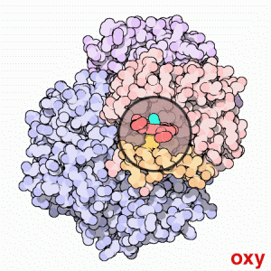
Hemoglobin movement from Wikipedia http://en.wikipedia.org/wiki/Hemoglobin

Slide 11
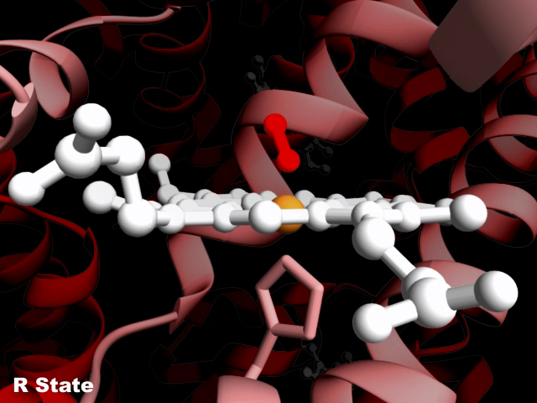
Hemoglobin movements
Acknowledgement to Janet Iwasa https://iwasa.hms.harvard.edu/project_pages/hemoglobin/hemoglobin.html

Slide 12
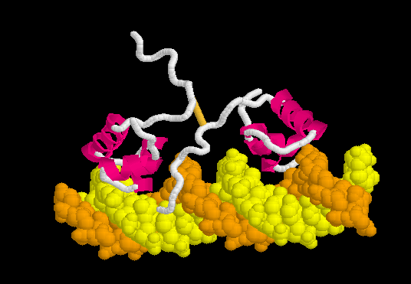
Proteins and DNA are flexible moving molecules
PROTEOPEDIA http://www.proteopedia.org/wiki/index.php/Lac_repressor

Slide 13
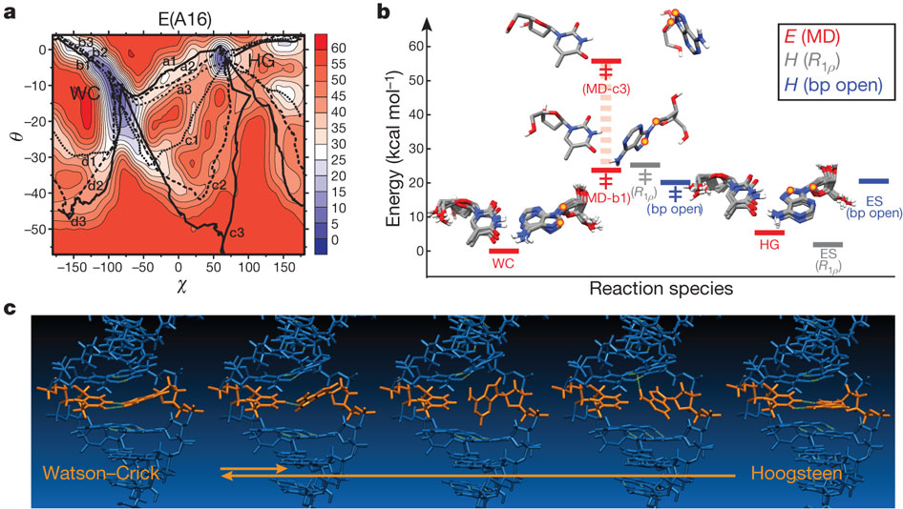
Novel DNA-world
Nikolova EN, Kim E, Wise AA, O'Brien PJ, Andricioaei I, Al-Hashimi HM.
Transient Hoogsteen base pairs in canonical duplex DNA. Nature. 2011; 470:498-502.

Slide 14
From the Abstract
By using nuclear magnetic resonance relaxation dispersion spectroscopy in concert with steered molecular dynamics simulations, we have observed transient sequence-specific excursions away from Watson–Crick base-pairing at CA and TA steps inside canonical duplex DNA towards low-populated and short-lived A•T and G•C Hoogsteen base pairs. The observation of Hoogsteen base pairs in DNA duplexes specifically bound to transcription factors and in damaged DNA sites implies that the DNA double helix intrinsically codes for excited state Hoogsteen base pairs as a means of expanding its structural complexity beyond that which can be achieved based on Watson–Crick base-pairing.
VIDEO 1: An A•T WC-to-HG base pair transition in duplex B-DNA
VIDEO 2: G•C WC-to-HG base pair transition in duplex B-DNA

Slide 15
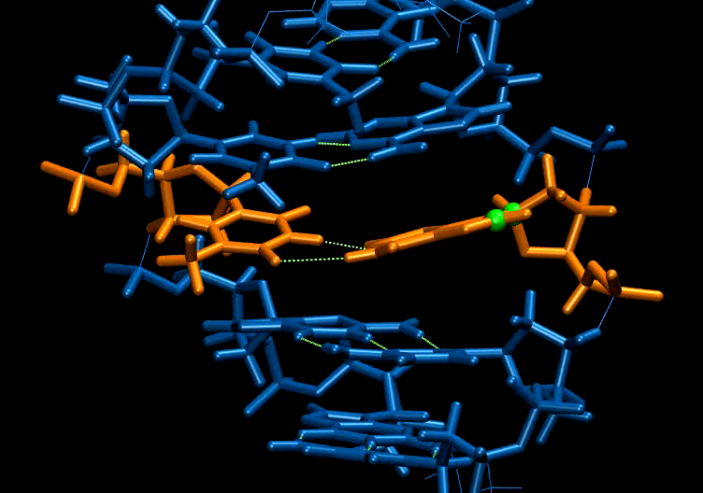

Slide 16
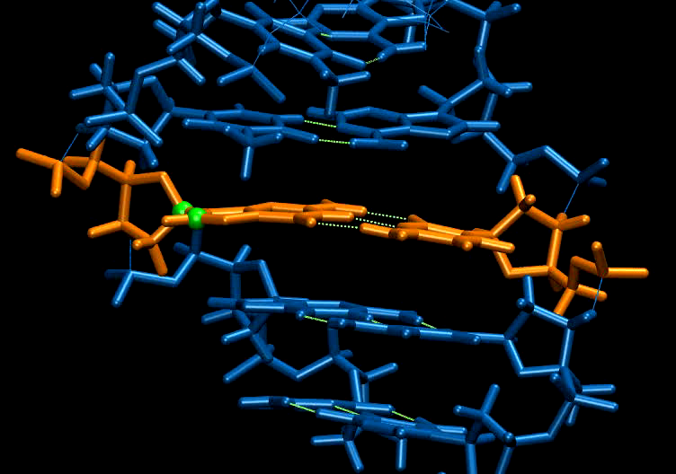

Slide 17
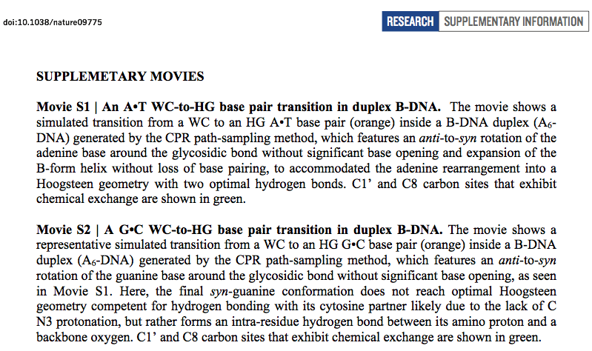

Slide 18
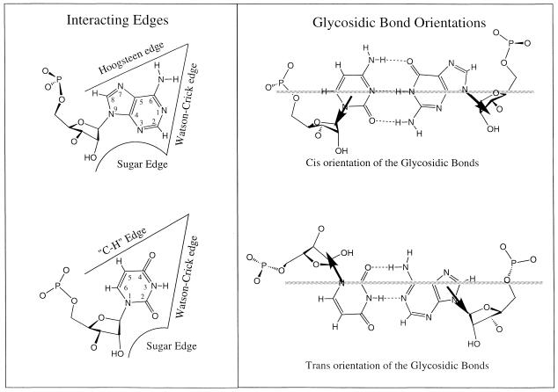
The non-Watson–Crick base pairs and their associated isostericity
matrices by Neocles Leontis, Jesse Stombaugh, Eric Westhof

Slide 19
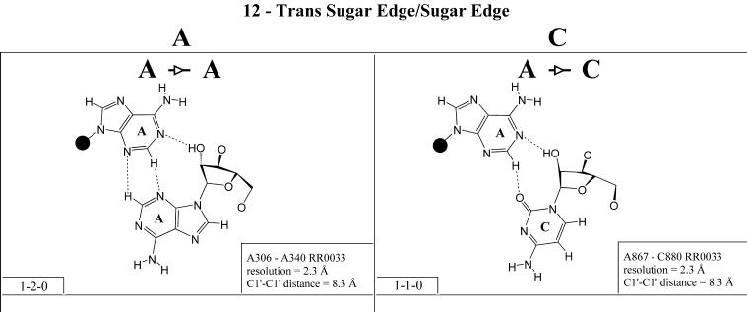
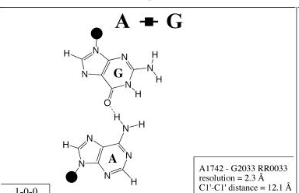
Hoogsteen-Hoogsteen
Nucleic Acids Res 2002
30(16): 3497–3531

Slide 20
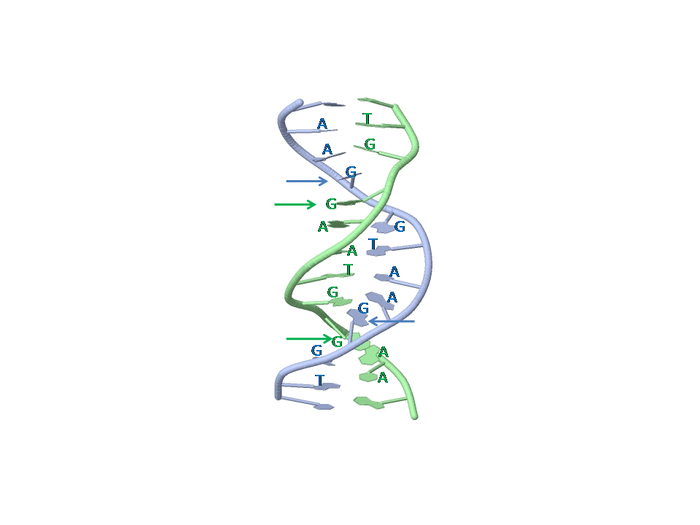
DNA duplex 5`TGGAATGGAA:TGGAATGGAA3` formed by two copies of TGGAA pentamer repeat
PDB identifier:
103D
Four arrows point to unpaired guanosine residues stacked between Hoogsteen G-A pairs.

Slide 21
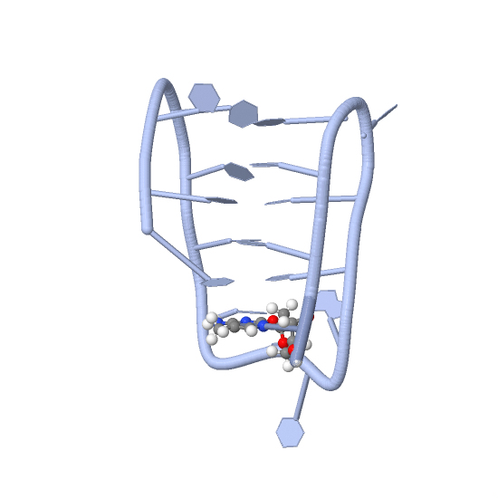
C-rich strand fragment of the human centromeric satellite III
(CCATTCCATTCCTTTCC) that forms intra-molecurlar i-motif structure
with C.C(+) pairs from parallel strands intercalated head-to-tail.
1G22
parallel stranded DNA duplex see 1R2L

Slide 22
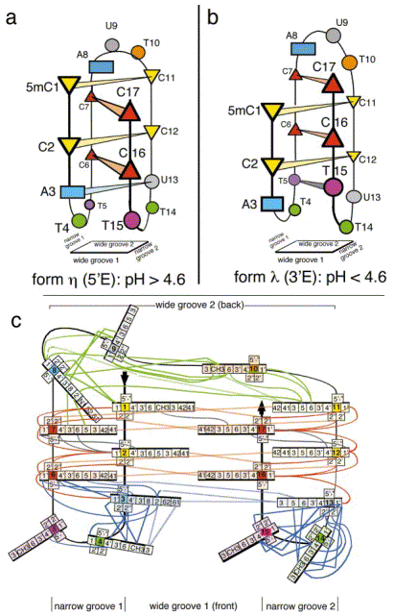
Nonin-Lecomte & Leroy
JMB 2001, 309:491-506

Slide 23
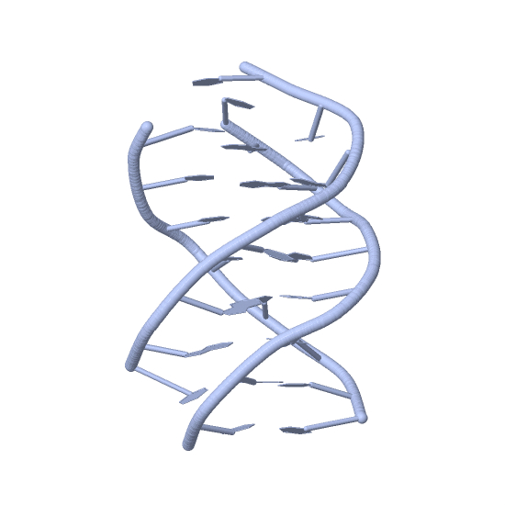
DNA triplex
134D
Third strand interacts via
Hoogsteen base pairing with
Watson-Crick DNA duplex
along its major groove

Slide 24
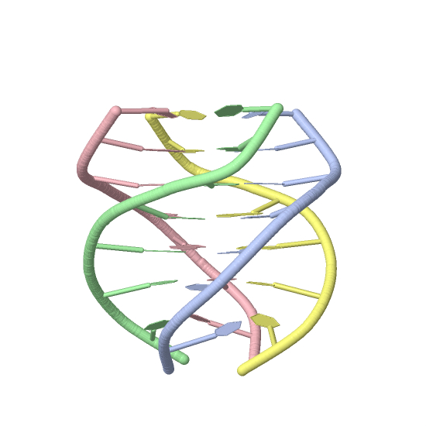
G-quadruplex, G-quartet, or G4, is formed
by guanine-rich strands of the repeats
TTAGGG
GGA and CGG
Quadruplexes are arranged in
four-stranded structures with
stands connected to each other
via Hoogsteen hydrogen bonding.
There are several alternative
conformations of G-quadruplexes.
Among them are anti-parallel,
parallel, and parallel/anti-parallel
hybrids

Slide 25
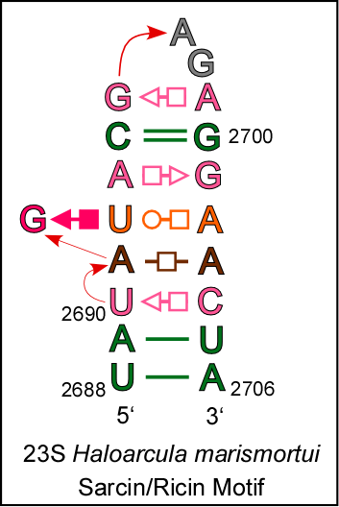
EXAMPLE: Sarcin/ricin stem-loop motif from 23S ribosomal RNA of Haloarcula marismortui.
Sequence:UAUAGUACGAGAGGAACUA
Annotation:((.....(....)....))

Slide 26
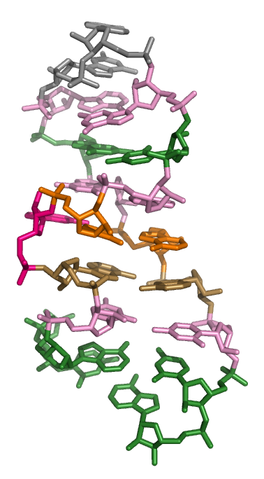
See also rat sarcin loop
1Q93 28S rRNA

Slide 27
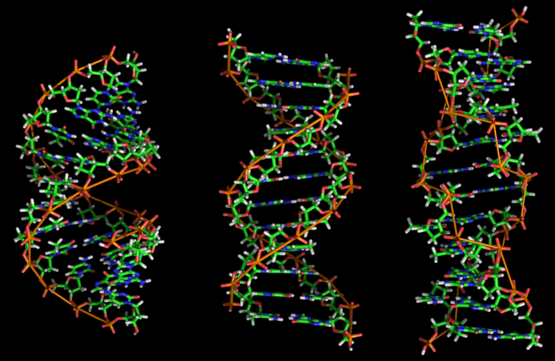
A-, B-, and Z- DNA

Slide 28
DNA and RNA can move!
non-B DNA conformations likely do not exist permanently, but only under specific conditions. Their formation can be facilitated by negative supercoiling during transcription or by binding with transcription factors (Mirkin 2008)
THE PROBLEM: DNA is so small, that it is still impossible to us to view it alive!

Slide 29
PART 3
DNA exists in a quantum world

Slide 30
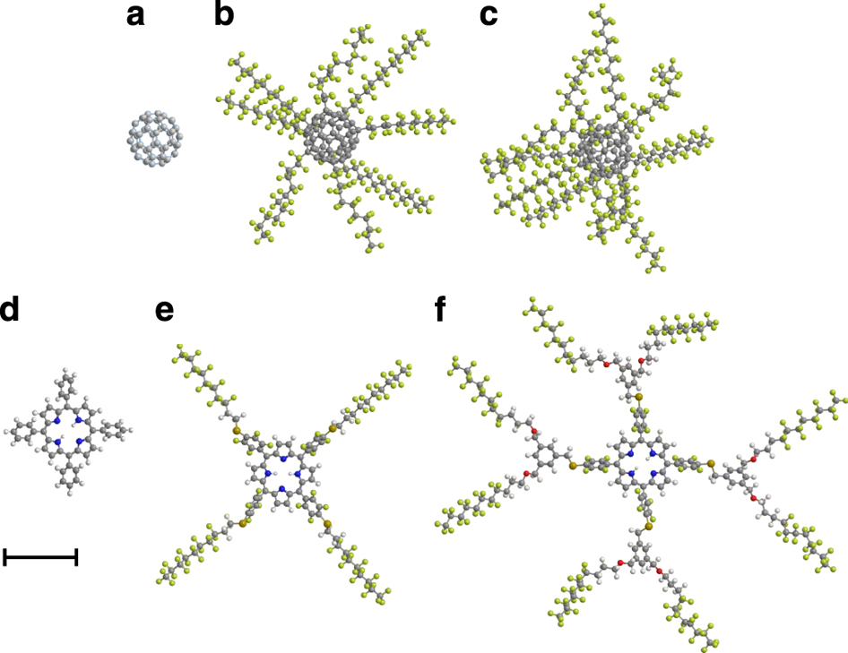
Gerlich S, Eibenberger S, Tomandl M, Nimmrichter S, Hornberger K, Fagan PJ, Tüxen J, Mayor M, Arndt M. Quantum interference of large organic molecules. Nat Commun. 2011;2:263.

Slide 31

Quantum coherent propagation of complex molecules through the frustule of the alga Amphipleura pellucida
Michele Sclafani, Thomas Juffmann, Christian Knobloch and Markus Arndt

Slide 32
Stacking in supramolecular chemistry
In supramolecular chemistry, an aromatic interaction (or π-π interaction) is a noncovalent interaction between organic compounds containing aromatic moieties. π-π interactions are caused by intermolecular overlapping of p-orbitals in π-conjugated systems, so they become stronger as the number of π-electrons increases. Other noncovalent interactions include hydrogen bonds, van der Waals forces, charge-transfer interactions, and dipole-dipole interactions.
π-π interactions act strongly on flat polycyclic aromatic hydrocarbons such as anthracene, triphenylene, and coronene because of the many delocalized π-electrons. This interaction, which is a bit stronger than other noncovalent interactions, plays an important role in various parts of supramolecular chemistry. For example, π-π interactions have a big influence on molecule-based crystal structures of aromatic compounds.
Stacking in biology
In DNA, pi stacking occurs between adjacent nucleotides and adds to the stability the molecular structure. The nitrogenous bases of the nucleotides are made from either purine or pyrimidine rings, consisting of aromatic rings. Within the DNA molecule, the aromatic rings are positioned nearly perpendicular to the length of the DNA strands. Thus, the faces of the aromatic rings are arranged parallel to each other, allowing the bases to participate in aromatic interactions. Through aromatic interactions, the pi bonds, extending from atoms participating in double bonds, overlap with pi bonds of adjacent bases. This is a type of non-covalent chemical bond. Though a non-covalent bond is weaker than a covalent bond, the sum of all pi stacking interactions within the double-stranded DNA molecule creates a strong net stabilizing effect.

Slide 33
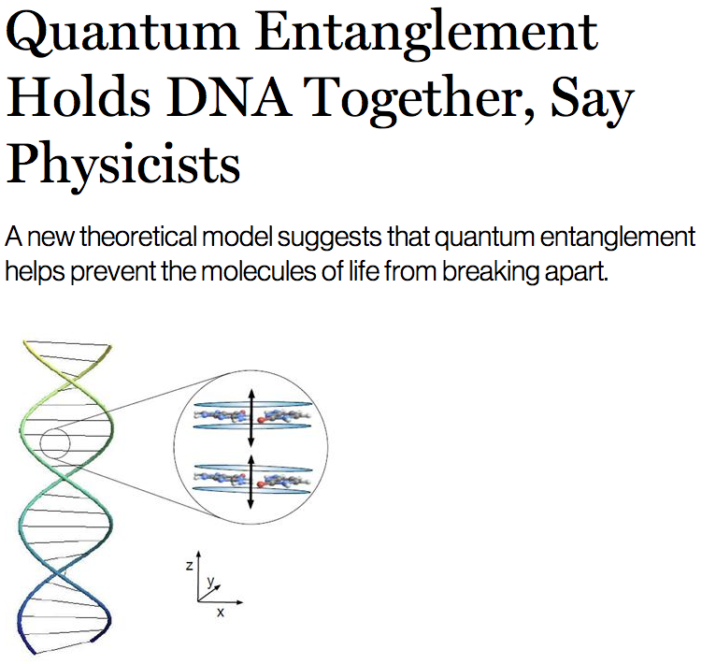
MIT Technology review http://www.technologyreview.com/view/419590/quantum-entanglement-holds-dna-together-say-physicists/

Slide 34
Nucleic acids might possess unknown and very strange properties described by quantum physics and we are only at the very beginning of this appreciation.
Rieper E, Anders J, and Vedral V. 2010. The relevance of continuous variable entanglement in DNA. arXiv:1006.4053v1
SUMMARY We consider a chain of harmonic oscillators with dipole-dipole interaction between nearest neighbours resulting in a van der Waals type bonding. The binding energies between entangled and classically correlated states are compared. We apply our model to DNA. By comparing our model with numerical simulations we conclude that entanglement may play a crucial role in explaining the stability of the DNA double helix.

Slide 35
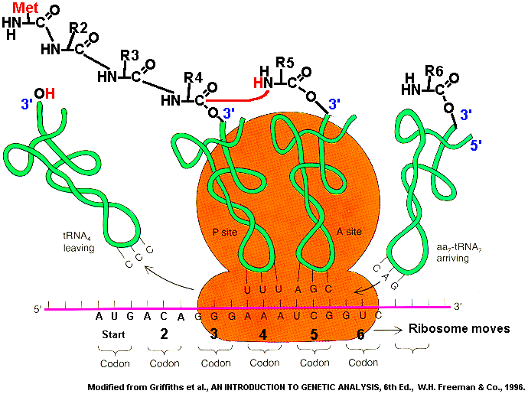
Ribosome machinery

Slide 36
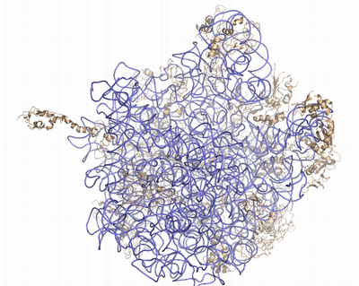
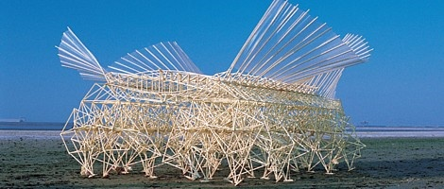
We are unable to see the complex behavior of nucleic acids because of their ultra-small size
Let’s compare nucleic acids with the autonomous, wind-powered machines.
The machines are composed mainly of plastic tubes and lemonade bottles.
http://www.youtube.com/watch?v=a7Ny5BYc-Fs video2
http://www.youtube.com/watch?v=b694exl_oZo video3
http://www.youtube.com/watch?v=pZ3_JAPpH3U

Slide 37
Important properties of the wind-powered beach creatures
Flexibility
Coordinated movement
Mechanisms for energy transformation for motion (wind -> movement)
What we still do not know about nucleic acids

Slide 38
'Telepathic' Genes Recognize Similarities In Each Other
ScienceDaily (Jan. 26, 2008) http://www.sciencedaily.com/releases/2008/01/080124103151.htm
Genes have the ability to recognise similarities in each other from a distance, without any proteins or other biological molecules aiding the process, according to new research. This discovery could explain how similar genes find each other and group together in order to perform key processes involved in the evolution of species.
Although the capacity for single complementary strands of DNA to attract each other is probably the best-known and most fundamental property of DNA, no-one knew until now that intact, double-stranded DNA could do this too.
The phenomenon might explain how identical paired DNA strands align themselves ready for repairs, copying, and alteration through a process called homologous recombination.
DNA double helices recognize mutual sequence homology in a protein free environment. Baldwin et al. J Phys Chem B. 2008;112(4):1060-4.

Slide 39
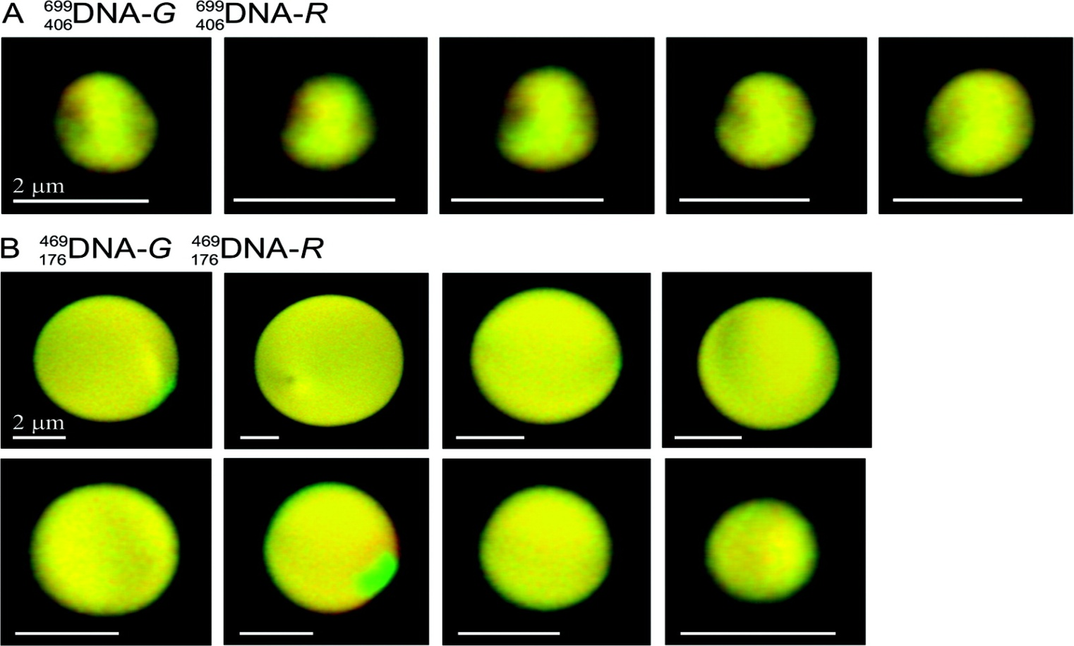
Figure 2 Confocal imaging of single DNA sequences in spherulites demonstrates that fluorescent dyes do not affect the localization of DNA within the spherulite. Typical confocal microscopy sections of spherulites condensed as described in Figure 1 from equal mixtures of (A)DNA-G withDNA-R and (B)DNA-G withDNA-R. The two color channels were normalized for intensity and corrected for chromatic aberration.
Published in: Geoff S. Baldwin; Nicholas J. Brooks; Rebecca E. Robson; Aaron Wynveen; Arach Goldar; Sergey Leikin; John M. Seddon; Alexei A. Kornyshev; J. Phys. Chem. B 2008, 112, 1060-1064.
DOI: 10.1021/jp7112297
Copyright © 2008 American Chemical Society

Slide 40
Crick’s unpairing hypothesis (1971)
Meiotic division is characterized by the union (or "conjugation" as the early cytologists called it) of your parental chromosomes. How parental duplex DNA molecules would be able to recognize each other?
In helical duplex DNA the bases were inward-looking. How could inward-looking bases in one duplex look outwards to recognize homologous bases in another DNA duplex?

Slide 41
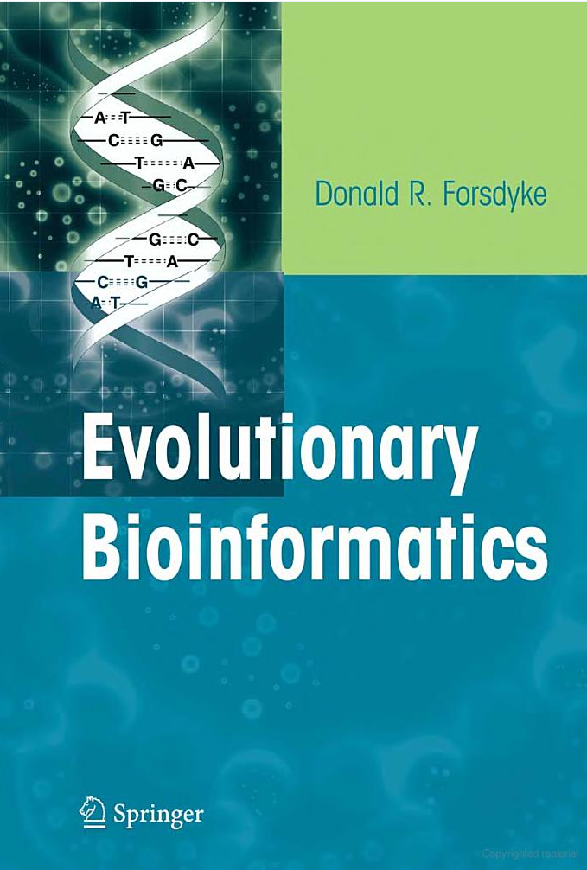
Kissing loops
Homepage of Dr. Donald Forsdyke http://post.queensu.ca/~forsdyke/index.htm
http://post.queensu.ca/~forsdyke/homepage.htm#Homepage
“Molecular sex” paper http://post.queensu.ca/~forsdyke/speciat4.htm

Slide 42
Conclusions
Nucleic acids are not just a simple set of instructions (texts)! They are dynamic and complex creatures.
We still do not know much about DNA and RNA!

Slide 43
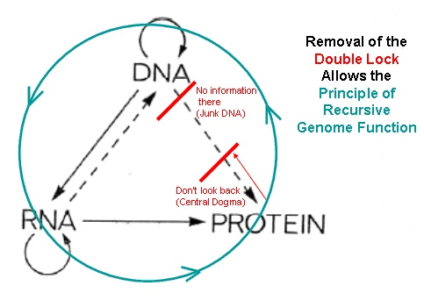
Andras Pellionisz
The principle of recursive genome function
Figure reference: http://www.junkdna.com/

Slide 44
Assignment
I. Read two reviews on DNA conformations
a) Zhao et al. 2010,
b) Fedorov & Fedorova 2010
Create a list of all unusual (non-B) DNA structures described in these reviews.
II. Watch video: nonB_DNA.mov. Read tutorials and learn how to work with Jmol viewer in PDB. Open a subset of PDB, so-called, Nucleic Acids Database (NDB). Find a section inside NDB that lists all unusual DNA structures. View all these unusual conformations using Jmol. Create a list of all unusual structures presented in NDB, which are missed in the reviews

