Slide 1
Recombination of nucleic acids
Alexei Fedorov
Recombination is an intrinsic property of nucleic acids and these molecules are susceptible to joining their ends.
Evolution invented thousands of proteins that assist DNA recombination and became crucial for cell functioning.

Slide 2
Homologous recombination during meiosis
Remember Crick’s puzzle and telepathic genes from previous lecture?
Homologous
chromosomes
gametogenesis
Father’s
Mother’s
Gametes consist of pieces of
Mother’s and father’s
chromosomes

Slide 3
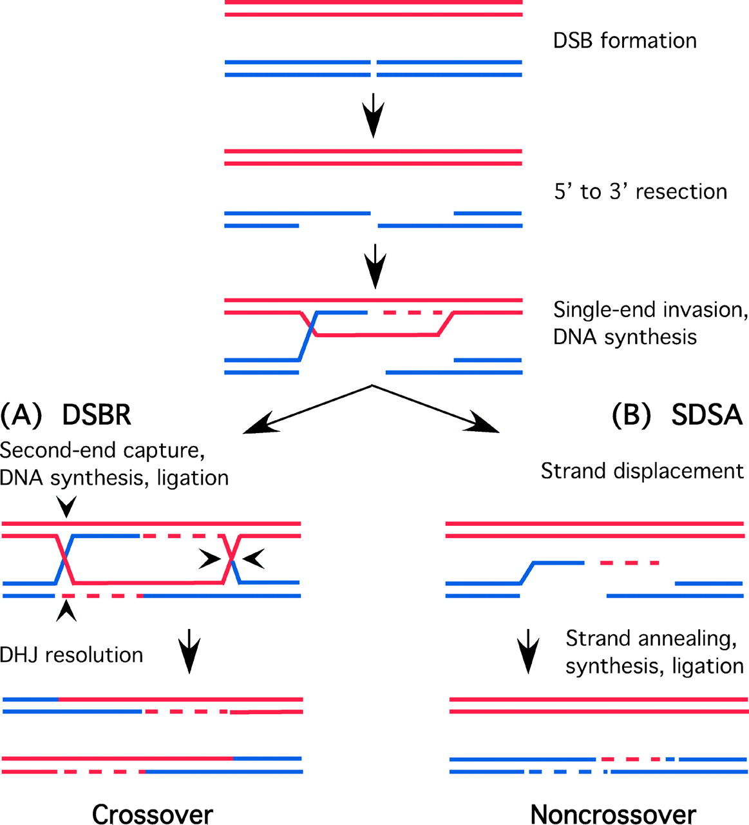
http://www.plantcell.org/content/14/5/1173/F2.expansion

Slide 4
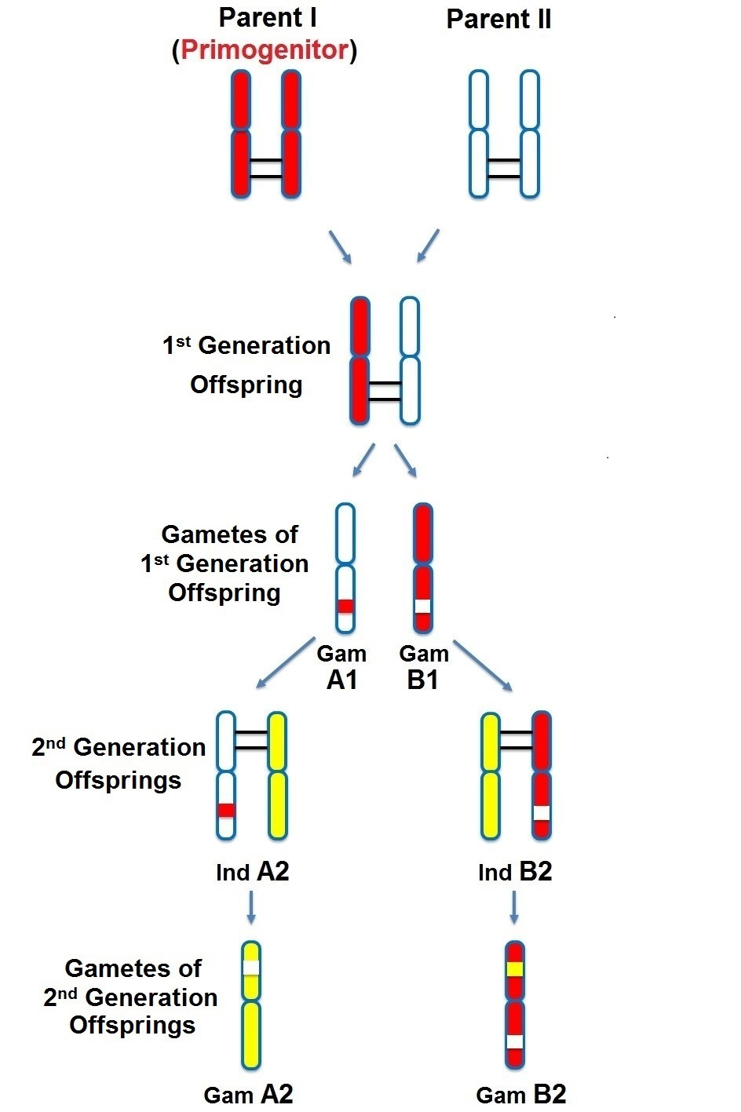
People inherit from predecessors not individual SNPs, but Identical-By-Descent (IBD) chromosomal segments

Slide 5
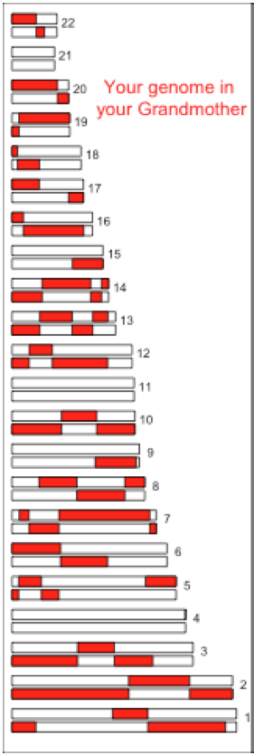
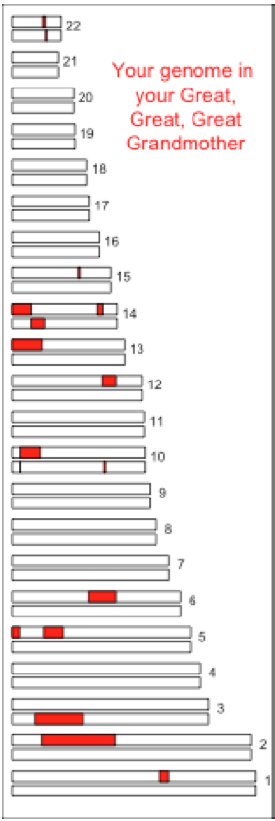
The Coop Lab https://gcbias.org/2013/12/02/how-many-genomic-blocks-do-you-share-with-a-cousin/

Slide 6
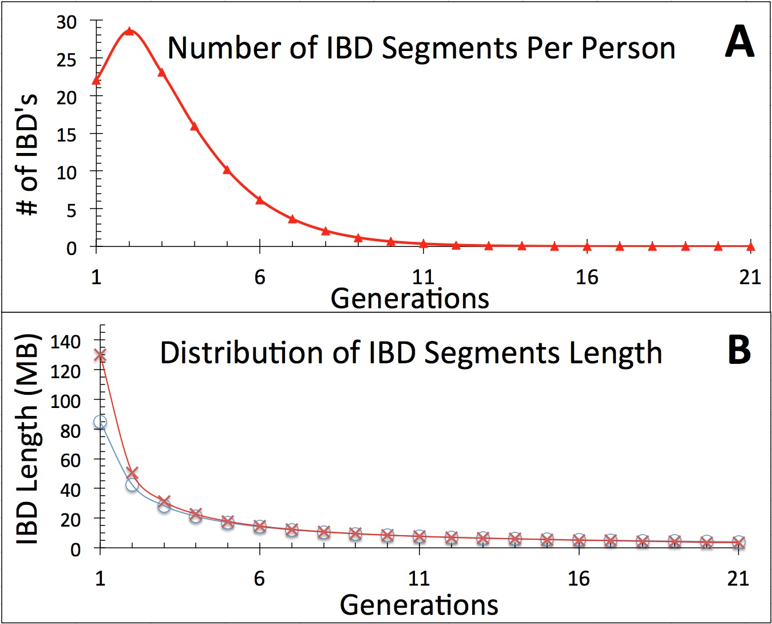
Modeling inheritance of IBDs in humans

Slide 7
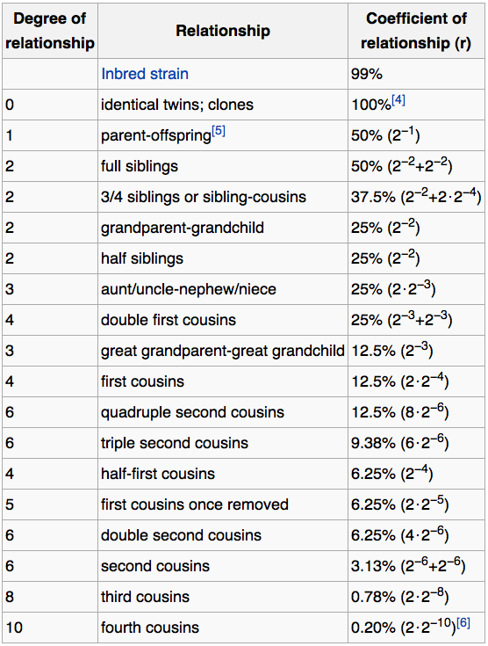
Wikipedia:
Coefficient of relationship
http://en.wikipedia.org/wiki/Coefficient_of_relationship

Slide 8
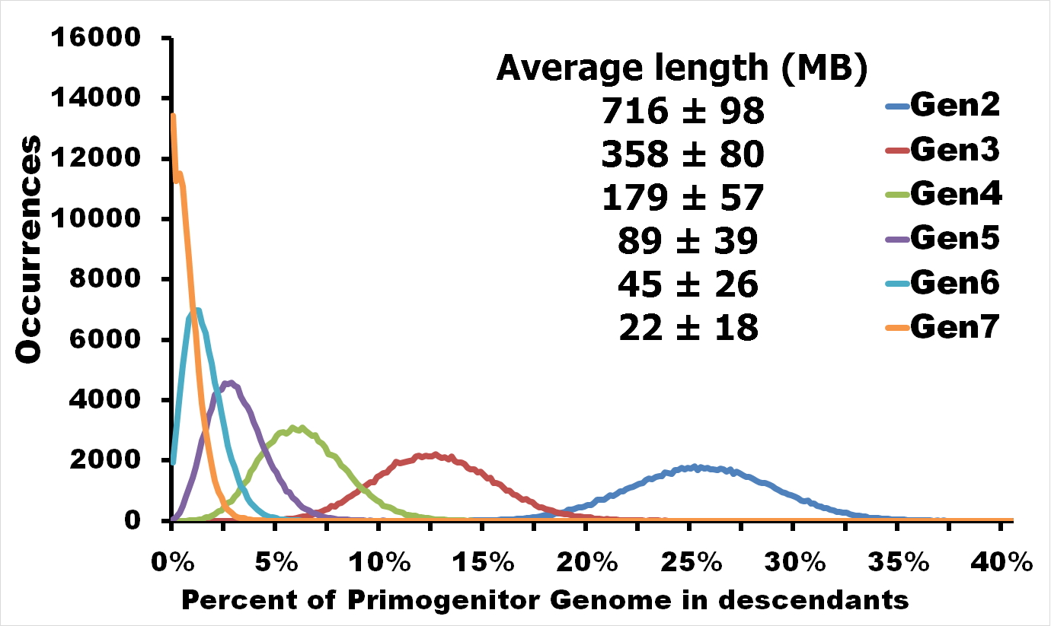
Distribution of proportion of model Primogenitor’s genetic materials inherited by descendants in six successive generations

Slide 9
Atlas of Cryptic Genetic Relatedness Among 1000 Human Genomes
Since all living species experience an intense influx of mutations in their genomes, very rare SNPs are very abundant. Any given human being has 50-100 de novo DNA changes, on average. Due to this intense mutagenesis, very rare SNPs occur by the tens of thousands in every individual and their patterns along chromosomes are exceptional clues and signs of their most recent evolution.

Slide 10
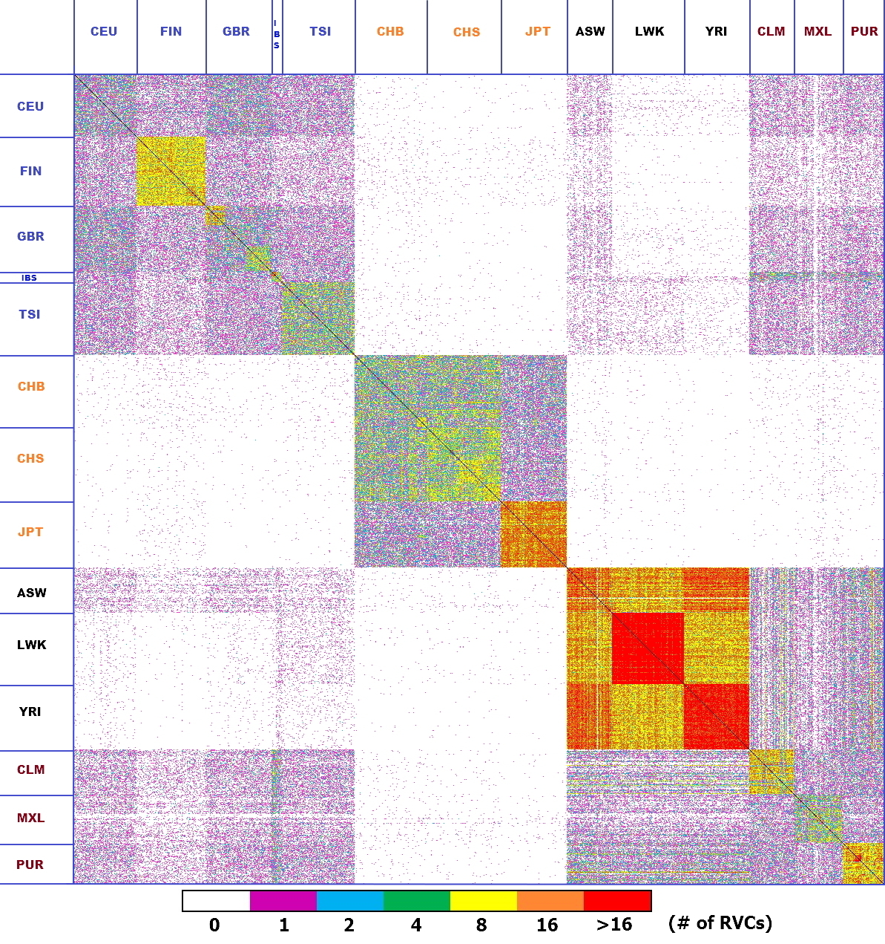
Heat-map table (1092x1092) presenting the number of shared IBD segments for every possible pair of 1092 individuals
America Africa Asia Europe

Slide 11
SUMMARY
Inheritance of genetic materials creates an intricate fractal mosaic of IBD chromosomal segments in the genome. Close familial relationships are presented by shared long IBD segments that in turn are mosaics of shorter IBD segments from previous generations. Further, each IBD segment is built from smaller pieces inherited from distant ancestors.

Slide 12
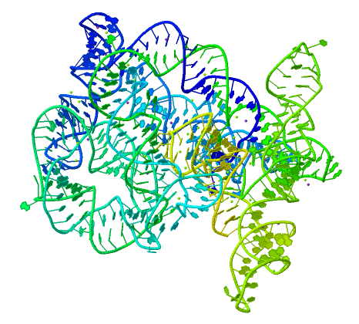
recombination is a fundamental intrinsic property of nucleic acids vital for every living organism.
RNA molecule can join its ends itself!
PDB: 3IGI
Mg⁺² and GTP
Tertiary architecture of the Oceanobacillus iheyensis group II intron
Toor et al. RNA 2010, 16:57-69.

Slide 13
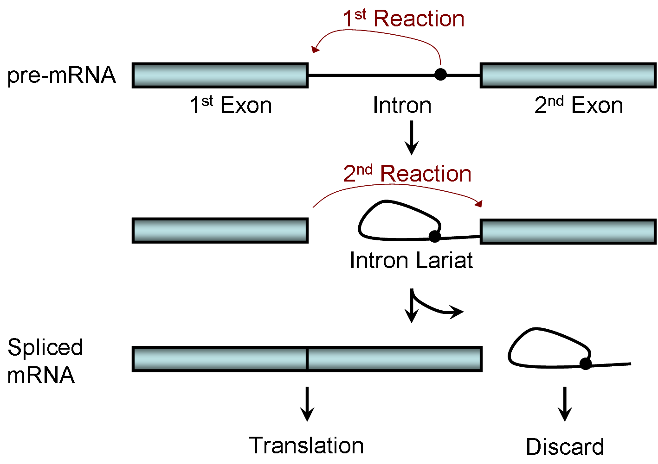
Splicing of nuclear and group II introns http://en.wikipedia.org/wiki/Intron_splicing
GT
AG

Slide 14
Group II introns in bacterial world F. Martinez-Abarca and N. Toro Molecular Microbiology 2000, 38:917-926
http://www.fp.ucalgary.ca/group2introns/wherefound.htm

Slide 15
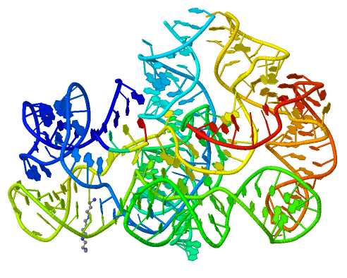
Crystal structure of a phage Twort group I ribozyme-product complex. Golden, B.L., Kim, H., Chase, E. (2005) Nat.Struct.Mol.Biol. 12: 82-89
1Y0Q

Slide 16
Splicing of Group I introns http://en.wikipedia.org/wiki/Group_I_catalytic_intron
Splicing of group I introns is processed by two sequential ester-transfer reactions.[3]
The exogenous guanosine or guanosine nucleotide (exoG) first docks onto the active
G-binding site located in P7, and its 3'-OH is aligned to attack the phosphodiester
bond at the 5' splice site located in P1, resulting in a free 3'-OH group at the upstream
exon and the exoG being attached to the 5' end of the intron. Then the terminal G
(omega G) of the intron swaps the exoG and occupies the G-binding site to organize
the second ester-transfer reaction, the 3'-OH group of the upstream exon in P1 is
aligned to attacks the 3' splice site in P10, leading to the ligation of the adjacent
upstream and downstream exons and free of the catalytic intron.

Slide 17
Dickson et al. “Retrotransposition of a yeast group II intron occures by reverse splicing directly into ectopic DNA sites”. PNAS 2001, 98:13207-13212 Reverse splicing of intronic RNA directly into DNA target sites
Retrotransposition mechanisms using DNA targets. The COXI gene of strain 1+t20 (top) contains both the donor aI1 intron (hatched) and the 5 848 ectopic site in intron 5 (open rectangle) The mechanism on the left begins with reverse splicing into the ectopic site in double-stranded DNA. Inefficient nicking of the antisense strand forms the primer for full-length cDNA synthesis by the RT with completion of intron insertion by DNA repair. The mechanism on the right begins with reverse splicing into the ectopic site at a replication fork. cDNA synthesis is initiated either de novo or by using the 3' end of the newly made leading strand with further replication and repair needed to complete intron insertion

Slide 19
DNA Recombination is vital to all organisms!
Repair of DNA double-strand breaks
Sexual reproduction
Genome evolution and creation on novel genes

Slide 20
Major types of DNA recombination from textbooks
Homologous recombination -- between two homologous DNA molecules.
Site-specific recombination -- at a specific DNA sequence which is present in both non-homologous DNA molecules that may have the recombination.
Transposition – occurs when a mobile element is inserted into a target DNA.
Non-homologous end joining (NHEJ) is a pathway that repairs double-strand breaks in DNA.

Slide 21
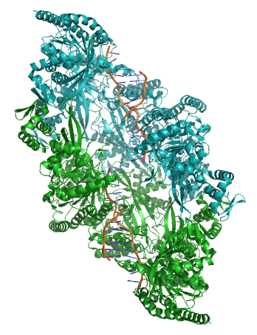
Crystal structure of two chains of the RecA protein bound to DNA. A double-strand break and two adjacent 3' overhangs are visible. http://en.wikipedia.org/wiki/Homologous_recombination

Slide 22
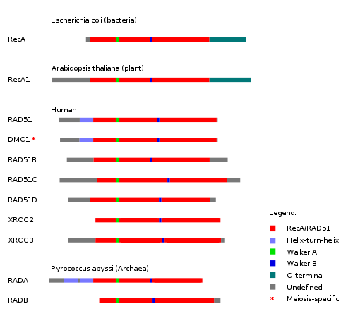
Human proteins homologous to E. coli RecA http://en.wikipedia.org/wiki/Homologous_recombination

Slide 23
Viruses and host cells
HIV virus integrase

Slide 24
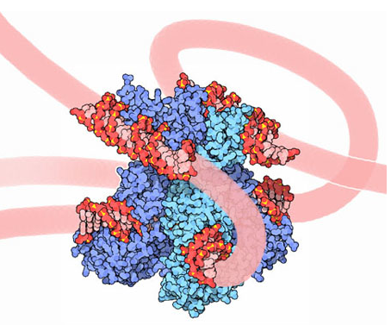
Site-specific recombination is used by bacteriophage λ to integrate or excise its genome into and out of the host chromosome. λ recombination is carried out by the bacteriophage-encoded integrase protein (λ -int). Nature 2005, 435:1059-66.
PDB: Molecule of the month: TRANSPOSASE
Lambda integrase from a bacteriophage (PDB entry 1z1g). This structure catches the Enzyme in the middle of its reaction, which involves an elaborate looping of DNA in and around the enzyme. http://www.pdb.org/pdb/static.do?p=education_discussion/molecule_of_the_month/pdb84_2.html

Slide 25
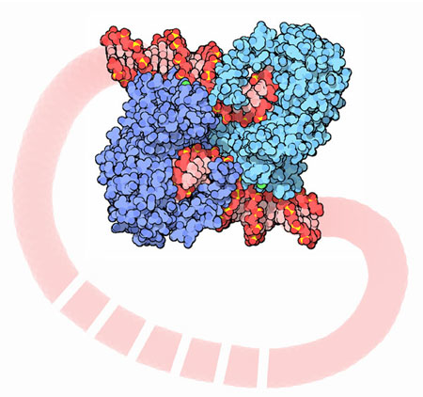
PDB: Molecule of the Month Transposase by David S. Goodsell http://www.pdb.org/pdb/static.do?p=education_discussion/molecule_of_the_month/pdb84_1.html
Bacterial transposase (PDB entry 1muh) that moves a transposon called Tn5. The transposition starts when two copies of enzyme bind to the DNA at the two ends of the transposon. Then, the two ends are brought together, closing the transposon into a big loop, and the transposase cuts the DNA at both ends.

Slide 26
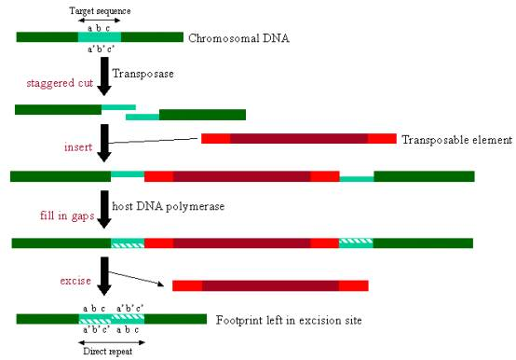
InterPro: Transposase By Jennifer McDowall http://www.ebi.ac.uk/interpro/potm/2006_12/Page1.htm

Slide 27
1muh

Slide 28
Site-specific recombination
×
×

Slide 29
Site-specific recombination
×
×

Slide 30
Site-specific recombination with inversion
a
b
a
×
b
b
a

Slide 31
Partial exon repetition
100 bp
GENE: ribosomal protein L7a
4
5
6
7
EST: CF127429
3
4
5
6
7
8
6
5
Exons 5 and 6, pieces of which are repeated within the EST, are shown in color.
Short direct repeated sequence CACCAC inside exon 5 and 6 is shown as a gray bar with an arrow above it. This repeat lies precisely in the junction of partial exon
repetition in the EST clone.

Slide 32
Partial exon scrambling
A
Gene: hypoxia-inducible factor-3 alpha isoform b
2
3
4
5
6
100 bp
EST AU118844
1
2
4
5
6
3
4
5

Slide 33
Mammalian chromosomes are mosaic and resulted from numerous recombinations
Genomic maps of human and mouse at NCBI
http://www.ncbi.nlm.nih.gov/projects/homology/maps/

Slide 34
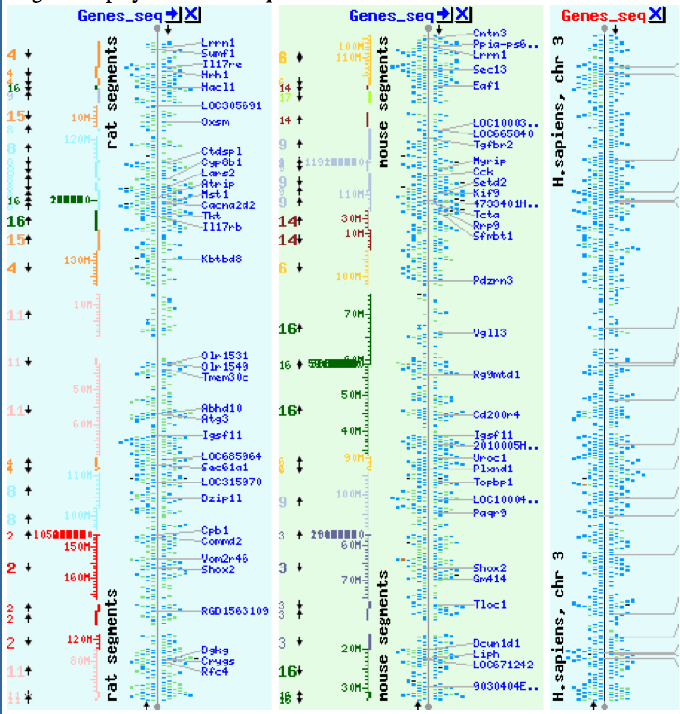
NCBI Homology maps http://www.ncbi.nlm.nih.gov/projects/homology/maps/

Slide 35
Segmental duplications between chromosomes in the human genome. The 24 panels show the 1077 duplicated blocks of genes, containing 10,310 pairs of genes in total.

Slide 36
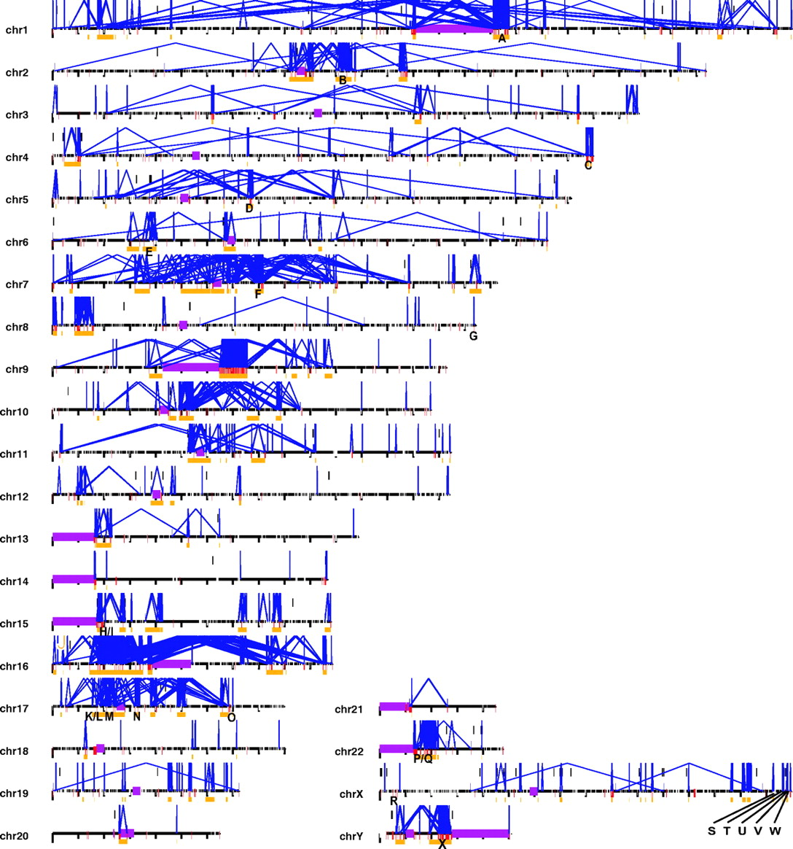
Figure 2 Patterns of intrachromosomal and interchromosomal duplication (≥10 kb; ≥95%).
J A Bailey et al. Science 2002;297:1003-1007
Published by AAAS
Notes:
Patterns of intrachromosomal and interchromosomal duplication (≥10 kb; ≥95%). The graphic shows a genome-wide view of intrachromosomal (blue, with connecting lines) and interchromosomal (red bars) segmental duplications. Purple bars represent areas (acrocentric chromosomal arms, heterochromatin satellite DNA, and centromeres) not targeted as part of the Human Genome Project. Unique regions (≥50 kb and <10 Mb) of the genome encompassed by intrachromosomal duplications (≥95% sequence identity and ≥10 kb) are shown as gold bars. Such regions are typically associated with recurrent chromosomal structural rearrangements associated with genetic disease. A total of 169 regions (∼298 Mb of sequence) were identified as potential hot spots for genomic rearrangement. Twenty-four of these regions (labeled A to X) correspond to known genomic disorders: (A) Gaucher disease, (B) familial juvenile nephronophthisis, (C) fascioscapulo- humeral muscular dystrophy, (D) spinal muscular atrophy, (E) congenital adrenal hyperplasia III, (F) Williams-Beuren syndrome, (G) glucocorticoid-remediable aldosteronism, (H) Prader-Willi syndrome, (I) Angelman syndrome, (J) polycystic kidney disease, (K) Charcot-Marie-Tooth disease type 1A, (L) hereditary neuropathy with liability to pressure palsies, (M) Smith-Magenis syndrome, (N) neurofibromatosis, (O) pituitary dwarfism, (P) cat eye syndrome, (Q) DiGeorge/velocardiofacial syndrome, (R) ichthyosis, (S) Hunter syndrome (mucopolysaccharidosis type II), (T) red-green color blindness, (U) Emery-Dreifuss muscular dystrophy, (V) incontinentia pigmenti, (W) hemophilia A, and (X) azoospermia (AZFc region). Specific regions corresponding to each region can be found athttp://humanparalogy.cwru.edu/SDD/hotspots.htm. For details about patterns of interchromosomal duplications, see fig. S4.

Slide 37
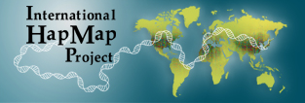
Hot and cold spots for homologous recombination http://hapmap.ncbi.nlm.nih.gov/downloads/recombination/
Physical map (position in nucleotides) | Ratio [ cM / Mb] | Genetic map Position in centiMorgans
1640705 1.2602869151 1.0447704391
1643532 1.1823811803 1.0483332702
0.002827 Mb
0.003563 cM
2,108,219 11.3590716646 1.873665397
1,021,403 0.2587157271 0.4358957457

Slide 38
Origin of novel genes by DNA recombination
Walter Gilbert
The inventor of DNA sequencing technique ( Nobel Prize 1982)
Exon shuffling theory 1978

Slide 39
Exon shuffling
Short ancient genes
Modern gene
Common case

Slide 40
Protein subcellular relocalization:a new perspective on the origin of novel genes. Byun-McKay S A. and Geeta R. 2007, TEE 22:338-344.

Slide 41
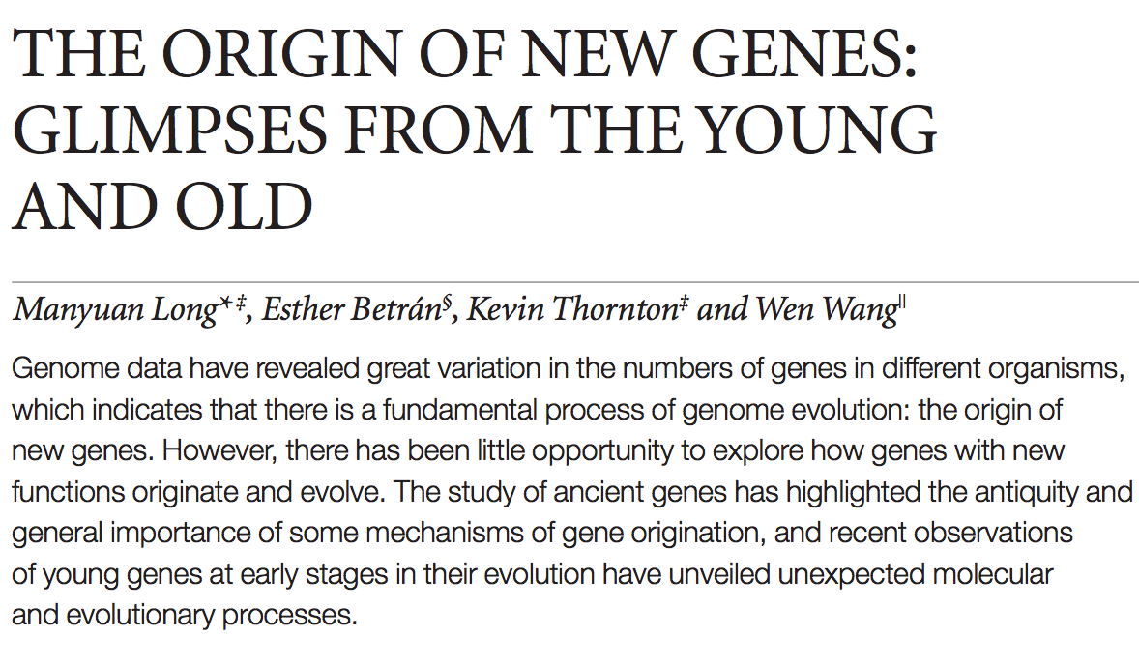
The origin of new genes: glimpses from the young and old. Long M, Betrán E, Thornton K, Wang W. Nat Rev Genet. 2003;4:865-75.

Slide 44
CONCLUSIONS
DNA recombination is a enormously important process for all species from viruses to humans.
Recombination is an intrinsic property of nucleic acids and these molecules are susceptible to joining their ends. In addition, evolution invented thousands of proteins that assist DNA recombination and became crucial for cell functioning.
Recombination is a major engine of evolution.

Slide 45
Homework assignment
Find the hottest and the coldest spot for recombination in one of the human chromosomes. Report your chromosome, the position, and recombination rate. (see slide 37)
Compare the structure of the EST with the structure of its gene. Describe the difference between the EST and the expected mRNA transcript of the gene and the reason for it. SEQUENCES: BP214078 and CO245739 (second character is “ou”, not zero)
(see slide 31-32)
(To get the sequence (e.g. BP214078) from NCBI web choose “Nucleotide” option). Use on-line BLAST to decipher the structure of BP214078 and CO245739

Slide 46
Hot and cold spots for homologous recombination http://hapmap.ncbi.nlm.nih.gov/downloads/recombination/
Physical map (position in nucleotides) | Ratio [ cM / Mb] | Genetic map Position in centiMorgans
1640705 1.2602869151 1.0447704391
1643532 1.1823811803 1.0483332702
0.002827 Mb
0.003563 cM
2,108,219 11.3590716646 1.873665397
1,021,403 0.2587157271 0.4358957457

