Slide 1


tranSMART
KNOWLEDGE MANAGEMENT PLATFORM for TRANSLATIONAL MEDICINE
Natalia Boukharov
Sr. Scientist
Thomson Reuters IP & Sciences
Clinical Data Management
February 5th, 2016

Slide 2
AGENDA
tranSMART Introduction
Browse & Search Interface
Analyze – Basic Functions
Analyze – Advanced Workflows

Slide 3
tranSMART INTRO

Slide 4
OVERVIEW
The tranSMART platform is an open-source, community-driven knowledge management platform for translational medicine
  Originally developed by scientists at Johnson & Johnson and Recombinant Data Corporation in 2009 and released as an open-source software platform in 2012
  Collaboratively developed by more than 100 computer scientists from more than 20 organizations from around the world.
  Managed by the tranSMART Foundation, a non-profit organization
tranSMART platform is a single, integrated analytics and data-sharing platform for clinical and translational research that is open to every scientist around the globe
tranSMART is supporting multiple data types
The platform has been downloaded by more than 150 academic, industrial, governmental, and private research organizations, as well as by key vendors and suppliers
  Clinical data
  Gene expression data
  RNAseq
  miRNA (qPCR and Sequence based)
  Small genomic variants (VCF)
  aCGH
  Proteomics
  Metabolomics
Notes:
tranSMART history
tranSMART was first developed by JnJ in 2009 and released as an open source in 2012.
Since then, it has became a standard and trendsetter in collaborative translational medicine platform.
Thomson Reuters team members (originally, as GeneGo) have been engaged in tranSMART since the beginning at JnJ as a data curator.

Slide 5































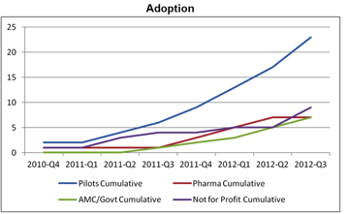
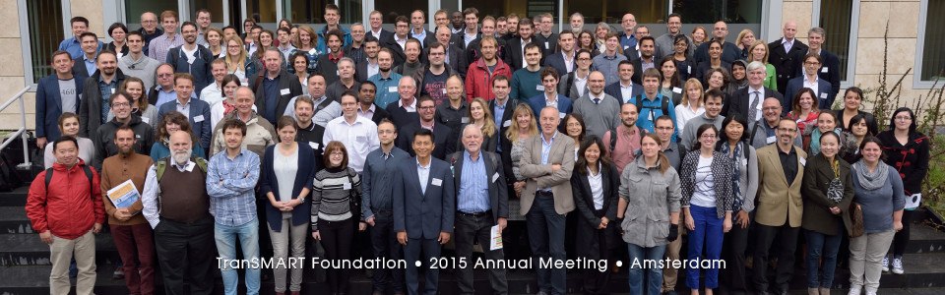
tranSMART COMMUNITY
Group photo from www.transmartfoundation.org
Notes:
Further tranSMART evolution is supported by a exponentially growing community of developers and biologists and an increasing number of users in different sectors: pharmaceutical companies, government organizations, non-profit organizations, academics.
Active community – several community meetings and on-going developer collaboration

Slide 6
transSMART AIDS ALL STAGES OF TRANSLATIONAL RESEARCH
tranSMART aggregates data from pre-clinical in vitro/in vivo assays to late phase clinical trials, and serves as a true translational platform by spanning all stages of disease research and drug discovery and development
By integrating clinical data and biomarker data, tranSMART enables scientists to derive and test hypothesis easily and quickly
From Bench:
  Hypothesis generation
  Preclinical data analysis
To Bedside:
  Clinical trial design
  Efficacy endpoints
  Evaluating drug functionality

Slide 7
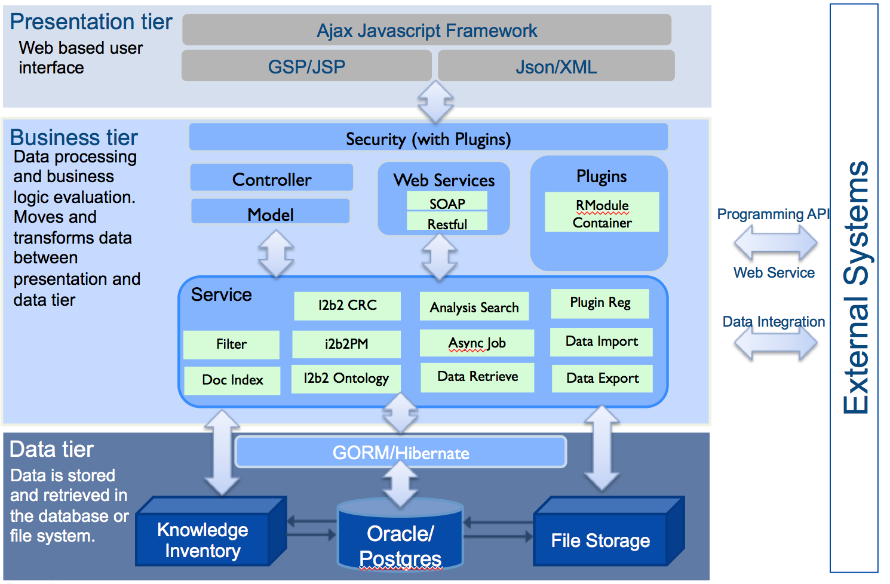
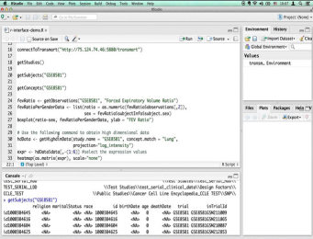
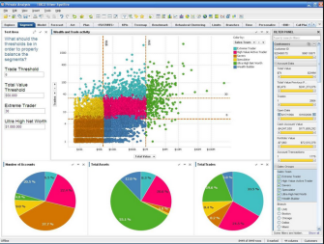
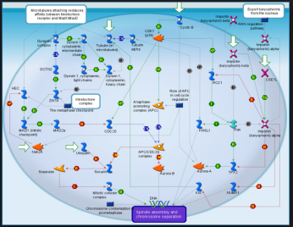
THE ARCHITECTURE
R Interface
Spotfire
MetaCore
Notes:
The tranSMART Knowledge Management Platform combines a data repository with intuitive search capabilities and analysis tools. tranSMART provides researchers a single self-service web portal with access to phenotypic, ‘omics’, and unstructured text-based data from multiple internal and external sources, aligned to allow exploration of many aspects of a potential hypothesis. tranSMART can help scientists develop and refine research hypotheses by investigating correlations between genetic and phenotypic data, and assessing their analytical results in the context of published literature and other work.

Slide 8
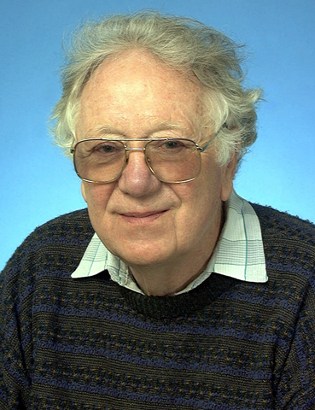
tranSMART:
A TOOL FOR “WEEKEND SCIENCE” OR ANYTIME!
Oliver Smithies - discovered methods of homologous recombination, the foundation of transgenic and knockout mice
  Weekends are the days when you take risks, you ask the questions that you are too busy to think of during the week, you wonder
  (He is now 90 years old - and still works in the lab 7 days a week…)
For the rest of us…
  tranSMART allows a researcher to hypothesize and quickly test these hypotheses using clinical and molecular data
Oliver Smithies,
University of North Carolina
Nobel Prize in Physiology/ Medicine, 2007
Notes:
All of his greatest work came out of his weekend experimentation

Slide 9


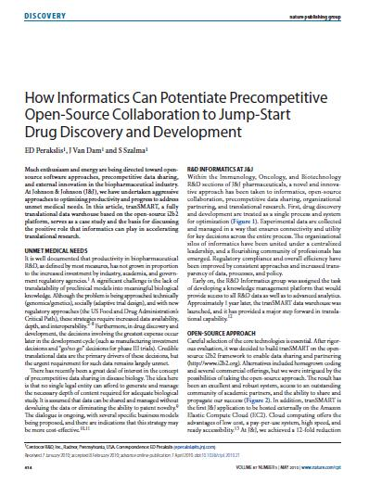
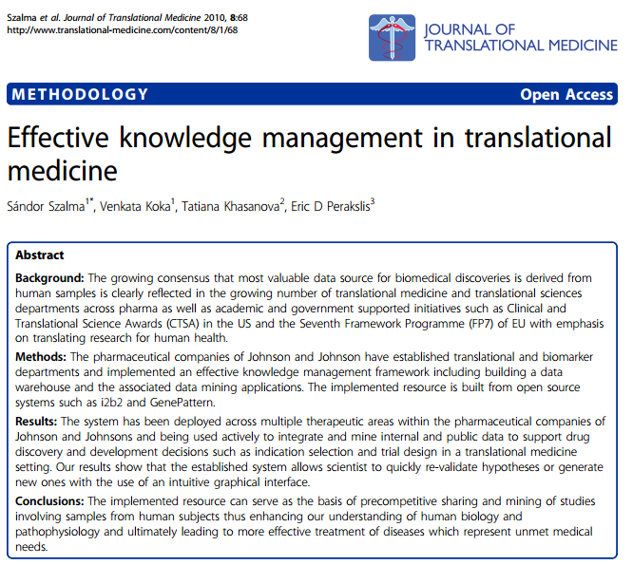
SUMMARY - WHAT IS tranSMART?
Open source innovation
Award winning platform for precompetitive collaboration and private-public partnerships in drug discovery and life sciences
The Standard & Trendsetter in
Translational Research
E.D. Perakslis, J. Van Dam, S. Szalma; Clin Pharmacol Ther 87: 614-616 (2010)
S. Szalma, V. Koka, T. Khasanova, E.D. Perakslis; Journal of Translational Medicine, 8:68 (2010)
Notes:
tranSMART history
tranSMART was first developed by JnJ in 2009 and released as an open source in 2012.
Since then, it has became a standard and trendsetter in collaborative translational medicine platform.
Thomson Reuters team members (originally, as GeneGo) have been engaged in tranSMART since the beginning at JnJ as a data curator.

Slide 10
tranSMART
PUBLIC INSTANCE AND DATA

Slide 11
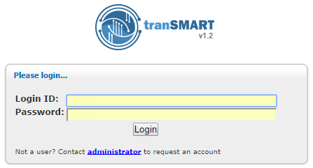
CURRENT VERSION IS V1.2.4
http://75.124.74.64/transmart/
account: guest
password: transmart2015
https://public.etriks.org/transmart/datasetExplorer
No login required

Slide 12
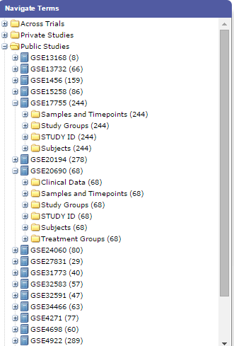
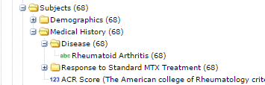
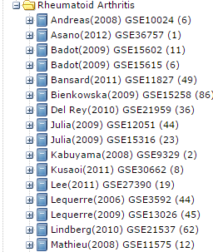
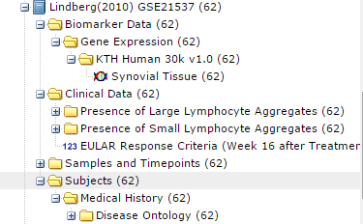
GEO STUDIES FOR MULTIPLE DISEASES
http://75.124.74.64/transmart/
https://public.etriks.org/transmart/datasetExplorer

Slide 13
tranSMART
BROWSE & SEARCH

Slide 14
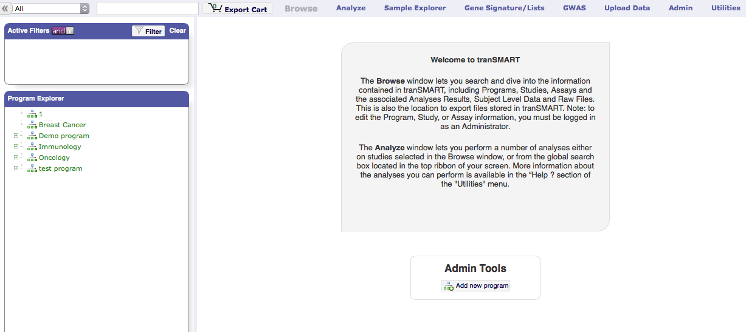
tranSMART
LANDING PAGE (BROWSE TAB)
Getting started
Search box
Tab selection bar
Filtering Panel
Facilitate the selection of the appropriate study from the library of studies loaded on the server.
Program Explorer
The program explorer allows the browsing of study meta-data, and exporting of files associated with the study of interest.
Notes:
The londing page available after providing login credentials for the server is the Browse tab of the tranSMART web interface. Its main components are:
A text search field
A Filtering field
The Program Explorer
A tab selection bar
The primary purposes of the browse tab is to facilitate the selection of the appropriate study from the library of studies loaded on the server. The program explorer allows the browsing of study meta-data, and the export of arbitrary files associated with a target study of interest.

Slide 15
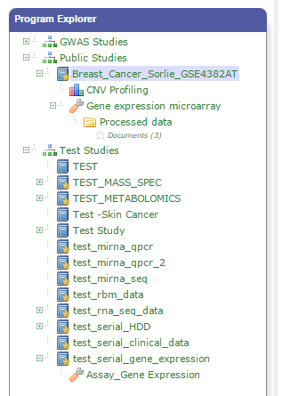









BROWSE AND SEARCH
Enable powerful search for datasets loaded in tranSMART
Organization in Browse is based on ISA standard:
  Program > Study > Assay / Analysis / Files
Program overview
(Browse tab)
Program
Study 1
Study 2
Study 3
Study overview
(Browse tab)
Assay
Analysis
(Findings)
File Folder
(e.g. Study Protocol)
Assay, Analysis,
Folder overview
(Browse tab)
Processed data
(subject-level data)
Processed data
(Analyze tab)
Folder overview
(Browse tab)
Raw data
Other files
(images,...)
Notes:
http://www.isa-tools.org/format.html
Interoperability Solutions for European Public Administrations
tranSMART provides five elements to facilitate organization of studies. Elements of the top layer are referred to as “Programs” (1). A given Program may contain one or more “Studies”(2). And each study may contain metadata (3), and Analysis types (4), Assay Types (5), and folders(6).

Slide 16
Getting started
tranSMART
TAB SELECTION BAR
Tab selection bar
Browse: Study selection, meta data, and file export
Analyze: Various analytic workflows
Sample Explorer*: Throwing errors ATM
Gene Signatures/Lists: User defined elements used in analyses
GWAS: a link that launches a web-stat applet called GWAVA
Upload Data: Upload data into GWAS, limited functionality currently
Admin: do not touch please.
Utilities: logout.

Slide 17
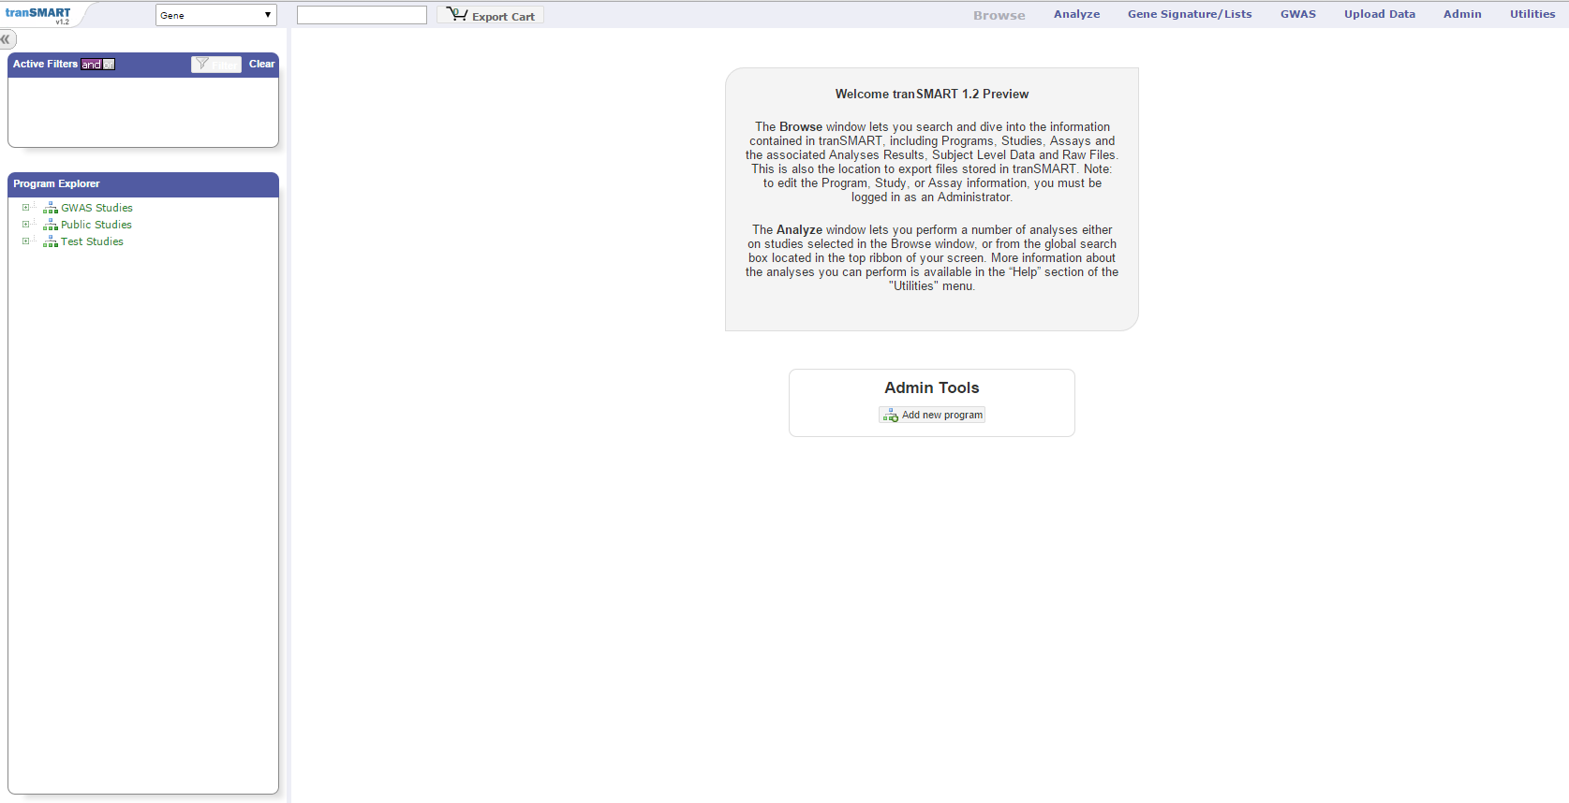
BROWSE AND SEARCH
Navigate within Programs > Studies > Assays / Analysis / file Folders
Search datasets using dictionaries
Create new Programs > Studies > Assays / File Folders, and annotate (tag) them
Search and Export files
Notes:
Browse – a tab where all studies are listed and described
Global search and filter applies to both Browse and Analyze tabs

Slide 18
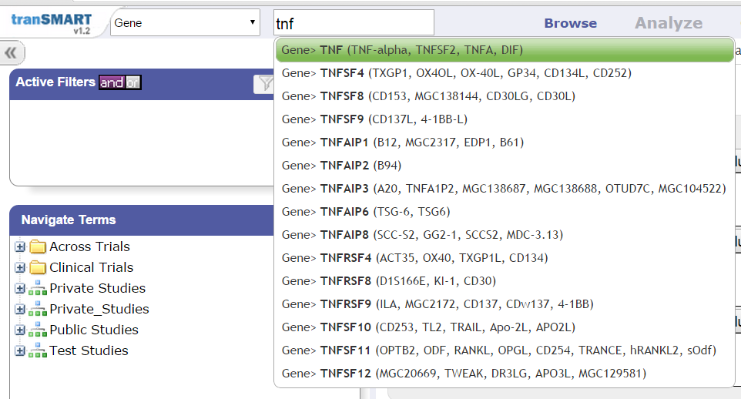
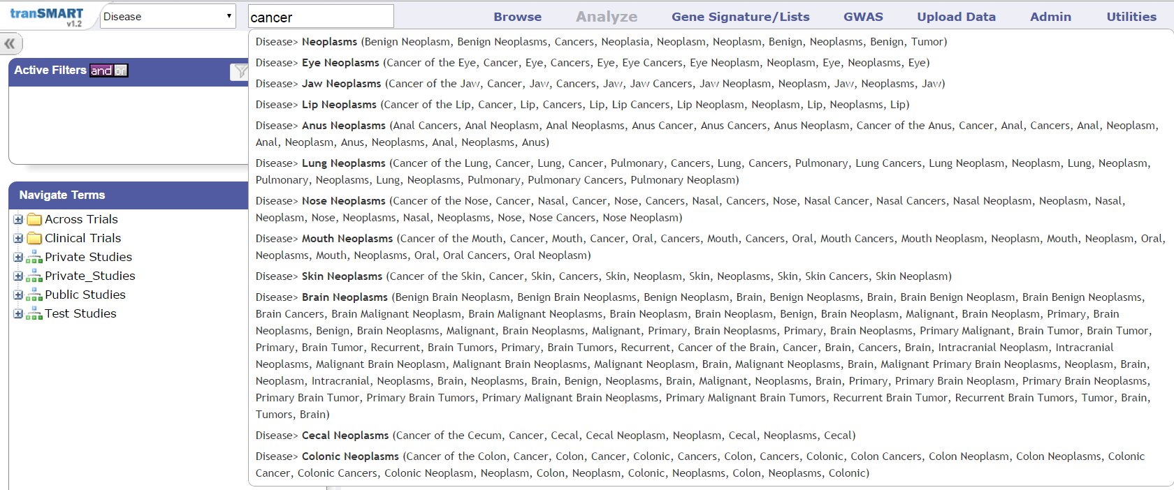
BROWSE AND SEARCH
Ontology-enabled search
Search across-studies metadata
Synonyms and auto-complete

Slide 19
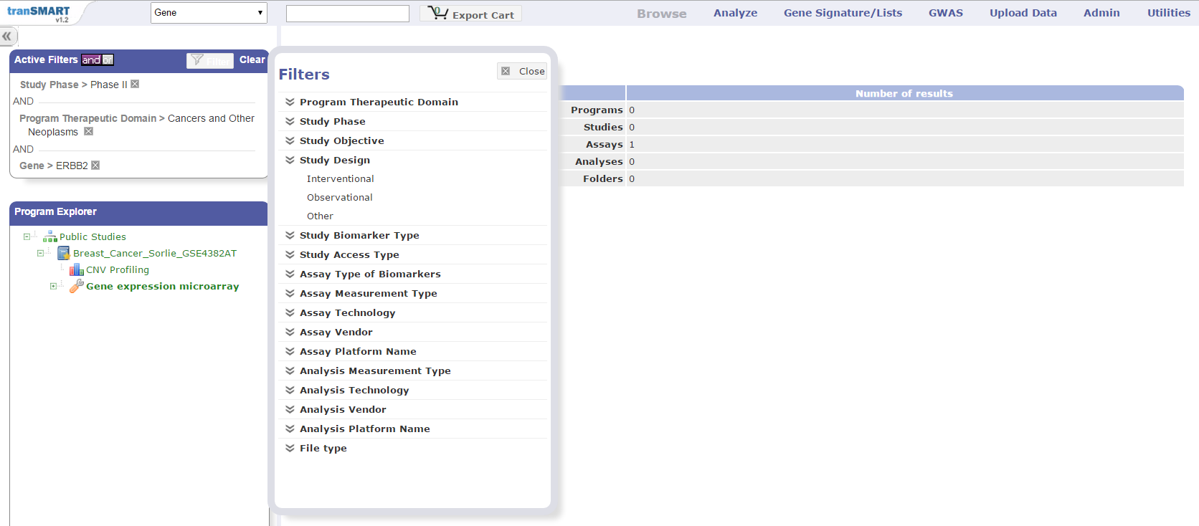
BROWSE AND SEARCH
Switch between “AND” “OR”
Search Results
Search
Search box
Filters
Automatically updates Program Explorer
Ontology-enabled search
Search across-studies metadata

Slide 20
tranSMART
ANALYZE
BASIC FUNCTIONS

Slide 21
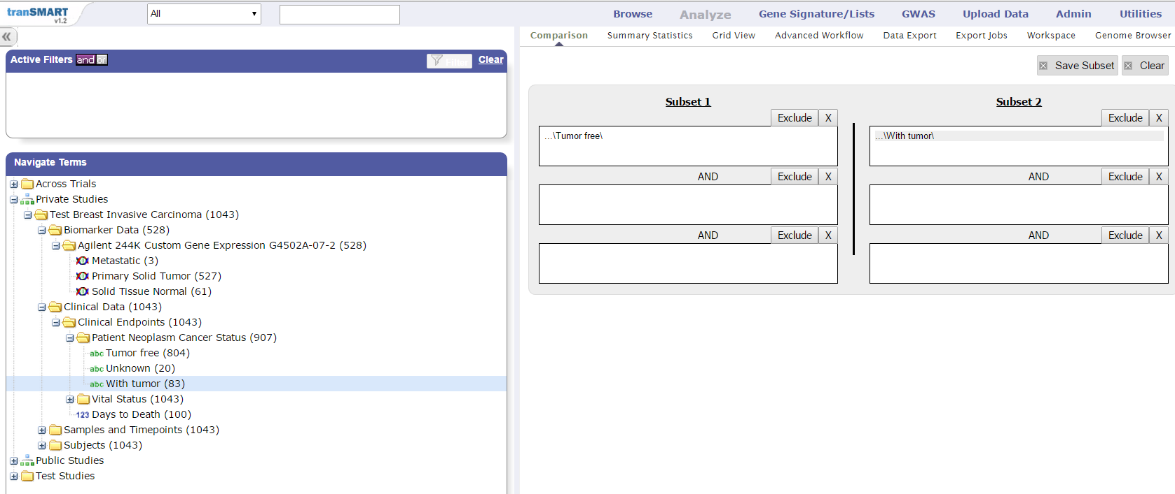
tranSMART
COHORT ANALYSIS
Select patient cohort
Drag & Drop
High Dimensional Data (HDD)
Categorical Variable
Low Dimensional Data (LDD)
Numerical Variable

Slide 22
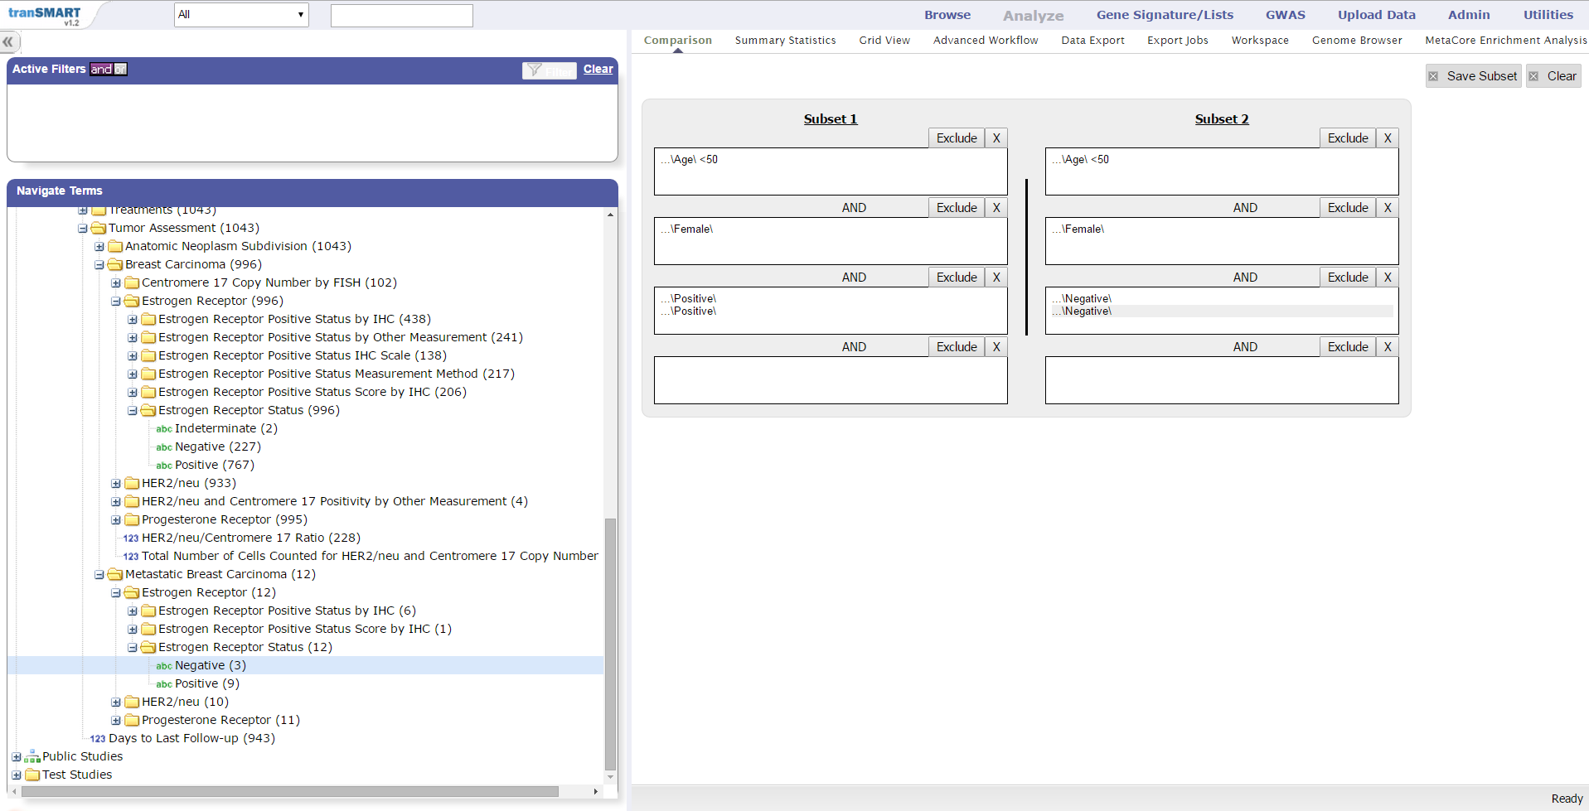

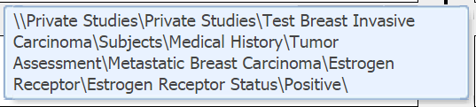
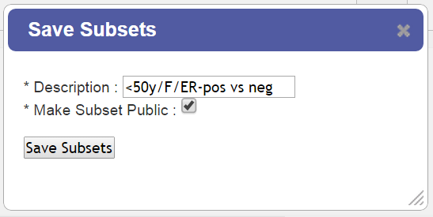
tranSMART
COHORT ANALYSIS: SAVE QUERY
Drag & Drop
Mouse over variable to see full variable path

Slide 23
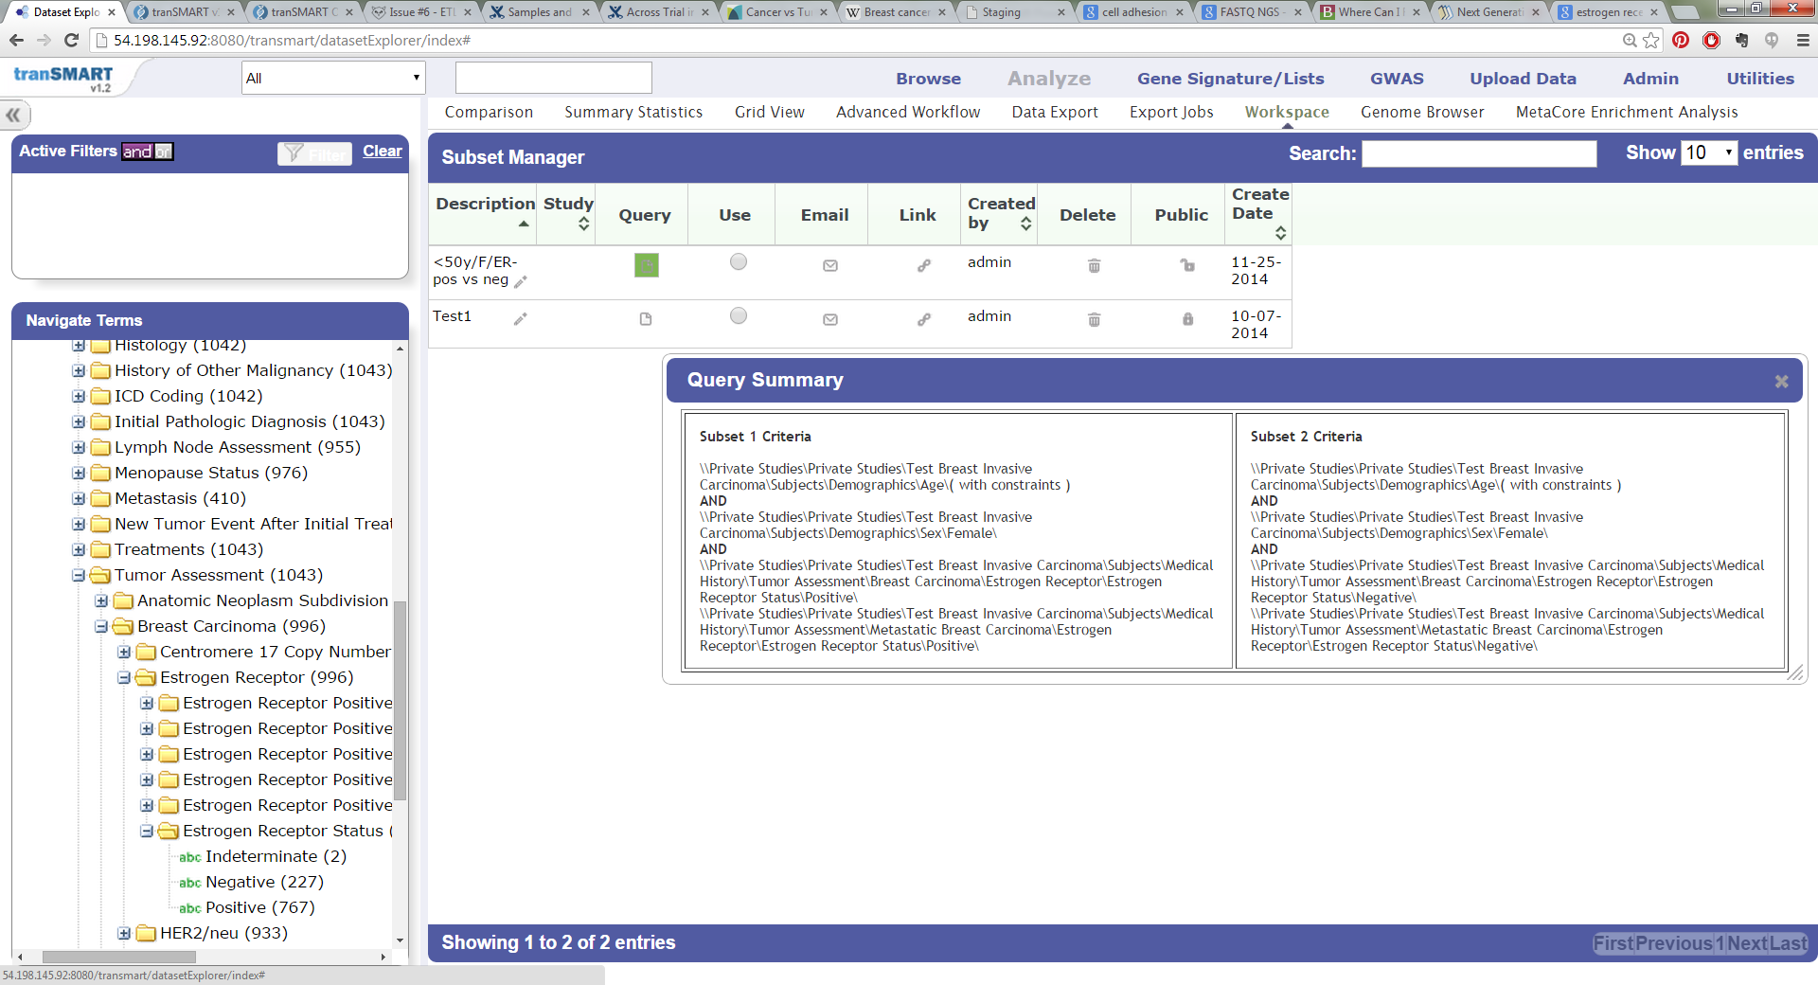
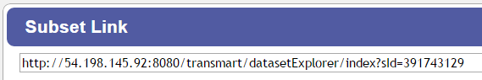
tranSMART
COHORT ANALYSIS: SAVE QUERY
Load query

Slide 24
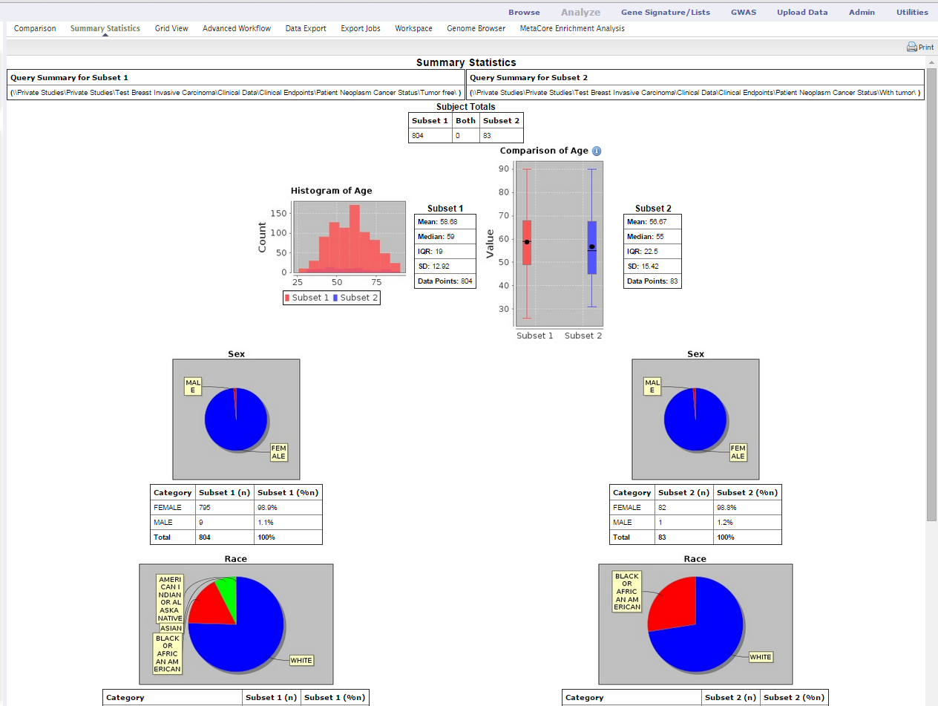
tranSMART
COHORT ANALYSIS: SUMMARY STATISTICS
Summary Statistics
Query description
Subset 1
Subset 2
Demographics
Age
Sex
Race

Slide 25
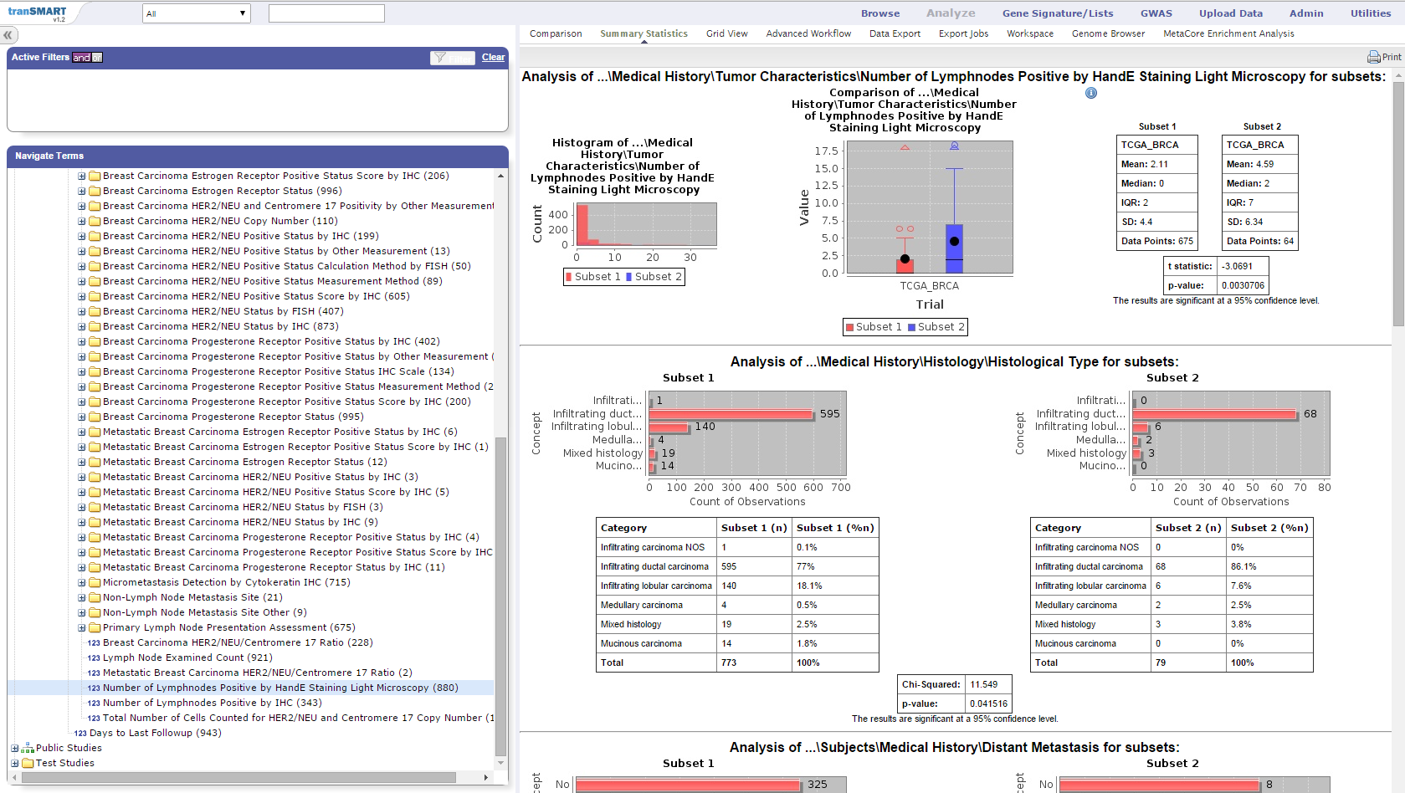
tranSMART
COHORT ANALYSIS: SUMMARY STATISTICS
Compare patient cohorts by “drag & drop” variables from navigation tree
Numerical variable
t-test
Drag & Drop
Categorical variable
Chi-squared test

Slide 26
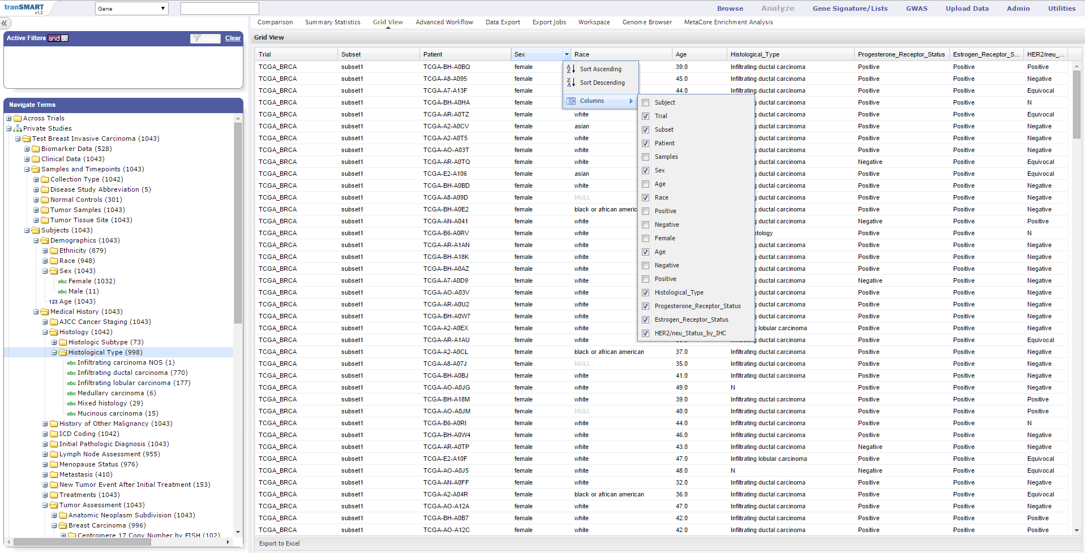
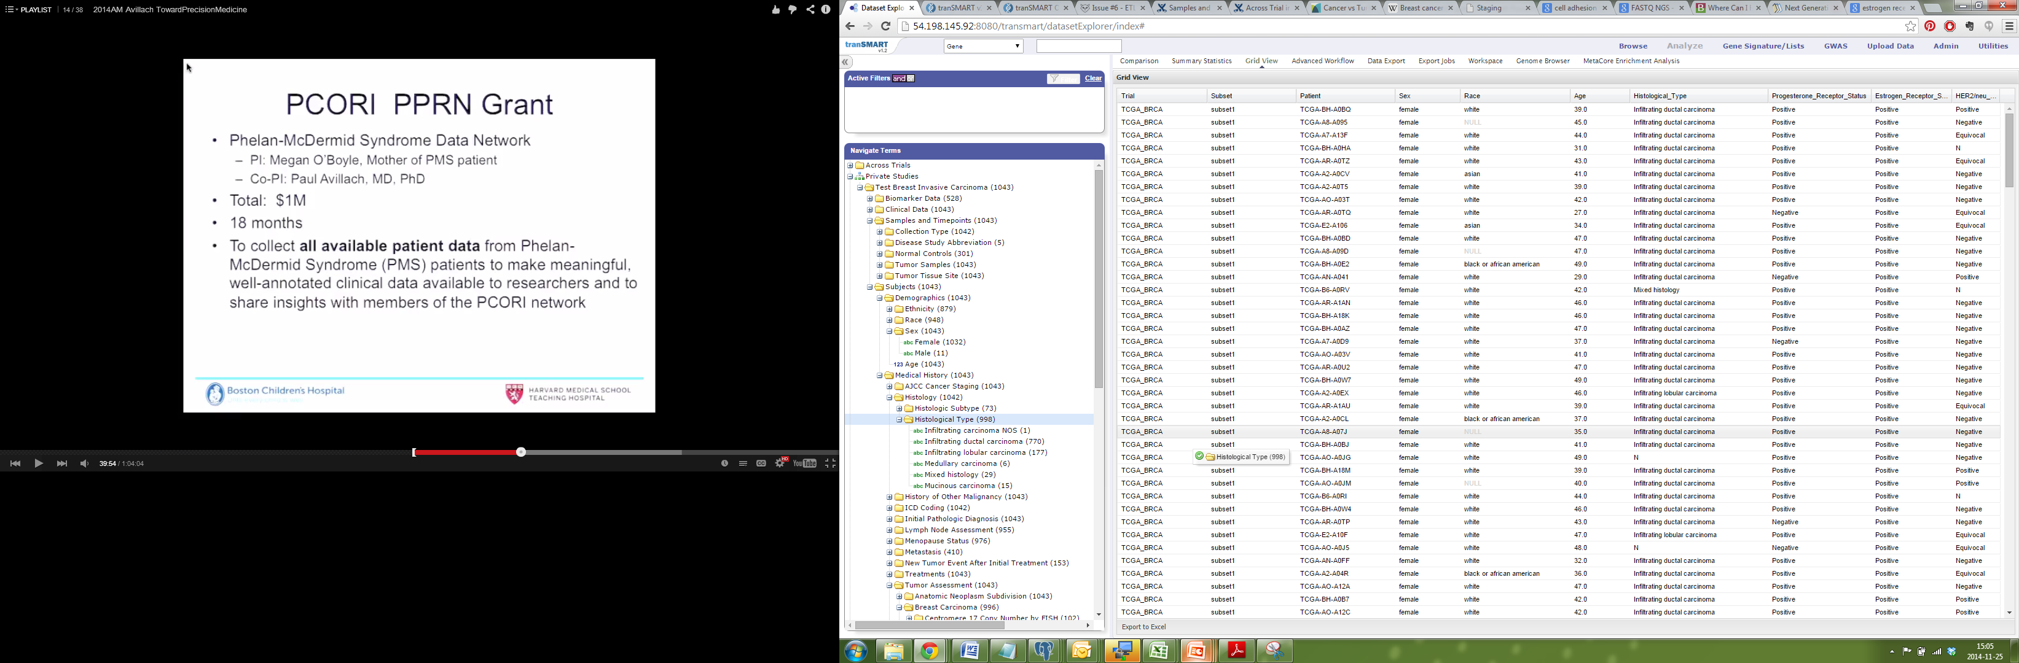
tranSMART
COHORT ANALYSIS: GRID VIEW
Subject-level data
Sort columns
Add variables by Drag & Drop into the Grid View
Variables used to build Patient Cohorts and included in Summary Statistics analysis will be displayed at a patient-level in the Grid View
Export table to Excel
Notes:
So, you have made an interesting cohort, and you have some summary statistics on the relevant subjects, the question then becomes: can I export the data related to these clinically defined cohorts for further analysis offline, or to send to a collaborator. This can be accomplished by clicking on the “Grid View” subtab. Columns can be added by dragging other concepts from the Navigate Terms Hierarchy into the grid (in this case, the node, Lymph Node Involvement), or removed through a pull down “column” menu. Data can be copied to the clipboard or exported to excel.

Slide 27
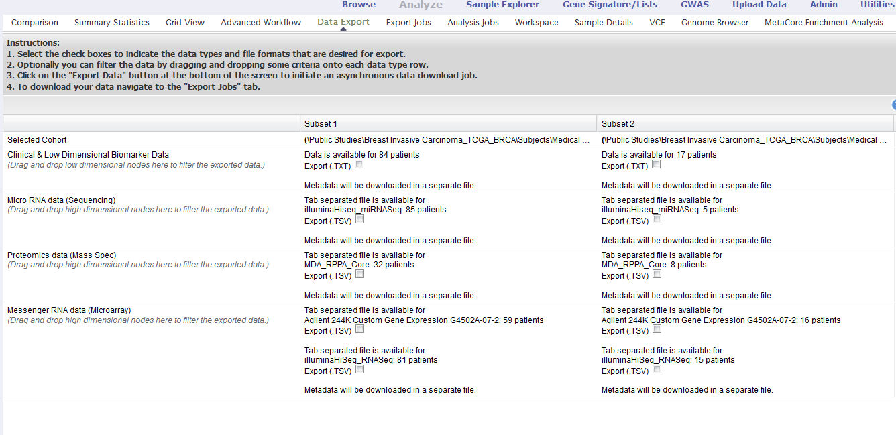
tranSMART: DATA EXPORT
Notes:
The Data Export subtab allows to download data, including gene expression data etc.. Data can b filtered by dragging concepts into the selection pane from the Navigate Terms Hierarchy. tM has many flexible data export options.

Slide 28
tranSMART
ANALYZE
ADVANCED WORKFLOWS

Slide 29
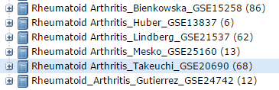
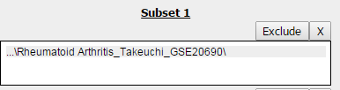
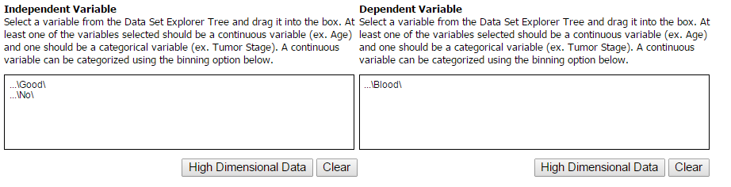
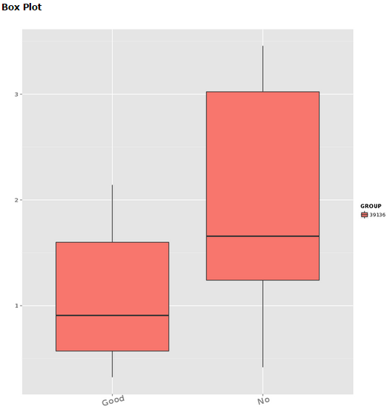
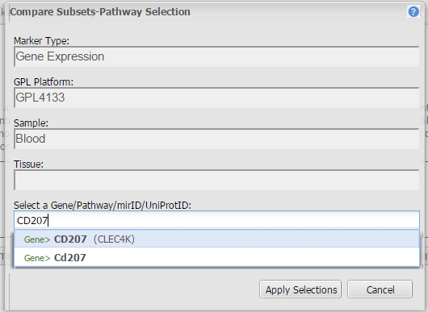
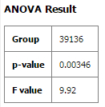
tranSMART: ADVANCED WORKFLOW
BOX PLOT with ANOVA
TNF
CD207

Slide 30
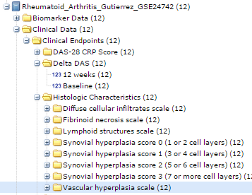
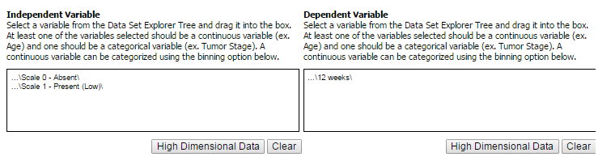
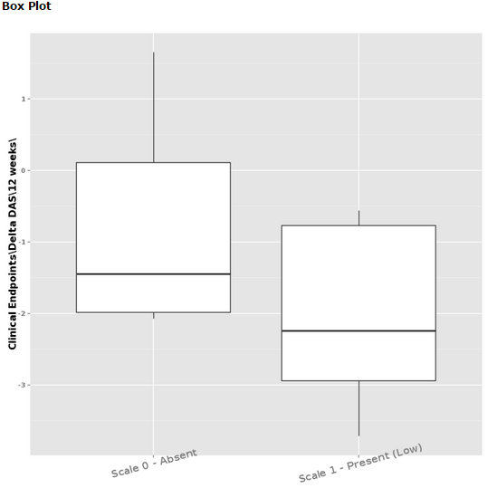
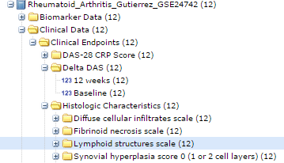
tranSMART: ADVANCED WORKFLOW
BOX PLOT with ANOVA

Slide 31
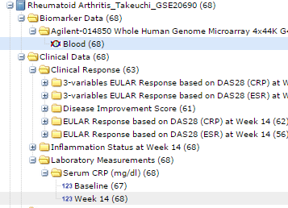
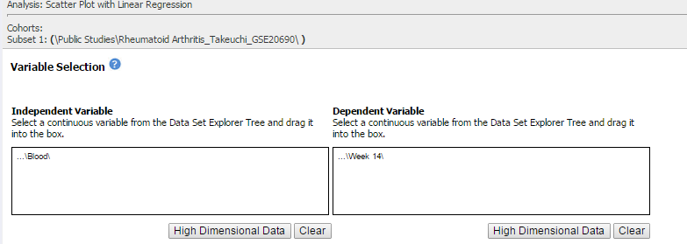
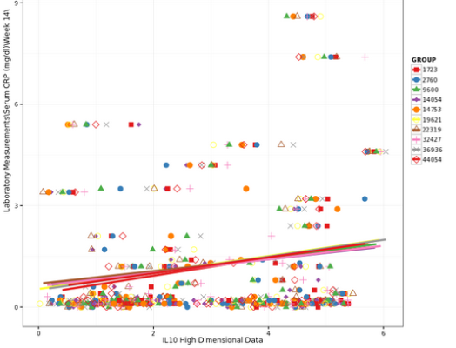
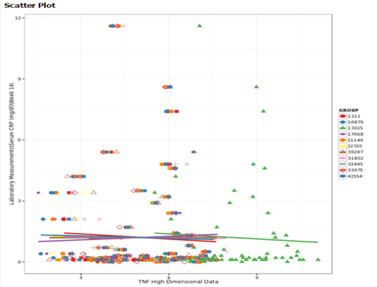
tranSMART: ADVANCED WORKFLOW
SCATTER PLOT with LINEAR REGRESSION
CRP at week 14 versus TNF or IL10 at baseline

Slide 32

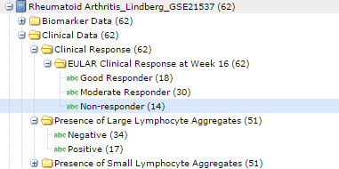
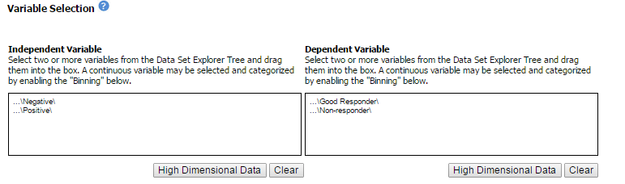
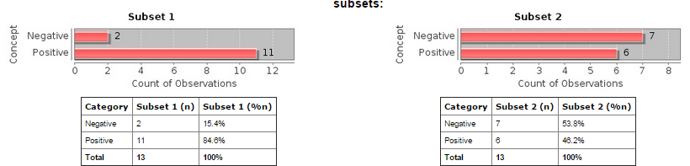
tranSMART: ADVANCED WORKFLOW
FISHER TEST
Lymphocyte aggregates vs response

Slide 33
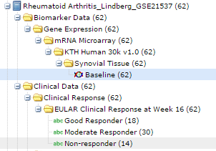
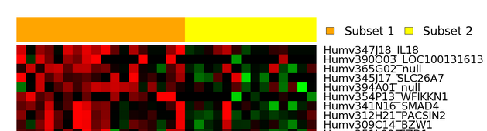
tranSMART: ADVANCED WOKFLOW
MARKER SELECTION
Good Responders vs Non Responders

Slide 34







tranSMART
ADVANCED WORKFLOW
CORRELATION ANALYSIS
GSE7390
Correlation between Nottingham Prognostic Index and Adjuvant Online Prognostic Tools
  PMID: 25628047

Slide 35



tranSMART
ADVANCED WORKFLOW
LOGISTIC REGRESSION
GSE9782
Subset 1: (\Public Studies\Multiple Myeloma_Mulligan_GSE9782\ )
Independent variable – Time to progression
Dependent variable – Treatment Groups: Bortezomib and Dexamethasone
Bortezomib treatment correlates with longer time to progression periods.
Notes:
This analysis (logistic regression) treats a binary outcome as the dependent variable and displays the probability of that outcome as a function of the value of a continuous measurement. To run this analysis select a clinical or biomarker variable as the independent variable and a binary outcome (sensible examples include metastatic vs. disease-free, alive vs. dead, diabetic vs. healthy, etc.) as the dependent variable. Bin the dependent variable if you choose a continuous numeric data type.
Example: In multiple myeloma patients does vital status correlates to time to progression?

Slide 36





GSE20690
  Drug response prediction of RA patients in retrospective study
tranSMART
ADVANCED WORKFLOW
HIERARCHICAL CLUSTERING
PMID: 19577537
Prediction of Infliximab response using transcriptome analysis of white blood cells.
Top 10 markers that showed predictive values for differentiating ‘‘no inﬂammation” (NI) from ‘‘residual inﬂammation” (RI)
NI
RI

Slide 37

R interface
Enable direct access to tranSMART database tables
  Eliminates some limitations of web interface, E.g. inability to perform multi-study queries and analyses.
  Provide a connection to the R environment, including diverse analysis packages
Sample functions
  getDistinctConcepts – given a keyword/string, returns study codes for matching clinical concepts in the tranSMART database
  getGEXdata – given study codes, gets Gene Expression data from the tranSMART database.
> br_concepts <- transmart.getDistinctConcepts(,'Breast_Cancer')
> study_list <- unique(br_concepts$STUDYCODE)
> ITGB2_GEP_BR2 <-
  transmart.getGEXData(study_list, gene.list='ITGB2', data.pivot=F)
> hist(ITGB2_GEP_BR2$LOG_INTENSITY, br=50, xlim=c(5,12), main="All ITGB2 GEP", xlab="GEP")

