Slide 1
Machine Learning, Bio-informatics and Weka
A Lecture by Dr. Gursel Serpen
Associate Professor & Director of Artificial Intelligence Lab
Electrical Engineering and Computer Science
University of Toledo
February 2017

Slide 2
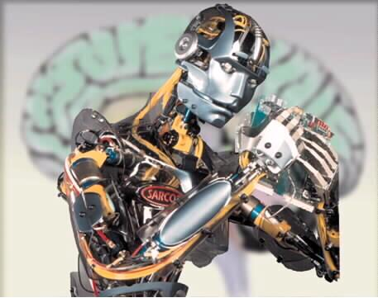




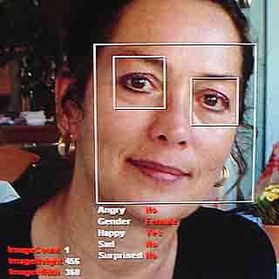
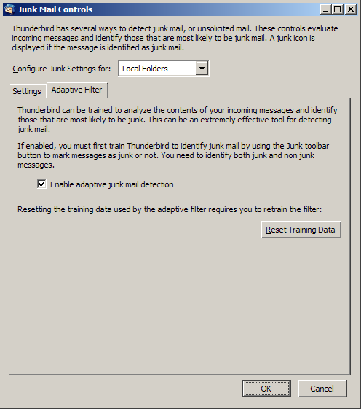

What is Machine Learning?

Slide 3
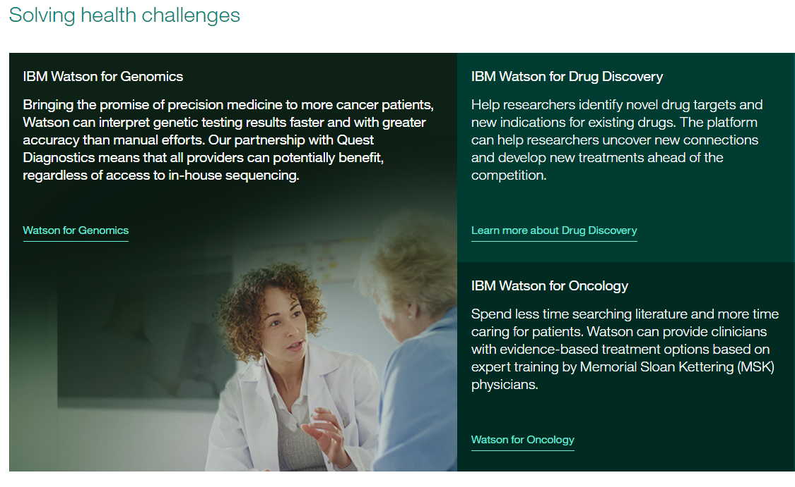
What is Machine Learning?

Slide 4
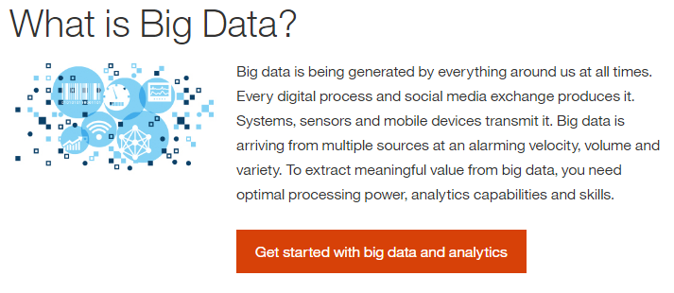
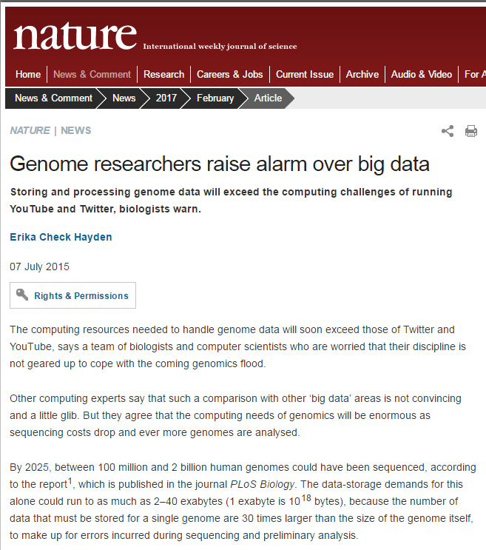
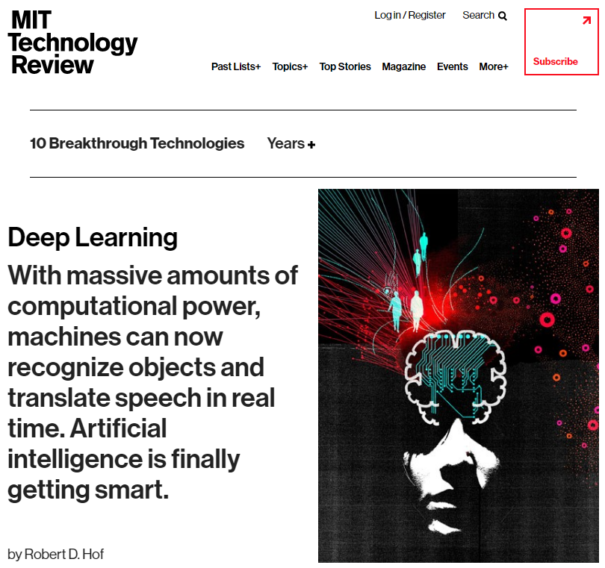
Big Data

Slide 5
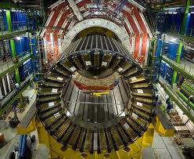
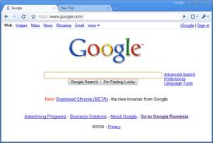
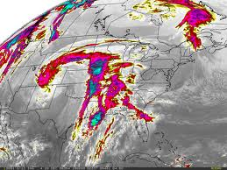
Learning from Data
The world is driven by data.
Germany’s climate research centre generates 10 petabytes per year
Google processes 24 petabytes per day
The Large Hadron Collider produces 60 gigabytes per minute (~12 DVDs)
There are over 50m credit card transactions a day in the US alone.

Slide 6
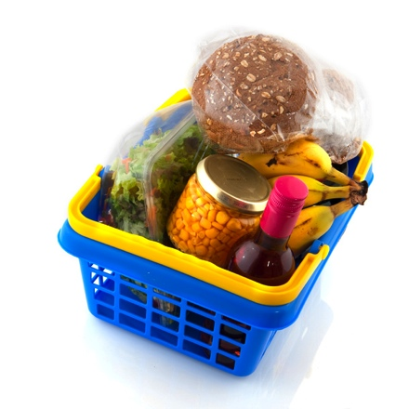
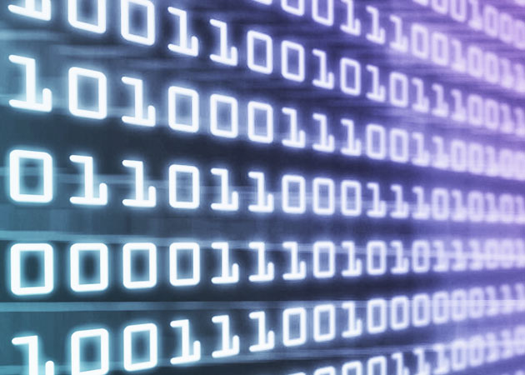
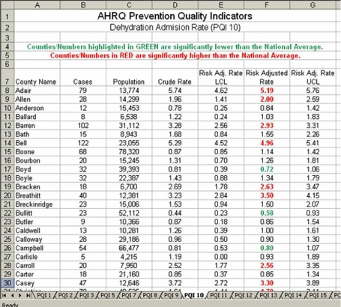
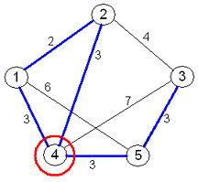
Learning from Data
Data is recorded from some real-world phenomenon.
What might we want to do with that data?
Prediction
- what can we predict about this phenomenon?
Description
- how can we describe/understand this phenomenon in a new way?

Slide 7


Learning from Data
How can we extract knowledge from data to help humans take decisions?
How can we automate decisions from data?
How can we adapt systems dynamically to enable better user experiences?
Write code to explicitly
do the above tasks
Write code to make the computer
learn how to do the tasks

Slide 8
Machine Learning
Where does it fit? What is it not?
Artificial Intelligence
Statistics / Mathematics
Data Mining
Machine Learning
Computer Vision
Robotics
(No definition of a field is perfect – the diagram above is just one interpretation, mine ;-)

Slide 9
Coding Skills
Maths/Statistics
Knowledge
Machine Learning
Data Science
Software Engineer
Statistician
Specialist Domain Knowledge

Slide 10


Many applications are immensely hard to program directly.
These almost always turn out to be “pattern recognition” tasks.
1. Program the computer to do the pattern recognition task directly.
1. Program the computer to be able to learn from examples.
2. Provide “training” data.

Slide 11
Definition of Machine Learning
self-configuring data structures that allow a computer to do things that would be called “intelligent” if a human did it
“making computers behave like they do in the movies”

Slide 12
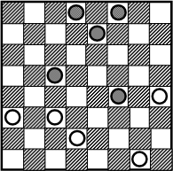
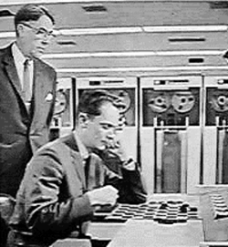
A Bit of History
Arthur Samuel (1959) wrote a program that learnt to play draughts (“checkers” if you’re American).

Slide 13
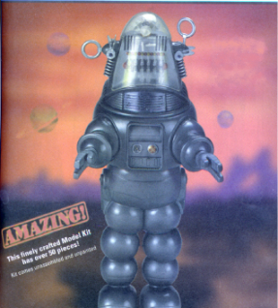
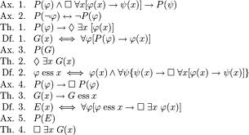
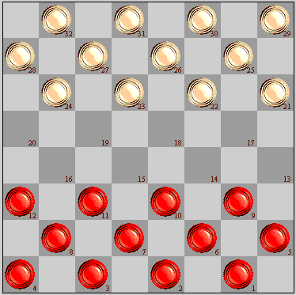
1940s
Human reasoning / logic first studied as a formal subject within mathematics (Claude Shannon, Kurt Godel et al).
1950s
The “Turing Test” is proposed: a test for true machine intelligence, expected to be passed by year 2000. Various game-playing programs built. 1956 “Dartmouth conference” coins the phrase “artificial intelligence”.
1960s
A.I. funding increased (mainly military). Famous quote: “Within a generation ... the problem of creating 'artificial intelligence' will substantially be solved."

Slide 14
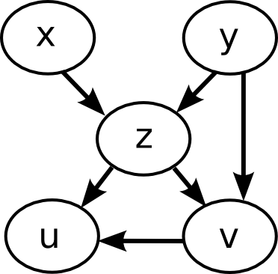
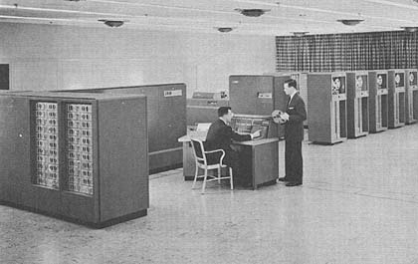
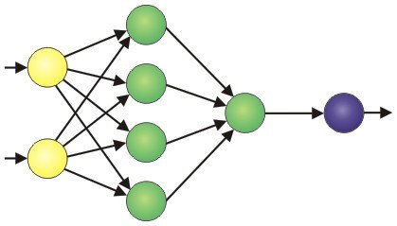

1970s
A.I. “winter”. Funding dries up as people realise it’s hard.
Limited computing power and dead-end frameworks.
1980s
Revival through bio-inspired algorithms: Neural networks, Genetic Algorithms.
A.I. promises the world – lots of commercial investment – mostly fails.
Rule based “expert systems” used in medical / legal professions.
1990s
AI diverges into separate fields: Computer Vision, Automated Reasoning, Planning systems, Natural Language processing, Machine Learning…
…Machine Learning begins to overlap with statistics / probability theory.

Slide 15
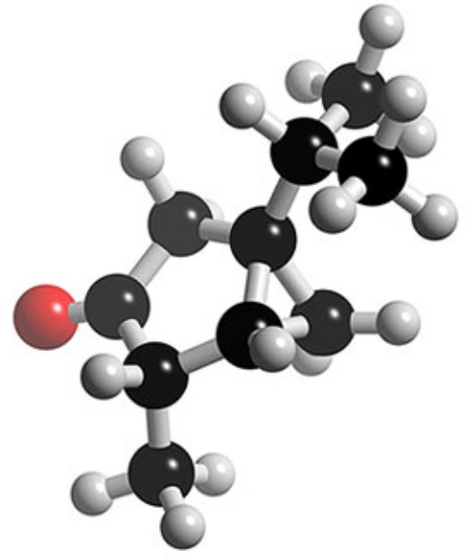
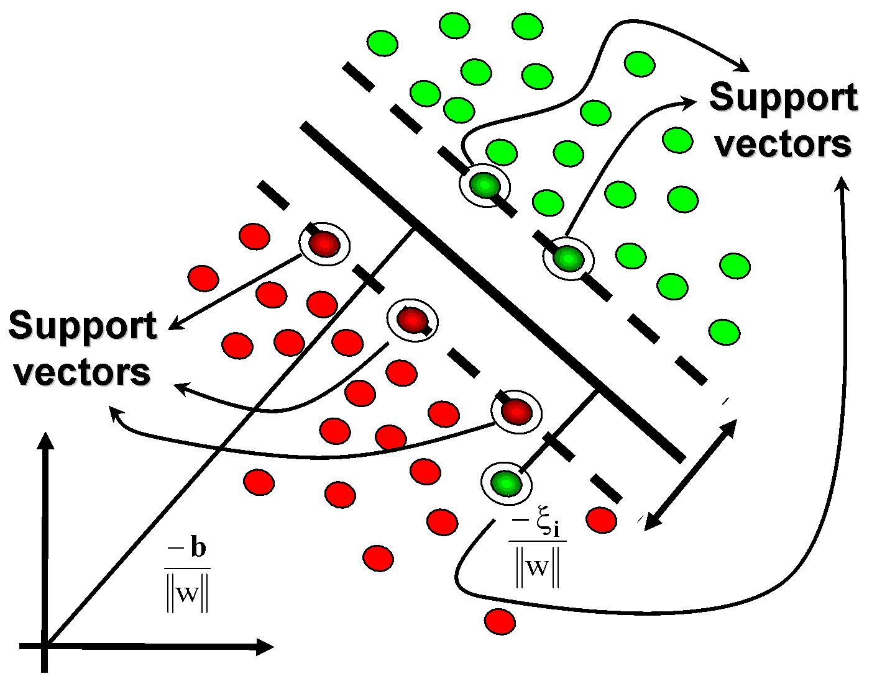
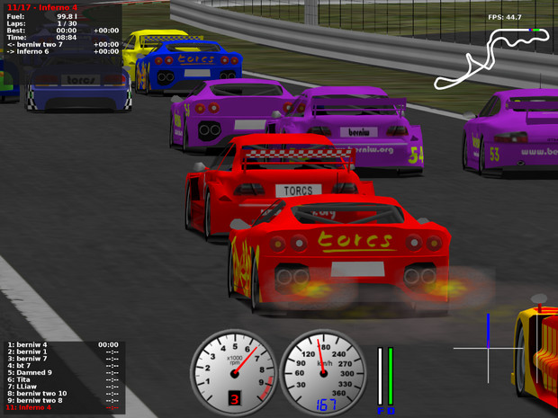
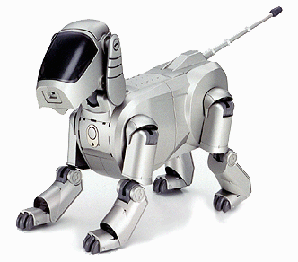
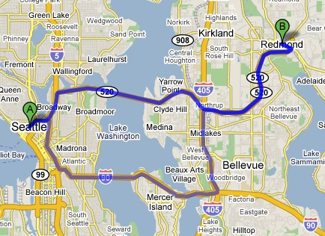
2000s
ML merging with statistics continues. Other subfields continue in parallel.
First commercial-strength applications: Google, Amazon, computer games, route-finding, credit card fraud detection, etc…
Tools adopted as standard by other fields e.g. biology
2010s…. IBM Watson, Siri, Computer Wins GO, Robotics, etc.

Slide 16
Types of Learning
Supervised (inductive) learning
  Training data includes desired outputs
Unsupervised learning
  Training data does not include desired outputs
Semi-supervised learning
  Training data includes a few desired outputs
Reinforcement learning
  Rewards from sequence of actions

Slide 17
Leading ML Algorithms
Supervised learning
  Decision tree induction
  Rule induction
  Instance-based learning
  Bayesian learning
  Neural networks
  Support vector machines
  Model ensembles
  Learning theory
Unsupervised learning
  Clustering
  Dimensionality reduction

Slide 20
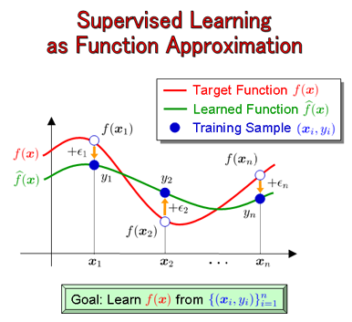
Supervised Learning
Pattern recognition
Set of input vectors and corresponding target vectors
Model tunes itself to minimize error of objective function.
  For instance, OF could be number of misclassifications
Used in prediction problems (classification, regression)
Notes:
Classifies input vectors into target vectors, discrete == classification
Model minimizes errors

Slide 21
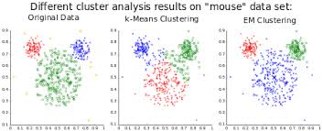
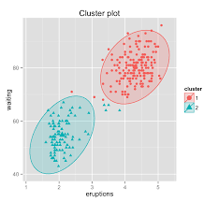
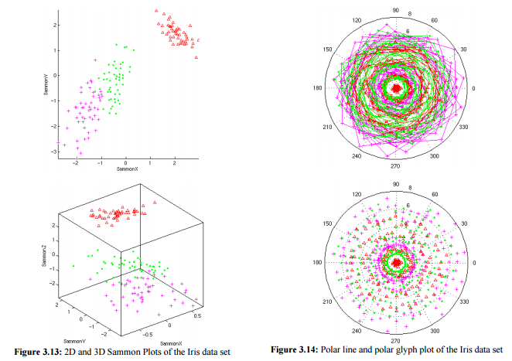
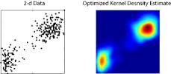
Unsupervised Learning
Pattern detection
Given set of input vectors, no target vectors
Uses
  Clustering – Similarity of data
  Density estimation – Extrapolation of probability density
  Visualization – Turn high dimensional data into human readable
Notes:
Clustering – partition related data into clusters, low variance inside clusters, large between clusters
In sequence analysis, clustering is used to group homologous sequences into gene families.
Density estimation – Estimate probablity density function of random variablegiven some data about a sample of a population, kernel density estimation makes it possible to extrapolate the data to the entire population.
Visualization -- reduce dimensions

Slide 22
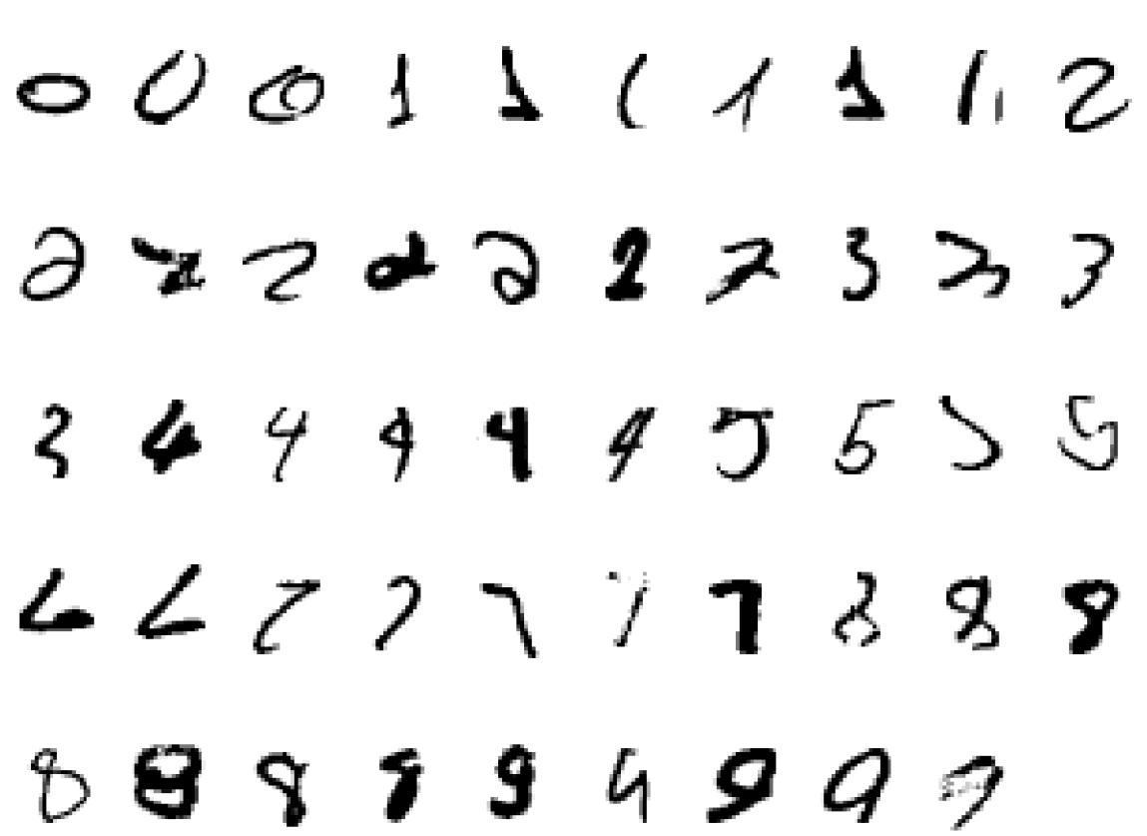
Example: Handwriting
Classification: recognize each number
Clustering: group same numbers together

Slide 24
Some real examples!
Too many to list here!
  Support Vector Machine Classification and Validation of Cancer Tissue Samples Using Microarray Expression Data
  Unsupervised Clustering of Bioinformatics Data
  Hidden Markov Models for Detecting Remote Protein Homologies
  Essential latent knowledge for protein-protein interactions: analysis by an unsupervised learning approaches
  Inference of Genetic Regulatory Networks with Recurrent Neural Network Models Using Particle Swarm Optimization
Finding genes in DNA using HMM

Slide 25
Uses in Bioinformatics
Sequence to structure
  Protein structure, protein function, etc.
DNA binding sites
Evolutionary information
Gene expression analysis
  Visualization
  Clustering
Inference of gene networks
Many more…
Notes:
Clustering --- figure out genes expressed to same result
Gene networks – what affects what

Slide 26
General Example (secondary structure)
Create a data set with input sequences and output secondary structure labels
Train a neural network on a portion of the dataset (training dataset)
Test on a new portion of the dataset (test dataset) to estimate the generalization performance.

Slide 27
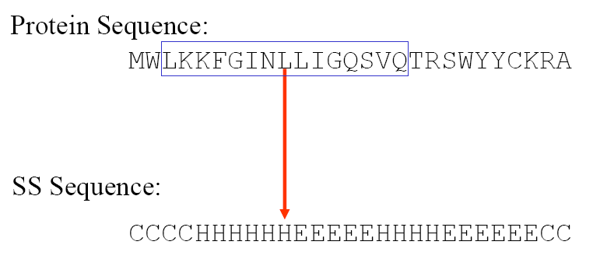
Create a Dataset
Download proteins from Protein Data Bank
Remove proteins with redundant patterns
  Need unbiased training set
Annotate protein sequence with secondary structure

Slide 28
Train and test
Partition dataset created in the previous slide into Train/Test sections
Use training set to build the Neural Net model
Use the test set to evaluate performance
  If results are satisfactory, we now have a method to turn sequences into secondary structure
  Emphasis: we have automatically created a model to create secondary structure from primary structure, this is a big deal.

Slide 29
Remember to read this article!

