Slide 1
ABPG 2015
LECTURE “RNA World”
Differences between DNA and RNA molecules
RNA World Doctrine

Slide 2
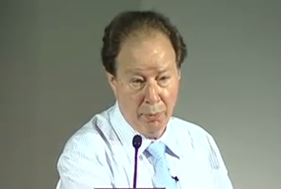
Homework assignment #1
Watch a video lecture at UC Berkley 2010
Nobel Laureate Sidney Altman,
Entering the RNA World
http://www.youtube.com/watch?v=IhQcK4PsStk

Slide 3

READ THE PAPER:
TheRNAworld1986.pdf
Homework assignment #1 questions:
Describe all RNA reactions mentioned in the lecture and the paper
Write all types of RNA functions from the lecture and the paper
Present all arguments suggesting the RNA world

Slide 4
Writing skills are the most important to students

Slide 5
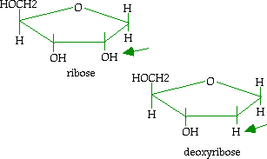
Where is the major difference between RNA and DNA?

Slide 6
There is a profound difference between RNA and DNA in structure, function and evolution!
SIMPLE AND MOST COMMON ANSWER I heard from the students:
DNA is more stable than RNA
Immediate D at your exam!

Slide 7
Watson et al. The molecular biology of the gene.
Chapter 6 The structures of RNA and DNA http://www.aw-bc.com/scp/watson5e/assets/pdf/watson_06.pdf
The presence of 2`-hydroxyls in the RNA backbone prevents RNA from adopting a B-form helix. Rather, double-helical RNA resembles the A-form structure of DNA. As such, the minor groove is wide and shallow, and hence accessible, but recall that the minor groove offers little sequence-specific information. Meanwhile, the major groove is so narrow and deep that it is not very accessible to amino acid side chains from interacting proteins. Thus, the RNA double helix is quite distinct from the DNA double helix in its detailed atomic structure and less well suited for sequence specific interactions with proteins (although some proteins do bind to RNA in a sequence-specific manner) (page 124)

Slide 8
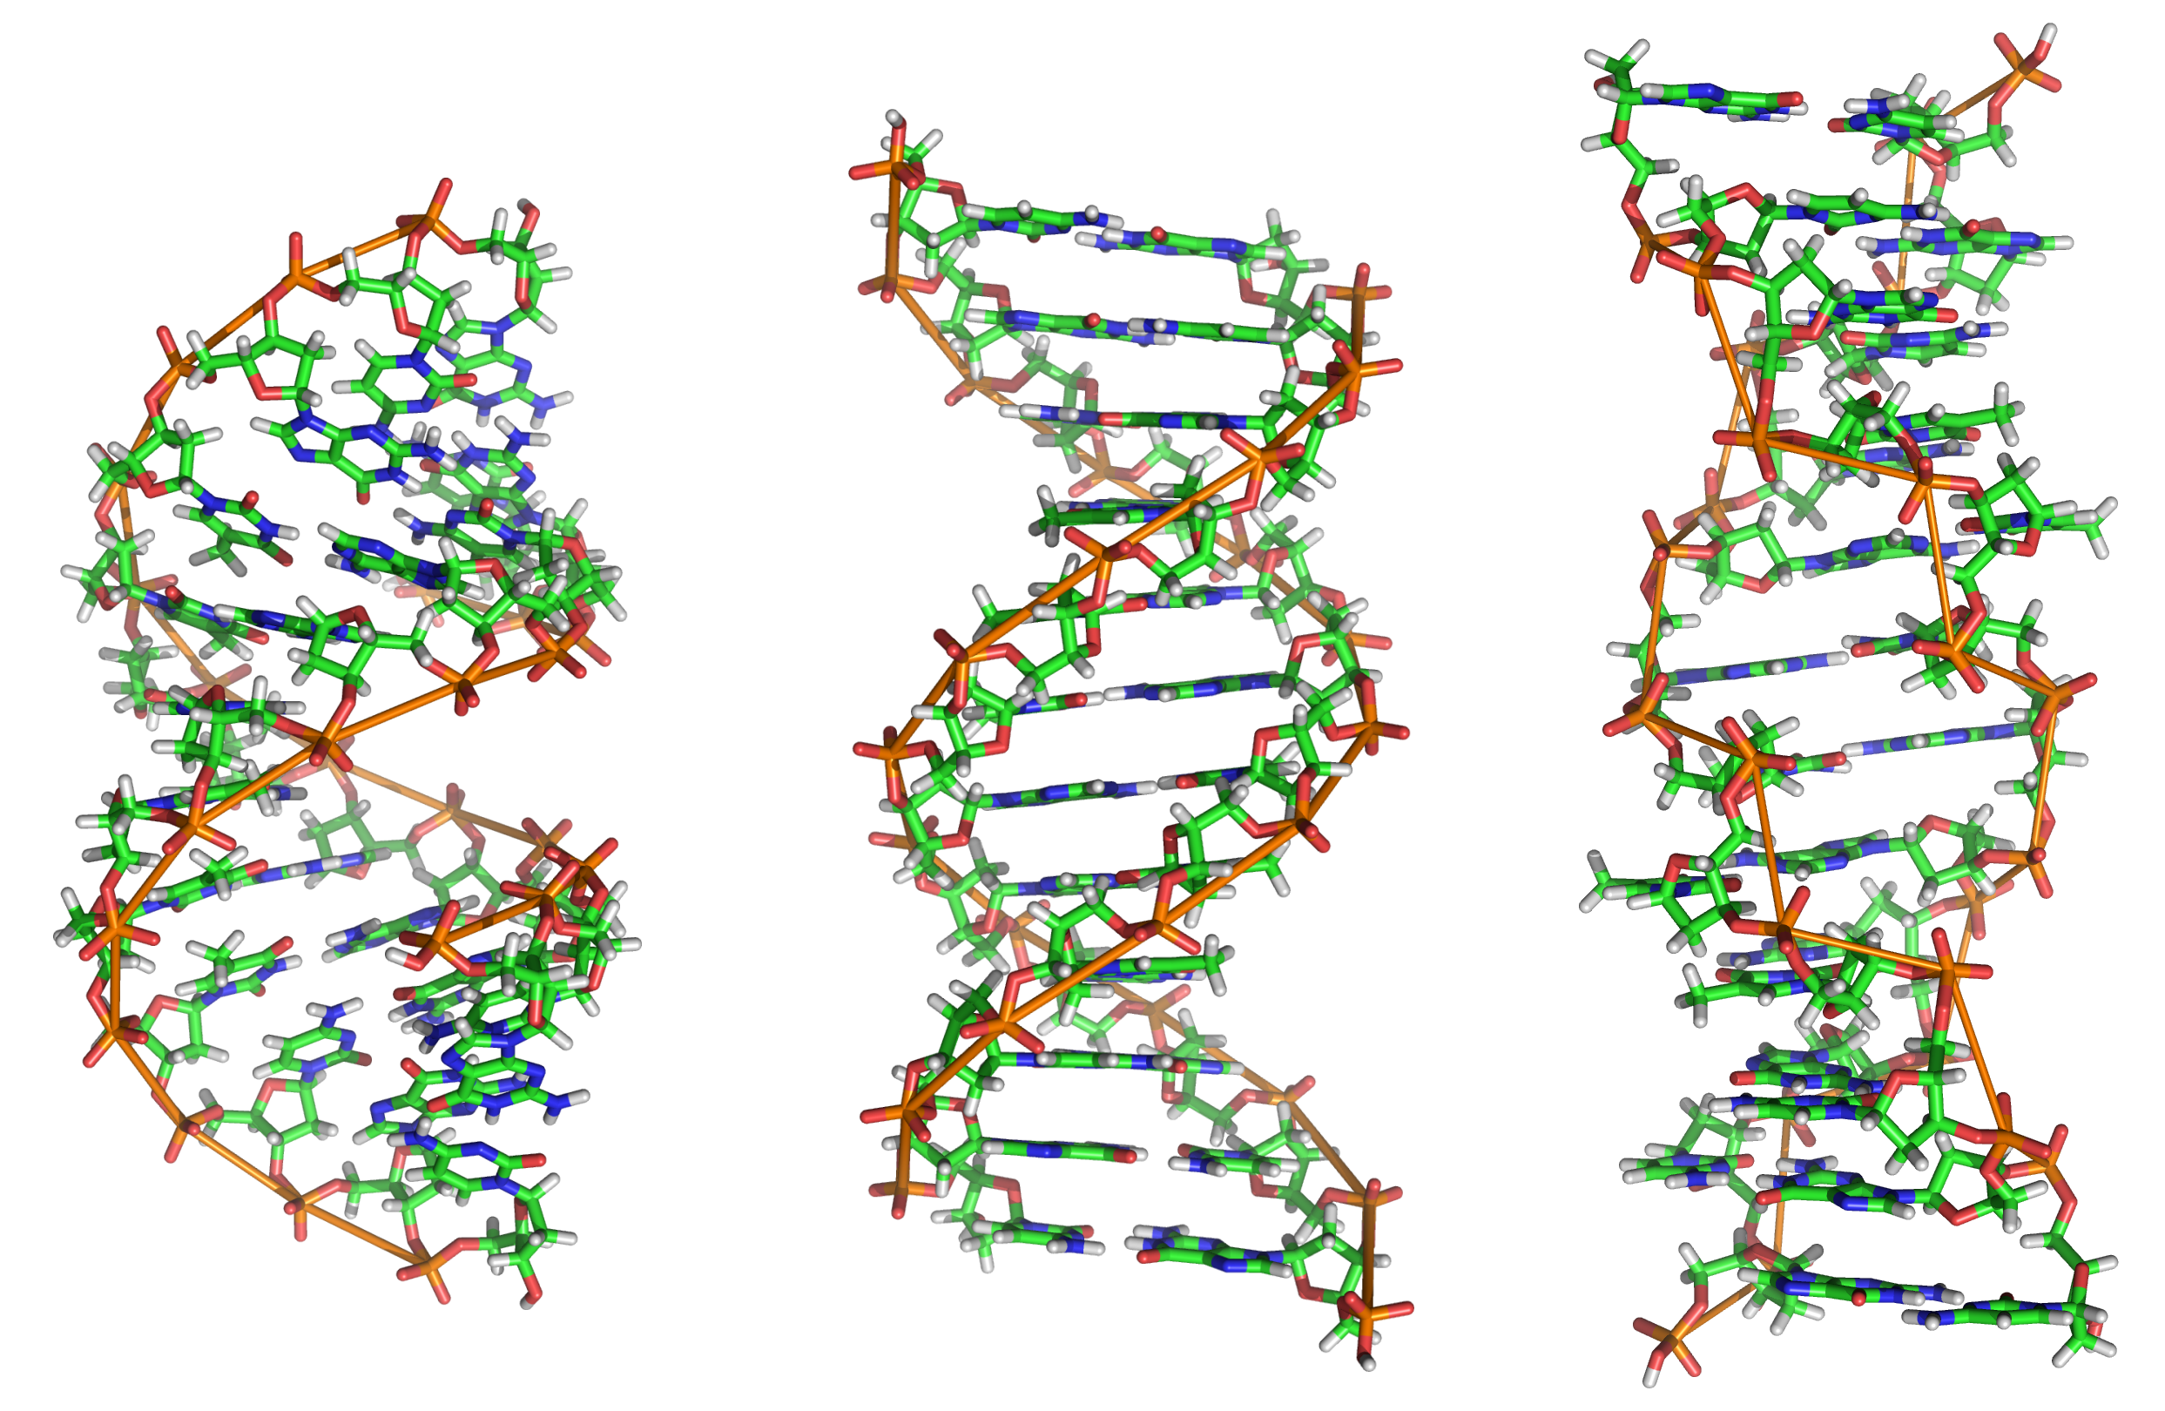
http://www.proteopedia.org/wiki/index.php/DNA http://upload.wikimedia.org/wikipedia/commons/b/b1/A-DNA,_B-DNA_and_Z-DNA.png

Slide 9

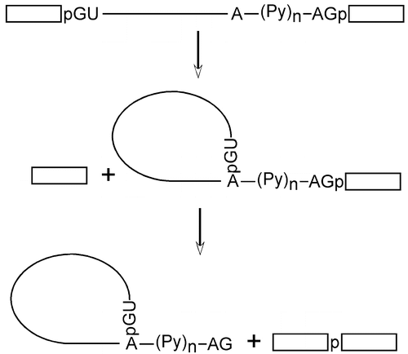

Slide 10
Wikipedia:
2`-Hydroxyl group makes the RNA molecule less stable than DNA —in flexible regions of an RNA molecule (i.e., where not constrained in a double helix), it can chemically attack the adjacent phosphodiester bond to cleave the phosphodiester backbone.
The hydroxyl group also forces the ribose into the C3'-endo sugar conformation unlike the C2'-endo conformation of the deoxyribose sugar in DNA. This forces an RNA double helix into a slightly different conformation than B-DNA, resembling A-DNA more closely.

Slide 11
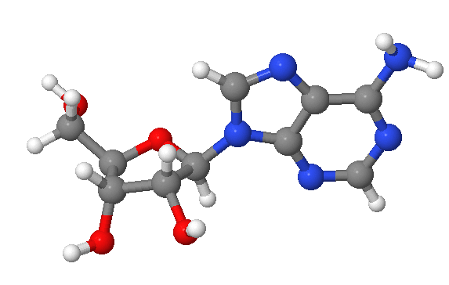
http://www.proteopedia.org/wiki/index.php/Syn_and_anti_nucleosides
PROTEOPEDIA
5`
4`
1`
3`
2`

Slide 12
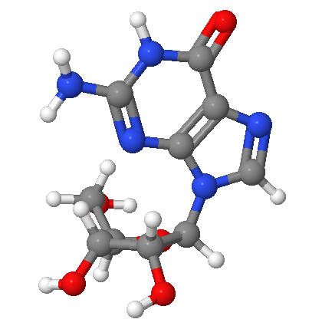
Syn Configuration of Purines
Groups on the ribofuranose, such as
the hydrogen on the 2' carbon sterically
hinder the rotation of the adenine about
the glycosidic bond. This lack of ability to
rotate results in two possible configurations.

Slide 13
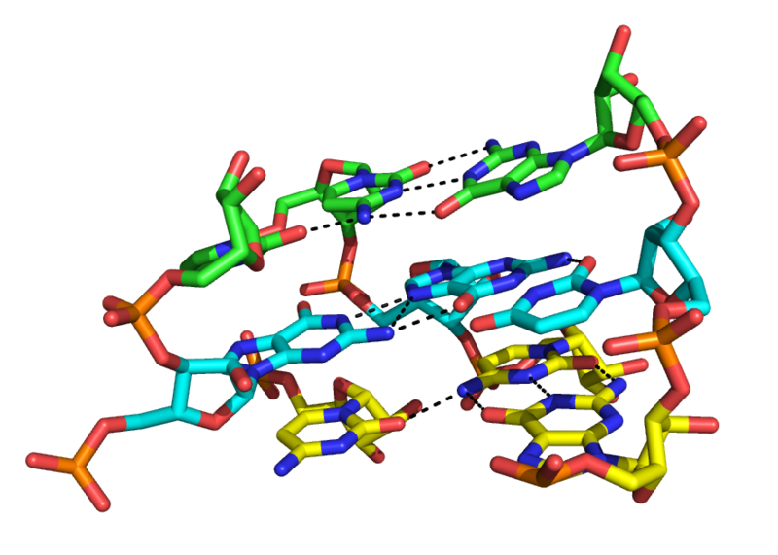
Nucleic acid tertiary structure http://en.wikipedia.org/wiki/Nucleic_acid_tertiary_structure
Figure Attribution:
Qinhua Zhou at en.wikipedia
“Although the major groove of standard A-form RNA is fairly narrow and therefore
less available for triplex interaction than the minor groove, major groove triplex
interactions can be observed in several RNA structures. “

Slide 14
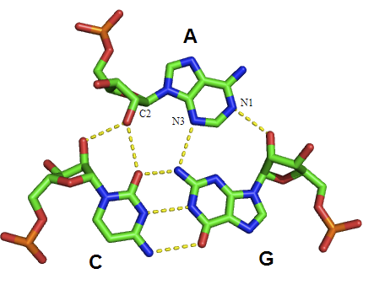
A-minor motif type I in an RNA triplex
2`-OH
“…The minor groove triple is a ubiquitous RNA structural motif. Because interactions
with the minor groove are often mediated by the 2'-OH of the ribose sugar, this
RNA motif looks very different from its DNA equivalent.”
“…The A-minor motif is a ubiquitous RNA tertiary structural motif. It is formed by the
insertion of an unpaired nucleoside into the minor groove of an RNA duplex. “

Slide 15
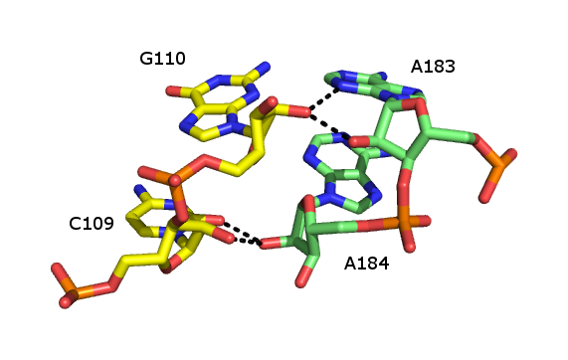
RIBOSE ZIPPER
2`-OH
“…The ribose zipper is an RNA tertiary structural element in which two RNA chains are held together by hydrogen bonding interactions involving the 2’OH of ribose sugars on different strands. The 2'OH can behave as both hydrogen bond donor and acceptor, which allows formation of bifurcated hydrogen bonds with another 2’ OH.
Numerous forms of ribose zipper have been reported, but a common type involves four hydrogen bonds between 2'-OH groups of two adjacent sugars. Ribose zippers commonly occur in arrays that stabilize interactions between separate RNA strands. Ribose zippers are often observed as Stem-loop interactions with very low sequence specificity.”

Slide 16
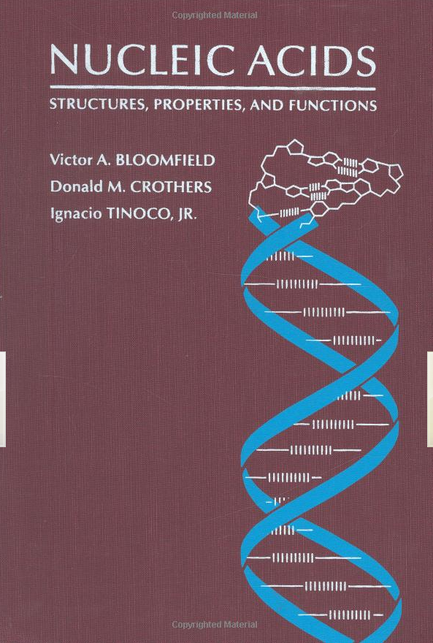
Next level of understanding
…Riboses have C3`-endo conformations in general. In about one-half of the cases , OH2` appears to form a hydrogen-bond to O4` of the following residue, similar to the finding in the tRNA structure. …
..The U•C pairs each form only one base-base hydrogen bond, but are stabilized by a water that bridges the ring nitrogens and four waters in the major grove which link bases and phosphates The G•U wobble pair is also stabilized by a water molecule in the minor groove that bridges the unpaired guanine amino and the ribose OH of the uracil. The hydrogen-bonding to water shows that specific hydrogen bonds between groups other than just the bases are important in the stabilizing double-helical RNA…

Slide 17
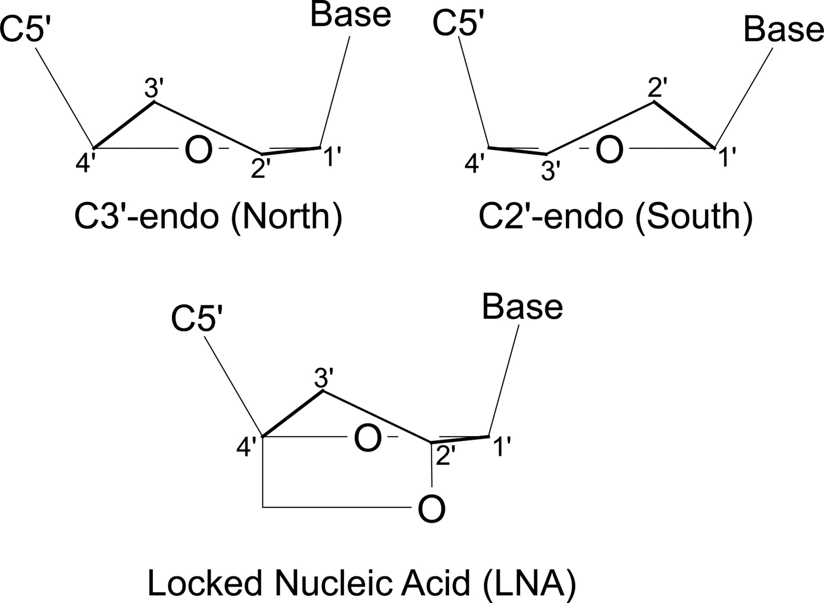

Conformationally locked nucleotides.
Julien K R et al. RNA 2008;14:1632-1643
Copyright © 2008 RNA Society
Notes:
Conformationally locked nucleotides. (Top) Edge-on views of C3′-endo and C2′-endo nucleic acid ribose pucker conformations. (Bottom) The introduction of a covalent linkage between C2′ and C4′ in locked nucleic acid (LNA) nucleotides. This linkage is geometrically incompatible with the C2′-endo pucker and thus locks the nucleotide into the C3′-endo conformation. Upper panel, structure redrawn from Altona and Sundaralingam (1972).

Slide 18
We introduce the use of commercially available locked nucleic acids (LNAs) as a functional probe in RNA. LNA nucleotides contain a covalent linkage that restricts the pseudorotation phase of the ribose to C3′-endo (A-form). Introduction of an LNA at a single site thus allows the role of ribose structure and dynamics in RNA function to be assessed. We apply LNA probing at multiple sites to analyze self-cleavage in the lead-dependent ribozyme (leadzyme), thermodynamic stability in the UUCG tetraloop, and the kinetics of recognition of U1A protein by U1 snRNA hairpin II. In the leadzyme, locking a single guanosine residue into the C3′-endo pucker increases the catalytic rate by a factor of 20, despite the fact that X-ray crystallographic and NMR structures of the leadzyme ground state reported a C2′-endo conformation at this site. These results strongly suggest that a conformational change at this position is critical for catalytic function. Functional insights obtained in all three systems demonstrate the highly general applicability of LNA probing in analysis of the role of ribose orientation in RNA structure, dynamics, and function.

Slide 19

RNA WORLD
2010
“…There is now strong evidence indicating that an RNA World did indeed exist on the early Earth. The smoking gun is seen in the structure of the contemporary ribosome (Ban et al. 2000;Wimberly et al. 2000; Yusupov et al. 2001). The active site for peptide-bond formation lies deep within a central core of RNA, whereas proteins decorate the outside of this RNA core and insert narrow fingers into it. No amino acid side chain comes within 18A° of the active site (Nissen et al. 2000). Clearly, the ribosome is a ribozyme (Steitz andMoore 2003), and it is hard to avoid the conclusion that, as suggested by Crick, “the primitive ribosome could have been made entirely of RNA” (1968).

Slide 20
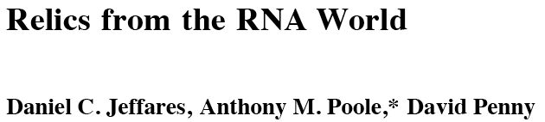
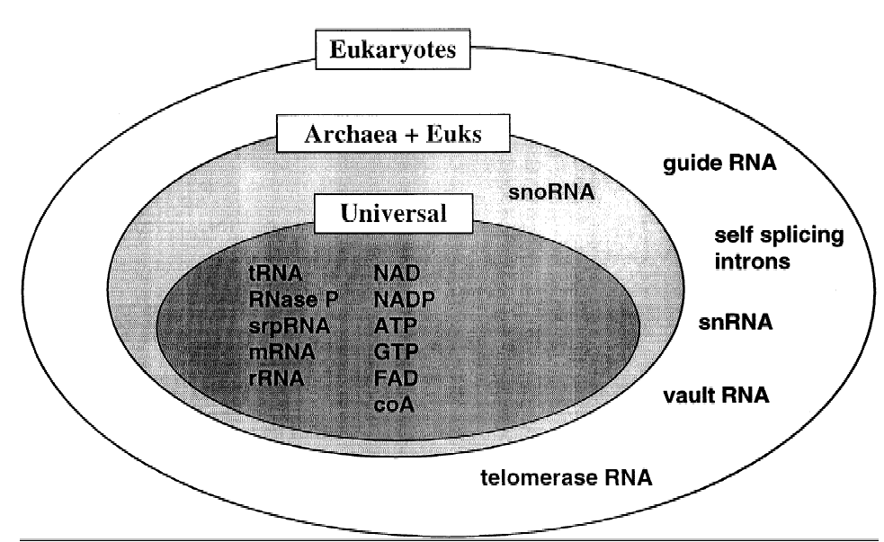
1998 JME
RNA based
COFACTORS
EXAM

Slide 21
The Origin of Life http://users.rcn.com/jkimball.ma.ultranet/BiologyPages/A/AbioticSynthesis.html
In the cell, all deoxyribonucleotides are synthesized from ribonucleotide precursors.
Many bacteria control the transcription and/or translation of certain genes with RNA molecules (Link to "riboswitches"), not protein molecules.
Ribozymes

Slide 22
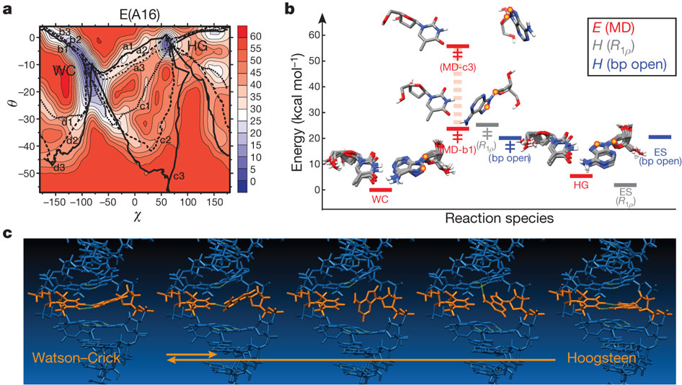
PART 2. Novel DNA-world
Nikolova EN, Kim E, Wise AA, O'Brien PJ, Andricioaei I, Al-Hashimi HM.
Transient Hoogsteen base pairs in canonical duplex DNA. Nature. 2011; 470:498-502.

Slide 23
From the Abstract
By using nuclear magnetic resonance relaxation dispersion spectroscopy in concert with steered molecular dynamics simulations, we have observed transient sequence-specific excursions away from Watson–Crick base-pairing at CA and TA steps inside canonical duplex DNA towards low-populated and short-lived A•T and G•C Hoogsteen base pairs. The observation of Hoogsteen base pairs in DNA duplexes specifically bound to transcription factors and in damaged DNA sites implies that the DNA double helix intrinsically codes for excited state Hoogsteen base pairs as a means of expanding its structural complexity beyond that which can be achieved based on Watson–Crick base-pairing.
VIDEO 1: An A•T WC-to-HG base pair transition in duplex B-DNA
VIDEO 2: G•C WC-to-HG base pair transition in duplex B-DNA

Slide 24
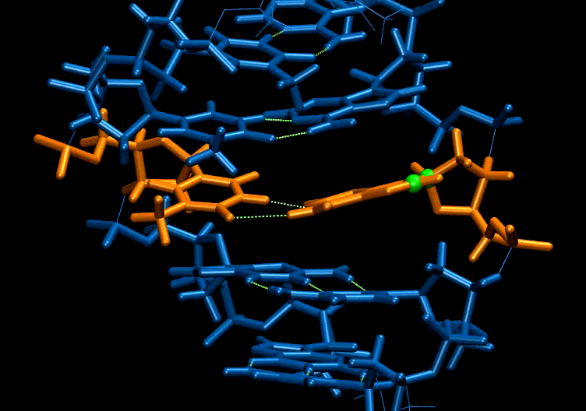

Slide 25
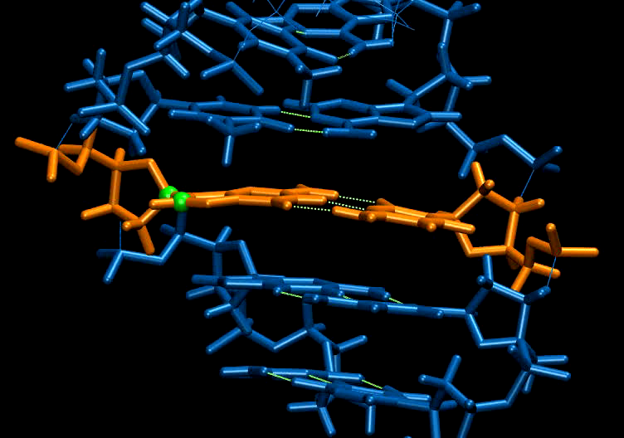

Slide 26
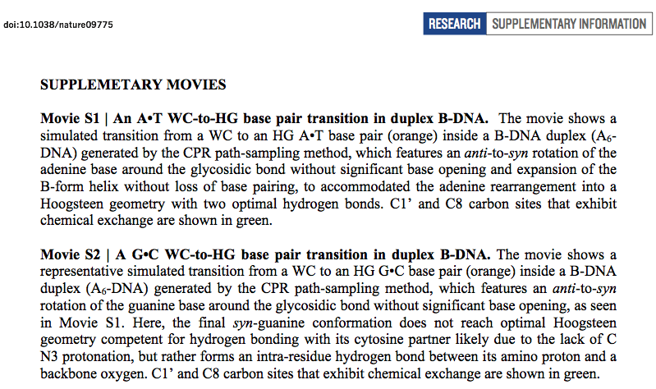

Slide 27
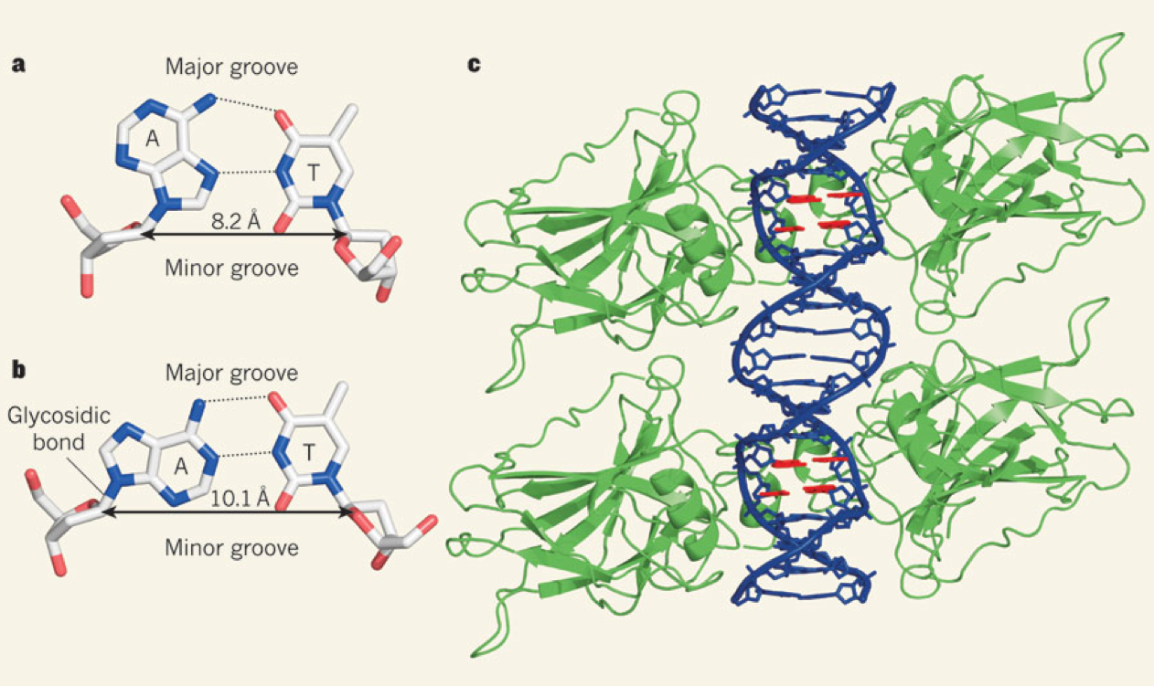
Flipping Watson and Crick
Honig & Rohs 2011 Nature 470:472-473

Slide 28
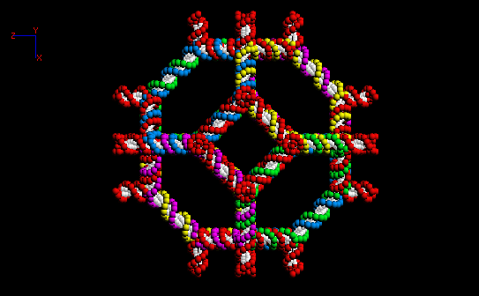
Nanotechnology DNA octahedron http://www.foresight.org/Conferences/MNT05/Papers/Seeman/

Slide 29
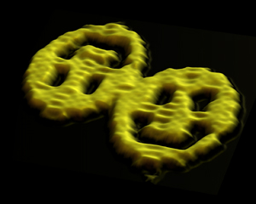
Paul W.K. Rothemund http://www.dna.caltech.edu/~pwkr/
Atomic Force Microscope
Nature 2006, 440_297-302: Folding DNA to create nanoscale shapes and patterns.

Slide 30
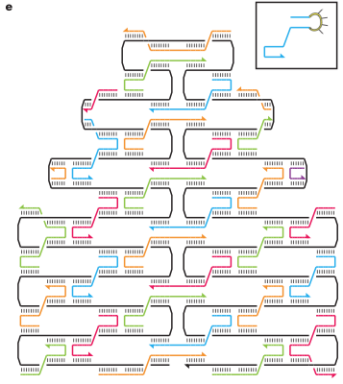
Figure 1 by
Paul Rothemund

Slide 31
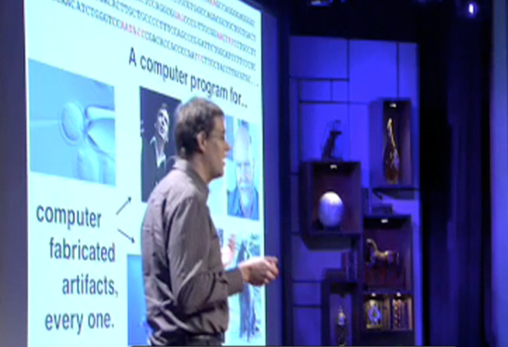

HW assignment: Watch the video
Presentation by Paul Rothemund, February 2008 http://www.ted.com/talks/paul_rothemund_details_dna_folding.html
Technology, Entertainment, Design. Ideas Worth Spreading

Slide 32
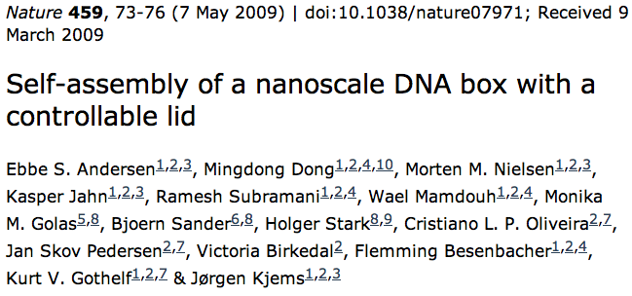
Jørgen Kjems http://www.rnai.dk/index.php?option=com_jresearch&view=member&task=show&id=3&Itemid=8

Slide 33
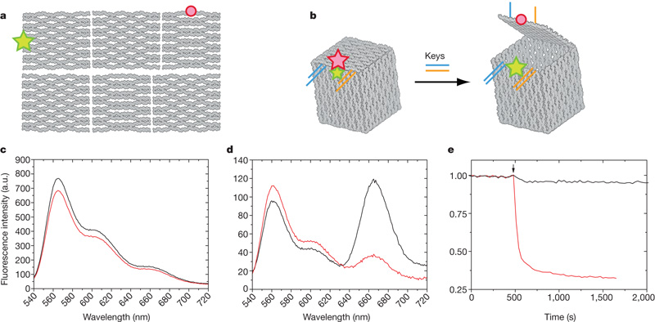

Programmed opening of the box lid.
ES Andersen et al. Nature 459, 73-76 (2009) doi:10.1038/nature07971

Slide 34
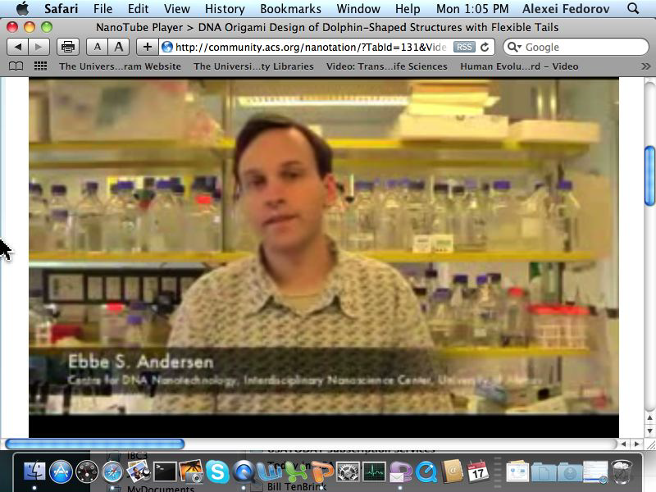

Slide 35

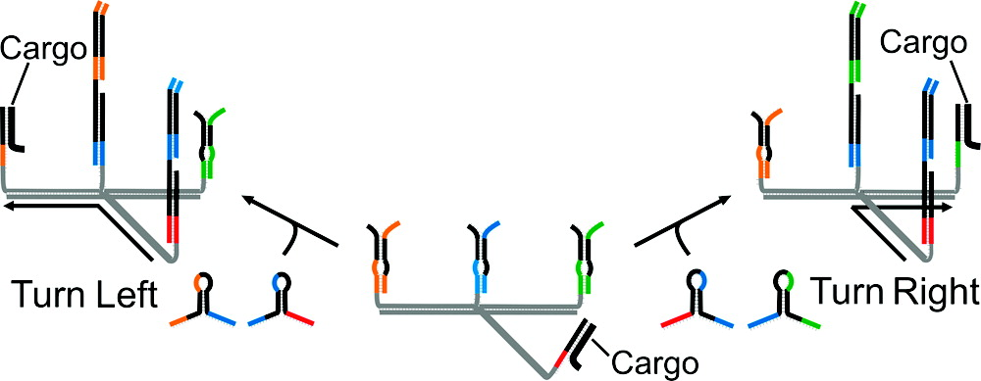
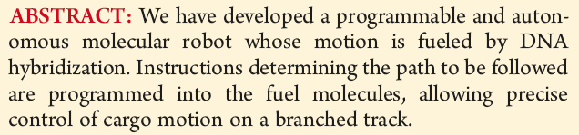
Published in: Richard A. Muscat; Jonathan Bath; Andrew J. Turberfield; Nano Lett. 2011, 11, 982-987.
Copyright © 2011 American Chemical Society

Slide 36
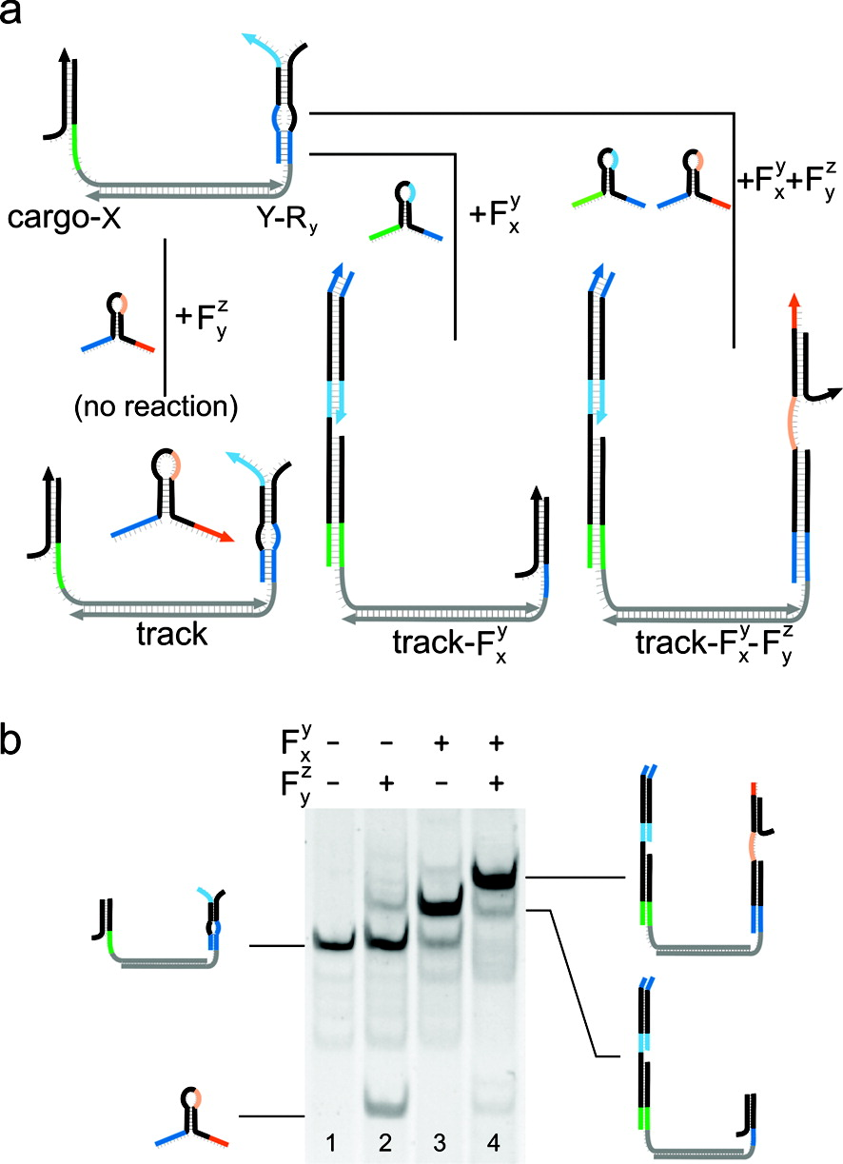
Control of the reactions of fuel hairpins. (a) Summary of designed interactions with fuels Fxy and Fyz. When the cargo is bound to anchorage X, no toehold is available to initiate interaction with Fyz. Fxy interacts with the cargo−anchorage X duplex through an active split toehold incorporating the source address domain X̅, transferring the cargo to anchorage Y (see Figure 1). The new cargo−anchorage Y duplex displays a new source toehold that can interact with Fyz, so if both fuel strands are added simultaneously they will react sequentially. (b) Polyacrylamide gel electrophoresis (PAGE) analysis of reactions with fuel. Fuel and cargo-laden track (100 nM) were incubated for 30 min (see Figures S3 and S4 in the Supporting Information for controls): lane 1, initial configuration with cargo bound to anchorage X; lane 2, addition of Fyz results in little interaction with track; lane 3, Fxy reacts readily, transferring cargo to anchorage Y; lane 4, simultaneous addition of Fxy and Fyz leads to a complex containing both fuel strands, completion of the first step from X to Y, mediated by Fxy, enables reaction with Fyz to initiate a second step, as designed.
Published in: Richard A. Muscat; Jonathan Bath; Andrew J. Turberfield; Nano Lett. 2011, 11, 982-987.
Copyright © 2011 American Chemical Society

Slide 37
Final remarks
Genomics and Rnomics are highly related to each other
DNA constantly produces different types of RNA molecules with the help of RNA polymerases
RNA frequently coverts into a DNA form via reverse transcription and integrates back into the genome (example > 1million of Alu-repeats, and >5,000 pseudogenes in the human genome)

Slide 38

Co-evolution of RNA and DNA
DNA
RNA

Slide 39
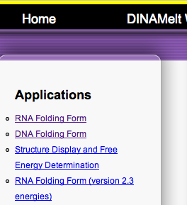
Bioinformatics assignment #2
There are a number of internet resources for the prediction of DNA and RNA secondary structures.
Investigate and characterize the difference in the single-stranded DNA and RNA folding via M-fold:
http://mfold.rna.albany.edu/?q=mfold/download-mfold
Click on these two links

Slide 40
Bioinformatics assignment #2
(additional explanations)
Perform your own RESEARCH using M-fold program
Your task is to write several pairs of identical single-stranded RNA and DNA sequences and investigate which type of base-pairing contributes to the difference in the folding of single stranded molecules. Is it mostly due to G-C pairs or A-T/A-U pairs or G-T/G-U pairs? And also, does stacking of neighboring nucleotides influence on the difference of folding RNA vs DNA?

Slide 41
Test sequences
Example_DNA
agcaagctagaacagggcaactaaattgaattttctgaggaatgttgtgaatcctatgtggaaaaaaaagtcatac
Example_RNA
agcaagcuagaacagggcaacuaaauugaauuuucugaggaauguugugaauccuauguggaaaaaaaagucauac

Slide 42
RNA folding
MFE (dG) = -7.20 kcal/mol

Slide 43
DNA folding
MFE (dG) = -3.68 kcal/mol

Slide 44
Extra assignment:
Gather 3 sequences of RNA from GenBank (NCBI) and convert them to DNA sequences. Fold all of them with the online M-fold. (size of the sequences 100-300 nt)
Describe the differences in the folding of single stranded RNA and DNA.
Analyze the influence of the salt concentrations and the temperature on the folding structures

Slide 45
Homework summary
For assignment #1 see slides 2 and 3
For assignment #2 see slides 39-44

