Slide 1
Lecture #4 ABPG+BRIM
Exome sequencing project
Alexei Fedorov
TOPICS:
Files: Fastq, sam, bam, vcf, bed;
Reference Human Genome;
Transferring files (FTP, SFTP, wget)

Slide 2
Input data: “Fastq” files
SG5_R1.fastq_1000 (first 1000 lines of 11 GB)
SG5_R2.fastq_1000
R1 and R2 stands for opposite strands
QUESTION (homework #1) Do corresponding R1 and R2 sequences from the same read (identifier) overlap? How? What is the total length of the read?

Slide 3
How to download the data?
FTP Credentials:
Link: ftp.medgenome.com
Port: 21
User: wuvonasi4074
Password: B!h#$21%arD5
Our attempts: ftp, wget, winscp (ftp graphical interface).
FTP to NCBI (USER: anonymous; password =email [any works])

Slide 4
Practice: Download Human Chromosome 19, build 37.5
Use NCBI web page for downloading (ftp)
User: anonymous;
Password “your_email_address”
HOMEWORK #2: Download the gbk file for one of the human chromosomes. Describe “gbk” format of the human genome representation (write 0.5-1 page)

Slide 5
Letter of agreement
DataAccessAgreementAshkenazi.doc
DataAccessAgreementUT_BioinfoStudent.doc every student must sign and return (ultimate HOMEWORK).

Slide 6
Our task:
Variant calling (SNPs and INDELs) should be performed using standard procedures of GATK or Samtools. Summary reports of variants called from each sample should be provided; number of SNPs, INDELs, homozygous and heterozygous variants and transition to transversion ratio, read depth and quality distribution of identified variants in each sample should be provided. Variant calling should be done individually and together (all samples together to produce single VCF file for all samples). Variant filtration should be done using standard procedures and parameters.

Slide 7
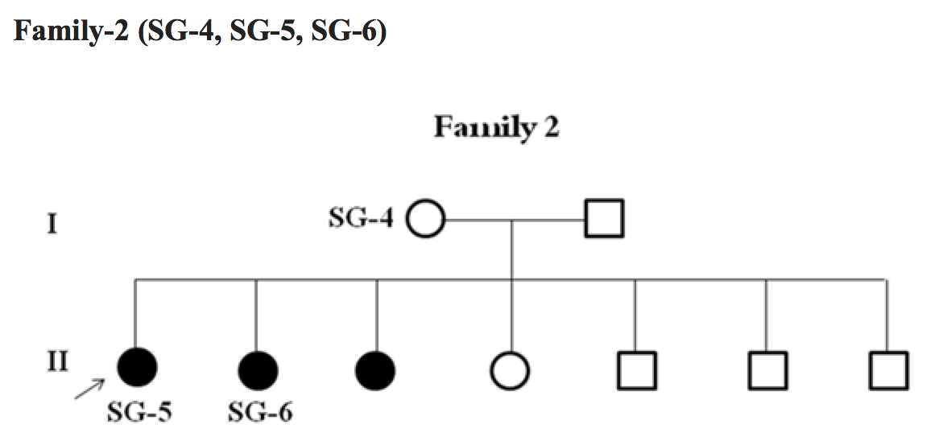
QUIZ: What is it?
Why autosomal recessive?
Why compound heterozygote?
What is consanguineous family?

Slide 8
Example of ‘SAM’ files
Neandertal200.sam (first 200 lines)
SAMV1.pdf (instruction to SAM format)

Slide 9
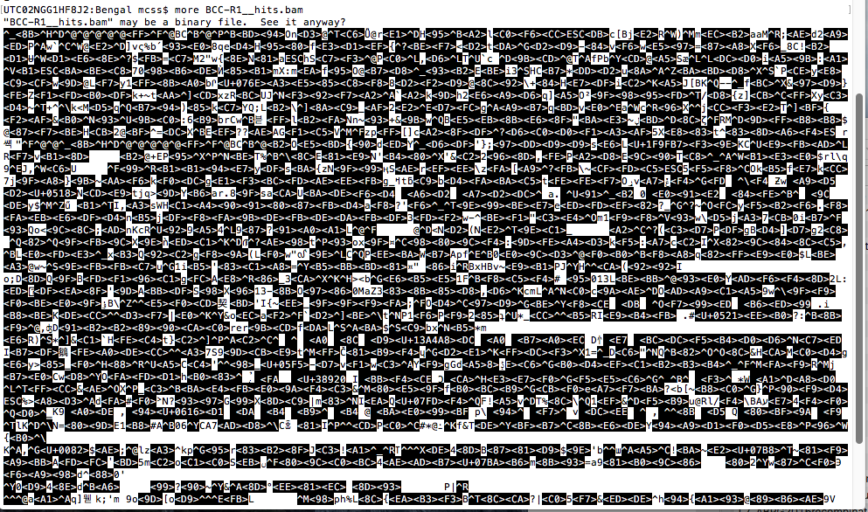
SAM <-> BAM file conversion
Binary “BAM” file is ~3 times smaller than SAM, yet is unreadable

Slide 10
Integrative Genomics Viewer (IGV)
https://www.broadinstitute.org/igv/
IGV user guide
http://jura.wi.mit.edu/bio/education/hot_topics/igv/IGV.pdf
https://www.youtube.com/watch?v=5kkPnCV06dE VIDEO
https://www.youtube.com/watch?v=YeoHJFHnCrw

Slide 11
Reference Human Genome
The first Human Genome Sequence that has been accomplished by the 13-years-long International Project and published in 2001 became the first Reference Human Genome. Under this project scientists sequenced diploid genomes of 6 anonymous people. Thus the reference genome is the mosaic of most frequent alleles found in these six individuals. Initial sequence had a number of sequencing errors and unreadable regions (gaps). Therefore reference genome is regularly updated by the Genome Reference Consortium. Newest releases are more accurate, have less and less gaps and more annotations. It is important to know the exact version of the Reference Genome (e.g. GRCh38.7 from March 2016) when individual genome is represented as a table of differences with the reference one (VCF format).
Additional information from Genome Reference Consortium https://www.ncbi.nlm.nih.gov/grc
Wikipedia: https://en.wikipedia.org/wiki/Reference_genome

Slide 12
Examples of VCF files
head100_1000genome_VCF
VCFdenisovCHR19_1000lines
It saves a lot of space to present a genome as a table that demonstrates only the difference between itself and the Reference Human Genome link1.4. This popular format of genome representation is known as Variant Call Format (VCF). Each of its line represents one genetic variant difference. An example of this format is exemplified in the files above.

Slide 13
VCF format
http://gatkforums.broadinstitute.org/gatk/discussion/1268/what-is-a-vcf-and-how-should-i-interpret-it
6. How to extract information from a VCF in a sane, (mostly) straightforward way
Use VariantsToTable.
No, really, don't write your own parser if you can avoid it. This is not a comment on how smart or how competent we think you are -- it's a comment on how annoyingly obtuse and convoluted the VCF format is.
Seriously. The VCF format lends itself really poorly to parsing methods like regular expressions, and we hear sob stories all the time from perfectly competent people whose home-brewed parser broke because it couldn't handle a more esoteric feature of the format. We know we broke a bunch of people's scripts when we introduced a new representation for spanning deletions in multisample callsets. OK, we ended up replacing it with a better representation a month later that was a lot less disruptive and more in line with the spirit of the specification -- but the point is, that first version was technically legal by the 4.2 spec, and that sort of thing can happen at any time. So yes, the VCF is a difficult format to work with, and one way to deal with that safely is to not home-brew parsers.
(Why are we sticking with it anyway? Because, as Winston Churchill famously put it, VCF is the worst variant call representation, except for all the others.)

Slide 14
Problems with VCF (examples)
/home/afedorov/1000GENOMES
esv2663150_10lines.txt and Excel file (esv2663150_10linesV2.xlsx)
vi resultJune8 (se nowrap) example with deletions
esv2663150 deletion on chr 19
http://www.ncbi.nlm.nih.gov/dbvar/variants/esv2663150/
/home/afedorov/DENISOV
zcat T_hg19_1000g.19.mod.vcf.gz |more
rs59558746 at 544960

Slide 15
What are our chances of success?
Exome sequencing?
Quality data?
Coverage?
Compound heterozygote?

Slide 16
Our approach
An example with Galaxy web recourse: watch YouTube (a nine minute video): https://www.youtube.com/watch?v=MbW_f4eZNKM
(TopHat alignment with Galaxy)

Slide 17
BED files and other formats
https://genome.ucsc.edu/FAQ/FAQformat (nice explanation)
Example BED: example_lncRNAhg38.BED
GVF format (paper GVFformat.pdf)

Slide 18
HOMEWORK ASSIGNMENTS
SLIDE#2: QUESTION (homework #1) Do corresponding R1 and R2 sequences from the same read (identifier) overlap? How? What is the total length of the read?
SLIDE#4: HOMEWORK #2: Download the gbk file for one of the human chromosomes. Describe “gbk” format of the human genome representation (write 0.5-1 page)
SLIDE#5: DataAccessAgreementUT_BioinfoStudent.doc every student must sign and return (ultimate HOMEWORK).

