Slide 1
Next Generation Sequencing Analysis
By Basil Khuder
Basil.Khuder@rockets.utoledo.edu
By Basil Khuder
Basil.Khuder@rockets.utoledo.edu

Slide 2
Workflow Part 1: Raw Reads to Analysis-Ready Reads
RAW Reads = FASTQ files
We convert FASTQ to uBAM, and then back to FASTQ
We take this converted FASTQ and map it to the reference using BWA, and run some preparatory procedures using Picard Tools
Tools Needed
Burrows-Wheeler Aligner
Picard Tools
SAMTools
Genome Analysis Toolkit
We finally run base recalibration on the aligned file to get into BAM format, and it’s not ready for variant calling.

Slide 3
Step 1: Creating a Reference Index
Why Create a Reference?
Since we are mapping many short reads to the reference sequence, we need to build a reference index so that it’s easier to find the exact sequence in the reference.
Without reference, process would be slow.

Slide 4
Step 1: Creating a Reference Index (Continued)
Creating a Reference index will produce 7 files, based upon the reference genome.
bwa index -a bwtsw hg19.fasta java -jar picard.jar
CreateSequenceDictionary R= hg19.fasta O= hg19.dict
samtools faidx hg19.fasta

Slide 6
Step 2: Converting FASTQ file to an Unmapped BAM
Why convert to an Unmapped BAM? According to the Broad Institute:
Most sequencing providers generate FASTQ files with the raw unmapped read sequences, This is not ideal because much of the metadata runs cannot be stored in FASTQ files, unlike BAM files.

Slide 7
Step 2: Converting FASTQ file to an Unmapped BAM (Continued)
Play close attention to the following options:
Sample Name, Library Name, Platform and Read Group Name:
Sample_NAME is simply the sample you are working with. In our case, SG4-6.
Library_Name is the library preparation that the sequencing data went through it. Our library prep was Agilent SureSelect Human All Exon V5 Kit.
Platform is the company who conducted the sequencing. In this case, it’s Illumina.
Read_Group_Name is taken from the FASTQ file. Specifically, the information in the third placeholder marked “C7H7” which is the flowcell id. You can ignore the EANXX, and then will also need to include the “5” which refers to the flow cell lane.

Slide 8
Step 2: Converting FASTQ file to an Unmapped BAM (Continued)
java -Xmx8G -jar picard.jar FastqToSam \ FASTQ=SG5_R1.fastq \ FASTQ2=SG5_R2.fastq \ OUTPUT=SG5_fastqtosam.bam \ READ_GROUP_NAME=C7H7:5 \ SAMPLE_NAME=SG_5 \ LIBRARY_NAME=Agilent_SureSelect \ PLATFORM=illumina \ RUN_DATE=2017-01-20T00:30:30+00:00 #using iso8601 http://www.timestampgenerator.com/

Slide 9
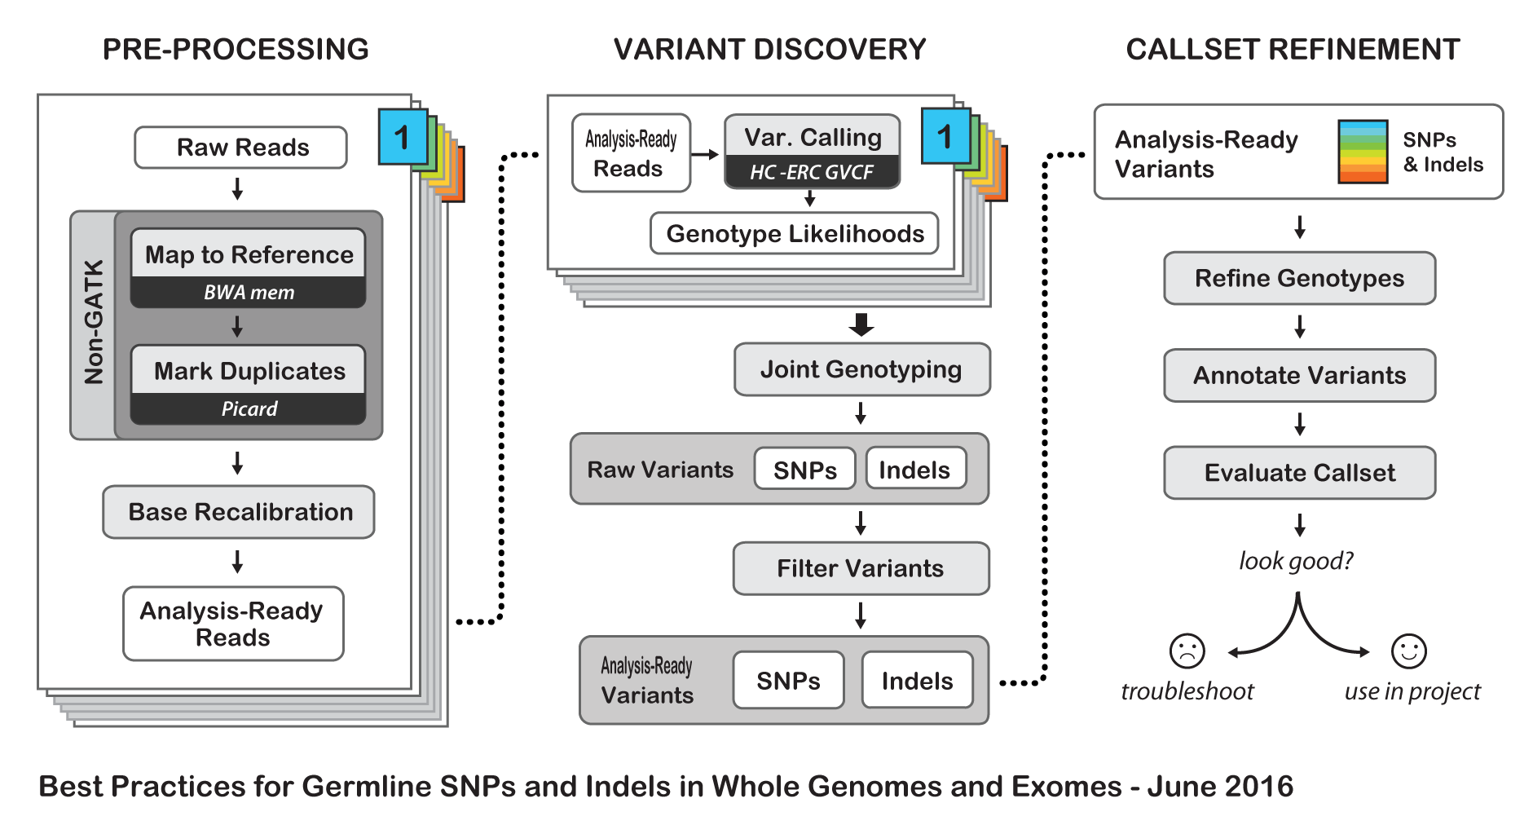

Slide 10
Step 3: Mark Illumnia Adatprers
Because the adapters that were used in the initial sequencing prep are still in the files, we must mark them. We do this using Picard Tools and the Mark Illumina Adapters option.
java -jar picard.jar MarkIlluminaAdapters \ I=SG5_fastqtosam.bam\ O=SG5_fastqtosam_markilluminaadapters.bam\ M=SG5_snippet_markilluminaadapters_metrics.txt

Slide 12
Step 4: Revert back to FASTQ, with required meta data.
java -jar picard.jarSamToFastq\
I=SG5_fastqtosam_markilluminaadapters.bam \
FASTQ=SG5_interleaved.fq \
CLIPPING_ATTRIBUTE=XT \ #Refers to the marking of adapters
CLIPPING_ACTION=2 \ #Refers to the marking of adapters
INTERLEAVE=true \ #Refers to paired reads
NON_PF=true \ #0x200 failedVendorQualityChecks flag #85

Slide 14
Step 5: Align to Reference Using BWA
Bwa is the alignnment tool, mem is the alrgorithm we are using.
-M allows MergeBamAlignment, a tool for the next step, to reassign proper secondary alignments. Secondary alignments are ambiguous alignments that might be mapped incorrectly (due to poor read quality, contamination ect.)
T refers to the amount of computer threads we want to use. (Use nproc to find number of processor threads.)
-P indicates the file contains interleaved paired reads.
bwa mem -M -t 30 -p hg19.fasta \
SG5_interleaved.fq > SG5_Hg19.sam

Slide 16
Step 6: Convert aligned SAM file to BAM
java -jar picard.jar MergeBamAlignment \ R=hg19.fasta \ UNMAPPED_BAM=SG6_fastqtosam.bam \ ALIGNED_BAM=SG6_Hg19.sam \ O=SG6_final_hg19.bam \ CREATE_INDEX=true \ ADD_MATE_CIGAR=true \ #Cigar is a string of sequences to help indicate mismatches, deletions, ect. CLIP_ADAPTERS=false \ #Already marked, no need to clip. CLIP_OVERLAPPING_READS=true \ #We will clip any overlapping reads SECONDARY_ALIGNMENTS=true \ #Remember this from Step 5 MAX_INSERTIONS_OR_DELETIONS=-1 \ PRIMARY_ALIGNMENT_STRATEGY=MostDistant\ #Recommended Algorithm ATTRIBUTES_TO_RETAIN=XS #Retaining Meta Data

Slide 17
Part 2: Variant Calling
We use HaplotypeCaller to produce the variants based off our BAM file.
Variant Calling is identifying the sites where your data displays variation relative to the reference genome, and calculate genotypes for each sample at that site.
We use VQSR to recalibrate SNPS and filter variants that don’t pass our threshold.

Slide 18
Using Haplotype Caller
java -jar GenomeAnalysisTK.jar \
-T HaplotypeCaller \
-R hg19.fasta \
-I SG6_final_hg19.bam \
-L 20 \ #Only used if you want to call variants for specific chromosome, ect.
--genotyping_mode DISCOVERY \
-stand_call_conf 30 \
-o raw_variants.vcf

Slide 19
Variant Filtration Steps
1.) Prepare recalibration parameters for SNPs
2.) Build the SNP recalibration model
3.) Apply the desired level of recalibration to the SNPs in the call set
4.) Prepare recalibration parameters for Indels
5.) Build the Indel recalibration model
6.) Apply the desired level of recalibration to the Indels in the call set

Slide 20
Prepare recalibration parameters for SNPs
Purpose: Specify which call sets the program should use as resources to build the recalibration model.
Annotation Programs to conduct recalibration:
QualByDepth: Produces variance confidence
FisherStrand: Measures strand bias (is the variation on forward or reverse strand? More bias = false positives.
StrandOddsRatio: Also measures strand bias.
MappingQualityRankSumTest: Test for mapping qualities.
ReadPostRankSumTest: Also tests for mapping qualities.
RMSMappingQuality: Estimates the overall mapping quality of variants.
Link: https://software.broadinstitute.org/gatk/guide/topic?name=tutorials

Slide 21
Prepare recalibration parameters for SNPs (Continued)
Tranches are essentially slices of variants, ranked by VQSLOD, with specific threshold values. These values refer to the sensitivity we can obtain when we apply them to the call sets that the program uses to train the model. The idea is that the lowest tranche is highly specific but less sensitive (there are very few false positives but potentially many false negatives, i.e. missing calls), and each subsequent tranche in turn introduces additional true positive calls along with a growing number of false positive calls. This allows us to filter variants based on how sensitive we want the call set to be, rather than applying hard filters and then only evaluating how sensitive the call set is using post hoc methods.

Slide 23
Step 2: Apply the desired level of recalibration to the SNPs in the call set

Slide 24
Step 3: Build the Indel Recalibration Model

Slide 25
Step 4: Apply the desired level of recalibration to the Indels in the call set

Slide 26
Homework
1.) Download the hg19 reference genome and describe the process. Explain the steps you would take to index this reference genome and the software used. Lastly, explain how you would conduct reference indexing and why it's a necessary step.
2.) What is the purpose of going from FASTQ to uBAM? Explain the importances of this conversion step and how uBAM differs from a traditional BAM file. 3.) What does variant filtration do? Describe the necessary parameters and procedures that are needed to conduct variant filtration? How does this step differ from variant calling?
BONUS:
How does the workflow of RNA-Seq to VCF differ than the workflow described today involving using Exome-Sequencing data? Explain the major differences between the two.

