Slide 1
Lecture #6 (ABPG+BRIM)
Visualization and examination of BAM files

Slide 2
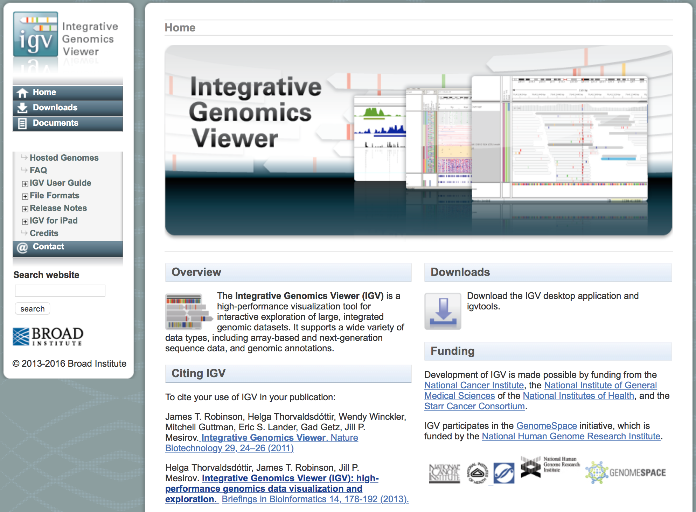
Integrative Genomics Viewer http://software.broadinstitute.org/software/igv/

Slide 3
Supporting materials
http://software.broadinstitute.org/software/igv/book/export/html/6
(user guide)
https://www.youtube.com/watch?v=IILfC3Uc6Vo
(youtube)
Paper (attached file IGV2011.pdf)
Documentation (attached file IGV-Roscoff-Septembre2015.pdf)

Slide 4
BAM + BAI files
I will use BAM and BAI files that were generated by Basil Khuder in our LAB on January 25th, 2017. These files are available from http://bpg.utoledo.edu/~afedorov/ABPG2017/Lecture6/
(however, BAM file is huge >4 GB )
Files: SG5_final_hg19.bam and SG5_final_hg19.bai

Slide 5
Take-home exam at the end of Unit1 (just before Spring break)
Each student will be assigned with a particular chromosome and should examine at least 10 human genes from this chromosome inside our SG5.bam file using IGV software. The goal of this project is to try to find possible mutations in exons of these genes that may be associated with the genetic disease. All observations and findings should be reported in the exam paper.
BONUS QUESTION. Find on your chromosome genes that are actively expressed in retina. Study five of these genes.

Slide 6
Dynamics of SNPs in a population is not trivial
Too many SNPs (millions)
Intricate arrangement of neighboring SNPs in different patterns (haplotypes and haplogroups)
Constant re-arrangements of haplotypes due to recombination events.

Slide 7
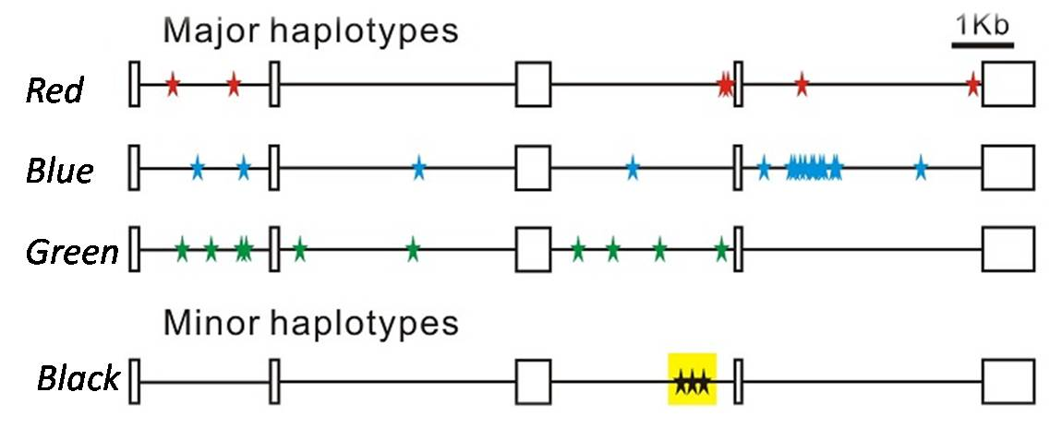
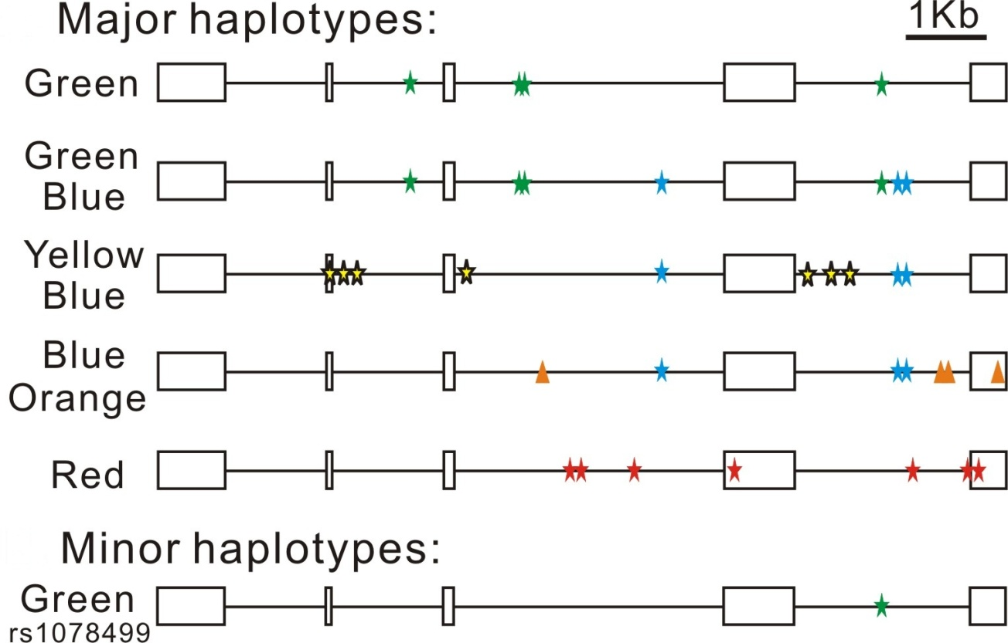
HAPLOTYPES and HAPLOGROUPS
HMOX1
AGT
Notes:
I do wish to point some exceptions in the examination of previously spoken super haplotypes only. Now in HMOX1 gene shown, we found a group of three mutations, that are not exactly strongly associated to each other, but they have a preferntial association with blue and green and a strong avoidance with red. Hence I have labelled it as a minor haplotype. In the AGT gene, I found several groups of mutations that like to associate with blue haplotype, in a way that blue never exists on its own but does so in association with either yellow, orange or green. And these can also be confirmed by obtaining several individuals who are homozygous with respect to a particular haplogroup. Since blue has a higher frequency of occurrence, one possible reason of its existence it originated earliest with respect to time and accumulated mutations with different frequencies in different population and thereby exists in such present haplotype configurations in the present day. However, the main focus of this project is not the study of ancestry or evolution of haplotypes. We next examine the biased gene conversion theory.

Slide 8
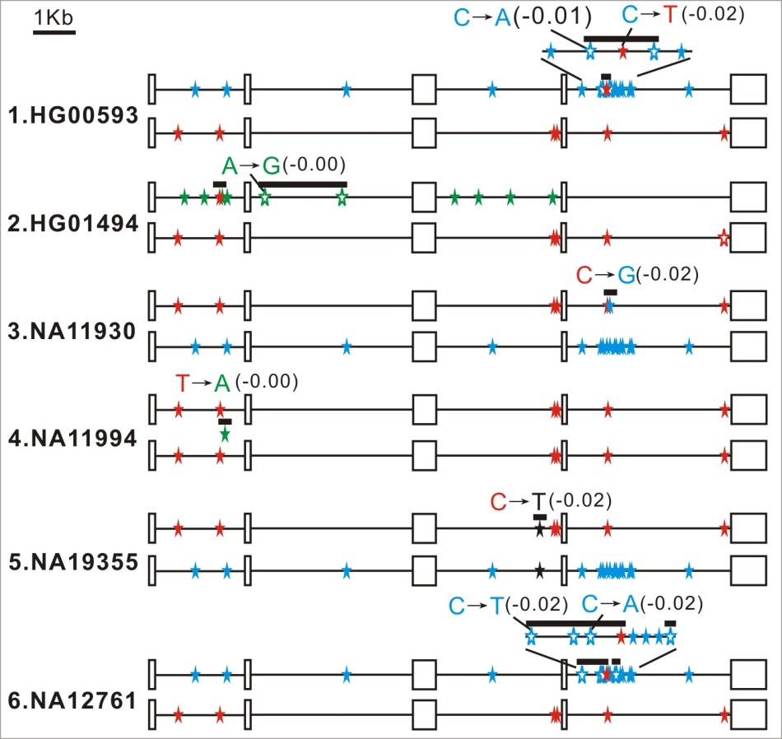
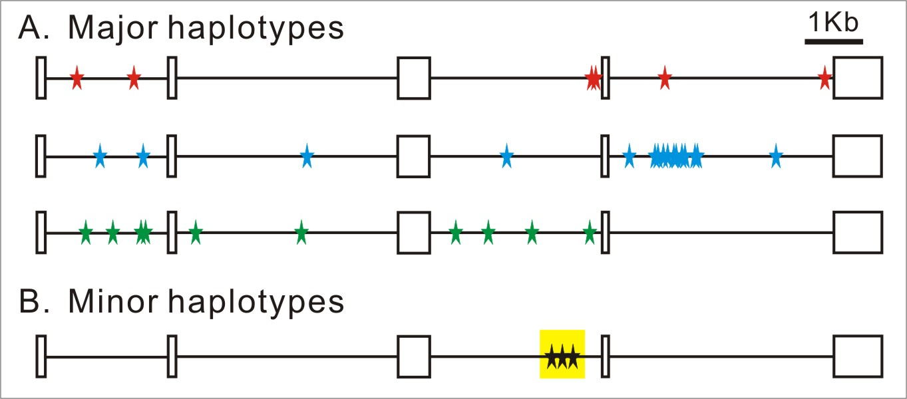
SNP flip-over SNPs can “jump” from one haplotype into another one.

Slide 9
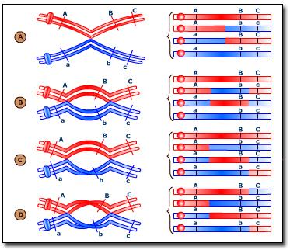
Meiotic recombination

Slide 10
Biased Gene Conversion Theory
Heteroduplex
Figure from Duret and Galtier, Annual rev. genet and hum.genomics, 2009
Notes:
Biased gene conversion theory was proposed in the last decade that explains the formation of heteroduplexes during meiotic recombinations as shown in green circles. During meiosis, if we assume that the blue chromosome and red chromosome came from different parents, then as homologous chromosomes participate in meiotic crossover, there are formations of short scale exchanges of genetic material known as heteroduplexes. Now, if there are polymorphic sites, a mismatch will occur and the repair mechanism driven by either of the two alleles will create a bias and hence a non-randomness in the nucleotide composition of the resulting gamete.

Slide 11
HETERODUPLEX FORMATION
A genotype study of individual NA12761 corresponding to HMOX1 gene as available from 1000 genomes data
Notes:
We next proceed to identify putative heteroduplexes through a manual study of the genotypes and haplotype alleles obtained through the previous programming approaches. This example of an individual NA12761 belonging to the Mexican population in Los Angeles has an allele in his HMOX gene which has been most likely caused due to a local recombination of the red with blue haplotype. Mismatch repair mechanisms driven by both the alleles resulted in preferential selection or deletion of either of them along different areas of the gene giving rise to one of the alleles that we see in the 1000 genomes database.

Slide 12
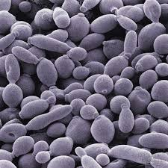
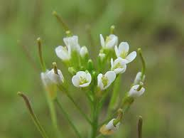
Implications of GC Biased Gene Conversion (gBGC) theory
Fixation of AT -> GC mutations
Evolution of GC rich isochors
Preventing the loss of 5 methyl cytosine from mammalian cells
Direct evidence found in yeast, arabidopsis and honeybee
Excess in recombination hotspots and fast evolving regions of human genome
We Support gBGC

Slide 13
1000 Human Genomes carry widespread signatures of GC biased gene conversion Rajib Dutta, Arnab Saha-Mandal, Xi Cheng, Shuhao Qiu, Jasmine Serpen, Larisa Fedorova, Alexei Fedorov 2017, paper under review
Surprisingly to us, we detected the strongest bias (16% excess) in AT->GC over GC->AT base pair changes within the set of 223,955 putative BGC events.
These results suggest that, on average, BGC is responsible for conversion of 3.6 AT base pairs to GC base pairs per human gamete.

Slide 14
Computational examination of putative SNP flip-over events

Slide 15
Problems in calculation of LD how to treat double heterozygotes?
SNP1
SNP2
maternal
AG
TG
paternal
LD_{AT} = F_{(AT)} – F_{(A)} * F_{(T)}

Slide 16
SHUHAO’s presentation

Slide 17
HOMEWORK L6
Download IGV program to your computer and learn how to work with it.

