Slide 1
ABPG 2017 Lecture/lab #7
Working with the Human Genome
Alexei Fedorov

Slide 2
Downloading Genomic sequences
NCBI ftp site releases, versions
gbk format, fasta format
TASK: get 90,000 bp nucleotide sequence of the LPL promoter (rs285 SNP, Lecture 1)

Slide 3
Human genome composition structure, organization, non-randomness
DNA repeats: interspersed (dispersed), tandemly organized, and simple repeats
Short and Long repeats
RepeatMasker program
TASK: Masking LPR promoter sequence

Slide 5
Composition of the human genome Jasinska A., Krzyzosiak W.J. FEBS Lett. 2004, 567:136-141

Slide 6
Tandemly organized DNA repeats - satellite or alphoid DNA
25% of the Human genome ?
millions of non-sequenced copies

Slide 7
40% of the Human genome are dispersed repetitive elements
L1 repeats 6,000 nt long
Alu repeats 300 nt long
Mir repeats
Minisatellites
Microsatellites

Slide 8
DNA fingerprint = restriction analysis of minisatellites
maternal allele
paternal allele
m
p
o
Gel electrophoresis

Slide 9
Retrotransposons and retroviruses

Slide 10
Alu-repeats evolved from 7SL RNA which is important component of Signal Recognition Particle (SRP)

Slide 11
“Mobile elements: Drivers of genome evolution” H. Kazazian Science, 2004, 303:1626-1632
Over millions of years of evolution, mobile elements have achieved a balance between detrimental effects on the individual and long-term beneficial effects on a species through genome modification. Indeed, we may soon learn that the shaping of the genome by mobile elements has played an important role in events leading to speciation. Whether these repeated sequences are now "junk DNA" is a complex issue. Some may have had an important function long ago, but have lost that role today. Others may never have had a function, yet the cluttering of our genomes with nonfunctional DNA was a small price to pay for the genome malleability they provided.

Slide 12
Homework Part 1
Take SNP rs560887
Get 90,000 bp sequence in front of it
Submit to RepeatMasker and analyze composition
Report differences in DNA repeats between your sequence and the LPL promoter region (we studied in the class)

Slide 13
Genomic sequence formats
Fasta
FastQ
BAM and SAM
BET

Slide 14
Integrative Genomics Viewer (IGV)
https://www.broadinstitute.org/igv/
IGV user guide
http://jura.wi.mit.edu/bio/education/hot_topics/igv/IGV.pdf
https://www.youtube.com/watch?v=5kkPnCV06dE VIDEO
https://www.youtube.com/watch?v=YeoHJFHnCrw

Slide 15
FastQ and SAM files
Demonstration neanderthal SAM 200 lines
Demonstration RNAseq files in BPG: /home/shuhao/JWilley/query1D.fastq

Slide 16
TopHat alignment
https://www.youtube.com/watch?v=MbW_f4eZNKM

Slide 17
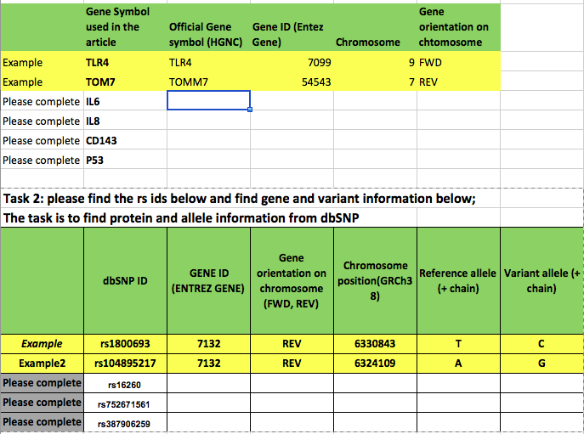
Homework part 2

