Slide 1
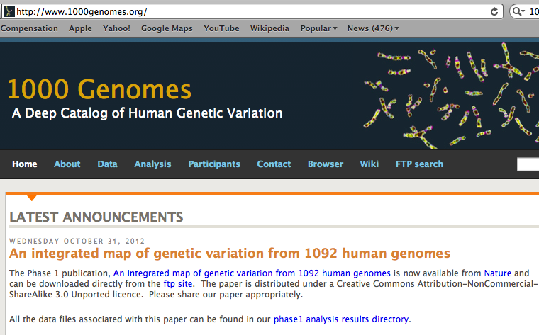
“1000 Genomes” international project

Slide 2
The 1000 Genome Project
ASW African Americans
YRI Nigeria
LWK Kenya
CEU Europeans in America
TSI Italy
FIN Finland
GBR Great Britain
IBS Spain
CHB Chinese in Beijing
CHS Chinese from South
JPT Japan
CLM Colombians
MXL Mexicans
PUR Puerto Rican
1000 Genome Project
LWK
FIN
JPT
GBR
CHB
TSI
PUR
MXL
IBS
CLM
CEU
ASW
YRI
CHS

Slide 3
BOTTOM LINE: Two individuals, even from the same population, differ from one another by millions of SNPs

Slide 4
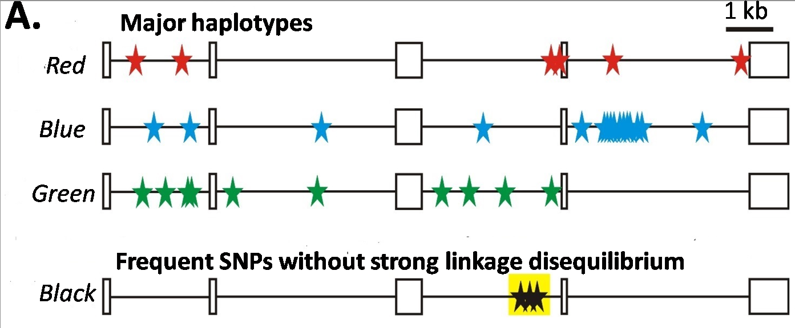
Major haplotypes of human hemeoxygenase-1 gene (only of frequent SNPs are shown)
The bottom line: Mutations never exist alone but in groups linked with each other and forming haplotypes that slowly change due to meiotic recombination and selection/drift

