Slide 1
Alexei Fedorov, Ph.D.
Associate Professor
Head of Bioinformatics Lab
Department of Medicine
Vice Director
Program in Bioinformatics and Genomics/Proteomics
Tel: (419)‑383‑5270
Email: alexei.fedorov@utoledo.edu
http://bpg.utoledo.edu/~afedorov/lab/

Slide 2
Accomplishment of “1000 Genome Project” revealed immense amount of information about variation, mutation dynamics, and evolution of the human DNA sequences.
Genomes of thousands patients have been sequenced
1092 genomes are publicly available
(~10x coverage)
Genomes of 12 famous humans are available(Jim Watson; Craig Venter) (~50x coverage)

Slide 3
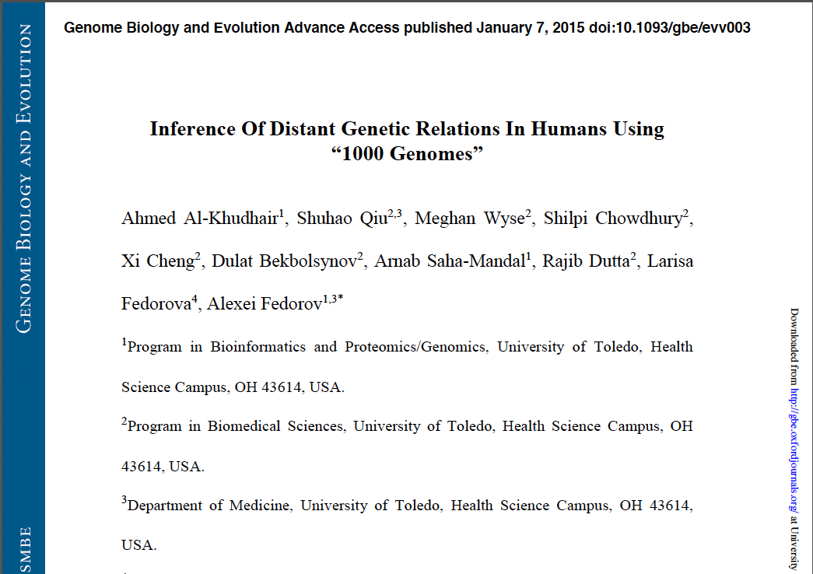

Slide 4
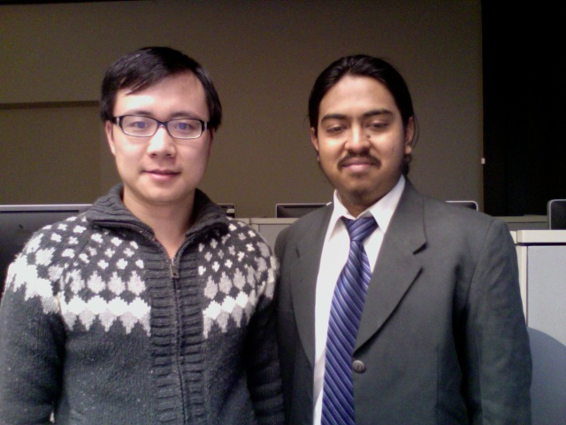
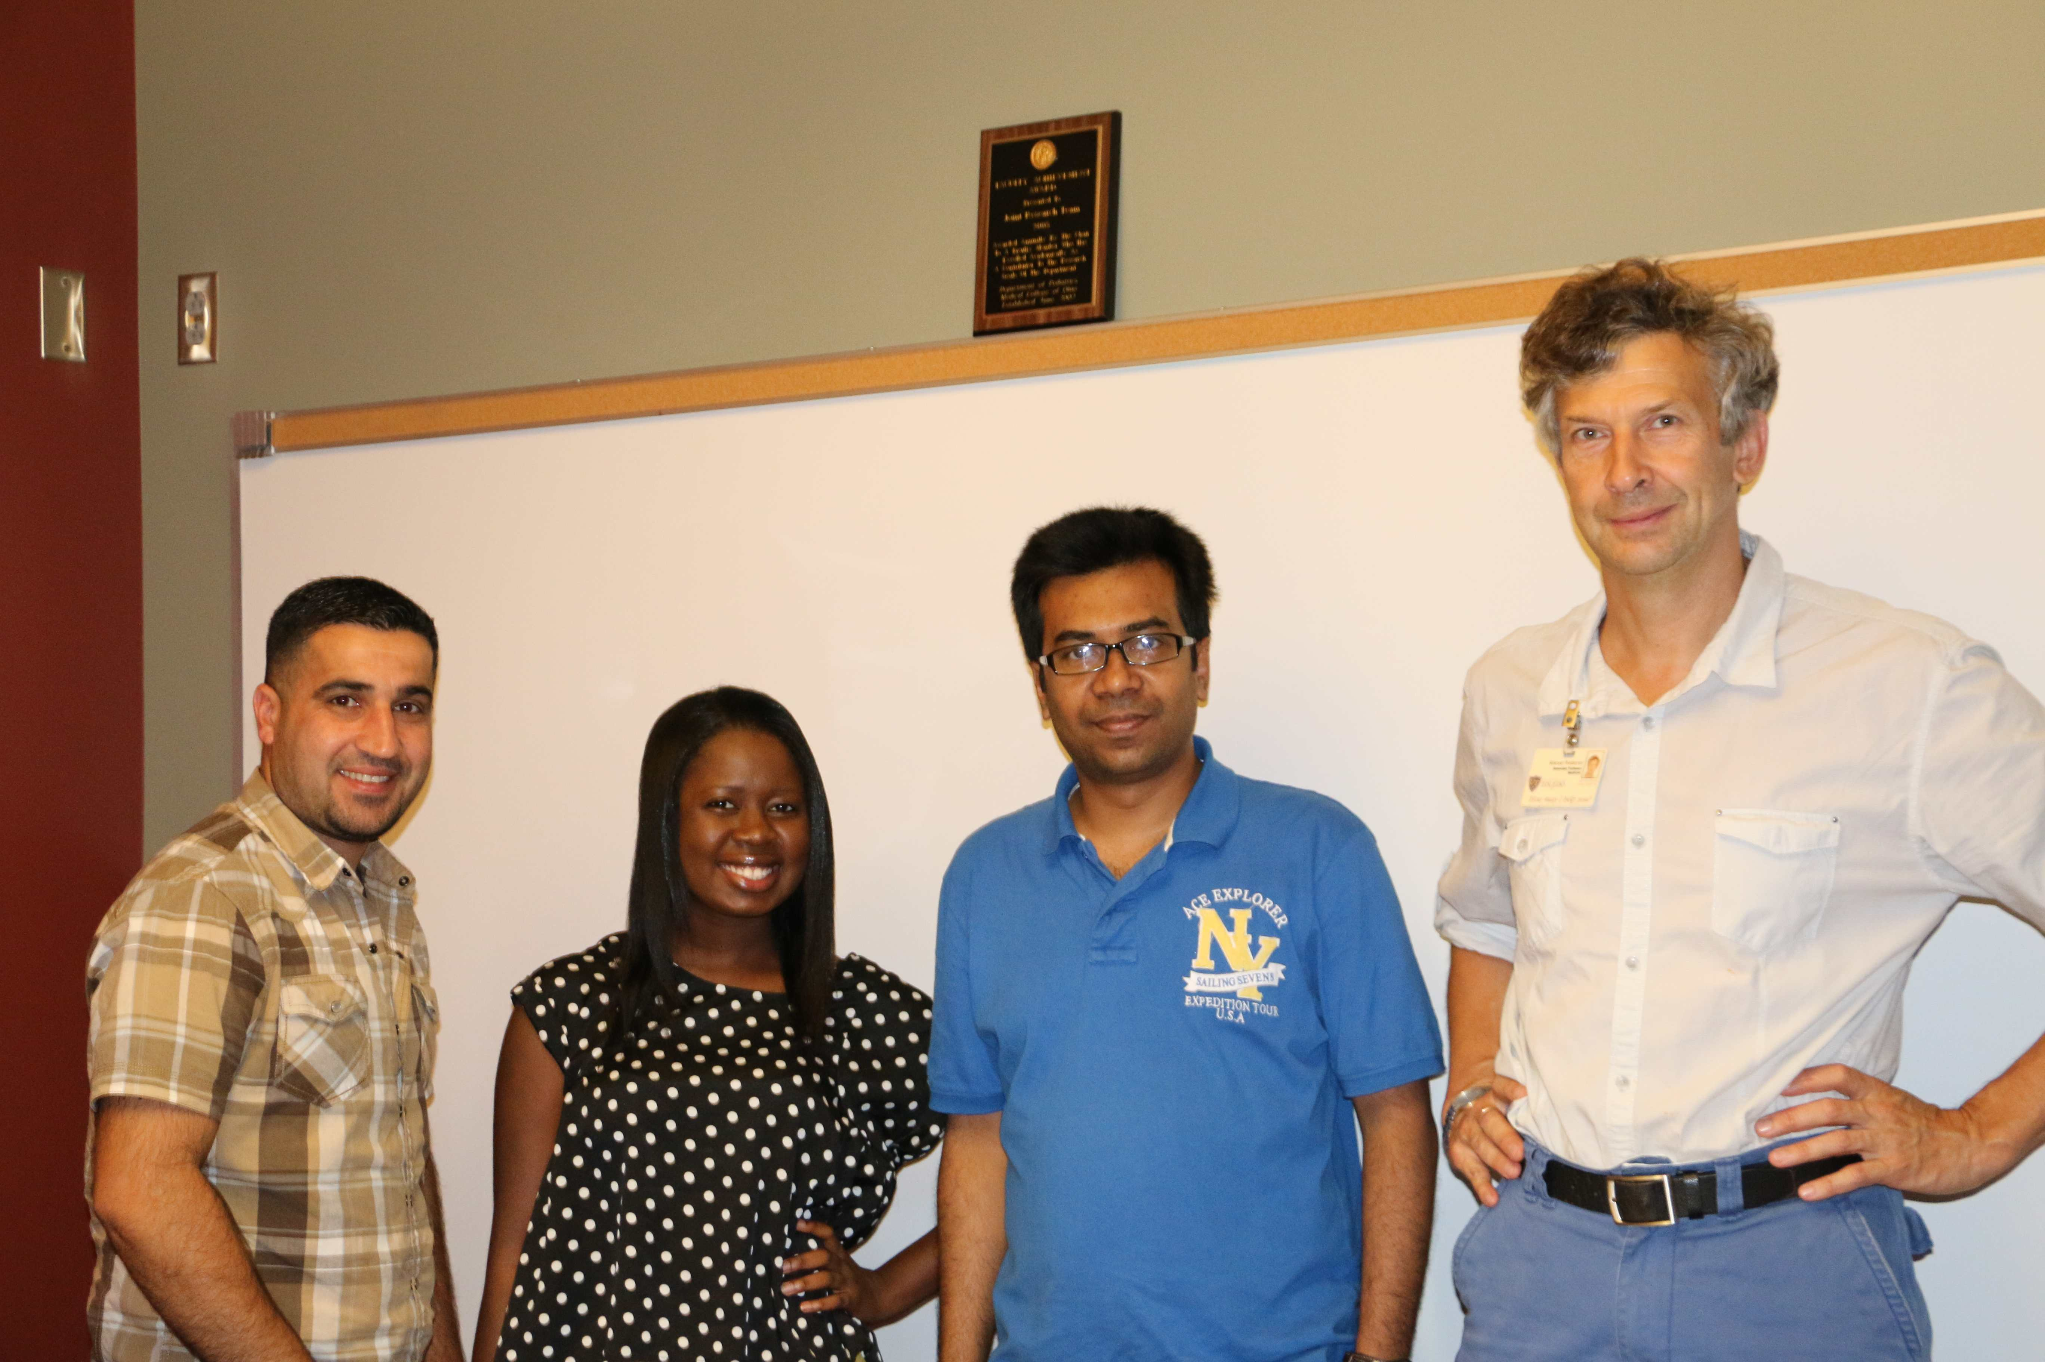
THANKS
Ahmed Al-Khudhair, Shuhao Qiu, Meghan Wyse, Shilpi Chowdhury,
Xi Cheng, Dulat Bekbolsynov, Arnab Saha-Mandal, Larisa Fedorova

Slide 5
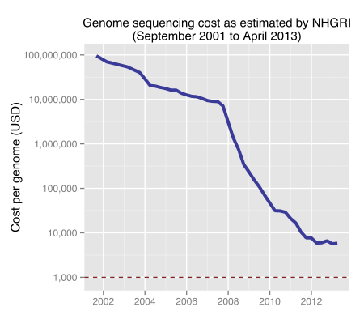
Wikipedia

Slide 6
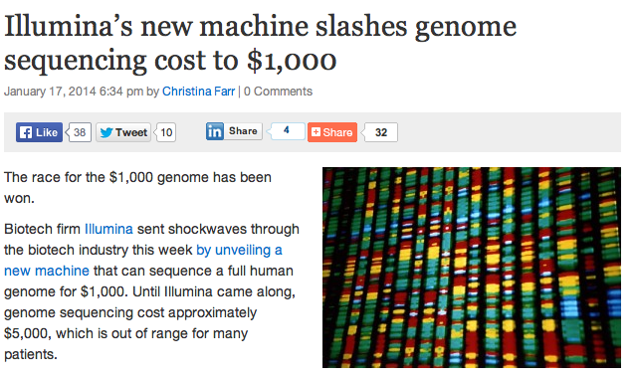
Presently: HiSeq X Ten

Slide 7
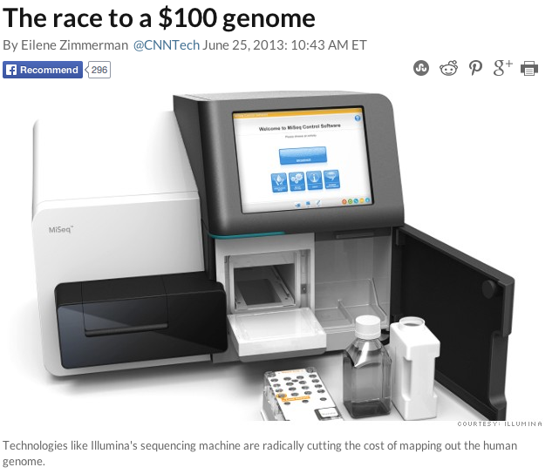
In the nearest future

Slide 8
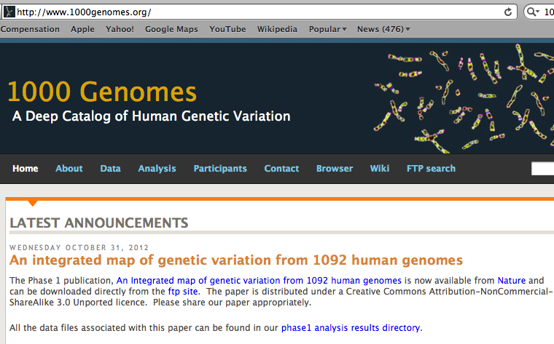
“1000 Genomes” international project

Slide 9
The 1000 Genome Project
ASW African Americans
YRI Nigeria
LWK Kenya
CEU Europeans in America
TSI Italy
FIN Finland
GBR Great Britain
IBS Spain
CHB Chinese in Beijing
CHS Chinese from South
JPT Japan
CLM Colombians
MXL Mexicans
PUR Puerto Rican
1000 Genome Project
LWK
FIN
JPT
GBR
CHB
TSI
PUR
MXL
IBS
CLM
CEU
ASW
YRI
CHS

Slide 10
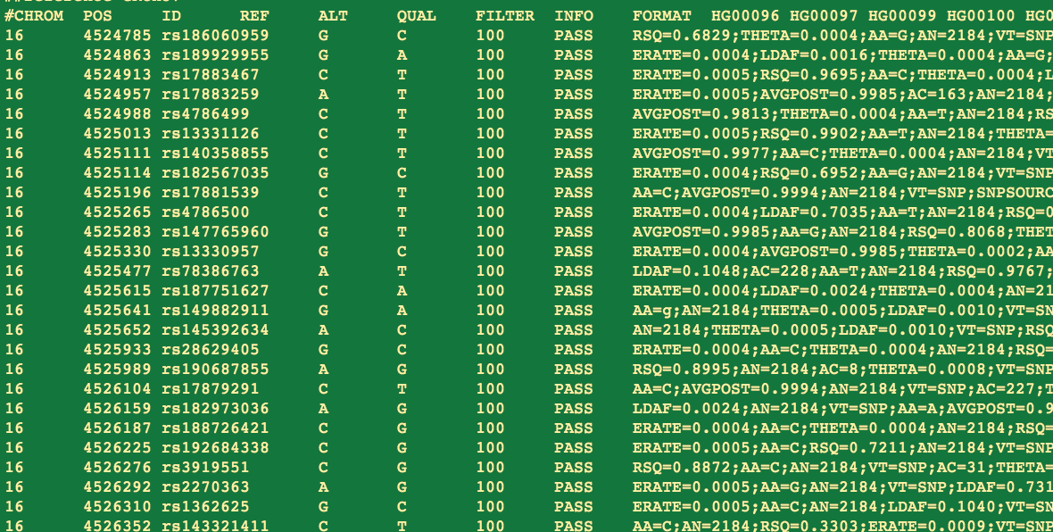
How genome sequence looks like?
38.2 M SNPs; 3.9 M short insertions/deletions; and 14 K deletions

Slide 11
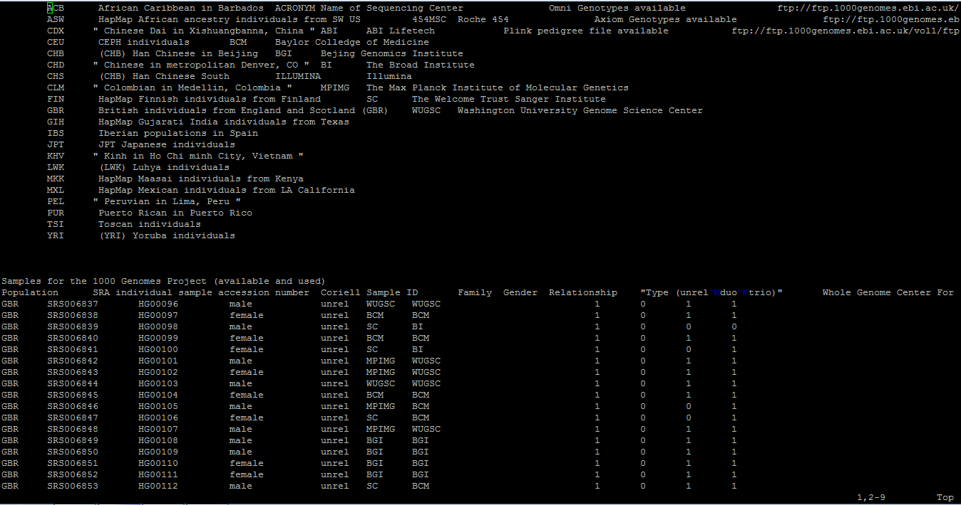
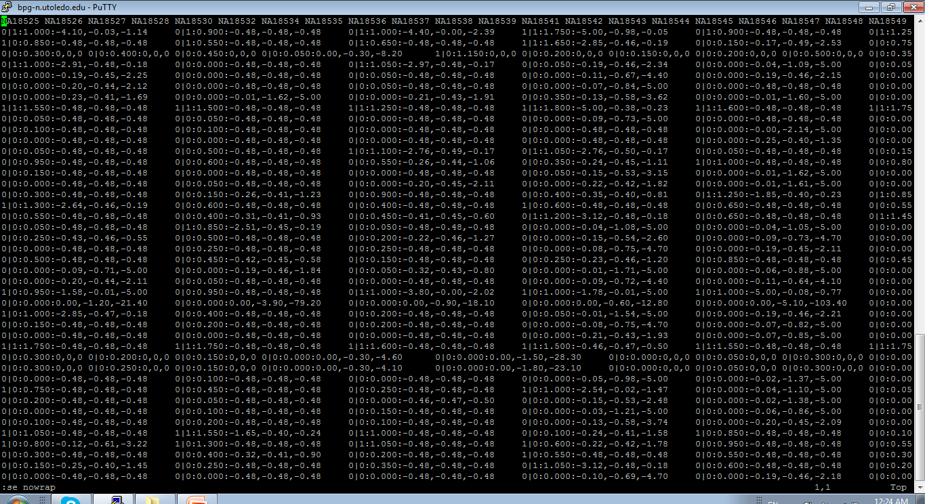

Slide 12
Human chromosome 1
4,814,628 lines =
=100,000 pages
= 100 books
(1000 pages each)

Slide 13
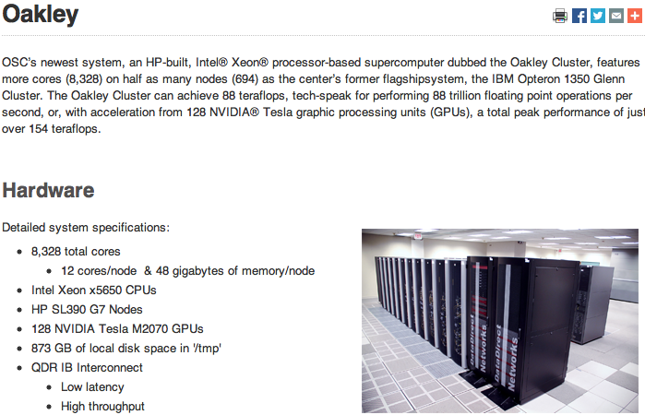

Slide 14
BOTTOM LINE: Two individuals, even from the same population, differ from one another by millions of SNPs

Slide 15
Differences between populations from different continents

Slide 16
Differences between populations from the same continent

Slide 17
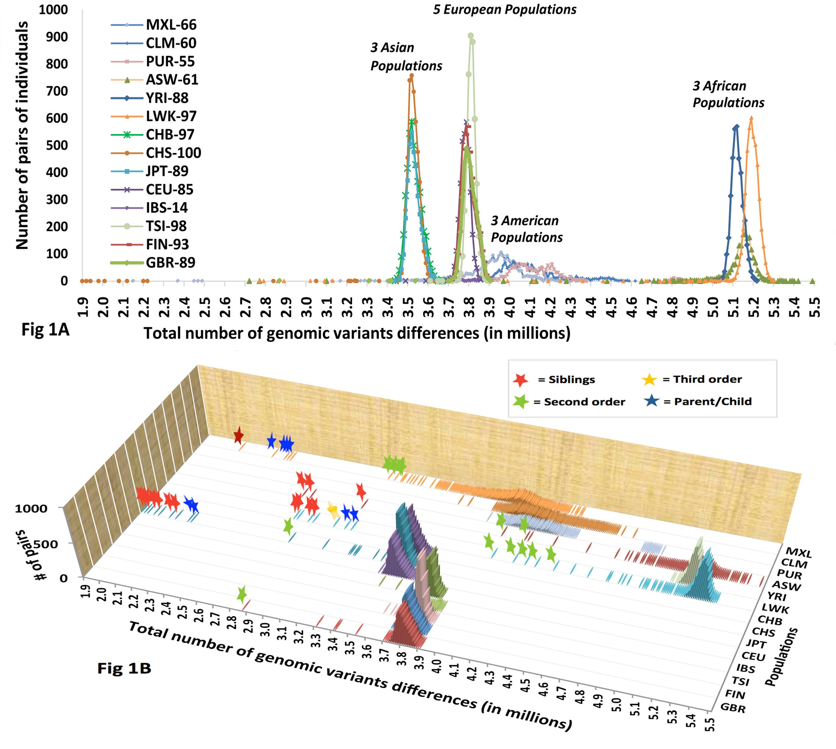
Why the peaks are narrow?

Slide 18
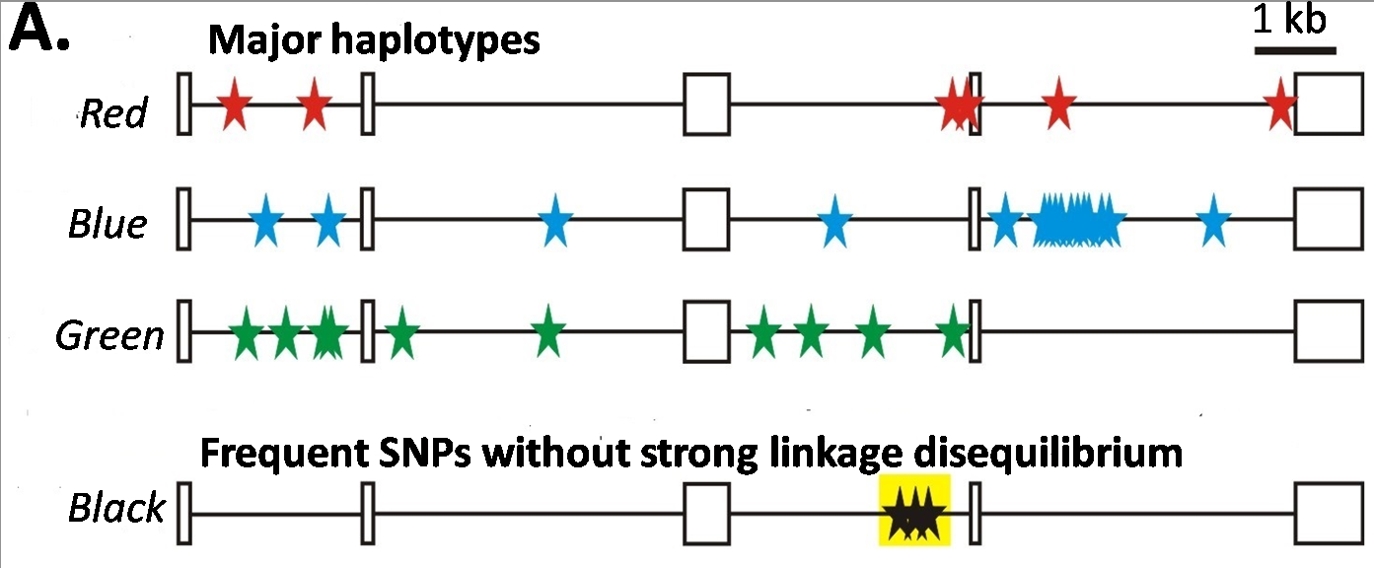
Major haplotypes of human hemeoxygenase-1 gene (only of frequent SNPs are shown)
The bottom line: Mutations never exist alone but in groups linked with each other and forming haplotypes that slowly change due to meiotic recombination and selection/drift

Slide 19
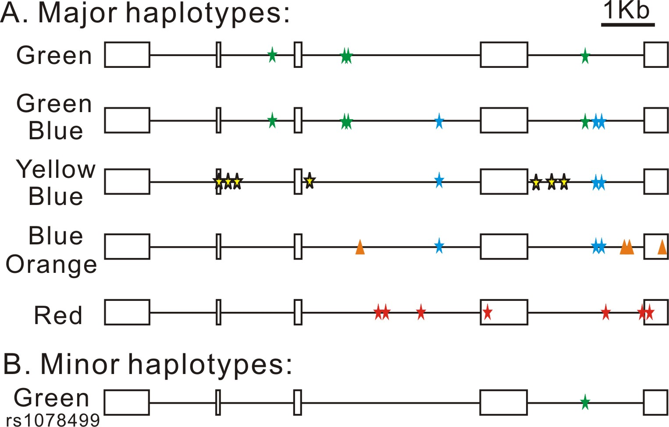
4th SNP of red haplotype in AGT responsible for myocardial infarction.
AGT gene

Slide 20
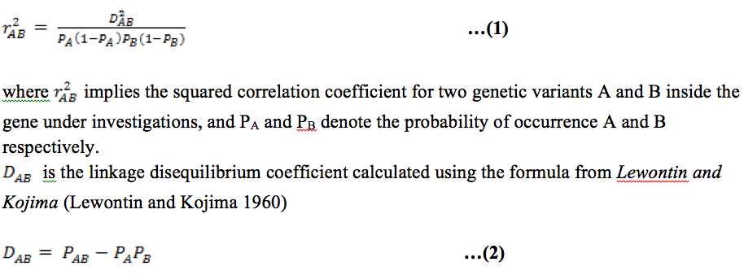
Linkage disequilibrium

Slide 21
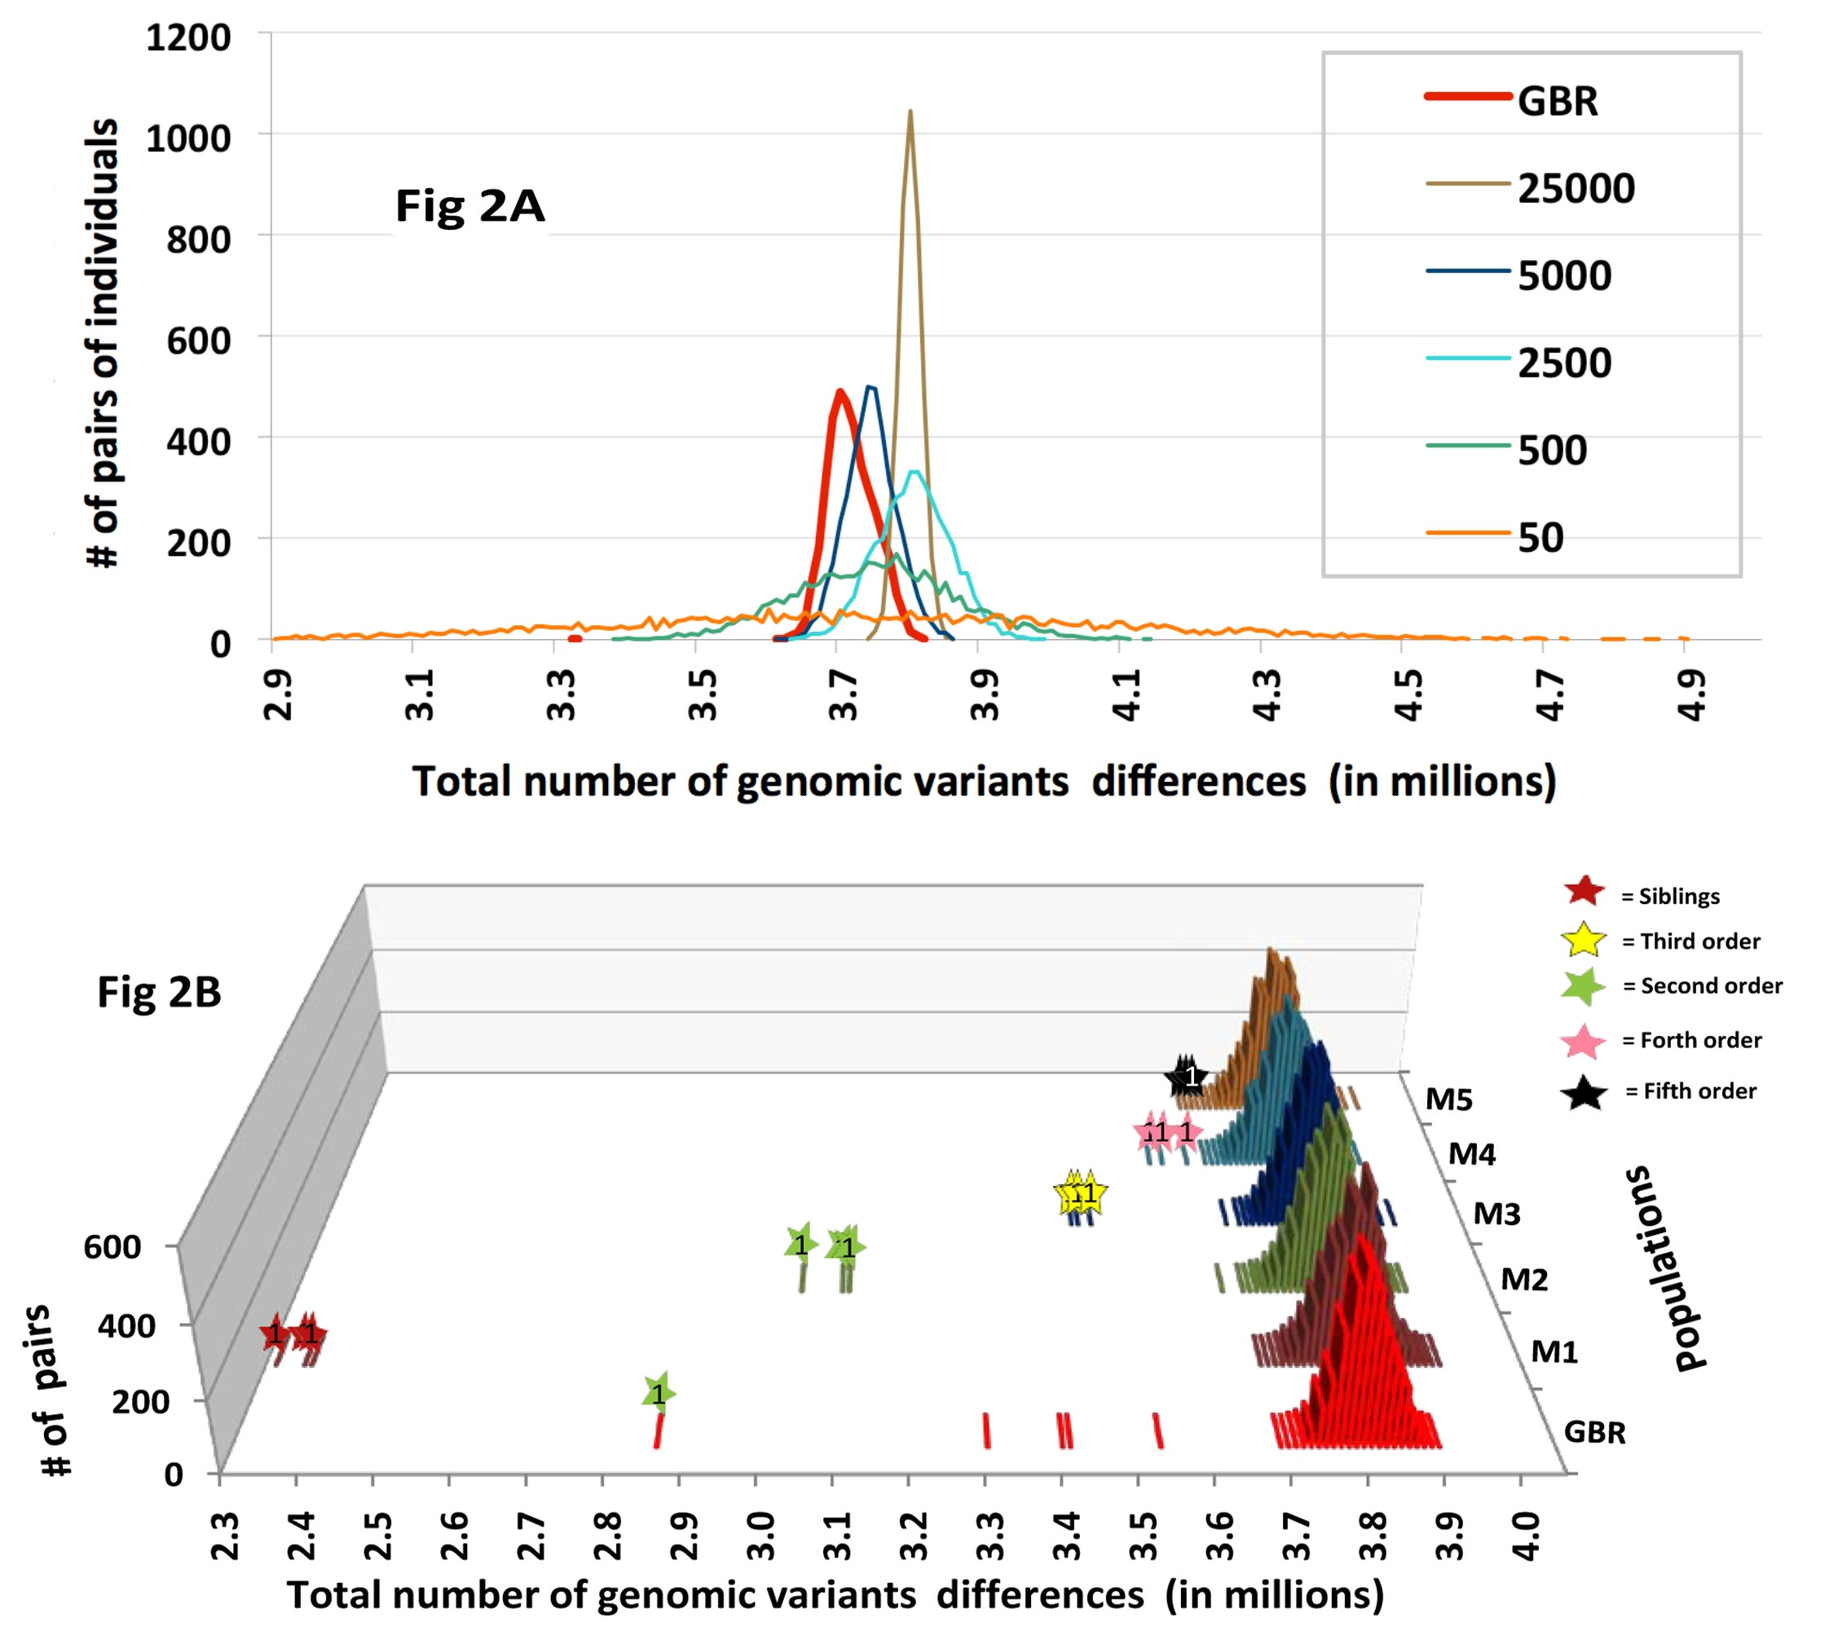
Why the peaks are narrow?
Number of loci
With equilibrium

Slide 22
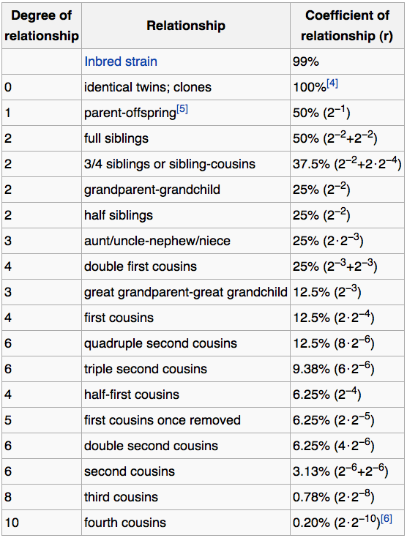
Wikipedia:
Coefficient of relationship
http://en.wikipedia.org/wiki/Coefficient_of_relationship

Slide 23
Finding distant genetic relationships
A majority of genomic differences between pairs of individuals is contributed by frequent SNPs that form several (usually from two to five) major haplotypes in each loci. These major haplotypes have a high probability of being the same between genetically non-related individuals.
This obstacle can be overcome if we consider only the very rare SNPs, for which probabilities of being shared by non-related individuals drop dramatically.

Slide 24
Very rare genetic variants (vrGVs)
Frequency less than 0.2% across all populations.
Number of vrGVs per individual
in different populations
Africa 67,000 ± 7,500
Asia 24,100 ± 4,100
Europe 16,200 ± 2,700

Slide 25
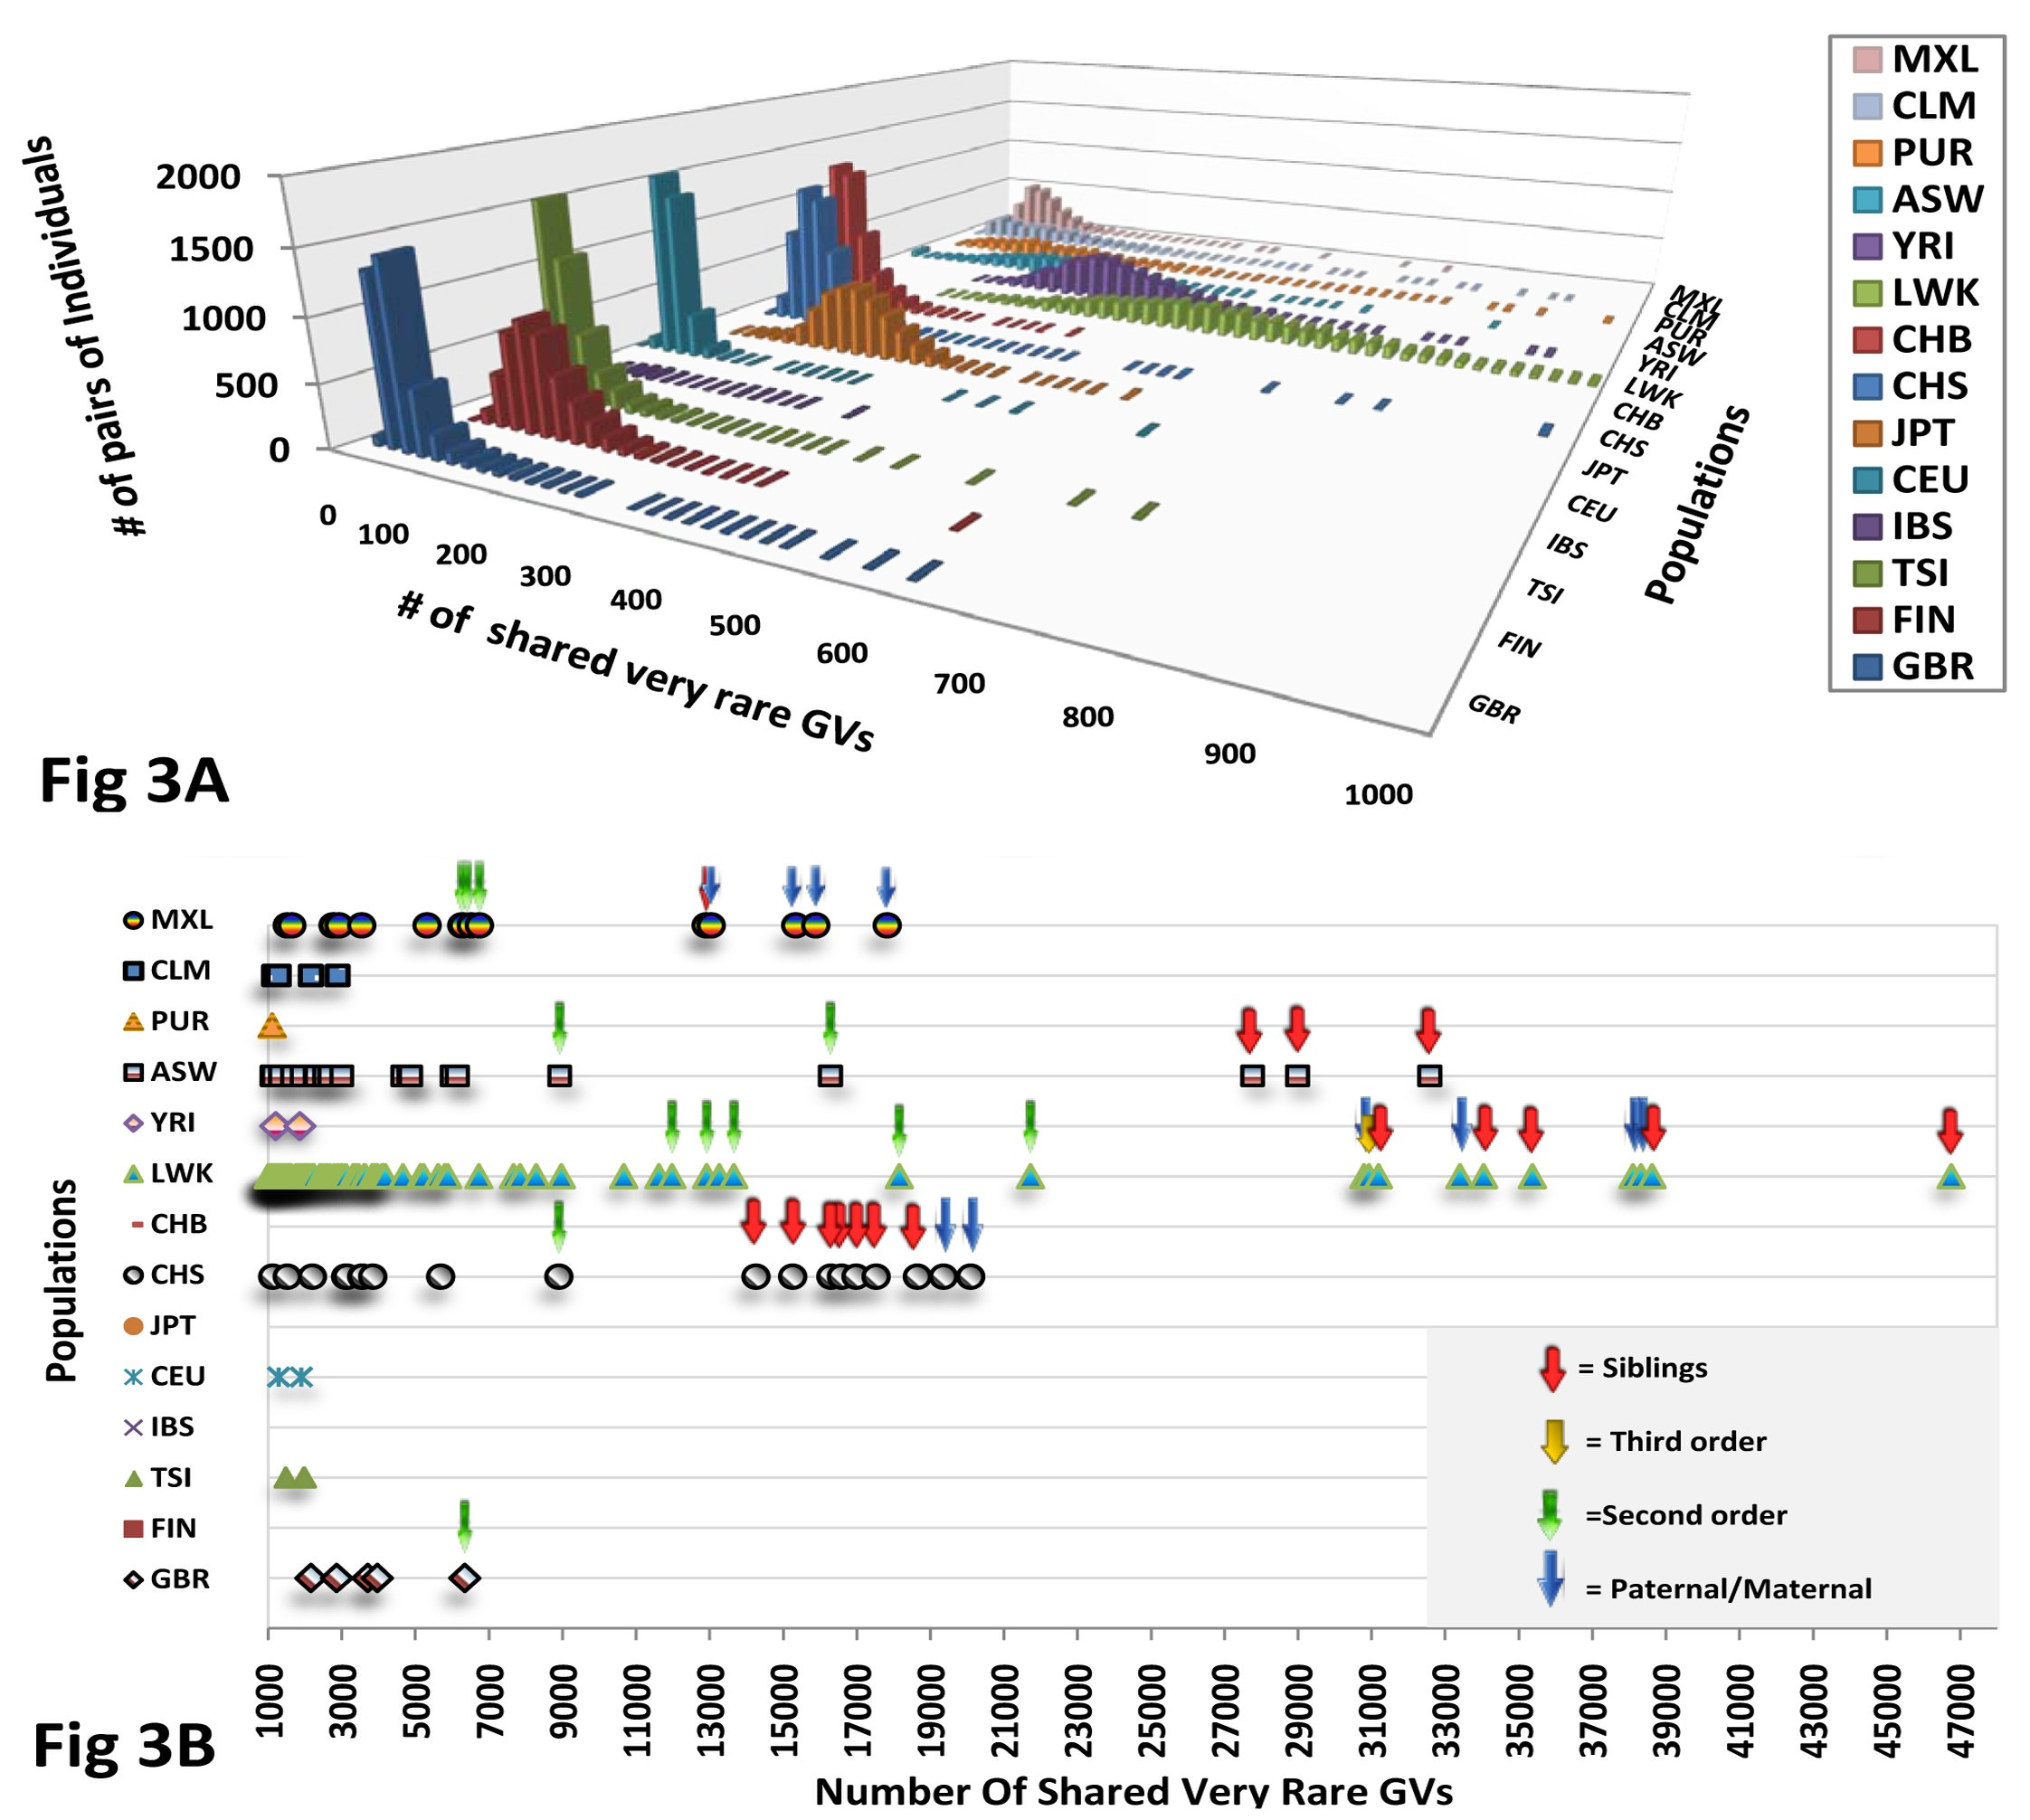
Number of shared vrGVs in human pairs from the same population

Slide 26
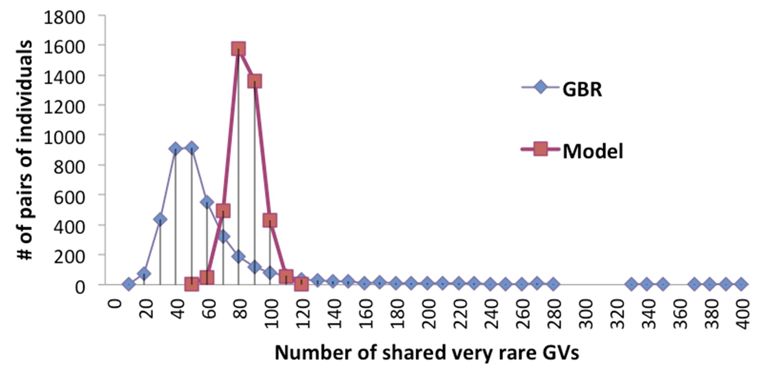
What is the chance for sharing vrGVs for non-related individuals?
Monte-Carlo computer simulations

Slide 27
Number of shared vrGVs between populations
The median number of shared vrGVs was 2 (for CHB-GBR populations), 6 (LWK-FIN), and 8 (for LWK-JPT)
44,278 studied pairs formed by individuals from two different continents have less than 118 shared vrGVs. The highest number of shared vrGVs between LWK and JPT is 37; LWK-FIN is 80; and GBR-CHB is 117
The number of shared vrGVs between populations from the same Asian or European continent is also low (for instance, maximal number between GBR and FIN is 159 and between CHB and JPT is 78)

Slide 28
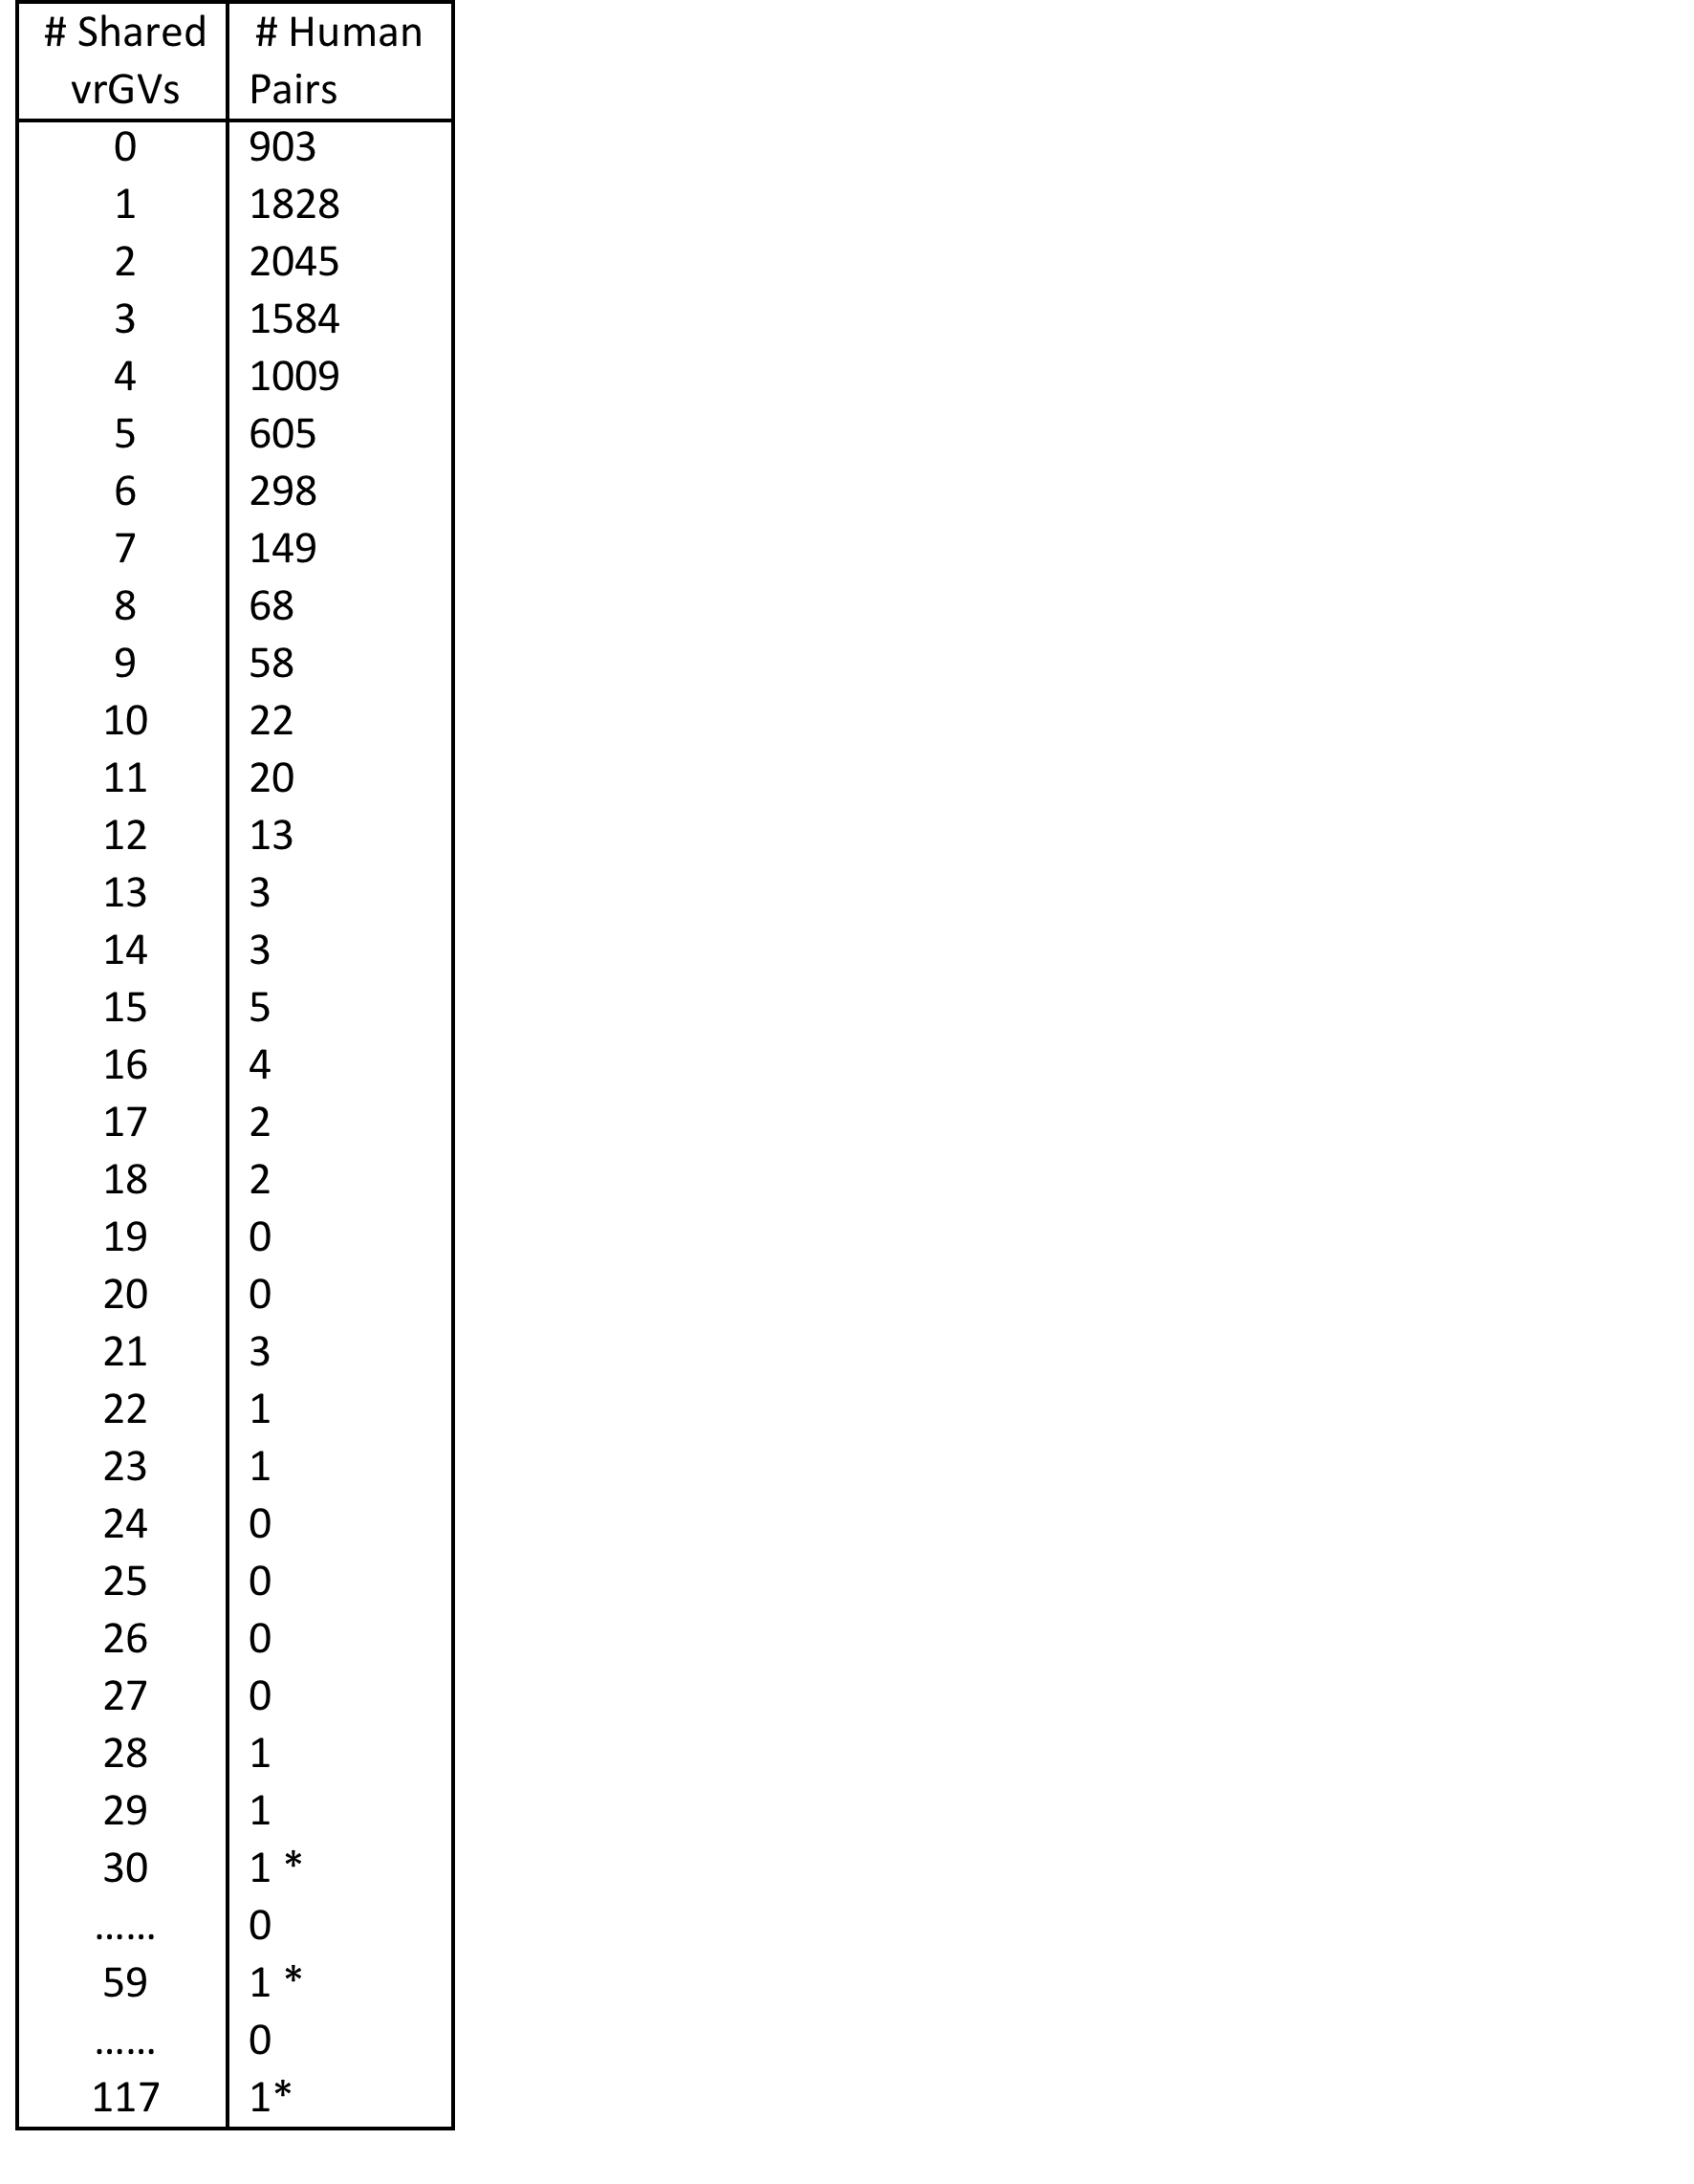
Table 1. Distribution of numbers of shared vrGVs for 8633 human pairs, where one person of a pair represents British population (GBR), while another person – Chinese population (CHB). *NOTES: detail characterization of shared vrGVs for the pair, which has 30 shared vrGVs, is shown in the Table 2. Detail characterization of shared vrGVs for three pairs at the bottom of this table (marked by *) is shown in the Supplementary Table S5.

Slide 29
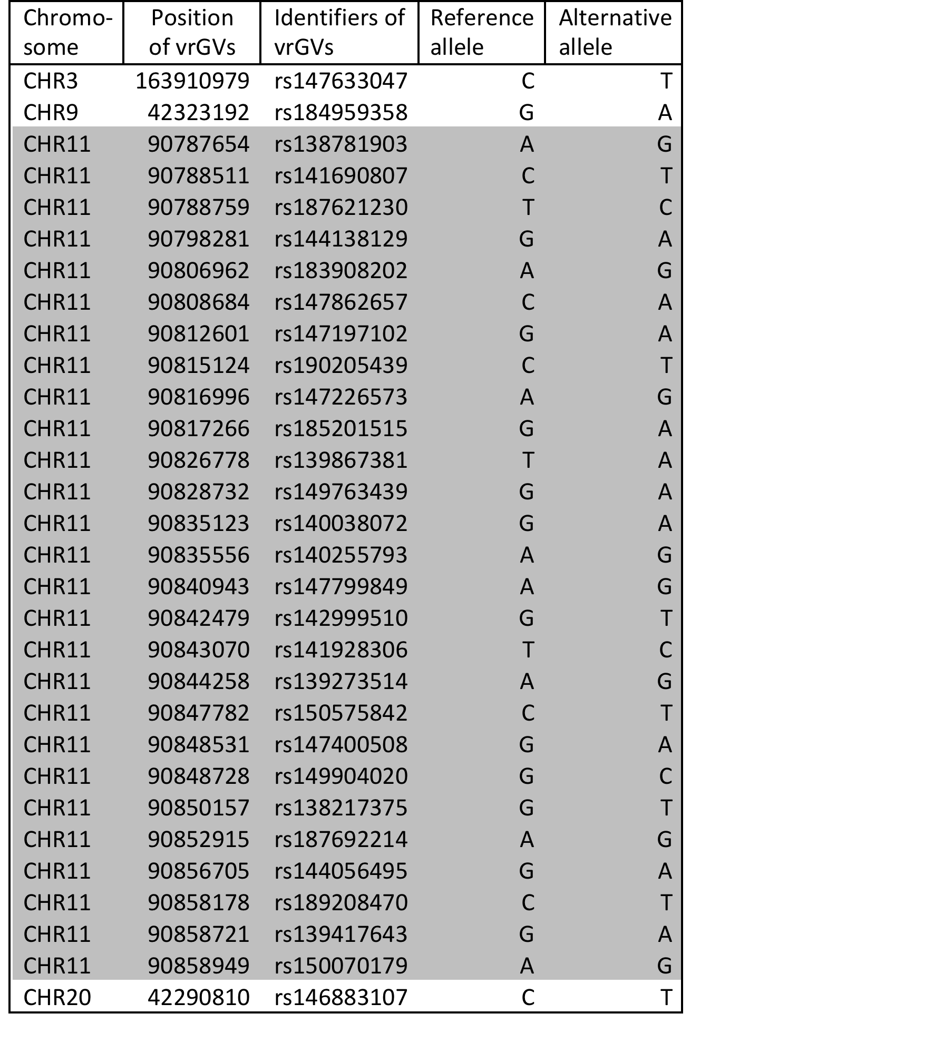
Table 2. Characterization of 30 shared vrGVs for the British-Chinese pair composed by HG00255 and NA18614 individuals. Those vrGVs that are located in the same locus on chromosome 11 are shaded.

Slide 30
How to calculate the coefficient of relationship from the number of shared vrGVs (N_{x})?
Use reference point – the number of shared vrGVs for siblings (N₅₀)
X%/(N_{x} –N_{peak}) = 50%/(N₅₀ –N_{peak})
N_{peak} is the number of shared vrGVs corresponding to the peak value (N_{peak}
approximates an average number of shared vrGVs for genetically non-related pairs)
N_{x} is the number of shared vrGVs for the pair under examination
ONLY FOR CLOSE RELATIVES !

Slide 31
Example of calculation of coefficient of relationship for Chinese population (CHS)
N_{x} = 303, N_{peak} =100
R = 0.59%
Third cousins
R=0.78%

Slide 32
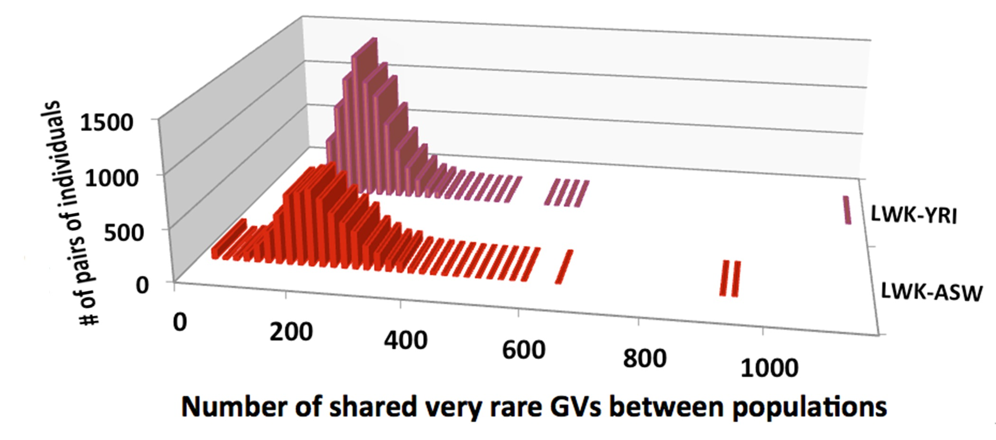
Number of shared vrGVs between African populations
NA19443– NA18508 pair for LWK-YRI has 1121 shared vrGVs (R =1.3%)
NA19350 - NA20348 and NA19397- NA20348 pairs for LWK-ASW have 903 and 939
of shared vrGVs respectively (R= 1.0%)

Slide 33
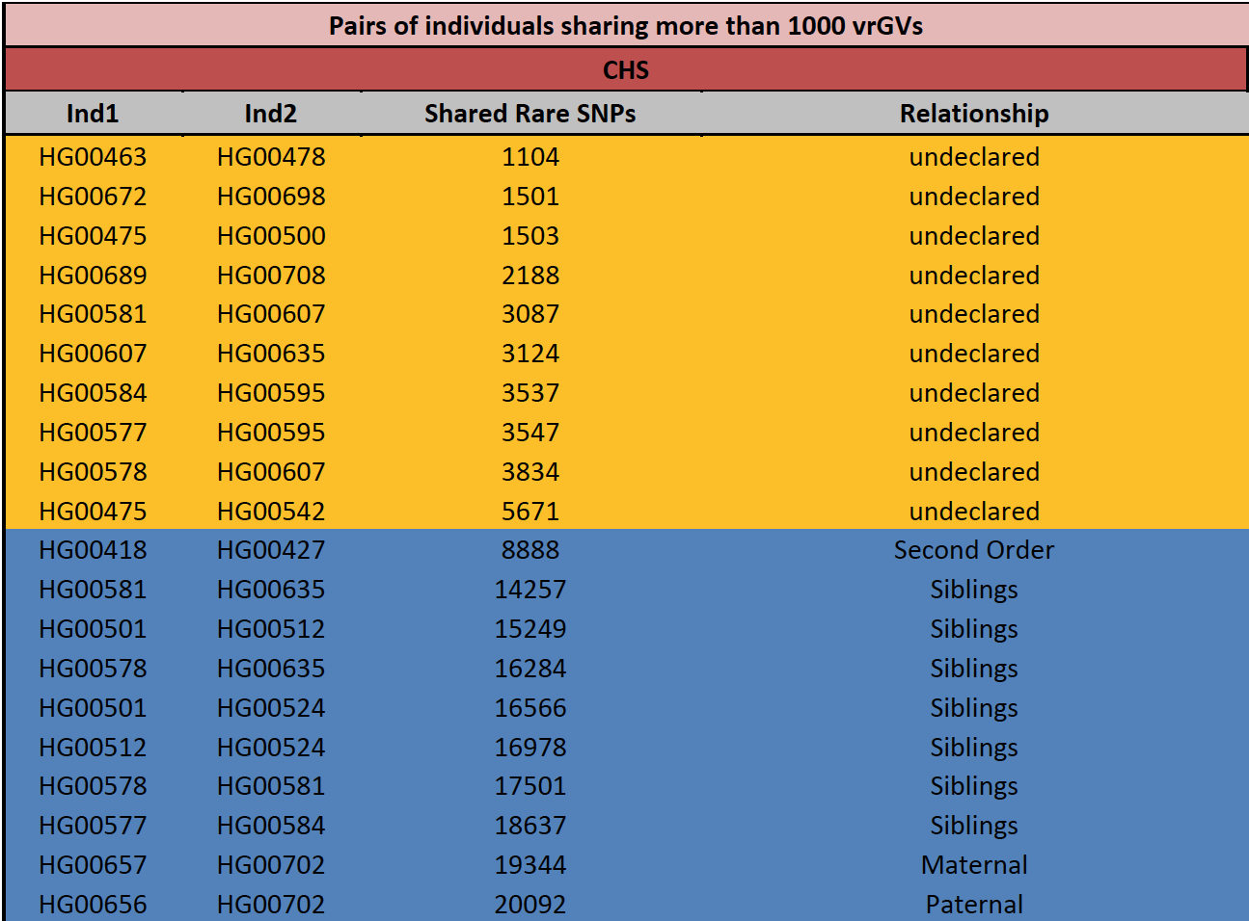

Slide 34
Nucleotide sequence differences on the whole-genome scale have been computed for 1092 people from 14 populations publicly available by the 1000 Genomes Project. Total number of differences in genetic variants between 96,464 human pairs has been calculated. The distributions of these differences for individuals within European, Asian or African origin were characterized by narrow unimodal peaks with mean values of 3.8, 3.5, and 5.1 million respectively and standard deviations of 0.1-0.03 million. The total numbers of genomic differences between pairs of all known relatives were found to be significantly lower than their respective population means and in reverse proportion to the distance of their consanguinity. By counting the total number of genomic differences it is possible to infer familial relations for people that share down to 6% of common loci identical-by-descent. Detection of familial relations can be radically improved when only very rare genetic variants (with frequencies less than 0.2%) are taken into account. Counting of total number of shared very rare SNPs from whole-genome sequences allows establishing distant familial relations for persons with 8th and 9th degree of relationship. Using this analysis we predicted 271 distant familial pair-wise relations among 1092 individuals that have not been declared by 1000 Genomes Project. With affordable whole-genome sequencing techniques, very rare SNPs should become important genetic markers for familial relationships and population stratification.

Slide 35
Dynamics of vrGVs
On average, each person has from 40 to 100 novel mutations that are absent in the genome his/her parents.
An intense influx of novel mutations is an important endless source for vrGVs, which pool continuously renovates and maintains at a very high level (14-40 thousand vrGVs per individual in European and Asian populations).

Slide 36
CONCLUSIONS
Application of vrGVs analysis for obtaining distant genetic relations could be a valuable molecular genetic technique in criminal investigations, in civil familial searching as well as for population, clinical and association studies.

Slide 37
Homework
1. Read the paper: Al-Khudhair A, Qiu S, Wyse M, Chowdhury S, Cheng X, Bekbolsynov D, Saha-Mandal A, Dutta R, Fedorova L, Fedorov A. Inference Of Distant Genetic Relations In Humans Using "1000 Genomes". Genome Biol Evol. 2015 Jan 7. pii: evv003. [Epubahead of print] PubMed PMID: 25573959.
2. Read to reviews on this paper from the first submission and the revision. Write an answer to these reviews (about one page long).

