Slide 1
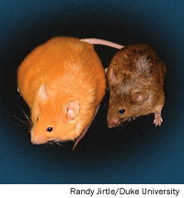
Epigenomics
Ivana de la Serna
Block Health Science 388
383-4111
ivana.delaserna@utoledo.edu
Notes:
i.e. folic acid, vitamin B12, choline and betaine) of Agouti mice during pregnancy alters adult phenotype by methylating a transposon in the promoter of the Agouti gene, not by directly mutating the gene. This epigenetic change not only changes coat color of offspring but also reduces their susceptibility to obesity, diabetes, and cancer; a clear example of "Nature via Nurture".

Slide 2
Outline
1. Epigenetics-definition and overview
2. DNA methylation/hydroxymethylation
3. Histone modifications
4. Nucleosome positioning
6. Methodology for assaying changes in DNA methylation and histone modifications
7. Epigenetic changes as biomarkers
8. Pharmacological targeting of epigenetic regulators

Slide 3
Goals
Know some of the key epigenetic modifications that are important in disease
Understand the mechanisms that give rise to epigenetic alterations in disease
Understand how epigenetic alterations can be used as biomarkers
How epigenetic regulators can be targeted in disease

Slide 4
Epigenetics/epigenomics- a definition
Any process that alters gene activity without changing the DNA sequence and leads to modifications that can be transmitted to daughter cells.
Epigenomics: global study of epigenetic changes across the entire genome

Slide 5
Epigenetics
All cells in a multicellular organism have the same genetic material, however, not every gene of an organism is active in each cell at all times.
Conrad Waddington (1905-1975) coined the term: “epigenetic landscape” to describe mechanisms that convert the genetic information into observable traits or phenotypes.
Epigenetic gene expression patterns and the associated phenotypes, once established, may persist through cell divisions without the involvement of a change in DNA sequence.

Slide 6
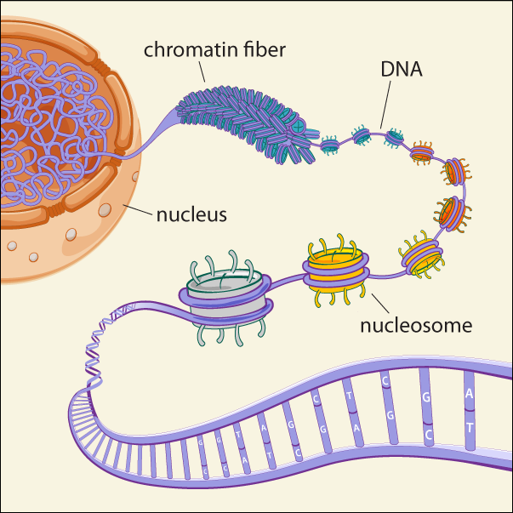
DNA/Chromatin
CH₃

Slide 7
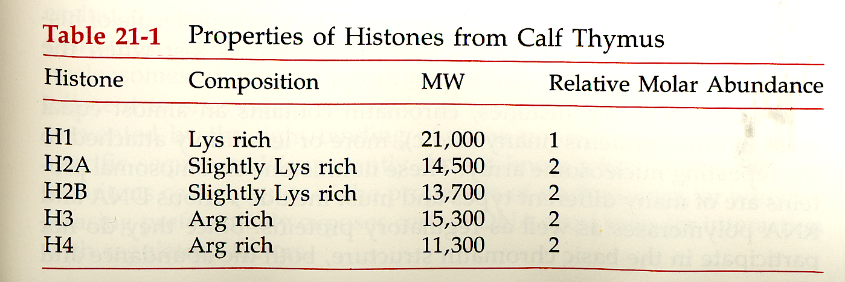
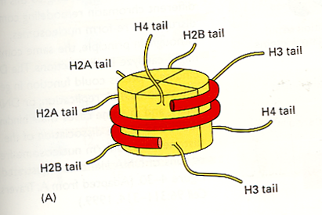
Nucleosome composition and Structure
Histone modifications
Acetylation
Methylation
Phosphorylation
Ubiquitination
Sumoylation
Ribosylation

Slide 8
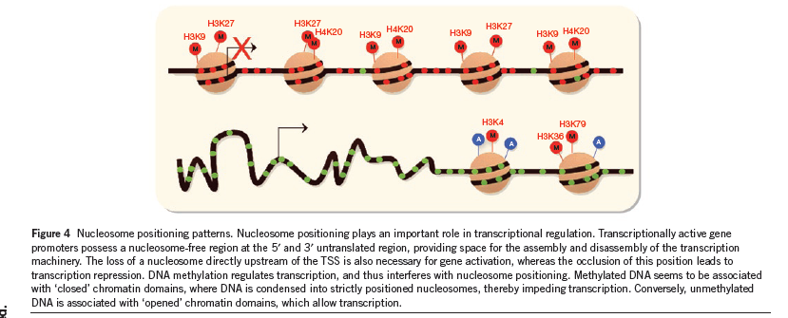
Epigenetics on a molecular level
Covalent modifications of cytosine bases and histones
Positioning of nucleosomes
Epigenetic modifiers
Gene expression
Non-coding RNA
mRNA

Slide 9
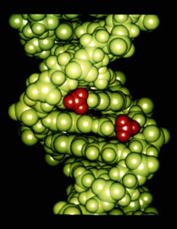
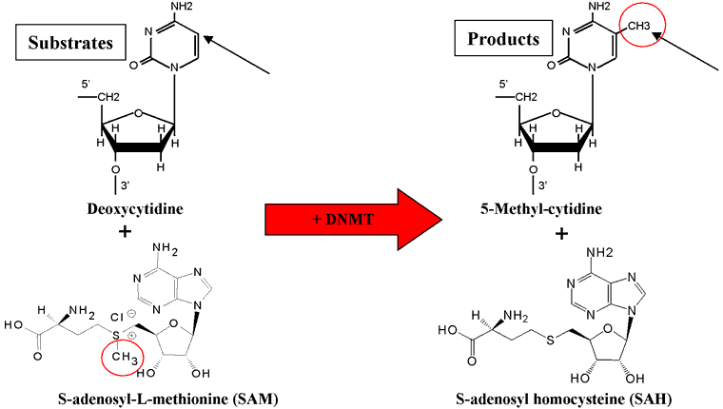
Covalent Modifications of DNA
Methyl groups
(red) in DNA
(provided by
Dr. Craig Cooney)
Most widely studied epigenetic modification is
cytosine methylation.
Notes:
DNA methylation involves the addition of a methyl group to the 5 position of the cytosine pyrimidine ring or the number 6 nitrogen of the adenine purine ring (cytosine and adenine are two of the four bases of DNA).

Slide 10
Fig. 1, Part 1
Functions of DNA methylation in mammals
Transcriptional gene silencing
Chromatin compaction
Genome stability
Suppression of homologous recombination between repeats
Genome defense
X chromosome inactivation (females)
Imprinting
Notes:
In mammals, however, a small proportion (<1%) of genes are imprinted, meaning that gene expression occurs from only one allele.^{[1]} The expressed allele is dependent upon its parental origin. For example, the gene encoding Insulin-like growth factor 2 (IGF2/Igf2) is only expressed from the allele inherited from the father.^{[2]}

Slide 11
Sites of Cytosine Methylation
CpG islands: regions of more than 200 bases (average of 1000 bases) with a G+C content of at least 50% (approximately 1% of the human genome, 60% of human gene promoters are associated with CpG islands.) CpG islands in promoters are usually unmethylated in normal cells. 6% become methylated in a tissue specific manner during early development or in differentiated tissues.
2. CpG island shores: regions of lower CpG density that lie in close proximity (2kb) of CpG islands. Most of the tissue –specific DNA methylation occurs in CpG island shores. 70% of the differentially methylated regions in reprogramming are associated with CpG island shores.
Gene body: seen in ubiquitously expressed genes, associated with transcriptional elongation.
Repetitive elements: protects chromosomal integrity by preventing reactivation of endoparasitic sequences that cause chromosomal instability, translocations, and gene disruption.
Notes:
DNA methylation principally occurs at cytosine residues
located in dinucleotide CpG sites [34,35]. CpG dinucleotides
are statistically under-represented in the genome but are found
concentrated at the expected levels in C+G rich regions termed
CpG islands that frequently coincide with promoter or gene regulatory
regions. However the bulk of lone CpG dinucleotides
are found within the intergenic and intronic regions of DNA
particularly within repeat sequences and transposable elements.
In normal somatic cells of human tissues, between 70 and 90%
of CpG dinucleotides are methylated which constitutes
approximately 0.75–1% of the total number of bases in the
genome [36,37].
In the healthy genome, most CpG islands are unmethylated,
and associated genes expressed [34] while the lone CpGs found
dispersed throughout the rest of the DNA are mostly methylated

Slide 12
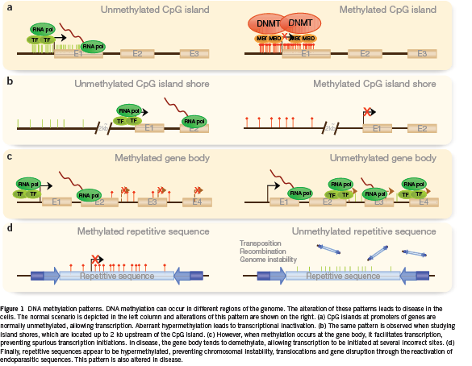
DNA Methylation and Gene Expression
STOP
STOP
Go

Slide 13
DNA Methyltransferases (DNMTs)
DNMT family members:
DNMT1, DNMT2, DNMT3A, DNMT3B, DNMT3L
DNMT3A and 3B: highly expressed in embryonic stem cells and thought to establish the pattern of methylation during embryonic development by catalyzing de novo methylation.
DNMT1: prefers hemi-methylated DNA but can methylate DNA de novo. Is the most abundant DNMT and required for maintenance of methylation patterns. It is required to methylate hemi-methylated sites during replication (in conjunction with UHRF1 and PCNA).
Notes:
UHRF1: ubiquitin-ike plant homeodomain and ring finger domain-containing protein 1-has SET domain that can recognize hemi-methylated DNA-tethers DNMT1.
DNMT3L stimulates DNMT3A and B
DNMT2 may methylate tRNA
May be recruited to specific regions by other epigenetic factors and by siRNA
(plants)/

Slide 14
Diet high in methyl donors promoted DNA methylation at agouti locus.
DNA methylation of CpG islands turned off agouti expression.
Melancortin receptors were activated.
Phenotype was strikingly changed.

Slide 15
Common Cancer Related Aberrations in DNA Methylation Patterns
Massive global loss of DNA methylation(20% to 60% less overall 5-methylcytosine).
Global hypomethylation occurs mainly at repetitive sequences, promoting chromosomal instability, translocations, gene disruption, and reactivation of endoparasitic sequences.
Hypo-methylation at specific promoters can activate the aberrant expression of oncogenes and induce loss of imprinting (LOI )
Hyper-methylation at the CpG islands of specific promoters can activate aberrant expression of oncogenes and induce loss of imprinting in some loci.
Most hyper-methylation in cancer occurs in CpG island shores.
Hyper-methylation patterns are tumor-type specific.
Notes:
Hypermethylated promoters:
DNA repair: MLH1, MGMT, WRN, BRCA1, p16, rb, p53 network
Hypermethylated island shores-eg HOXA2 GATA2
Hypermethylation also contributes to silencing of some microRNA genes

Slide 16
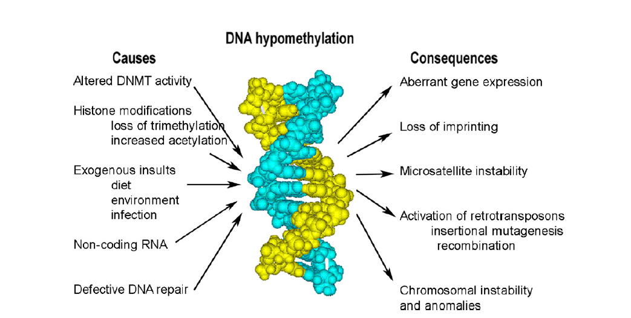
Re-activation of retrotransposons?
DNA hypermethylation
Silencing of tumor suppressors

Slide 17
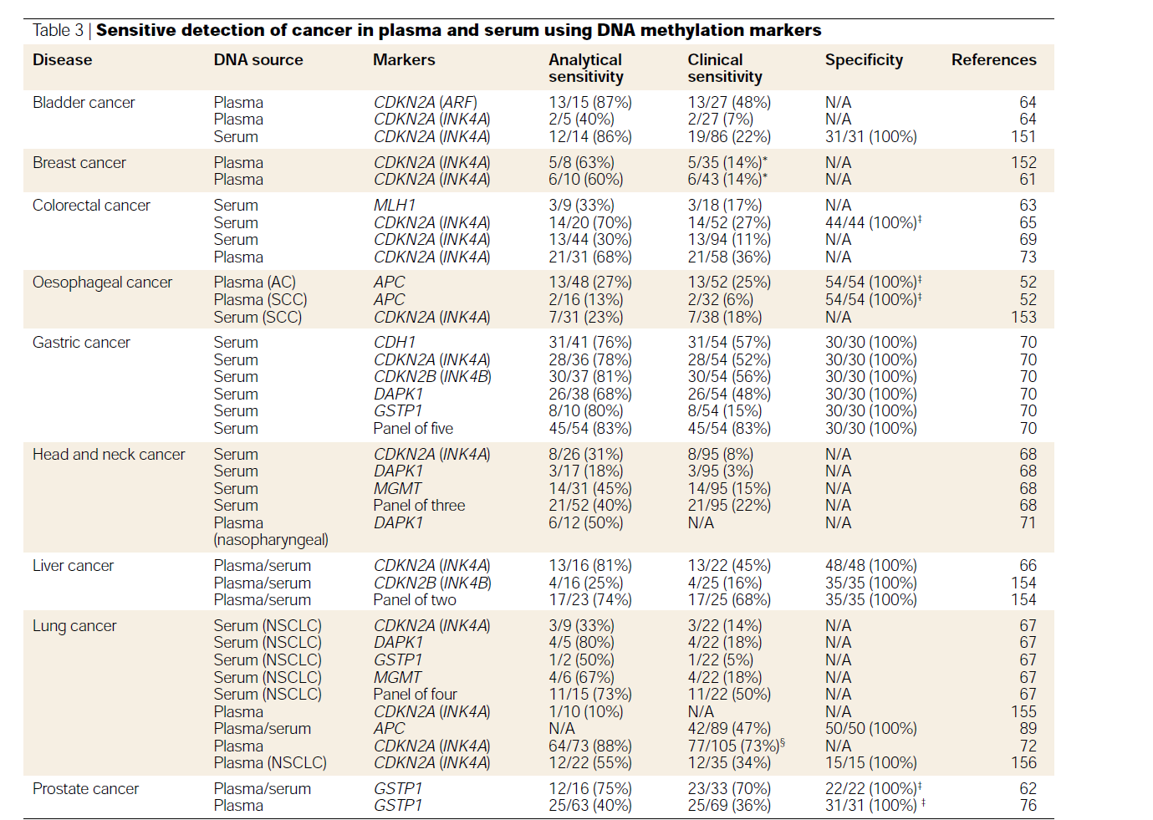

Slide 18
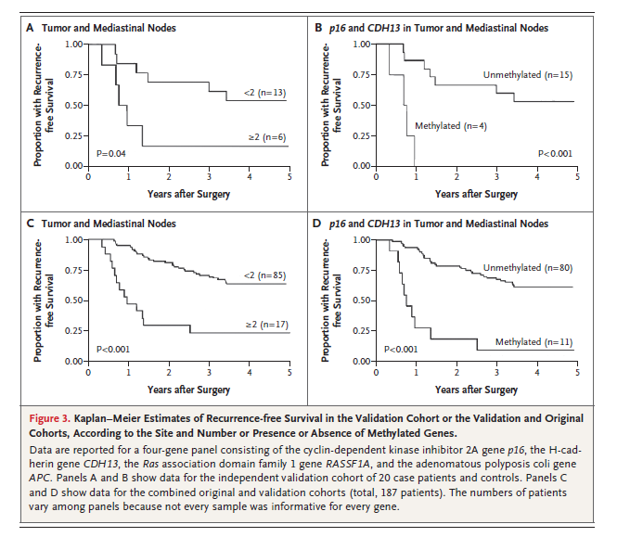
DNA Methylation and Patient Survival in Lung Cancer
Brock et al, New England Journal of Medicine, 2008
Notes:
Fifty-one patients with stage I NSCLC who underwent curative resection but who
had a recurrence within 40 months after resection (case patients) were matched on
the basis of age, NSCLC stage, sex, and date of surgery to 116 patients with stage I
NSCLC who underwent curative resection but who did not have a recurrence within
40 months after resection (controls). We investigated whether the methylation of seven

Slide 19

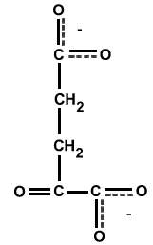

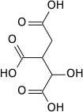
Hydroxymethylation
CO₂
TET proteins: family of hydroxylases
Ten-eleven translocation 1 (TET1) is the founding member of this family
Tet proteins are responsible for the conversion of 5mC to 5mhC in a 2-oxoglutarate- and Fe(II)-dependent manner
TET1
Initially identified in acute myeloid leukemia (AML) as a fusion partner of the histone methyltransferase, mixed-lineage leukemia(MLL)
Converts 5-methylcytosine (5mC) to 5-hydroxymethylcytosine (5hmC)
Can find 5mC oxidation derivatives on genomic DNA
IDHs (isocitrate dehydrogenases)
The cofactor α-ketoglutarate (α-KG) is absolutely required and plays a positive and critical role in the conversion of 5-mC to 5-hmC . Isocitrate dehydrogenases (IDHs) catalyze oxidative decarboxylation of isocitrate, producing α-ketoglutarate (α-KG) and CO₂
α-KG
CO₂
Succinate
IDH
Isocitrate

Slide 20
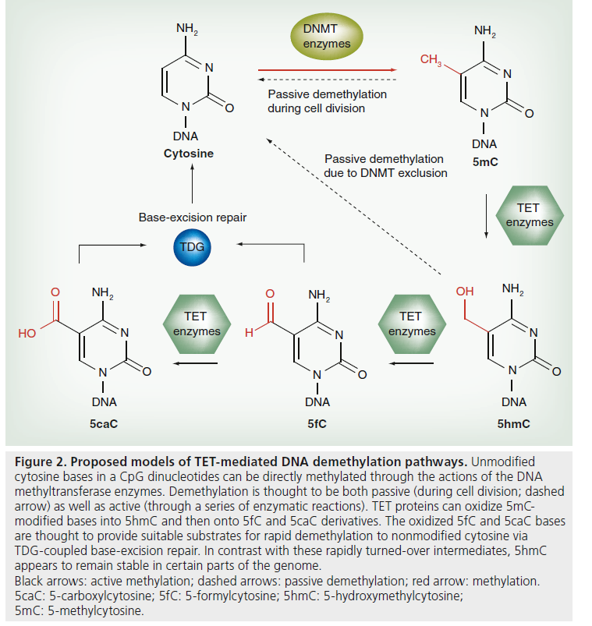
Notes:
Although the biological significance of Tet-mediated oxidation of 5mC is largely unclear, the relative abundance of 5mC oxidation derivatives such as 5hmC in genomic DNA suggests that these modified cytosine bases may play important roles in modulating 5mC-dependent gene regulatory and biological functions.
Methyl binding proteins such as methyl-cpg-binding proteins 2 (MeCP2) do not recognize 5hmC

Slide 21
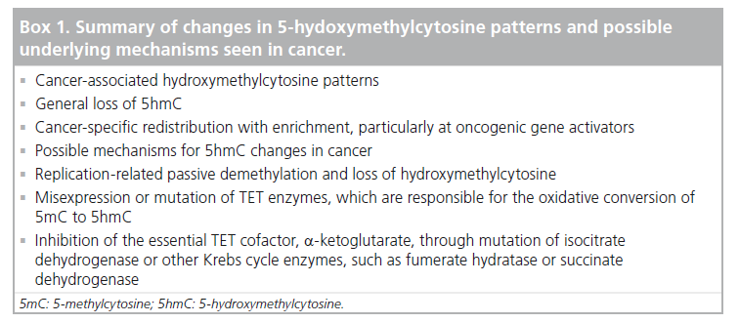

Slide 22
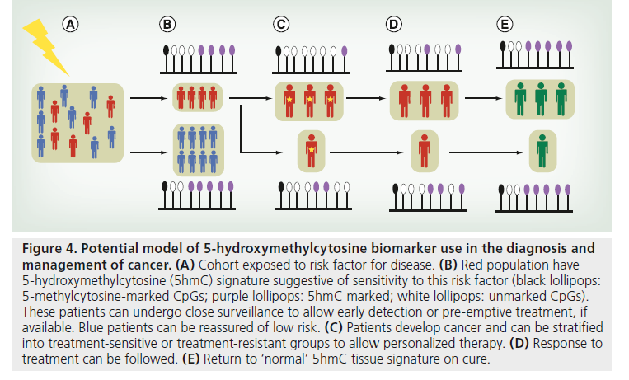

Slide 23
Methods for detecting DNA methylation
Methylation sensitive restriction enzymes
Immunoprecipitation based enrichment assays
Methylation sensitive PCR (MSP)
Bisulfite conversion

Slide 24
Methylation-Sensitive Restriction Digestion Assay
Cost effective method for initial screening
HELP Assay
Use restriction enzymes (HpaII and MspI) to determine methylation status
HpaII Tiny Fragments (HTFs)
HTF enrichment by ligation-mediated PCR
Combine with microarrays

Slide 25
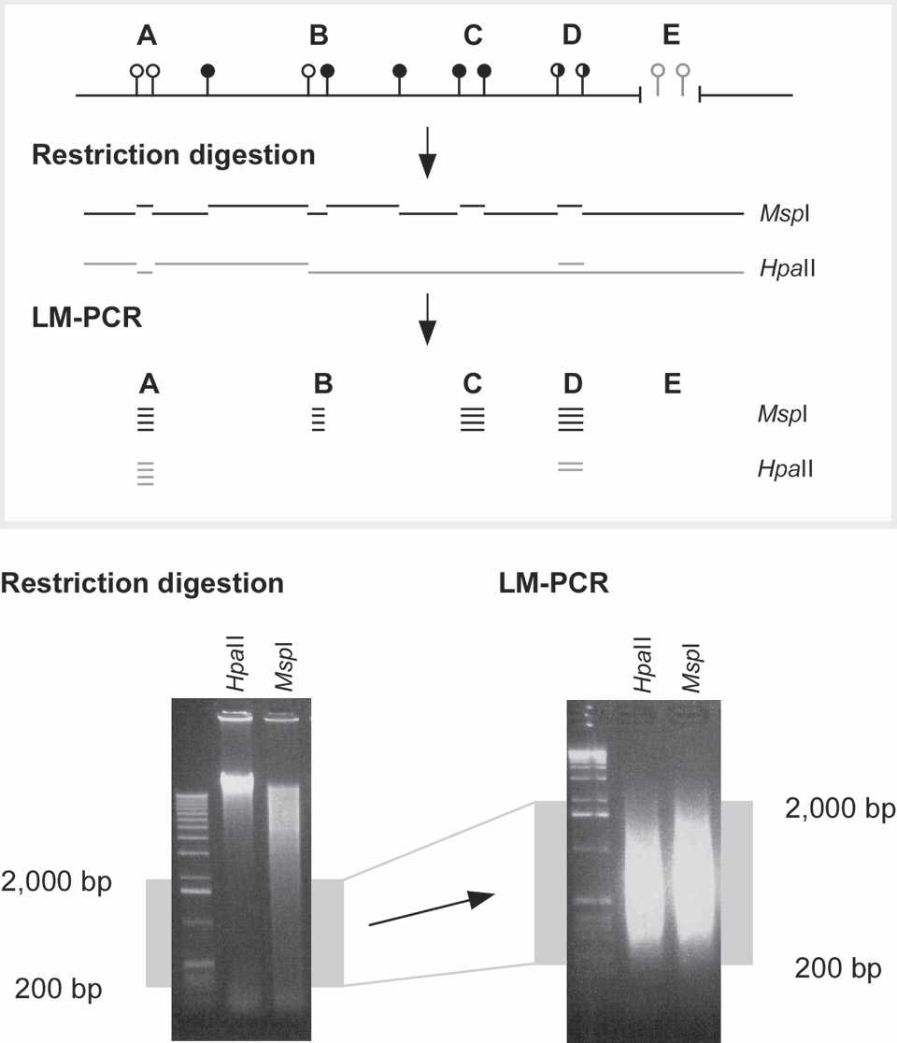
HELP Assay
(5-CCGG-3) (< than 12% of these sites are in
CpG islands
Methylation insensitive
Methylation sensitive
Generate HpaII/MspI
Khulan et al Genome Research, 2012
Notes:
Gel purify DNA in range of 200-2000bp
Since 70% of sites are methylated, Msp1 is the total number of sites
And HpaII are a subset of the total number of sites
It was subsequently recognized
that 55%–70% of HpaII sites in animal genomes are methylated
at the central cytosine (Bird 1980; Bestor et al. 1984), which is
part of a CpG dinucleotide. The minority of genomic DNA that
cuts to a size of hundreds of base pairs was defined as HpaII Tiny
Fragments (HTFs) (Bird 1986), revealing a population of sites in
the genome at which two HpaII sites are close to each other and
both unmethylated on the same DNA molecule. Cloning and
sequencing of these HTFs revealed them to be (G+C)- and CpG
dinucleotide-rich, allowing base compositional criteria to be created
to predict presumably hypomethylated CpG islands
(Gardiner-Garden and Frommer 1987). These criteria remain in
use for genomic annotations today, defining sequences that tend
to localize with transcription start sites, especially of genes active
constitutively (Larsen et al. 1992) or during embryogenesis
(Ponger et al. 2001).
Genome sequencing project data have revealed that <12%
of HpaII sites in the human genome (and <9% in mouse) are
located within annotated CpG islands (Fazzari and Greally 2004).
This raised the question of whether a substantial proportion of
HTFs is, in fact, derived from non-CpG island sequences and
could be used to examine many non-CpG island sites in the
genome for cytosine methylation status. We describe a technique

Slide 26
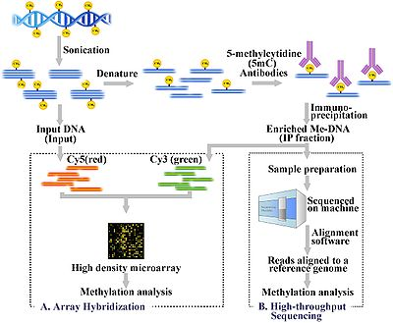
Immunoprecipitation Based Enrichment Assays
MeDip
Antibodies directed against methylated CpGs are used to enrich DNA in methylated sequences relative to control DNA.
The resulting intensity ratio represents a ratio of methylated fragments over the total control and positive values are interpreted as enrichment for methylation.
Although this method is not constrained to measuring methylation in recognition sites, the drawback is a lack of specificity in low CpG dense regions due to noise.

Slide 27
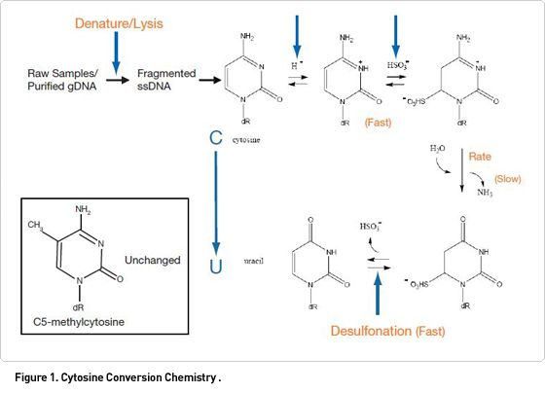
Bisulfite Conversion
Bisulfite (HSO₃⁻): converts unmethylated cytosines into uracil
Uracil is converted to thymine following PCR amplification while leaving methylated cytosines unconverted
Bisulfite conversion offers single CpG resolution when PCR product is analyzed by PCR, microarray, or sequencing.

Slide 28
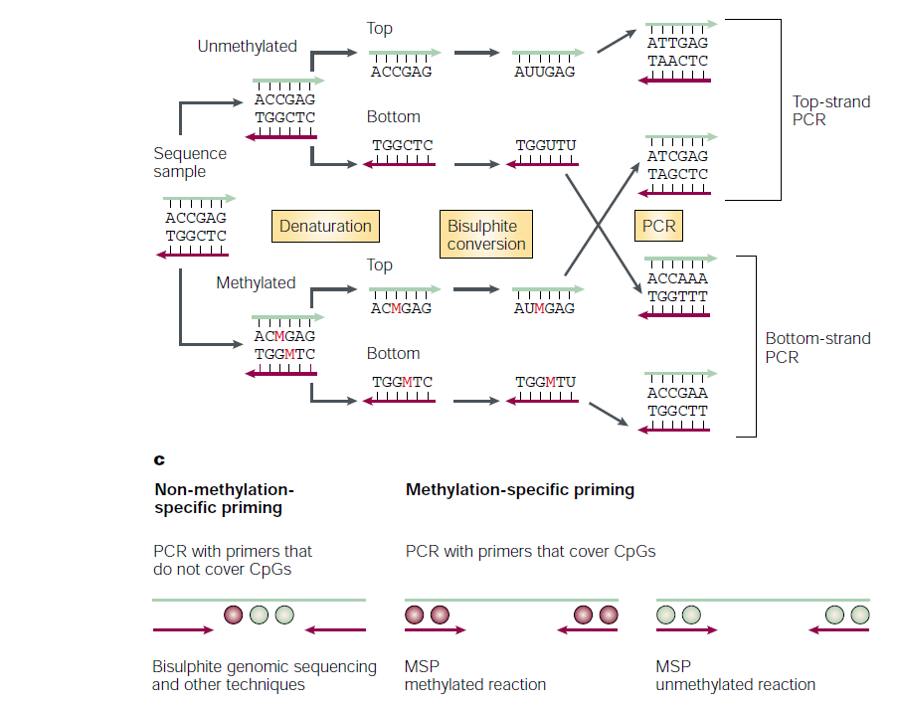
Laird, Nature Rev. Cancer, 2003

Slide 29
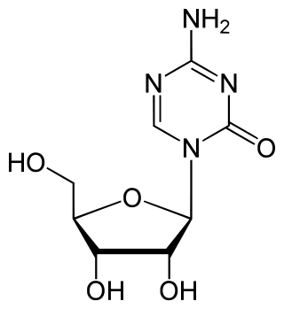
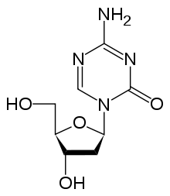
Epigenetic Treatment
DNA Methylation Inhibitors: nucleoside analogues that exert their demethylating activity through the establishment of an irreversible covalent bond with DNMTs after their incorporation into DNA.
5-Aza-2’deoxy-cytidine
5-Azacytidine
Notes:
cytidine

Slide 30
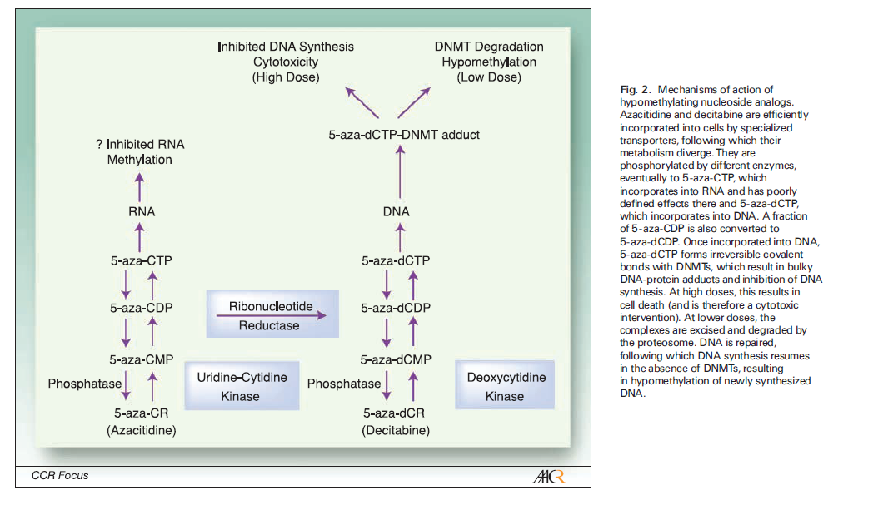
Mechanisms of Action

Slide 31
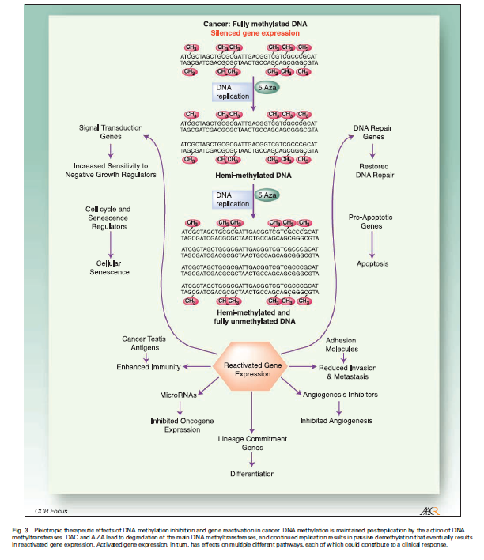

Slide 32
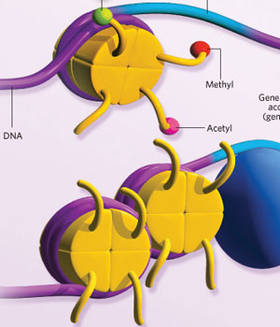
Chromatin as an Epigenetic Regulator
1. Histone Modifications
2. Nucleosome Positioning

Slide 33
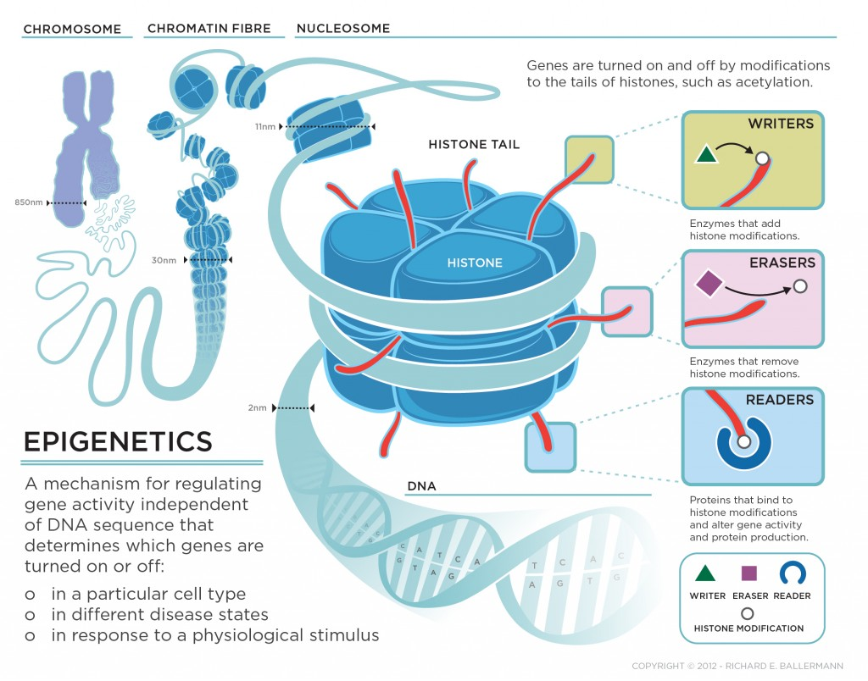
…and ATP dependent chromatin remodeling enzymes

Slide 34
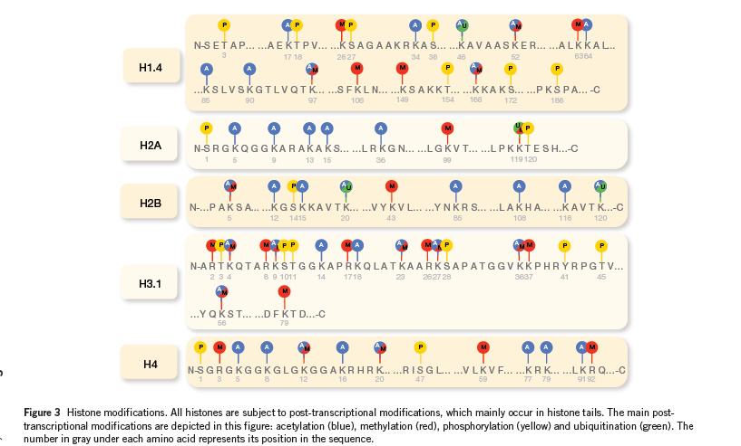
Histone Modifications

Slide 35
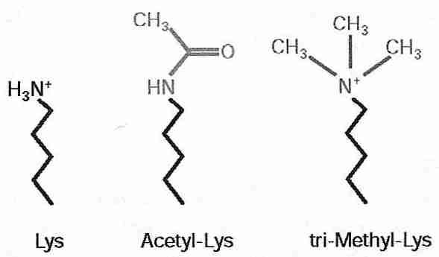
Acetylation and Methylation of Histone N terminal tails
Nomenclature:
Histone-Position-modification-number of modifications
H(1,2,3,4)-K/R-ac/Me-_2,3
e.g. H3K4
H3K4me
H3K4me2
H3K4me3
H3K9ac

Slide 36
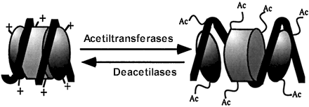
Histone Modifying Enzymes
Histone Acetyl Transferases (HATs)/Histone Deacetylases (HDACs)
HATs
HDACs

Slide 37
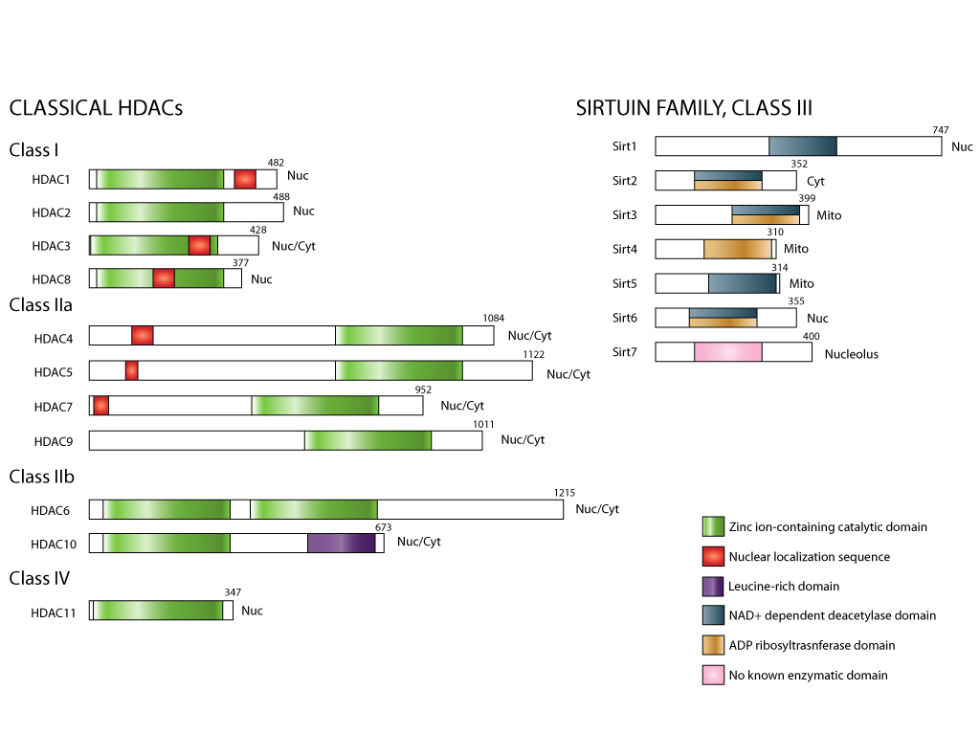
(Courtesy of Philip Wong)
Notes:
18 HDACs in mammals classified based on homology to yeast proteins. 11 are zinc depenent , class II have homology to yeat sir2 and ahave a requirement for NAD.
Phylogenetic analysis indicates that the evolution of HDACs preceded that of histones. Class Iia and Iib hdacs do not have histones as primary substrates.

Slide 38
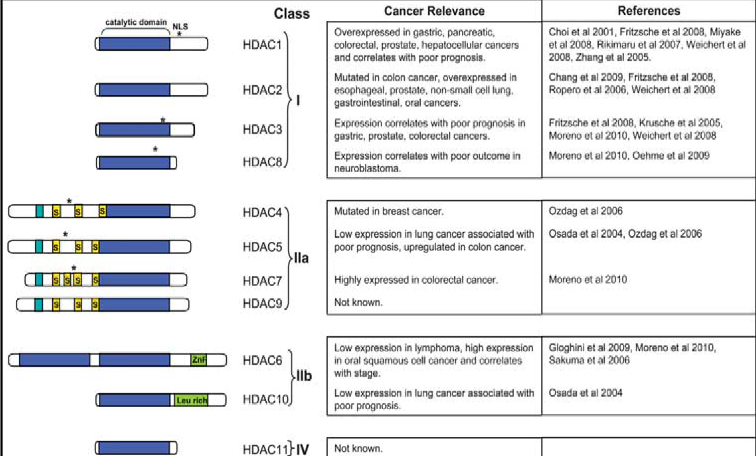

Slide 39
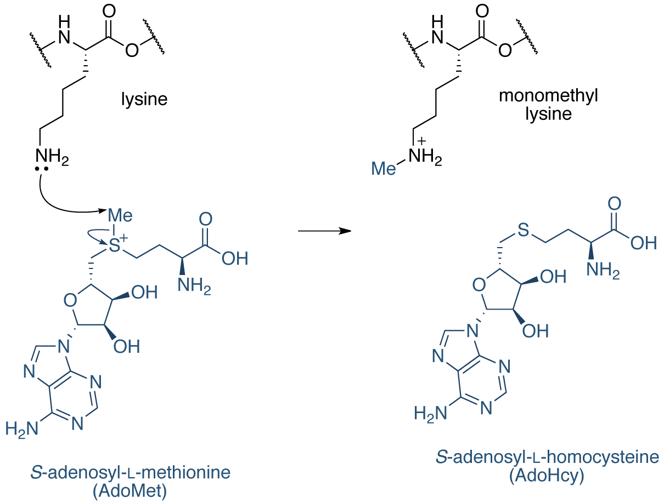
Histone Modifying Enzymes
Histone Methyltransferases (HMTs)/Histone Demethylases (HDMs)
HMT
HDM

Slide 40
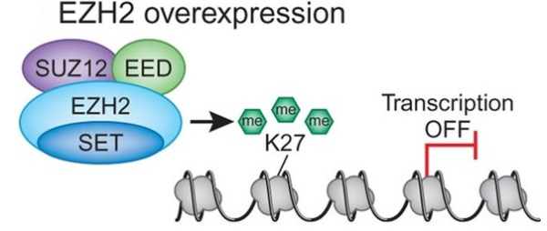

Slide 41
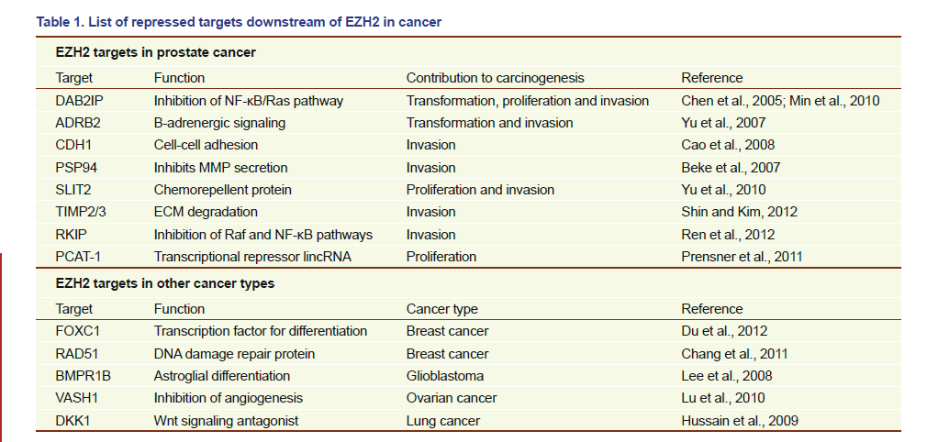
EZH2 mediated gene silencing in Cancer

Slide 42
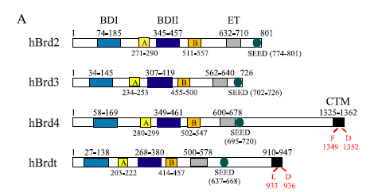
BET-family of Bromodomain containing proteins
Bromodomains (BRDs) are epigenetic readers that recognize acetylated-lysine (KAc) on proteins and are implicated in a number of diseases.
The BET (bromodomain and external domain
family:
BRD2
BRD3
BRD4
BRDT

Slide 43
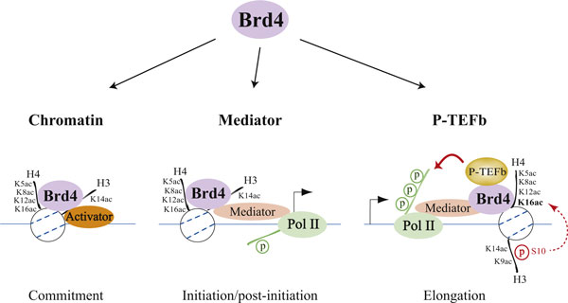
BRD4 Promotes Transcription

Slide 44
Nucleosome Positioning

Slide 45
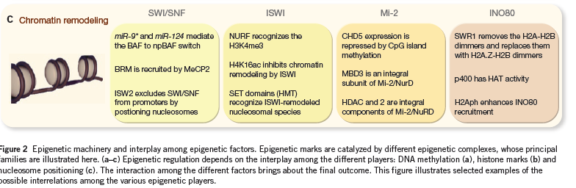
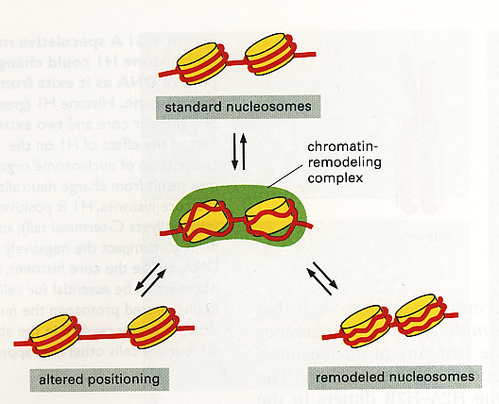
Enzymes that Regulate Nucleosome Positioning/structure

Slide 46
Components of the SWI/SNF Complex
BAF250b
BAF180
β-actin
BAF250a
BAF60b
β-actin
BAF200
BAF60b
BAF155
BRG1
BAF60a
BAF155
BRG1
BAF60a
BAF53a
BAF60c
BAF53a
BAF60c
BAF170
BAF170
Baf47
BAF57
Baf47
BAF57
BAF250b
β-actin
BAF250a
BAF60b
BAF155
BRM
BAF60a
BAF53a
BAF60c
BAF170
Baf47
BAF57

Slide 47
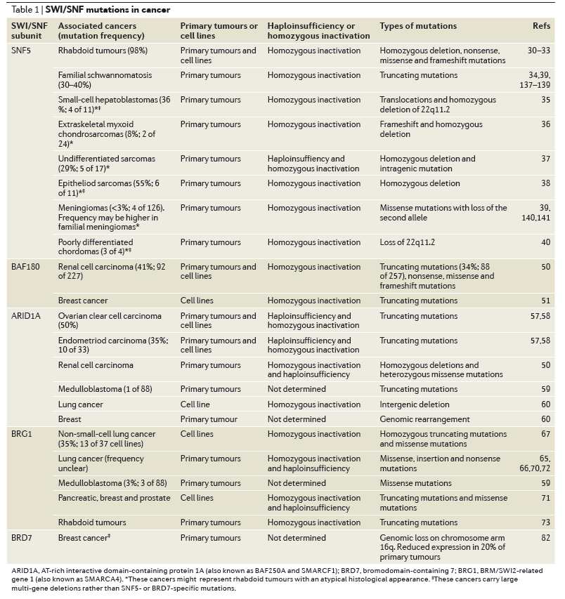
Disruption of SWI/SNF components in cancer
(Wilson and Roberts, Nat. Reviews 2011)

Slide 48
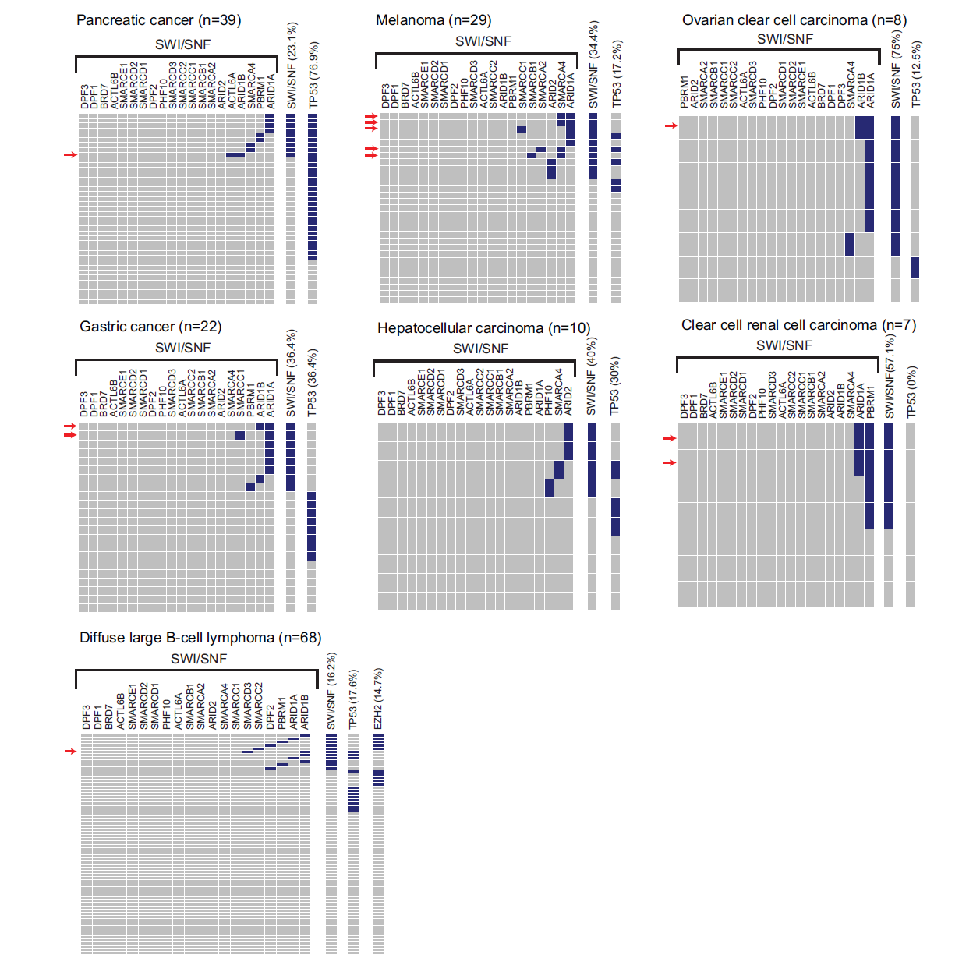
Shane, Plos One, 2012

Slide 49
Chromatin Immunoprecipitation for investigating histone modifications
Formaldehyde treat cells
.
.
.
.
Isolate chromatin
.
.
.
.
.
.
.
.
.
.
.
.
.
.
Analyze by: PCR
Microarray
Sequencing
.
Sonicate
.
.
.
.
.
.
.
.
.
.
.
.
.
.
Y
.
.
.
.
.
.
Y
.
.
.
.
.
.
Y
.
Purify DNA
.
Y
.
.
Immunoprecipitate

Slide 50
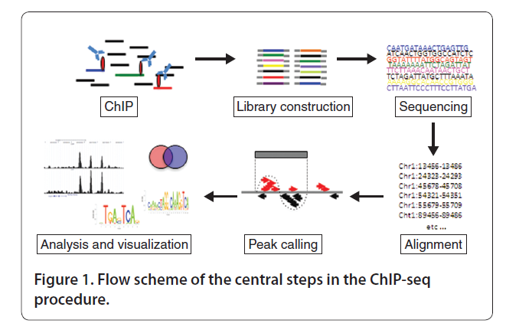
Analysis by ChIP-Seq
Notes:
Peaks are regions of significant tag enrichment that are presumed to represent transcription factor binding. Need to compare with a control library. Confidence in the peaks is quantified by p values or false discovery rates, usually by comparing ChIP library with control library.

Slide 51
Potential Epigenetic Biomarkers
Expression/mutational status of histone modifying enzymes
PRC components: EZH2, BM1
SWI/SNF components: BAF47, BRG1, BRM
DNA Methylation /hydroxymethylation
Changes at specific loci or regions may be indicative of disease
Changes in genomic levels
Histone covalent modifications
Changes at specific loci or regions may be indicative of disease
Changes in genomic levels:
Decreased H3K16ac, H3K4me3, H4K20me3, increased H3K9me

Slide 52
Epigenetic Treatment
HDAC Inhibitors: target the catalytic domain of HDACs, thus interfering with their substrate recognition
Short chain fatty acids:
Sodium phenylbutyrate, sodium butyrate, and valproic acid
Hydroxamic acids:
Trichostatin A, vorinostat, and panobinostat
Cyclic Peptides:
Romidepsin
Benzamides:
MGCD-0103
eninostat

Slide 53
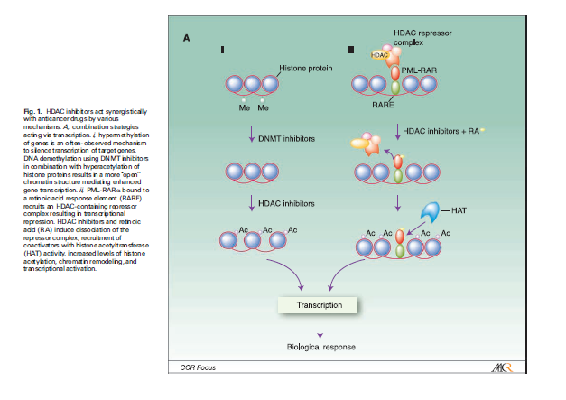
HDACis are used in conjunction with other drugs

Slide 54
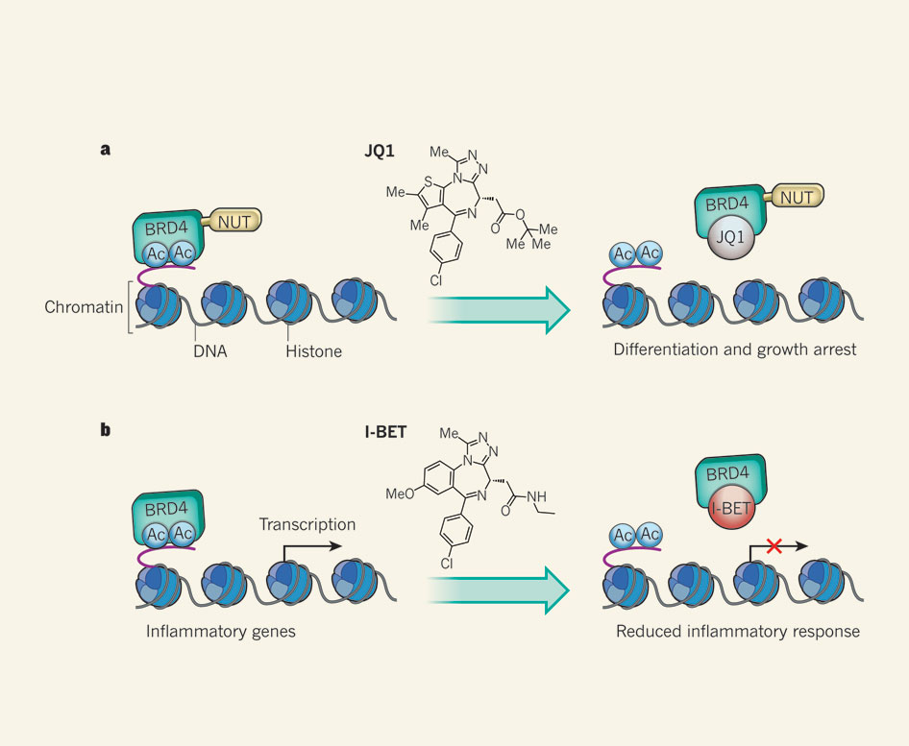
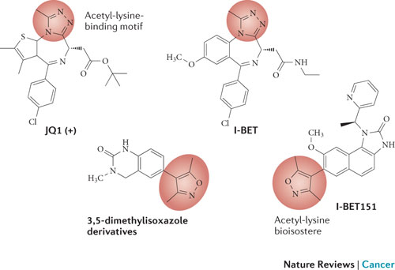
Inhibiting BET-family proteins
Chemical Inhibition of BRD4 Alters Gene Expression
Nature. 2010 December 23; 468(7327): 1067–1073.

Slide 55
Summary
Epigenetics: “An epigenetic trait is a stably heritable phenotype resulting from changes in a chromosome without alterations in the DNA sequence.
The best characterized epigenetic changes to occur in human diseases involve changes in DNA methylation profiles and/or histone modifications.
These changes are amenable to therapeutic intervention.

Slide 56
Biomarkers: measurable indicators of illnesses, the clinical course, and therapeutic outcome.
Gene expression
Mutation analysis
DNA methylation
Chromatin modifications

Slide 57
References
Portella and Esteller (2010) Epigenetic Modifications and Human Disease.Nature Biotech 28:1057-1068
Taby and Issa (2010) Cancer Epigenetics. CA CANCER J CLIN 2010;60:376–392
Allis and Muir (2010) Spreading Chromatin into Chemical Biology. ChemBiochem. 12, 264 – 279

