Slide 1
The Human Microbiome and its Role
in Medicine and as a Biomarker
  Dr. Bob Blumenthal, UTHSC Robert.Blumenthal@utoledo.edu
BRIM 6200/6800
Biomarker Discovery, Validation and Implementation
Suggested reading:
http://academy.asm.org/index.php/faq-series/5122-humanmicrobiome

Slide 2
The Human Microbiome and its Role
in Medicine and as a Biomarker
1. Background
  Distribution and ubiquity of bacteria
  Metagenomics to escape the limits of culturability
  C. 16S rRNA and “Next Generation Sequencing”
2. Genome sequence as “parts list”
  A. Gene numbers
  B. Identifying pathways, virulence factors, drug/vaccine targets
3. The human microbiome and how it is characterized
  A. Bacterial “species”, and how they change
  B. Microbiome microbes
  C. α vs. β diversity
  D. Composition at different body sites
  E. Twin studies
  F. Stability and resilience
4. Medical conditions correlated with microbiome properties
5. Microbiome properties that can serve as biomarkers
  A. Specific genes/organisms
  B. Community structure
6. Manipulation of the microbiome in individualized medicine
  A. Diet and pre/pro/syn-biotics B. Antibiotics and vaccines C. Transplants
7. Homework assignment

Slide 3

1. Background – A. Distribution and ubiquity of bacteria
• The great majority of infectious agents are not pathogenic to humans.
  Molecular methods indicate >400 species of bacteria in the human oral cavity. Only ~150 of those species have been cultured in laboratories and identified.
  Similar situation for human colon.
  Total estimated number
  of bacteria on Earth:
  ______
10–100 trillion (10¹³-10¹⁴) symbiotic microbial cells harbored by each person, primarily bacteria in the gut

Slide 4
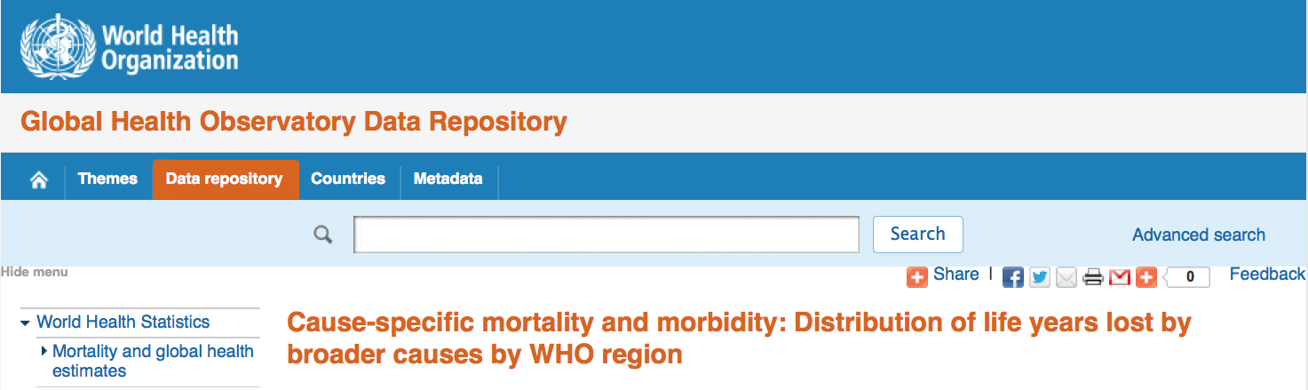
1. Background – A. Distribution and ubiquity of bacteria
http://apps.who.int/gho/data/view.main.1430?lang=en
Most bacteria do not cause human disease,
but they cause a lot of death and disease.
Accidents
Over 17 million people die annually from
infectious diseases, equivalent to nearly the combined populations of Chicago, Los Angeles and New York City.
[ > 45,000 each day, ~ one every two seconds ]
Infectious diseases
Noninfectious diseases

Slide 5
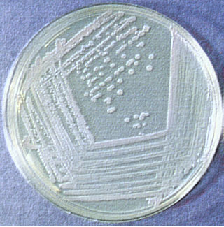
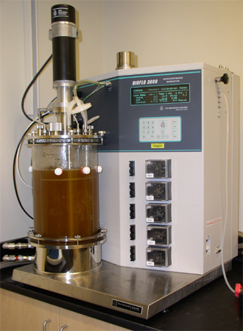
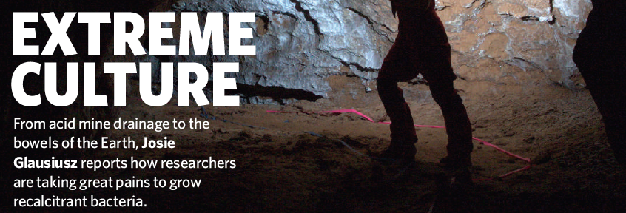
1. Background – B. Metagenomics to escape the limits of culturability
Growth parameters commonly dealt with:
pH salinity temperature pO₂
simple nutrients (too many?) light osmolarity
Difficult to accommodate:
obligate partnerships
complex nutrients etc.
The great majority of bacteria (>>95%) have never been grown in the laboratory.

Slide 6
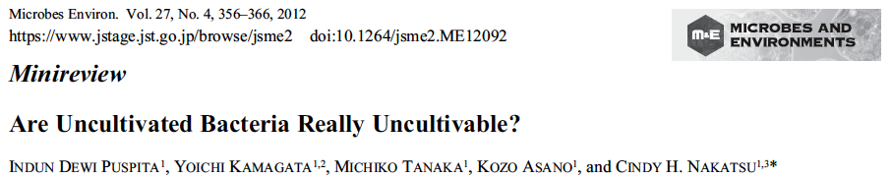
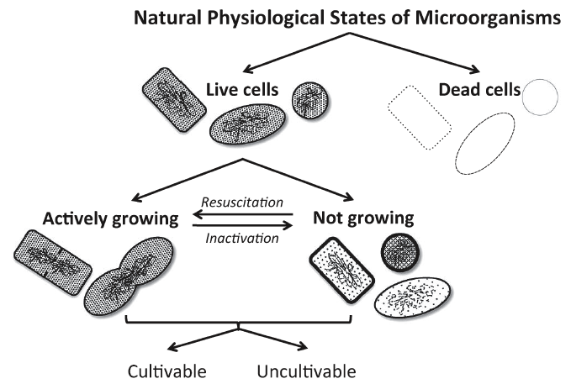
1. Background – B. Metagenomics to escape the limits of culturability
Need to determine conditions for resuscitation AND growth

Slide 7

1. Background – B. Metagenomics to escape the limits of culturability
The finding that certain bacterial species have never been identified by culture may be a simple matter of coincidence: an organism that has a low prevalence or is particularly slow-growing may have been overlooked in cultural analyses. Additionally, many genetically distinct phylotypes are phenotypically indistinguishable and are lumped together if conventional biochemical methods for identification are used. Conversely, some bacteria are genuinely resistant to culture in isolation on conventional media.
An alternative approach for the culture of as-yet-uncultivated organisms is to simulate their natural environment in vitro. Kaeberlein et al. (2002) constructed a diffusion chamber that allowed the passage of substances from the natural environment (intertidal marine sediment) across a membrane and successfully grew bacteria from marine sediment that were previously uncultivated.

Slide 8
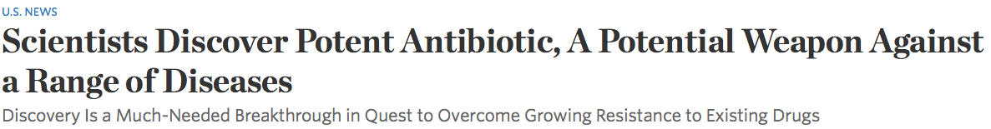

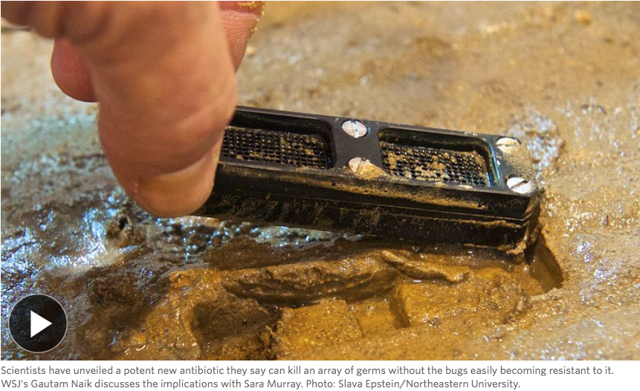
1. Background – B. Metagenomics to escape the limits of culturability
http://www.wsj.com/articles/scientists-discover-new-antibiotic-a-potential-weapon-against-a-range-of-diseases-1420654892
Even if one could culture 1000s of individual species,
would that be the best approach?

Slide 9
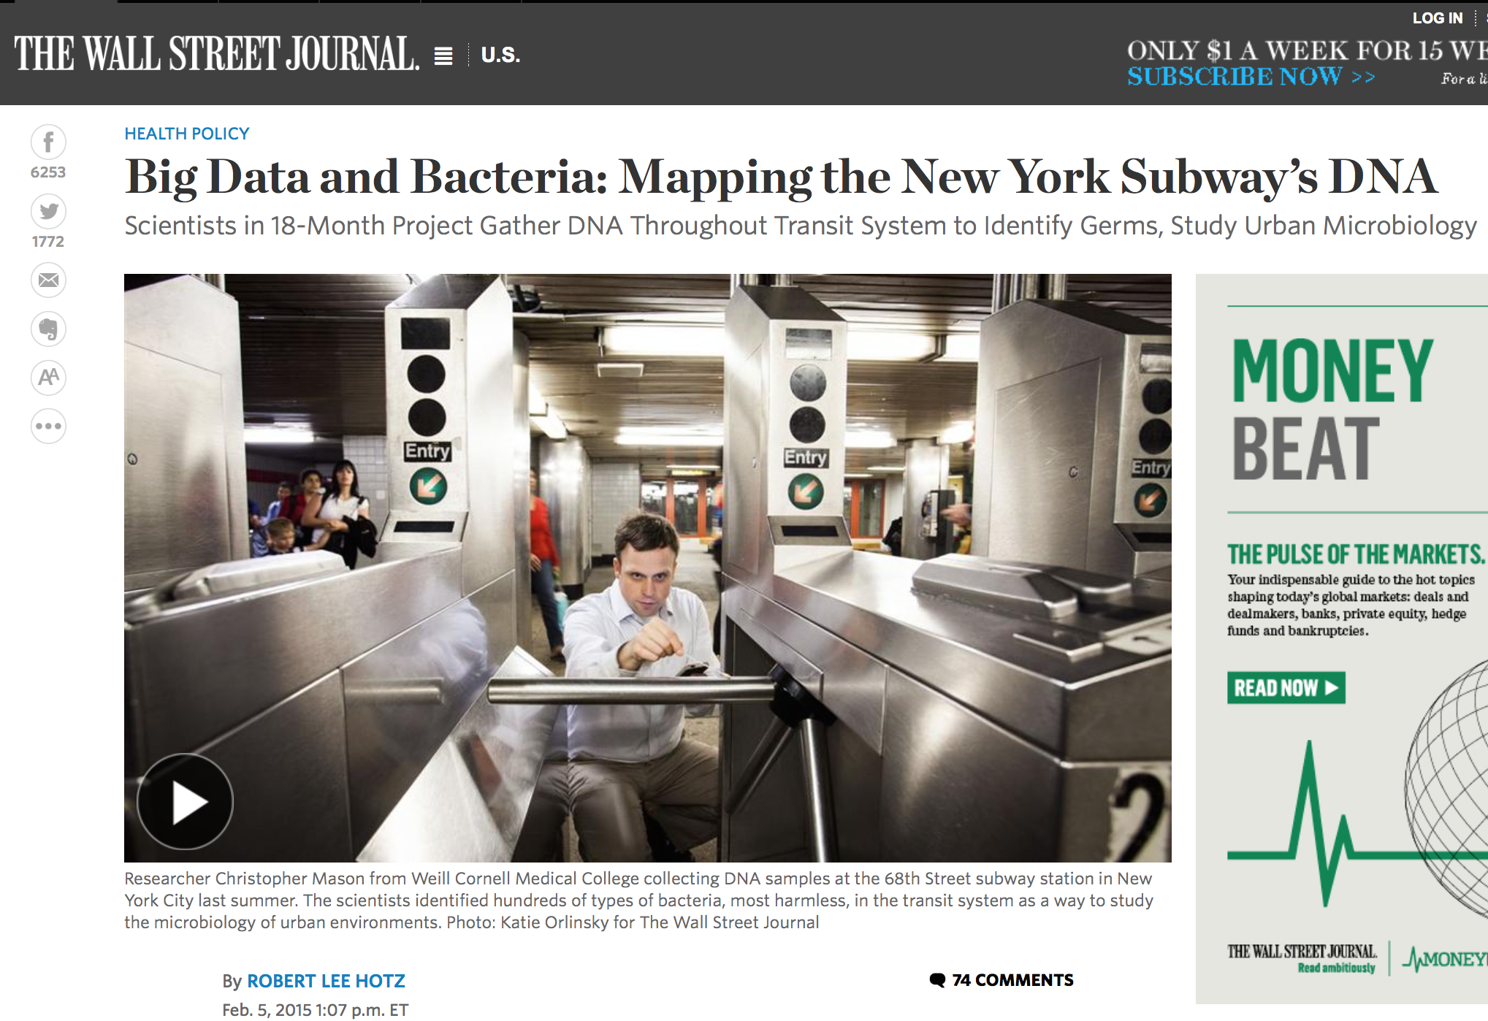
1. Background – B. Metagenomics to escape the limits of culturability
http://www.wsj.com/articles/big-data-and-bacteria-mapping-the-new-york-subways-dna-1423159629
Metagenomics in the news; 05-Feb-2015
[ The research team found bacteria associated with everything from human diseases to mozzarella cheese.
Future: track outbreaks ]

Slide 10
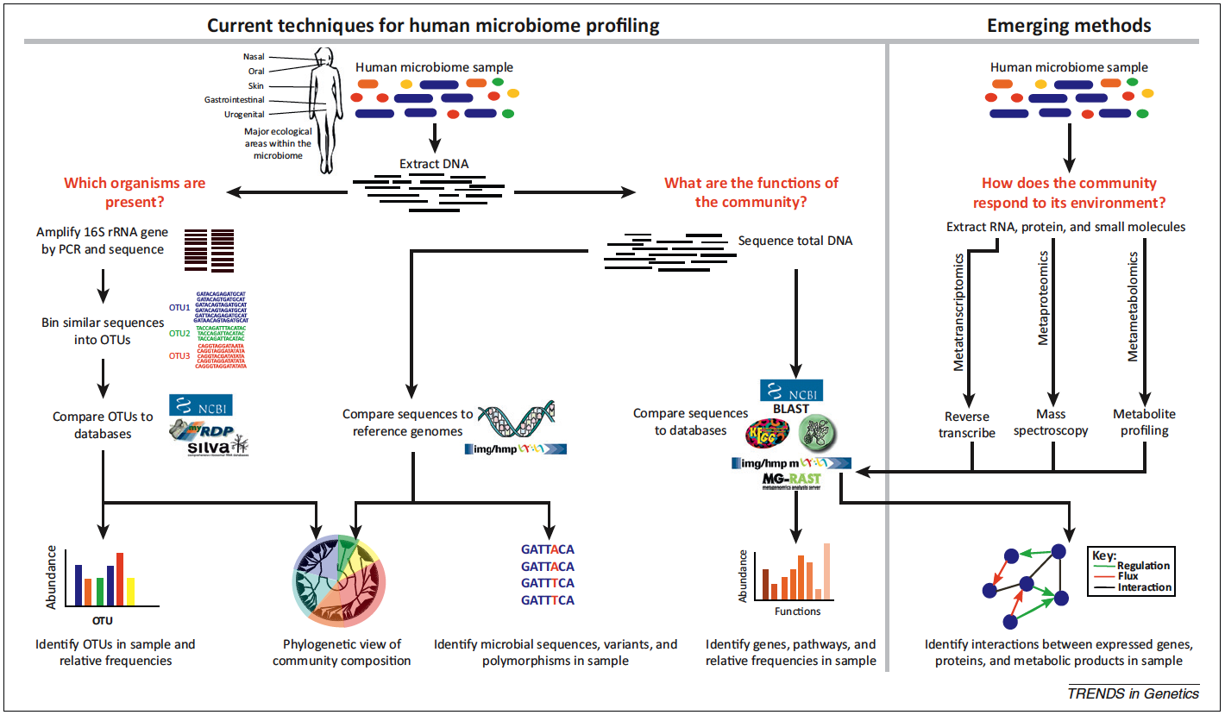
1. Background – C. 16S rRNA and
“Next Generation” Sequencing
(Morgan et al., 2013; PMID: 23140990; Fig 1)

Slide 11
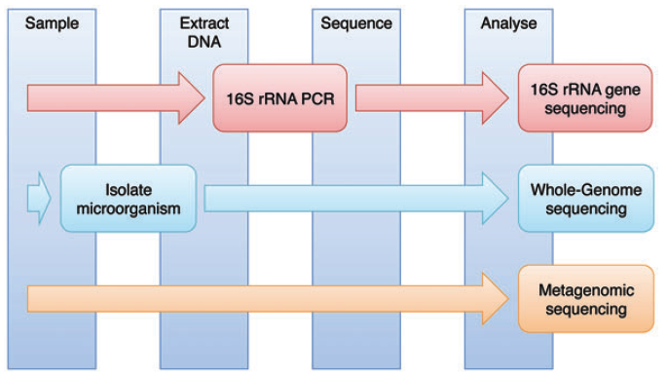
1. Background – C. 16S rRNA and
“Next Generation” Sequencing
  (Cox et al., 2013; PMID: 23943792; Fig. 1)

Slide 12
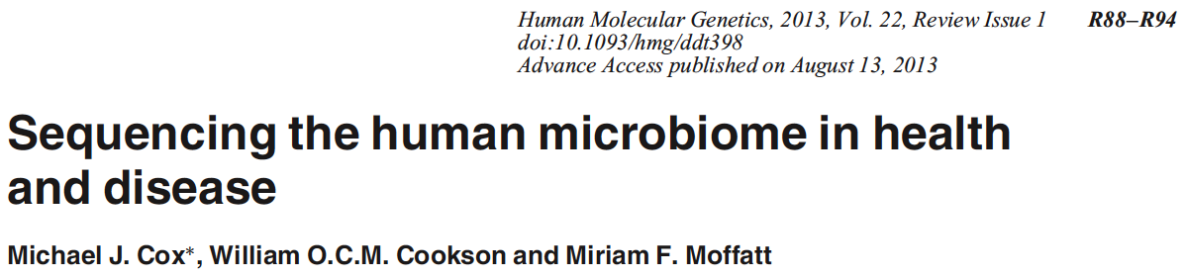
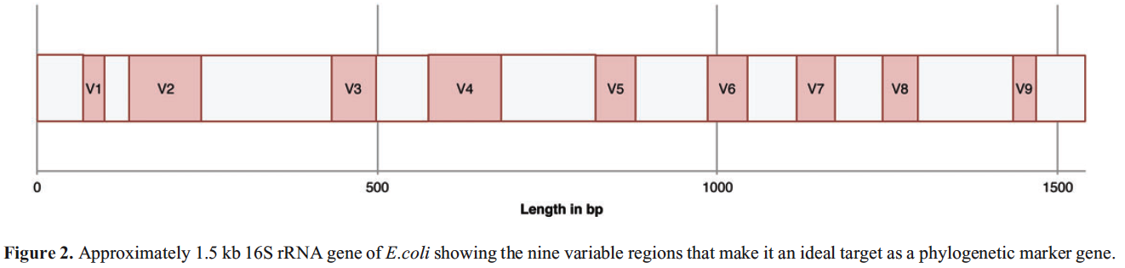
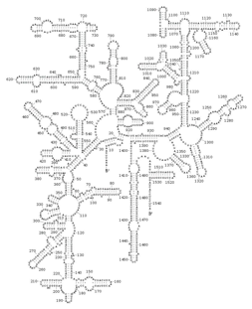
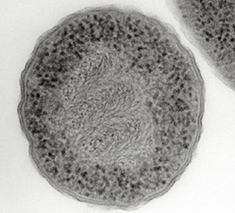
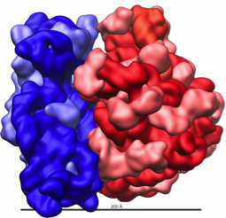
1. Background – C. 16S rRNA and
“Next Generation” Sequencing
Clusters of similar sequences = “operational taxonomic units” (OTUs)
97% rRNA sequence identity → same species
93% rRNA sequence identity → same genus
Warning: up to 5% of 16S rRNA sequences in GenBank may be erroneous (Ashelford et al., 2005; PMID 16332745)
WARNING #2: 16S variable regions are not inert barcodes
PMID: 23943792
Notes:
http://www.nature.com/scitable/content/an-electron-micrograph-of-a-prokaryote-escherichia-14708319 ; http://en.wikipedia.org/wiki/Ribosome ; http://rna.ucsc.edu/rnacenter/xrna/xrna_gallery.html

Slide 13

WARNING #3
PMID 24306768
“There still is widespread misconception that if a new isolate has <97 % 16S rRNA gene similarity with the closest named (and preferentially cultivated) relative, description of a new species is warranted, while a value above this 97 % cutoff value indicates that the isolate belongs to a known species. It cannot be stressed sufficiently that the 16S rRNA gene sequence similarity alone cannot be used to reliably delineate species.”
“Naming a species is stating a hypothesis”,
in part due to mosaicism.

Slide 14
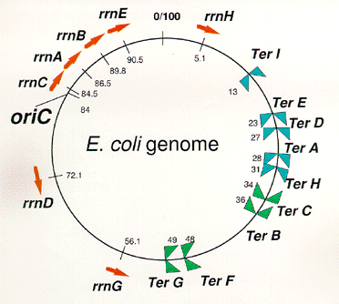
WARNING #4: MANY species have >1 16S rRNA gene

Slide 15
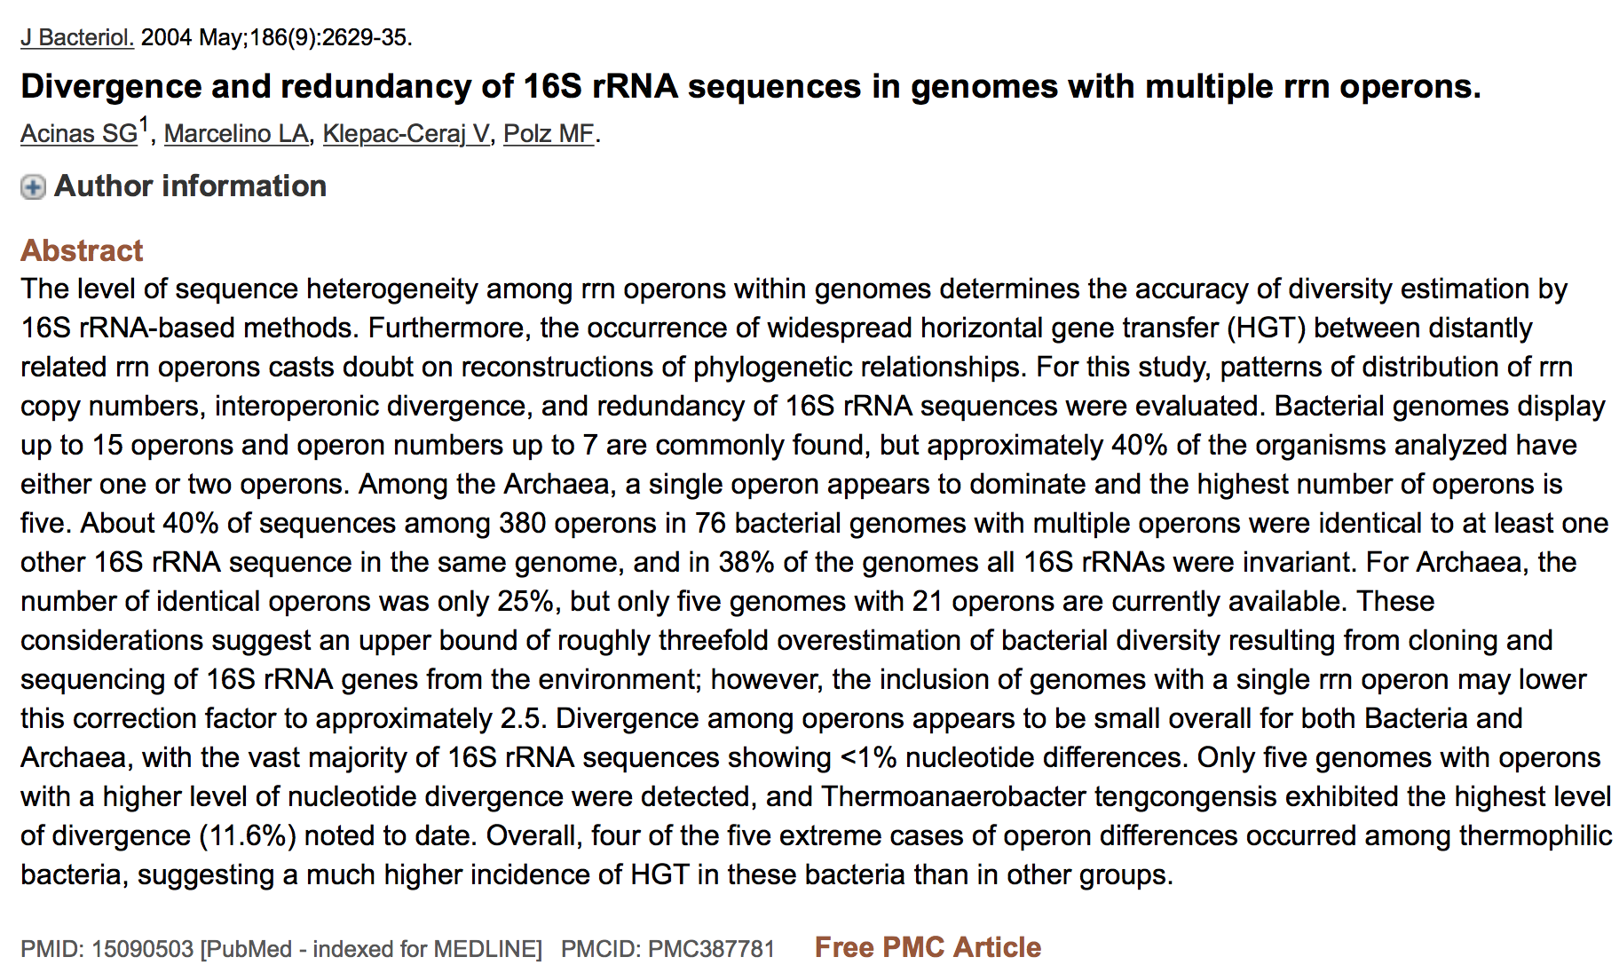
WARNING #4: MANY species have >1 16S rRNA gene

Slide 16

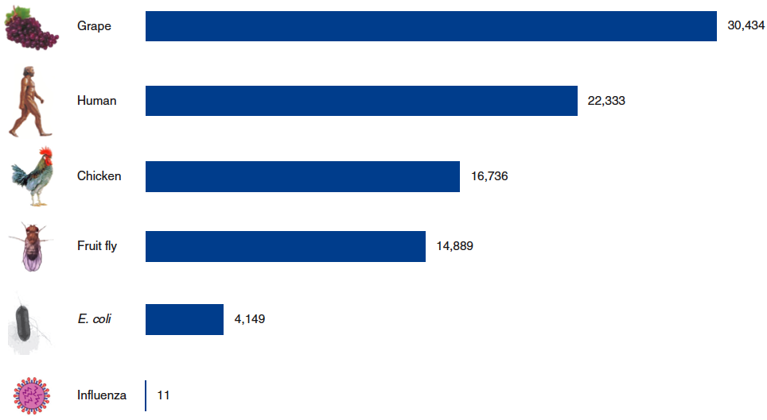
2. Genome as “Parts List” – A. Gene Numbers
Ktedonobacter 13,000
yeast 8,000
Mycoplasma 500

Slide 17
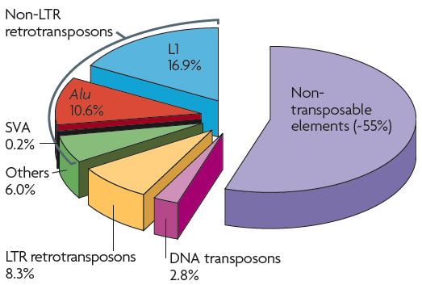
2. Genome as “Parts List” – A. Gene Numbers
Approximately 45% of the human genome is currently recognized as being derived from transposable elements.
~1.5% codes for proteins.

Slide 18
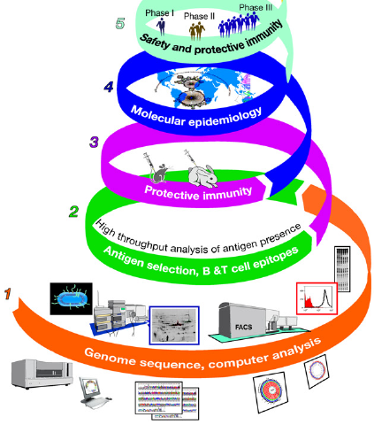
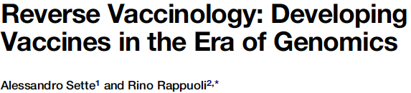
2. Genome as “Parts List” – B. Identifying Pathways, Virulence Factors, Drug/Vaccine Targets
(1) Computer analysis of the whole genome identifies the genes coding for predicted antigens, and eliminates antigens with homologies to human proteins. (2) Then the identified antigens are screened for expression by the pathogen and for immuno-genicity during infection. (3) The selected antigens are then used to test whether immunization induces a protective response.
(4) Protective antigens are then tested for their presence and conservation across the species (molecular epidemiology). (5) Selected antigens are produced in large scale for clinical trials.

Slide 19
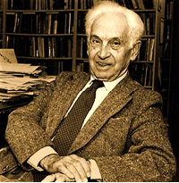
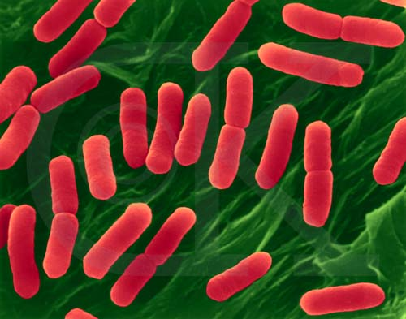
3. The human microbiome and how it is characterized –
A. Bacterial “species” and how they change
“Species are groups of interbreeding natural populations that are reproductively isolated from other such groups."
Ernst Mayr (1905 - 2005)
Bacteria reproduce asexually (and most have single chromosomes).
image is copyright Dennis Kunkel

Slide 20
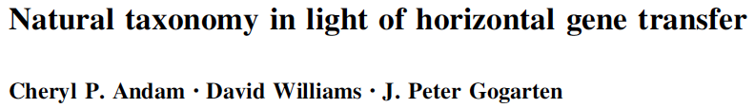
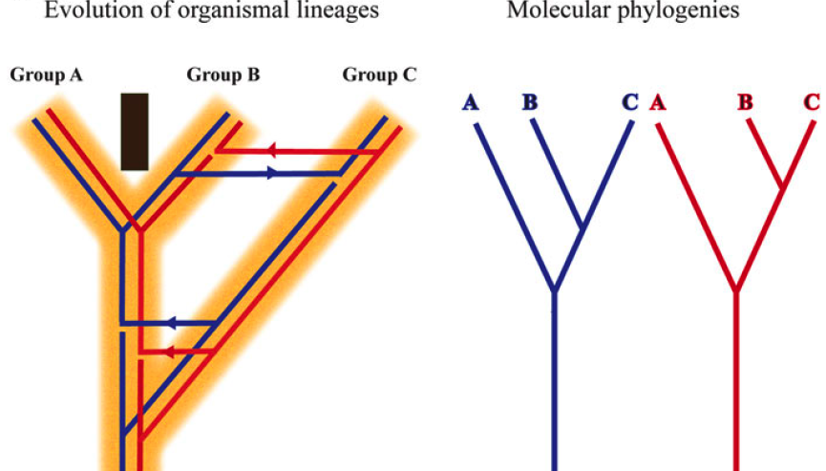
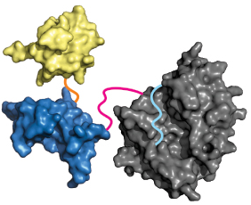
3. The human microbiome and how it is characterized –
A. Bacterial “species” and how they change

Slide 21
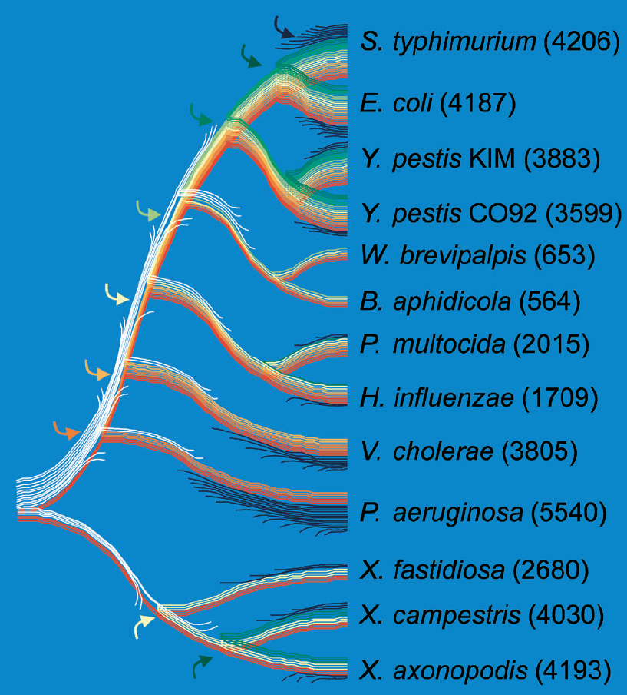
3. The human microbiome and how it is characterized –
A. Bacterial “species” and how they change
Genome Evolution in γ-Proteo-bacteria
Only a small proportion of genes have been retained since the common ancestor of γ-proteo-bacteria (red). If ancestral and contemporary genome sizes are similar, most genes from this ancestral genome (white) have been replaced by nonhomologous genes (yellow to green), usually via HGT from organisms outside of this clade. The abundance of genes unique to a species (blue) indicates that these bacteria (with the exception of the endosymbionts) constantly acquire new genes, most of which do not persist long-term within lineages. (Numbers of non-IS or -phage ORFs are shown in parentheses).
Lerat et al., 2005. PLoS Biol. 3(5): e130, 1-8

Slide 22
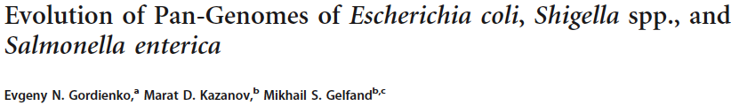
The pan-genome is the total complement of genes from all sequenced strains of the same species, genus, or a larger group.
The pan-genome consists of three parts:
  the universal genome with genes common for all strains
  the unique genome with strain-specific genes (known as ORFans)
  the periphery (genes that are present in a subset of strains).
In most studied bacterial species, the gene content of strains varies widely, and each additional sequenced strain adds new genes to the pan-genome.
  The E. coli pan-genome is open (far from saturation).
The distribution of the OGs by the number of strains in which they are present has a well-known U-shape form.
  The periphery genes tend to be rare (present in just 2-3 strains) or almost universal (absent from only a few strains).
  This holds true for the E. coli-plus-Shigella distribution .
  Overrepresented functions in the unique genome tend to be plasmid related, e.g., “DNA restriction-modification system” or “response to mercury ion.”

Slide 23
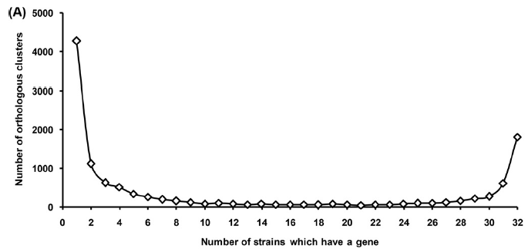
The pan-genome is the total complement of genes from all sequenced strains of the same species, genus, or a larger group.
The pan-genome consists of three parts:
  the universal genome with genes common for all strains
  the unique genome with strain-specific genes (known as ORFans)
  the periphery (genes that are present in a subset of strains).
In most studied bacterial species, the gene content of strains varies widely, and each additional sequenced strain adds new genes to the pan-genome.
  The E. coli pan-genome is open (far from saturation).
The distribution of the OGs by the number of strains in which they are present has a well-known U-shape form.
  The periphery genes tend to be rare (present in just 2-3 strains) or almost universal (absent from only a few strains).
  This holds true for the E. coli-plus-Shigella distribution .
  Overrepresented functions in the unique genome tend to be plasmid related, e.g., “DNA restriction-modification system” or “response to mercury ion.”
unique (ORFans)
universal
periphery

Slide 24
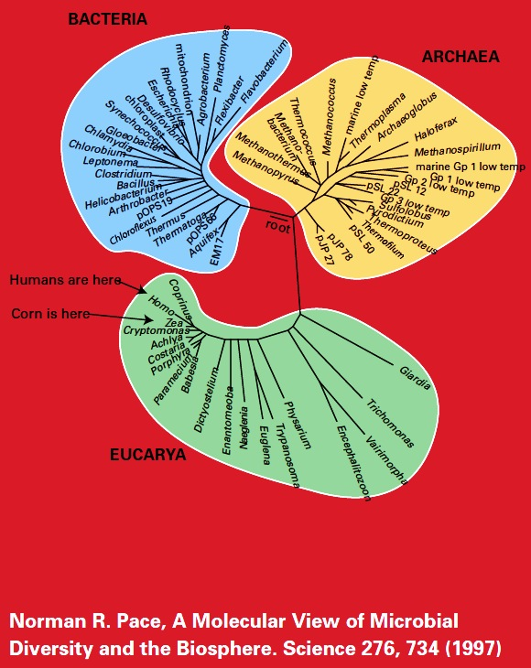
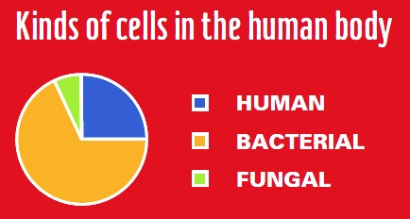
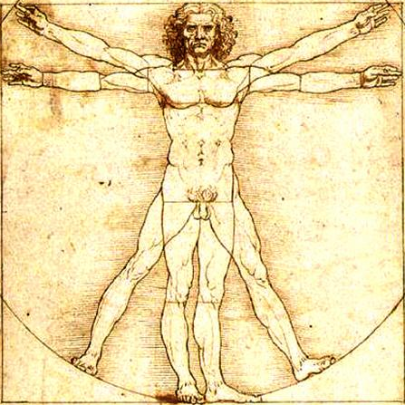
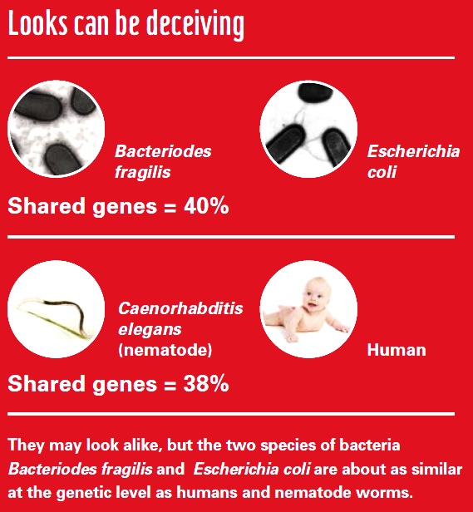
3. The human microbiome and how it is characterized –
B. Microbiome microbes

Slide 25
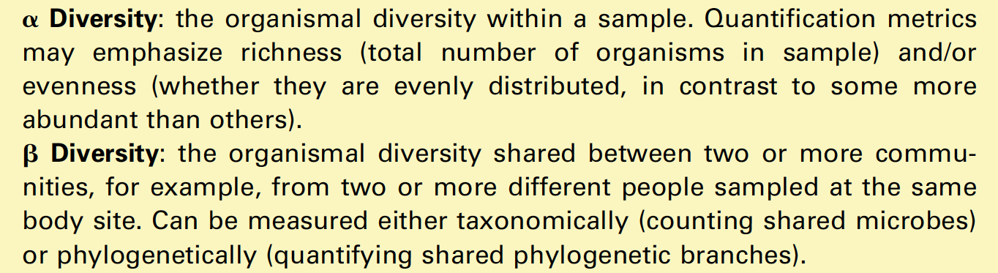


3. The human microbiome and how it is characterized –
  C. α vs. β diversity
Notes:
also from (Morgan)

Slide 26
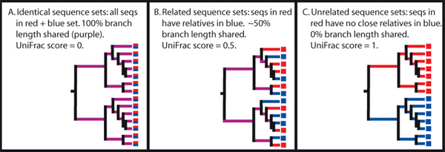
4. The human microbiome and how it is characterized –
  C. α vs. β diversity
The UniFrac metric measures the difference between two samples in the branch length that is unique to one sample or the other.
LEFT: every sequence in the top set has a very similar counterpart in the bottom set, so all branch length comes from nodes that have descendants in both samples (purple). This gives the minimum UniFrac distance of 0.0.
MIDDLE: there is about as much branch length unique to each sample as is shared between samples, so the UniFrac distance is ~0.5.
RIGHT: the division between the two samples occurs very early in the tree, so that all of the branch length is unique to one sample or the other. This results in the maximum UniFrac distance possible, 1.0.
http://unifrac.colorado.edu/root?tool_id=unifrac_significance

Slide 27
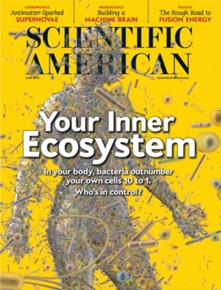

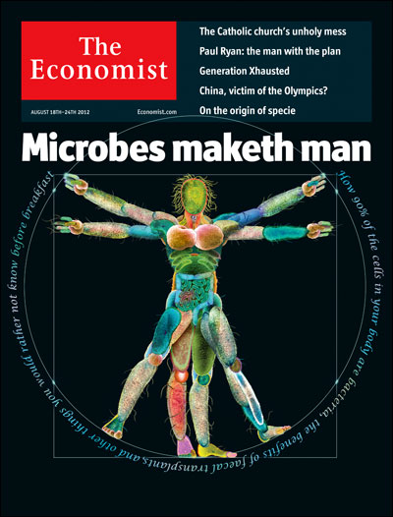
3. The human microbiome and how it is characterized –
D. Composition at different body sites

Slide 28
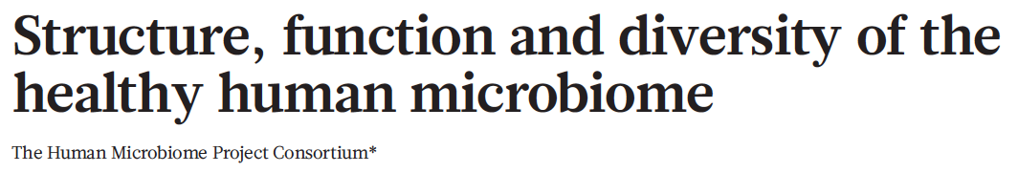
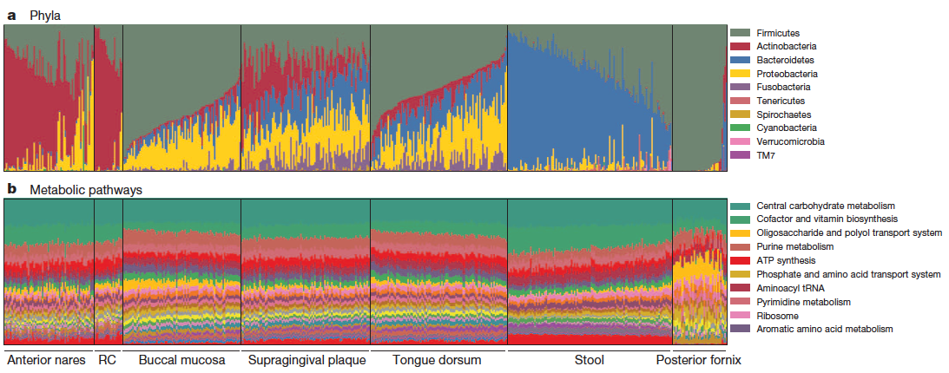
3. The human microbiome and how it is characterized –
D. Composition at different body sites

Slide 29
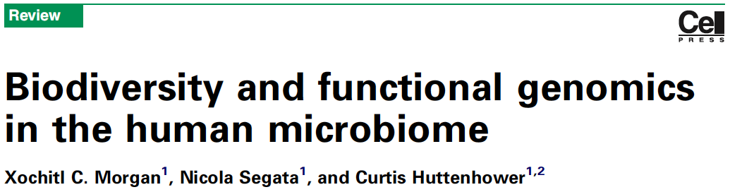
3. The human microbiome and how it is characterized –
D. Composition at different body sites
PMID: 23140990
Habitat-specific functionality as a principle of human microbiome organization
Several human microbiome studies have reported the metagenomic distribution of pathways within each body habitat to be much more consistent among individuals than are microbial abundances
Specific sets of site-specific gene function were maintained within each habitat regardless of the taxa present.
The stool microbiome was particularly abundant in genes related to complex carbohydrate degradation despite highly variable Bacteroidetes:Firmicutes ratios…
The oral cavity microbiome, for example, was optimized for simple sugar metabolism and particularly for dextran, whereas
the vaginal microbiome was optimized for glycogen and peptidoglycan degradation.
Much like individual bacterial genomes, each habitat thus seems to have a core metagenome present in most hosts, in addition to a pan-metagenome of more flexible auxiliary genes carried by the community of each habitat.

Slide 30
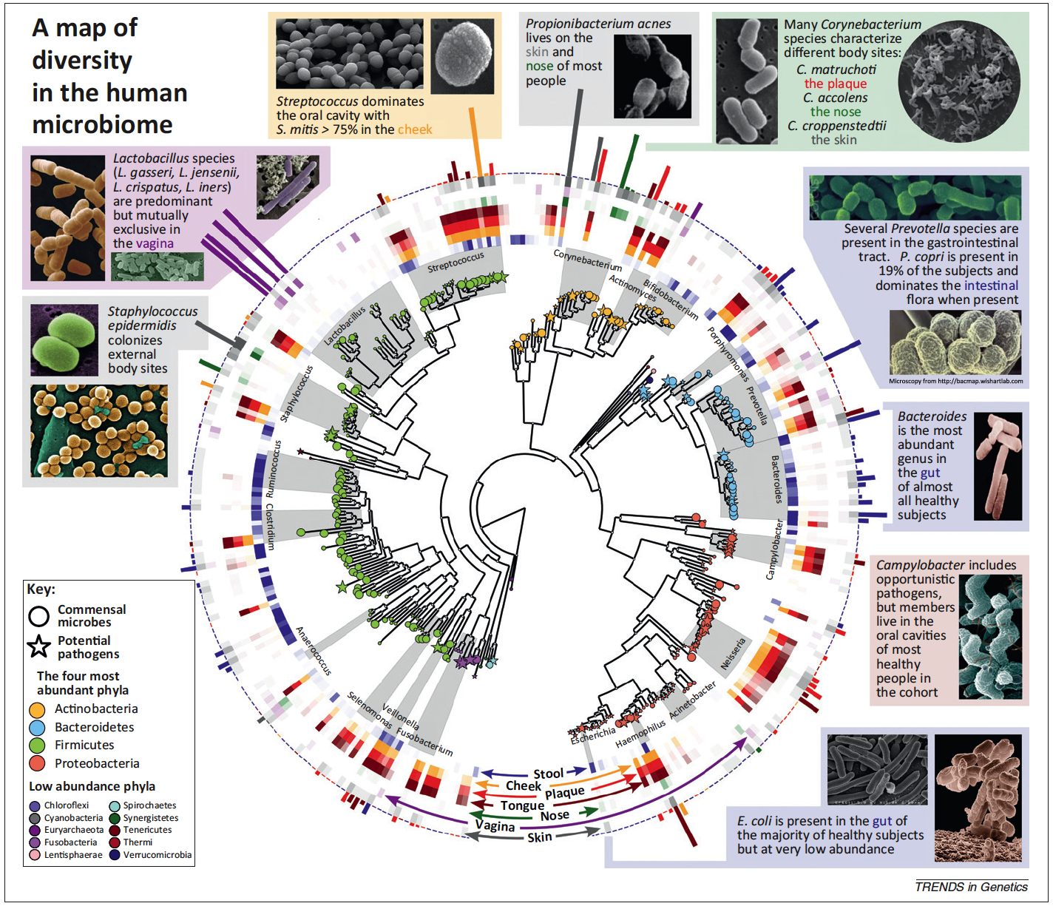
Notes:
Figure 2. A map of diversity in the human microbiome. The human microbiome is dominated by four phyla: Actinobacteria, Bacteroidetes, Firmicutes, and Proteobacteria. In the center is a phylogenetic tree of organisms abundant in the human microbiome. Commensal microbes are indicated by circles, and potential pathogens are indicated by stars. The middle ring corresponds to body sites at which the various taxa are abundant and is color-coded by site [e.g., Ruminococcus (blue) is found mostly in the gut, whereas Lactobacillus (purple) is found mostly in the vagina]. The bar heights on the outside of the circle are proportional to taxa abundance at the body site of greatest prevalence [e.g., Streptococcus mitis (yellow) dominates the inside of the cheek, whereas the gut is abundant in a variety of Bacteroides]. The intensity of external colors corresponds to species prevalence in each body site. Data from the Human Microbiome Project [10] and MetaPhlan [75]; microscopy images from BacMap [76].

Slide 31
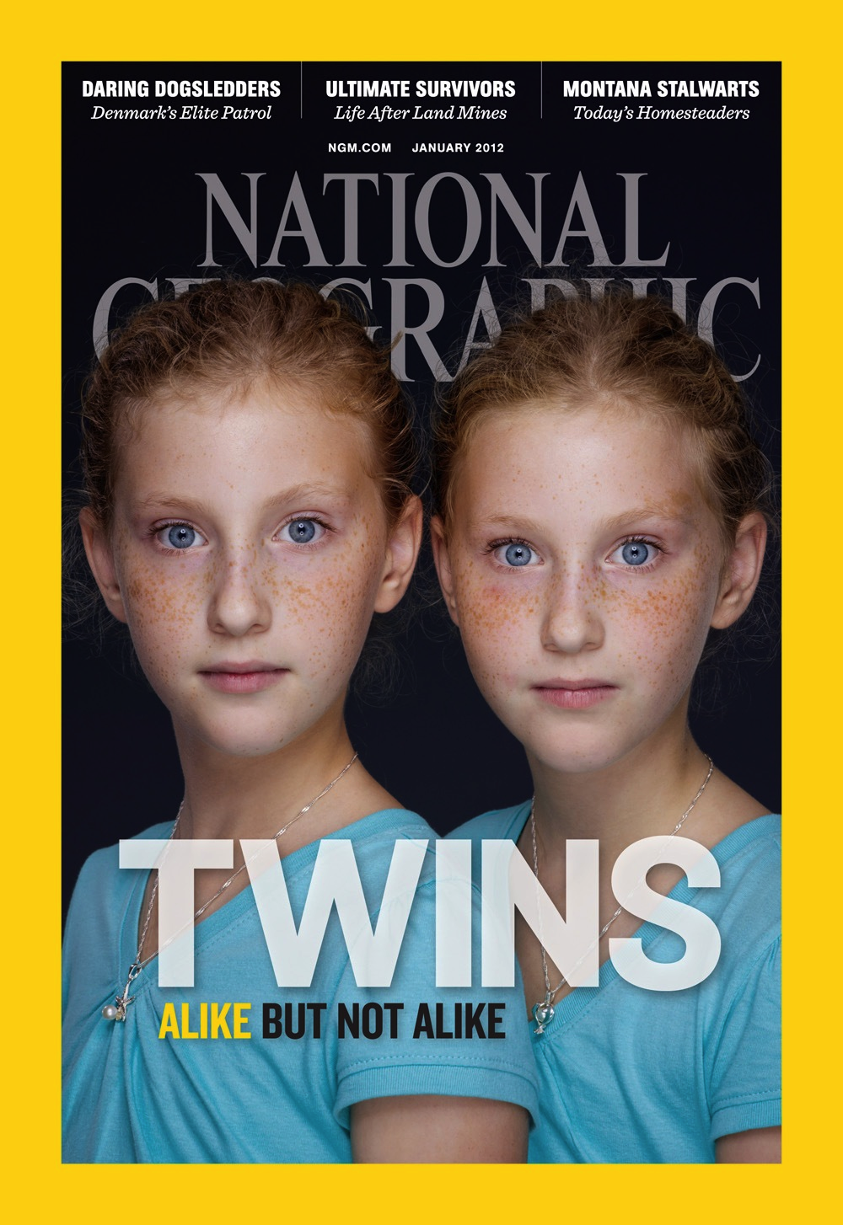
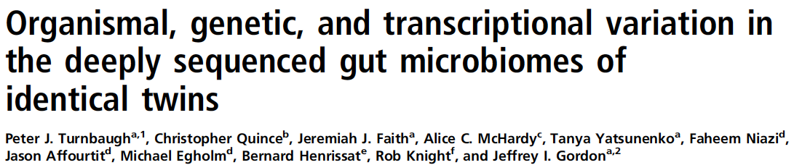
3. The human microbiome and how it is characterized –
E. Twin studies
“The genetic and transcriptional diversity of the human gut microbiome is remarkable. Much of this diversity has not been previously identified through sequencing cultured human gut isolates; 64% of the gene clusters present in our microbiome bins had no representative in a set of 122 human gut microbial genomes, and only 17% were shared between the two cotwins. This diversity, even between genetically identical individuals, provides an expanded view of our multicellularity and interpersonal genetic variation.”
“We deeply sampled the organismal, genetic, and transcriptional diversity in fecal samples collected from a monozygotic (MZ) twin pair…”

Slide 32
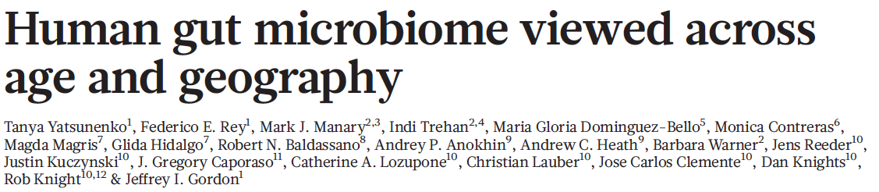
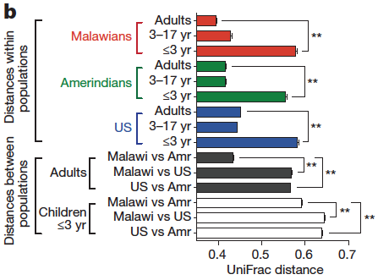
3. The human microbiome and how it is characterized –
E. Twin studies
To examine how gut microbiomes differ among human populations, here we characterize bacterial species in fecal samples from 531 individuals, plus the gene content of 110 of them. The cohort encompassed healthy children and adults from the Amazonas of Venezuela, rural Malawi and US metropolitan areas and included mono- and dizygotic twins.

Slide 33
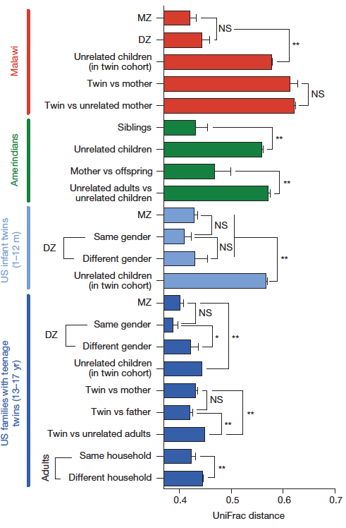
“We previously observed that adult monozygotic twins are no more similar to one another in terms of their gut bacterial community structure than are adult dizygotic twins. This result suggests that the overall heritability of the microbiome is low. We confirmed that the phylogenetic architecture of the fecal microbiota of monozygotic Malawian co-twins ≤3 years of age is no more similar than the microbiota of similarly aged dizygotic cotwins (n=15 monozygotic and 6 dizygotic twin pairs). We found that this is also true for monozygotic and dizygotic twin pairs aged 1–12 months (n=16 twin pairs), as well as teenaged twins (13– 17 years old; n=50 pairs) living together in the United States.”

Slide 34

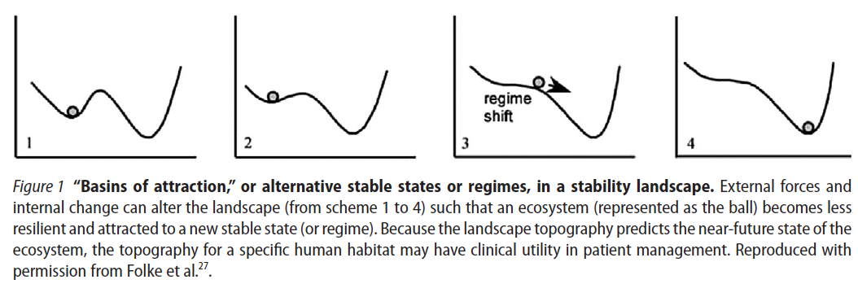
3. The human microbiome and how it is characterized –
  F. Stability and resilience
“The responses to an antibiotic are individualized and are influenced by prior experience with the same antibiotic. Besides serving to reveal critical underlying functional attributes, microbial interactions, and keystone species within the indigenous microbiota, the response to a standardized disturbance may have value in predicting future instability and disease and in restoring a preferred ecosystem regime.”

Slide 35
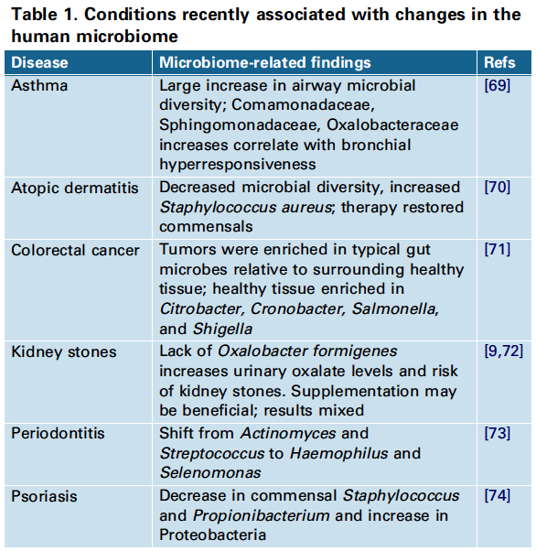
4. Medical conditions correlated with microbiome properties
PMID
21194740
22310478
21647227
(Morgan et al., 2013; PMID: 23140990)
18322162
21460356
22675498
22065152
Clostridium difficile (“C-diff”): http://www.cdc.gov/drugresistance/threat-report-2013/

Slide 36
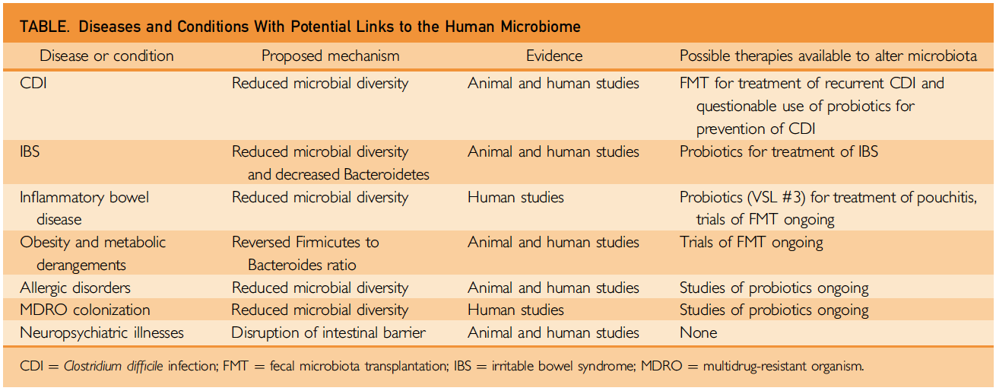

4. Medical conditions correlated with microbiome properties
PMID:
24388028

Slide 37


4. Medical conditions correlated with microbiome properties
Possible systemic effects:
Inflammatory mediators
Clotting activation
Bacteremia
etc.
Caries,
Periodontal disease,
Oral cancer

Slide 38



4. Medical conditions correlated with microbiome properties
2012
Bacterial vaginosis (BV) is the most common vaginal disorder of reproductive age women, resulting in millions of health care visits annually in the US alone.
In nonpregnant women: associated with infertility, endometritis, and pelvic inflammatory disease, as well as an increased risk of acquiring HIV, Neisseria gonorrhoeae , and other STIs.
During pregnancy: associated with preterm delivery, spontaneous abortion, premature rupture of membranes, preterm birth, amniotic fluid infections, postpartum endometritis, and endometritis following Caesarian section.
• Fallacies permeate thinking about the diagnosis and treatment of BV. One is that BV is an infectious disease. Though true for a number of pathogens, it may be inadequate to explain other diseases caused by mixtures of organisms.”

Slide 39


4. Medical conditions correlated with microbiome properties
[O]ne reason underlying the expectation that the airways were sterile was that the bacteria present there could not be cultured.
It is now clear, based upon work from a number of research groups worldwide, that there are bacteria resident in the airways and, additionally, the bacterial load and proportions of phyla vary under healthy or diseased conditions.
In a landmark article by Hilty and colleagues, the airway microbiome was shown to be different between healthy individuals and those with asthma or COPD.

Slide 40

4. Medical conditions correlated with microbiome properties
Not yet clear which is CAUSE and which is EFFECT.

Slide 41

4. Medical conditions correlated with microbiome properties
PMID 21677749
Short-chain fatty acids (SCFAs) provide one of the clearest examples of how nutrient processing by the microbiota and host diet combine to shape immune responses.
SCFAs are the end products of microbial fermentation of plant polysaccharides that cannot be digested by humans alone, and the SCFAs affect host immune responses.
Butyrate modifies cytokine production by T_{H} cells, and promotes intestinal epithelial barrier integrity, which in turn limits the exposure of the mucosal immune system to lumenal microbes, and thus prevents aberrant inflammatory responses.
Acetate promotes the resolution of intestinal inflammation by the G-protein-coupled receptor GPR43.
SCFAs may also regulate the acetylation of lysine residues, a covalent modification that affects proteins involved in a variety of signalling and metabolic processes.

Slide 42
PMID: 25974299

Slide 43

PMID: 25974299
Abbott NJ et al. (2006)
PMID: 16371949
Astrocyte–endothelial interactions at the blood–brain barrier
Nat. Rev. Neuro. 7: 41–53

Slide 44


4. Medical conditions correlated with microbiome properties
PMID: 22483040
At a hypothalamic level classic neurotransmitters and cytokines regulate corticotrophin releasing hormone (CRH) and vasopressin (AVP) release into the portal vasculature.
Negative feedback loops control the forward drive.
The adrenal cortex can be directly activated by PGE2 from immune cells stimulated by gut pathogens.

Slide 45



4. Medical conditions correlated with microbiome properties
Plus NO, modulation of serotonin via effects on Trp levels

Slide 46


5. Microbiome properties that can serve as biomarkers
Specific genes/organisms
Community structure
Detect individual pathogens or genes for functional pathways.
Zobellia galactanivorans is a marine bacterium that can digest porphyran derived from marine algae.
Homologs of porphyranase genes from Z. galactanivorans are present in the human gut bacterium Bacteroides plebeius, and are prominent in the microbiomes of Japanese but not of N. Americans.
Systematic changes in overall dietary consumption patterns across a population might lead to changes in the microbiome, with consequences for host nutritional status and immune response.
Detect dysbiotic (or abnormal) communities
Biomarkers for:
Nutritional status
Immune status
etc.
Kau et al. PMID: 21677749
Effects on microbiome?

Slide 47
6. Manipulation of the microbiome in individualized medicine
Promote desired microbes
  Diet and pre/pro/syn-biotics
  Antibiotics and vaccines
  Transplants
Selectively remove undesired microbes
Replace entire microbial community

Slide 48


6. Manipulation of the microbiome in individualized medicine
We examined whether dietary interventions in humans can alter gut microbial communities in a rapid, diet-specific manner.
Two diets, varied by their primary food source: a ‘plant-based diet’, rich in grains, legumes, fruits and vegetables; and an ‘animal-based diet’, which was composed of meats, eggs and cheeses.
Each diet was consumed ad libitum for five consecutive days by six male and four female American volunteers between the ages of 21 and 33, whose body mass indices ranged from19 to 32 kgm.

Slide 49

6. Manipulation of the microbiome in individualized medicine
Although no significant differences in α diversity were detected on either diet, we observed a significant increase in β diversity that was unique to the animal-based diet.
This change occurred only 1 day after the diet reached the distal gut microbiota (as indicated by the food tracking dye).
Subjects’ gut microbiota reverted to their original structure 2 days after the animal-based diet ended.

Slide 50



6. Manipulation of the microbiome in individualized medicine
PRE- PRO- SYN-
Synbiotics:
Combinations of pre- and pro- biotics meant to work synergistically
Probiotics:
Particular bacteria (or mixes of them)
Despite substantial enthusiasm for probiotics to treat conditions that may stem from microbiome disruptions, use of currently-available probiotics alone for these conditions has not proven to be curative.
This is likely due, in part, to the disparity between the complexity and diversity of the gut microbial ecologic system (mostly uncul-turable anaerobic microbiota) and the single organism often contained in OTC probiotics.
Prebiotics:
Nutrients that favor growth of particular bacteria

Slide 51


6. Manipulation of the microbiome in individualized medicine
  Antibiotics and vaccines
Prevent growth of particular species
Depending on broad vs. narrow spectrum of antibiotics, could eliminate particular groups of bacteria or prepare to replace entire microbial community.

Slide 52


6. Manipulation of the microbiome in individualized medicine

Slide 53


6. Manipulation of the microbiome in individualized medicine

Slide 54

6. Manipulation of the microbiome in individualized medicine
Winter, 2015
PMID: 26034755

Slide 55
PMID: 24467987
Patient 1 was a 74-year-old who presented with six episodes of recurrent CDI over 18 months. The first episode of CDI developed after orthopedic surgery when the patient received preoperative cefazolin.
Patient 2 was a 70-year-old with a history of peripheral neuropathy, which predisposed her to recurrent skin and soft tissue infections. She developed her initial CDI after receiving cefazolin for cellulitis, and had three CDI episodes, the last of which had failed standard medical therapy.
33 strains

Slide 56
Take-home lessons
There is a large number of bacteria in/on the human body.
Most of these species cannot be grown in the lab, so metagenomics is used.
16S rRNA sequences are useful for metagenomics, but there are caveats.
The microbiome can be described via distributions of species or metabolic genes, or by determining α or β diversity.
Microbiome alterations are associated with several medical conditions.
This association may or may not lead to useful therapeutic approaches in a given case, but may at least be useful as a biomarker.
We are still learning the methods for and consequences of manipulating the human microbiome.

Slide 57

BRIM 6200/6800 7.
B i o m a r k e r s
Choose three or more papers
  that we did NOT use in this lecture
  that focus on microbiomics
  preferably that focuses on a disease or physiological phenomenon relevant to your research
  provide the full author list, title, year, journal, volume, pages, AND PMID for each
  provide a 2-3 sentence summary of each paper (except for the one you discuss in detail, per #2)
Discuss one of those papers
  why did you choose this paper to discuss?
  what problem were the authors attempting to address?
  what microbiomic approaches did they use?
  what did they conclude?
  why were/weren’t their conclusions supported by their results?
  what new questions are raised by this work?
Warnings
  I will compare homework from different students.
  I will look to see if you’re simply quoting from the abstract.
  I will only grade homework that has been submitted by email as .rtf, .doc, or .docx
  Be sure to put your name in the document itself, not just the file title.

