Slide 1
Lecture 8. Population Genetics
Mathematical modeling versus
Computer modeling
February 06th, 2012
Alexei Fedorov, HSC UT

Slide 2
Every human being has about 80 de novo mutations
It means that two persons from an isolated village have
thousands of nucleotide differences in their genomes.
Many of these mutations will be drifted away, some of them
will be fixed in the population, while the rest will be present as
polymorphic biomarkers for a considerable period of time.
A special field of science that tries to predict the fate of these
mutations is known as Population Genetics

Slide 3
Wikipedia
Population genetics is the study of allele frequency distribution and change under the influence of the four main evolutionary processes: natural selection, genetic drift, mutation and gene flow. It also takes into account the factors of recombination, population subdivision and population structure. It attempts to explain such phenomena as adaptation and speciation.

Slide 4
Known controversies in Population Genetics:
Selectionism versus Neutralism
“The Neutral Theory of Molecular Evolution in the Genomic Era” 2010, by Masatoshi Nei, Yoshiyuki Suzuki, and Masafumi Nozawa.
“Neutralism and selectionism: a network-based reconciliation” 2008 by Andreas Wagner

Slide 5
Homework assignment
Read two reviews by Nei et al. 2010 and Wagner 2008.
List all arguments presented in these papers that support Neutralism.
List all arguments presented in these papers that support Selectionism.

Slide 6
From Andreas Wagner paper 2008
“The tension between neutralism and selectionism is at least as old as the field of molecular evolution^{1”.}
“…To neutralism, beneficial mutations are rare and are fixed less frequently than neutral or slightly deleterious mutations². By contrast, according to selectionism, beneficial mutations are abundant: most mutations that go to fixation in a population would be beneficial, or are at least linked to abundantly occurring beneficial mutations.”

Slide 7
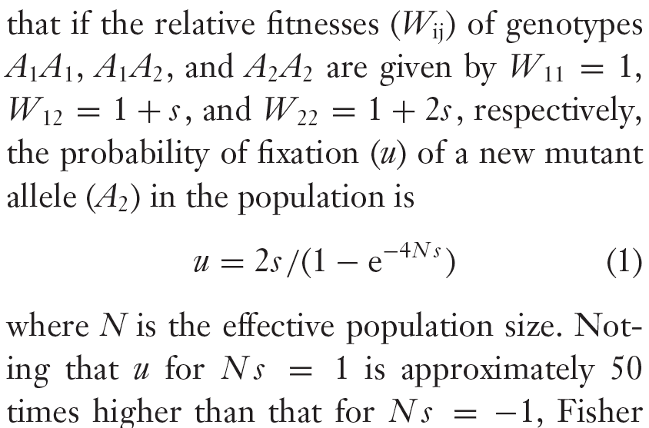
Each mutation can be characterized by selection coefficient (s) and fitness (W)
From Nei et al. 2010

Slide 8
Selection coefficient (S) and fitness (w)
(Wikipedia)
Natural selection is the fact that some traits make it more likely for an organism to survive and reproduce. Population genetics describes natural selection by defining fitness as a propensity or probability of survival and reproduction in a particular environment. The fitness is normally given by the symbol w=1+s where s is the selection coefficient. Natural selection acts on phenotypes, or the observable characteristics of organisms, but the genetically heritable basis of any phenotype which gives a reproductive advantage will become more common in a population (see allele frequency). In this way, natural selection converts differences in fitness into changes in allele frequency in a population over successive generations.

Slide 9
PROBLEM !!!
It is absolutely impossible to measure the selection coefficient S for a given mutation in experiments with complex organisms like mouse or wheat
… unless this mutation is deleterious
Therefore, the crucial parameter (S) for each theory
is totally elusive and the dispute between
Selectionism versus Neutralism cannot be resolved!

Slide 10
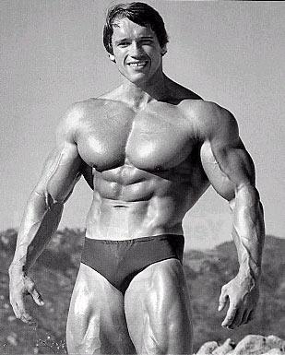

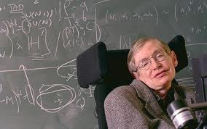
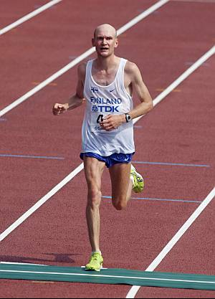



How has the highest fitness ?
Arnold Schwarznegger, Andrea Boceli, Stephen Hawking,
A marathon runner, Usain Bolt, Warren Buffet, Lindsay Lohan

Slide 11
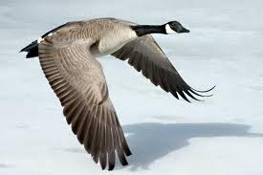
Fitness – a tricky illusive parameter
Multiple environmental habitats (goose)
Environmental changes (temperature,
water conditions, chemistry (volcano), etc.)
A mutation could be good for one environment and very bad for others (globin gene example).
CONCLUSION: Assignment of scalar values for S and W is an enormous simplification. These parameters should be matrixes that change in time.

Slide 12
Problems with bacteria
In a haploid organism fitness parameter (w) expresses a growth rate of that haploid genotype (p.206, Hartl and Clark, 4th edition Principles of Population Genetics)
However, a vast majority of bacteria (~99%) in our planet is impossible to growth in the lab (So, is their fitness equal to zero?)

Slide 13
A vast majority of equations in Population Genetics study a single locus (enormous simplification)
From Sanford’s “Genomic Entropy” (p.69):
“…Traditionally, geneticists have studied the problem of mutations by simply considering one mutation at a time. It has been widely assumed that what works for one mutation can be extended to apply to all mutations. … This is like saying that if I can juggle three balls I can juggle 300! We are learning that the really tough problems are not seen with single genes but arise when we consider all genetic units combined (the whole genome)”

Slide 14
Each mutation can be characterized by selection coefficient (s) and fitness (W)
From Nei et al. 2010

Slide 15
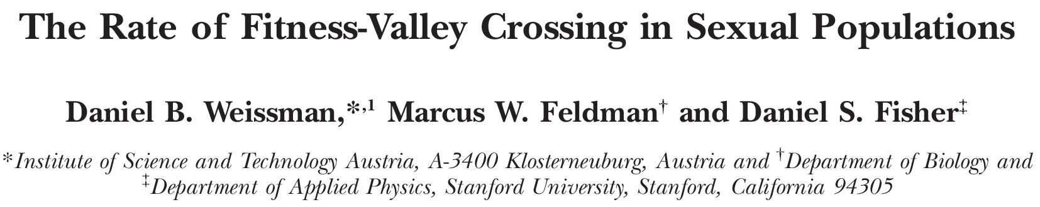
Biological traits result in part from interactions between different genetic loci. This can lead to sign epistasis, in which a beneficial adaptation involves a combination of individually deleterious or neutral mutations; in this case, a population must cross a "fitness valley" to adapt. Recombination can assist this process by combining mutations from different individuals or retard it by breaking up the adaptive combination. Here, we analyze the simplest fitness valley, in which an adaptation requires one mutation at each of two loci to provide a fitness benefit. We present a theoretical analysis of the effect of recombination on the valley-crossing process across the full spectrum of possible parameter regimes. We find that low recombination rates can speed up valley crossing relative to the asexual case, while higher recombination rates slow down valley crossing, with the transition between the two regimes occurring when the recombination rate between the loci is approximately equal to the selective advantage provided by the adaptation. In large populations, if the recombination rate is high and selection against single mutants is substantial, the time to cross the valley grows exponentially with population size, effectively meaning that the population cannot acquire the adaptation. Recombination at the optimal (low) rate can reduce the valley-crossing time by up to several orders of magnitude relative to that in an asexual population.

Slide 16
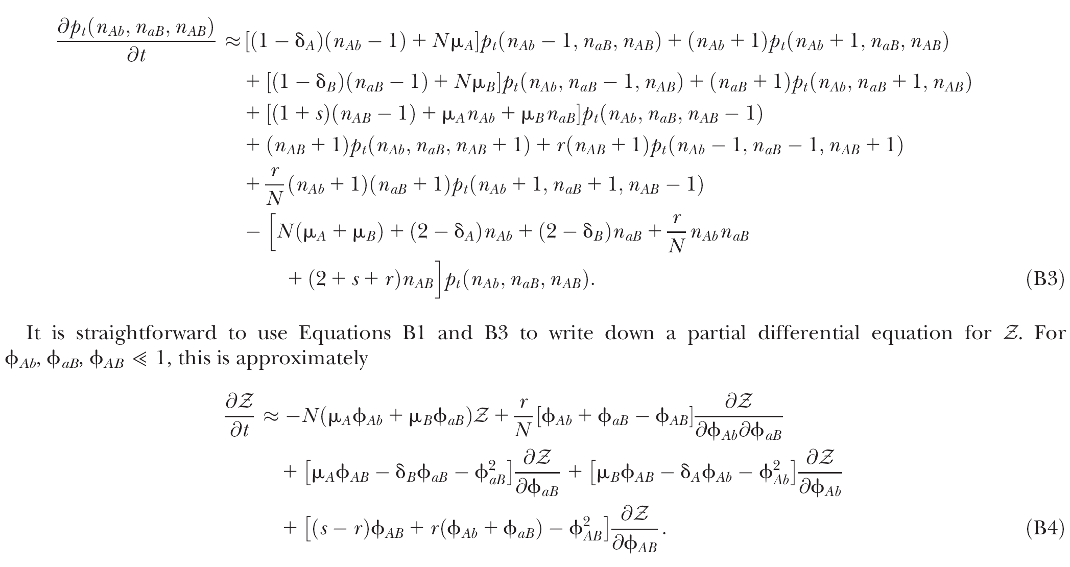
Elegant and straightforward solution by Weissman et al. 2010

Slide 17
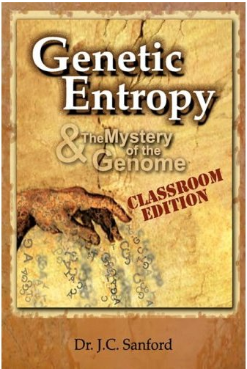
From Dr. Sanford’s book (p.53)
… The models did not match biological reality, but these men [famous scientists] had an incredible aura of intellectual authority, their arguments were very abstract, and they used highly mathematical formulations which could effectively intimidate most biologists.

Slide 18
Genetic Entropy & the Mystery of the Genome (2005)
The book claims that the genome is deteriorating and therefore could not have evolved in the way specified by the Modern evolutionary synthesis.
Sanford is a prolific inventor with more than 30 patents. At Cornell Sanford and colleagues developed the "Biolistic Particle Delivery System" or so-called "gene gun”. He is the co-inventor of the Pathogen-derived Resistance process and the co-inventor of the genetic vaccination process. He was given the "Distinguished Inventor Award" by the Central New York Patent Law Association in 1990 and 1995. He has founded two biotechnology companies, Sanford Scientific and Biolistics. In 1998 he retired on the proceeds from the sale of his biotech companies, and continued at Cornell as a courtesy associate professor. http://www.youtube.com/watch?v=0-rx_lS3ZwI

Slide 19
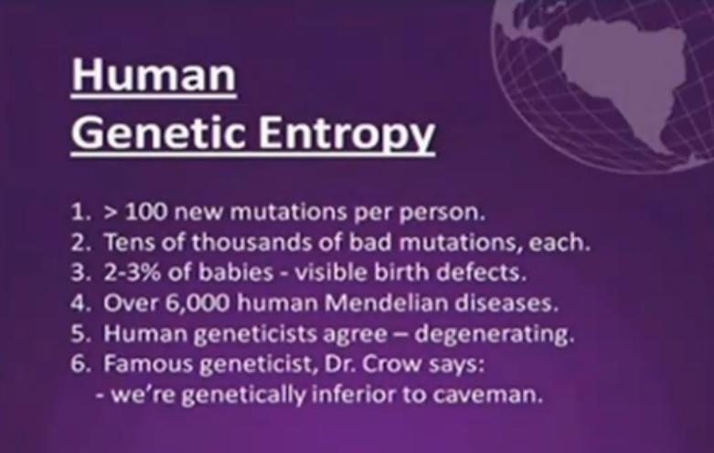
From Dr. Sanford’s presentation http://www.youtube.com/watch?v=0-rx_lS3ZwI

Slide 20
HOMEWORK ASSIGNMENT #2
CONCLUSION: Human genome is enormously complicated system and we still at the very beginning of understanding its structure, functioning, and evolution.
Watch my public lecture from the Internet about an alternative to Dr. Sanford
explanation for the origin of new genes http://bpg.utoledo.edu/~afedorov/lab/
Write a half-page summary.

Slide 21
Mathematical modeling versus
Computer modeling in Population Genetics
Mathematical approach requires non-trivial equations and deep knowledge of math.
Computer Modeling = A New Kind of Science
“ ≈ Computer experiments are able to reveal unexpected results and open a whole new way of looking at the operation of our universe”

Slide 22
Advantages of computer modeling
No mathematics
Allows to observe behavior of complex systems with hundreds of variables and parameters (e.g. thousands of genes with thousands of mutations in organisms exposed to multiple environments)
Allows to study influences of specific non-random arrangement of system elements (gene deserts, hot spots of recombinations, etc)
Allows to make a vast number of changes in the system and investigate their effects (e.g. populations with constant families, free mating, complex families, any relations between fitness and number of offspring, etc.)

Slide 23
Matrix Algorithms for Genome Evolution
?
A computational approach for modeling intricacies of the human genome evolution
Alexei Fedorov,
Associate Professor, Department of Medicine
University of Toledo, HSC

Slide 24
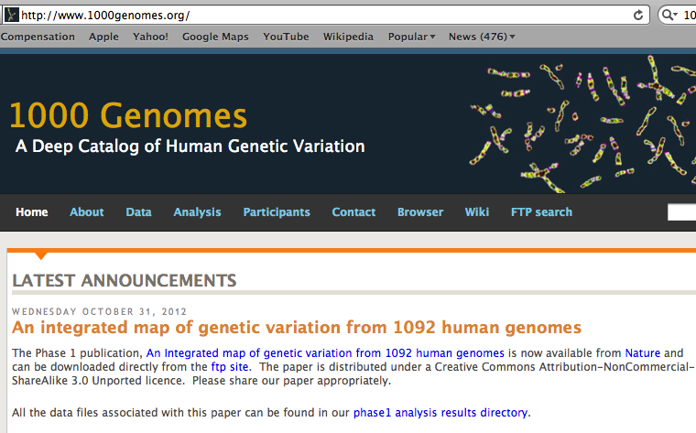
“1000 Genomes” international project

Slide 25
The 1000 Genome Project
ASW African Americans
YRI Nigeria
LWK Kenya
CEU Europeans in America
TSI Italy
FIN Finland
GBR Great Britain
IBS Spain
CHB Chinese in Beijing
CHS Chinese from South
JPT Japan
CLM Colombians
MXL Mexicans
PUR Puerto Rican
1000 Genome Project
LWK
FIN
JPT
GBR
CHB
TSI
PUR
MXL
IBS
CLM
CEU
ASW
YRI
CHS

Slide 26
BOTTOM LINE: Two individuals, even from the same population, differ from one another by millions of SNPs

Slide 27
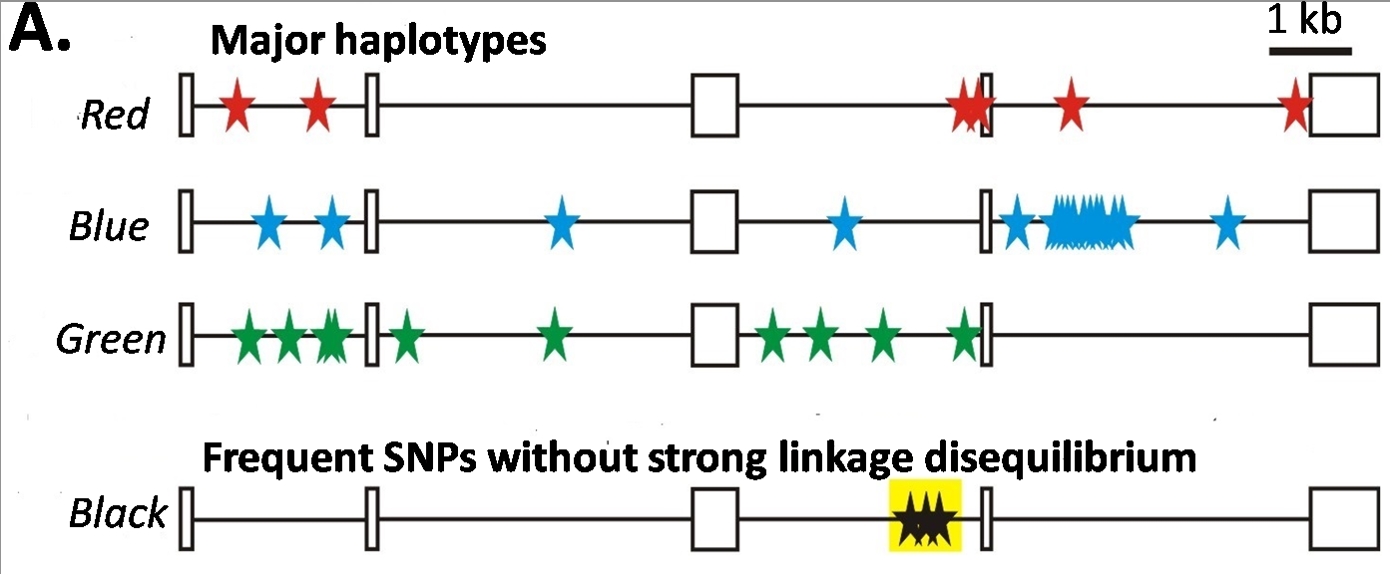
Major haplotypes of human hemeoxygenase-1 gene (only of frequent SNPs are shown)
The bottom line: Mutations never exist alone but in groups linked with each other and forming haplotypes that slowly change due to meiotic recombination and selection/drift

Slide 28
Every human being has 50- 100 de novo mutations
Many of these mutations will drift away. Some of them
will be eventually fixed in the population. The rest will be present as polymorphic biomarkers for a considerable period of time.
The major question I would like to answer at this presentation:
What parameters are most important for maintaining the fitness of population under the intense influx of novel mutations when deleterious ones overwhelm beneficial?

Slide 29
Mathematical modeling versus
Computer modeling in Population Genetics
Not trivial
Considerable simplificaton of reality
Several opposing theories
FROM: Weissman et al. 2010 The rate of fitness-valley crossing in sexual populations

Slide 30
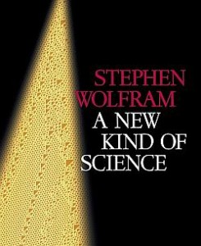
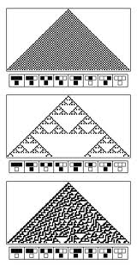
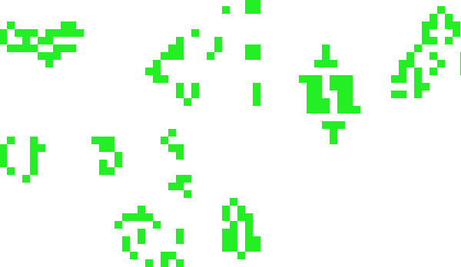
Mathematical modeling versus
Computer modeling in Population Genetics
Cellular Automata
Game of life
Computer experiments are able to reveal unexpected results and open a whole new way of looking at the operation of our universe
BOTTOM LINE: Instead of utilizing mathematical modeling, prediction of the fate of mutations can be approached more fruitfully from a different dimension: taking advantage of the enormous power of contemporary supercomputers.

Slide 31
Advantages of computer modeling
No mathematics
Allows observation of cooperation of thousands elements (SNPs)
Behavior of the system with multiple parameters and inhomogeneity

Slide 32
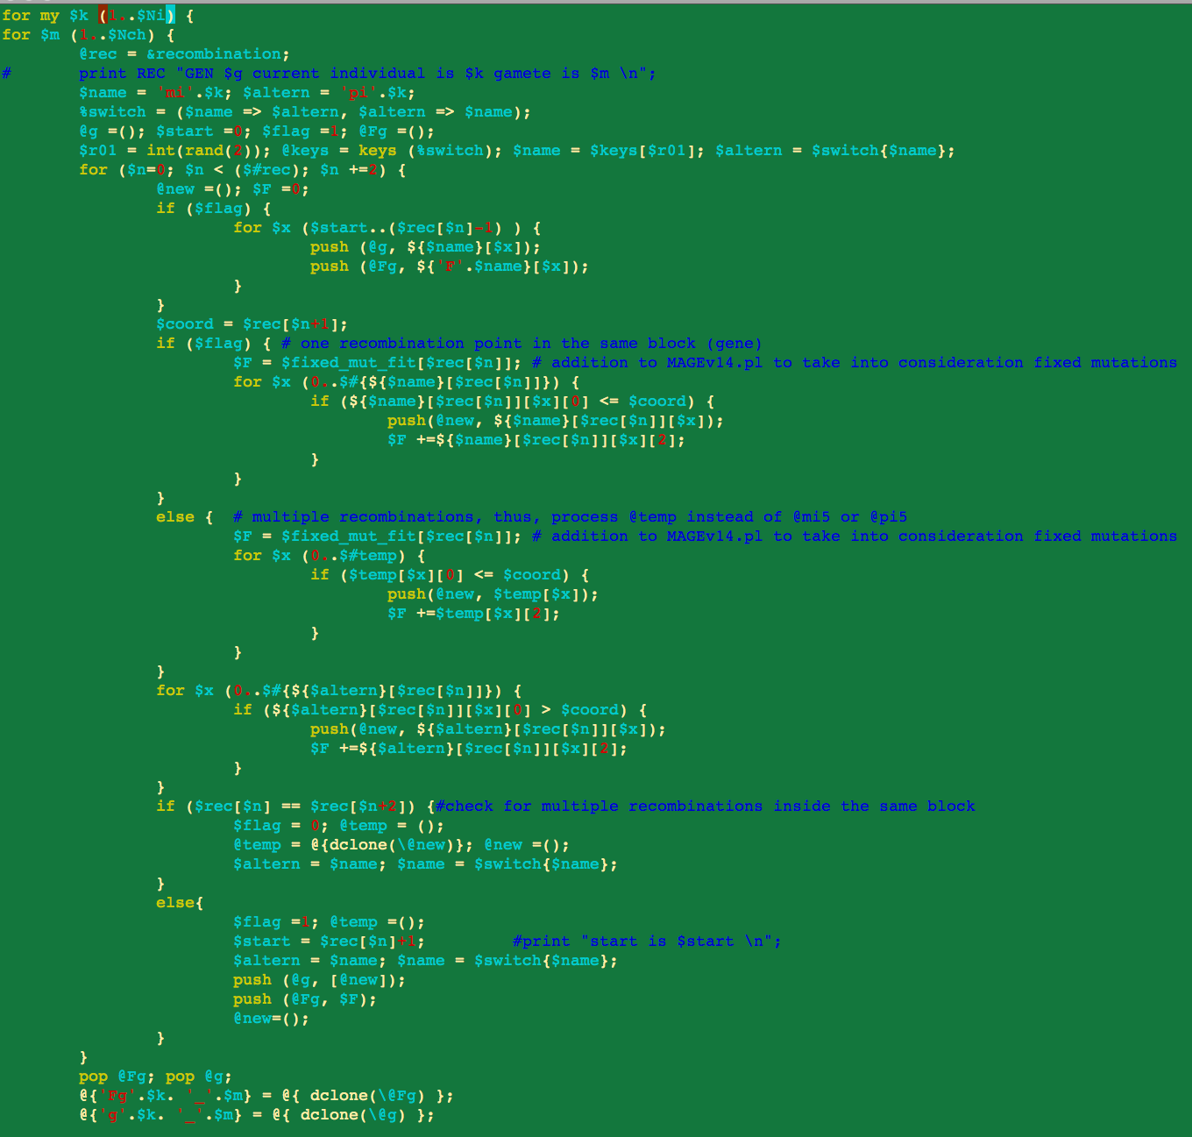
Matrix Algorithms for Genome Evolution (MAGE)
Advanced version
MAGE.java
150 pages of scripts
Core version
MAGE.pl
15 pages

Slide 33
Genetically Identical Starting Population, size N
Mutations in each individual
Mating between N/2 mating pairs
Combine male and female gametes to make offspring
Calculate fitness of offspring
N most fit offspring to survive and reproduce
Observe population fitness & DNA sequences changes after a certain number of generations

Slide 34
A large portion of a real genomic sequence (even whole chromosomes of human or other species) can be assigned as a reference genome for a model population
A user specifies the number of individuals in the population (parameter N)
Each individual is constructed as a diploid genome that descended as two haploid gamete genomes from its parents.

Slide 35
Mutations are created randomly taking a user-defined parameter μ (number of novel mutations per gamete)
Each individual accumulates a number of mutations in their germ cells
  Effects fitness of next generation inheriting the mutations
Effect of mutation on fitness of offspring: “selective advantage” value (s)
    Beneficial: improves fitness
    Deleterious: decreases fitness

Slide 36
Upon generation of a mutation, MAGE assigns a selection coefficient (s) to the mutation using a user-defined s-distribution.
Since s is an experimentally immeasurable parameter, MAGE assigns non-normalized values of s for generated mutations.
When s > 0 the mutation is beneficial
When s< 0, the mutation is deleterious
BOTTOM LINE: Absolute values of s are not of primary importance, yet the distribution of these s-values among all mutations is crucial.
Distribution of s is a D-parameter

Slide 37
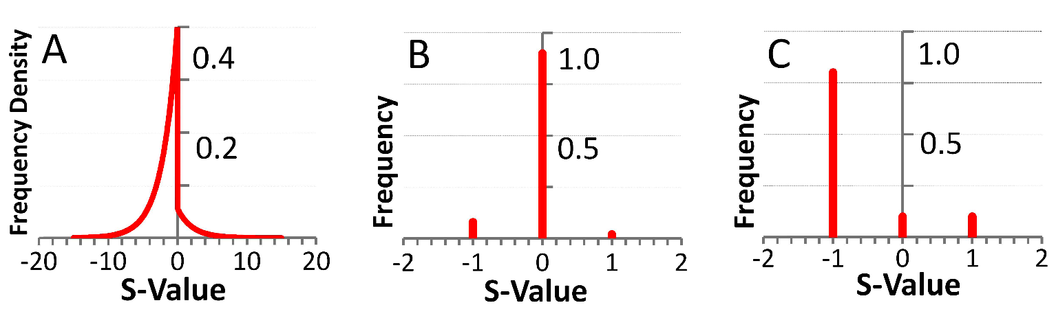
Our popular distributions (D parameters)
Deleterious mutations are 9 times more abundant than beneficial

Slide 38
Scheme of meiotic recombination
Number of recombination events per gamete – parameter r
Maternal
5’
3’
Paternal
5’
3’
r=1
Gamete 1
5’
3’
R=15
Gamete 2
5’
3’

Slide 39


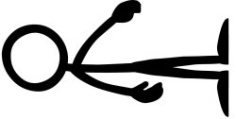






Mating schemes and generation of offspring
Number of offspring per individual parameter α
α = 3
α = 6

Slide 40
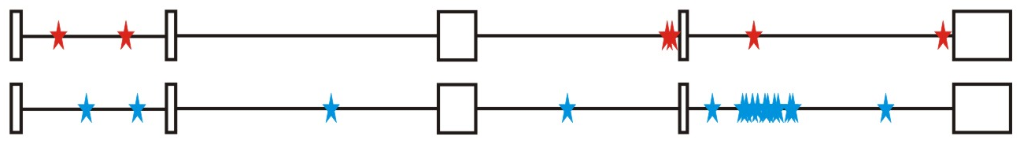
Calculation of fitness for each generated offspring
Maternal allele: fitness W_{m}
Paternal allele: fitness W_{p}
MAGE calculates fitness for each gene for both parental chromosomes by summing all the s-values of mutations within that gene.
The fitness of the maternal allele for the given gene (w_{m}) will be a sum of s-values for all SNPs within maternal haplotype of this gene, while the fitness of the paternal allele (w_{p}) will be a sum of s-values for all the paternal SNPs.

Slide 41
The fitness of a gene in is calculated from the w_{m} and w_{p} values and also another user-defined parameter, the dominance coefficient (h parameter).
In a co-dominance mode (h=0.5), the gene fitness is the average of the fitness of maternal and paternal alleles.
Under a recessive mode (h=1), which corresponds to recessive genes, the fitness is the maximum between w_{m} and w_{p} values (heterozygotes with one deleterious allele are healthy).
for a dominant mode (h=0), which corresponds to dominant genes, the gene fitness is the minimum between w_{m} and w_{p} values.
For a general case, the gene fitness is calculated by the formula:
w = min(w_{m}, w_{p}) + h×abs(w_{m}-w_{p})
Fitness of an individual is the sum of fitnesses of all his/her genes

Slide 42
Darwinian selection – The fittest are survive only
N fittest offspring will survive and create new generations.
Fitness

Slide 43
Results of MAGE simulations
Population size N from 50 to 200
Mutations per gamete μ from 1 to 50
Recombinations per gamete r from 0 to 48
Dominance coefficient h 0, 0.5, or 1
Distribution of selection coefficients D: (deleterious mutations 8-10 overwhelm beneficial ones)
Offspring per individual α from 2 to 10
Does NOT
matter
Number of genes in the genome 600-6000
Length of genes 1000 bp -10,000 bp

Slide 44
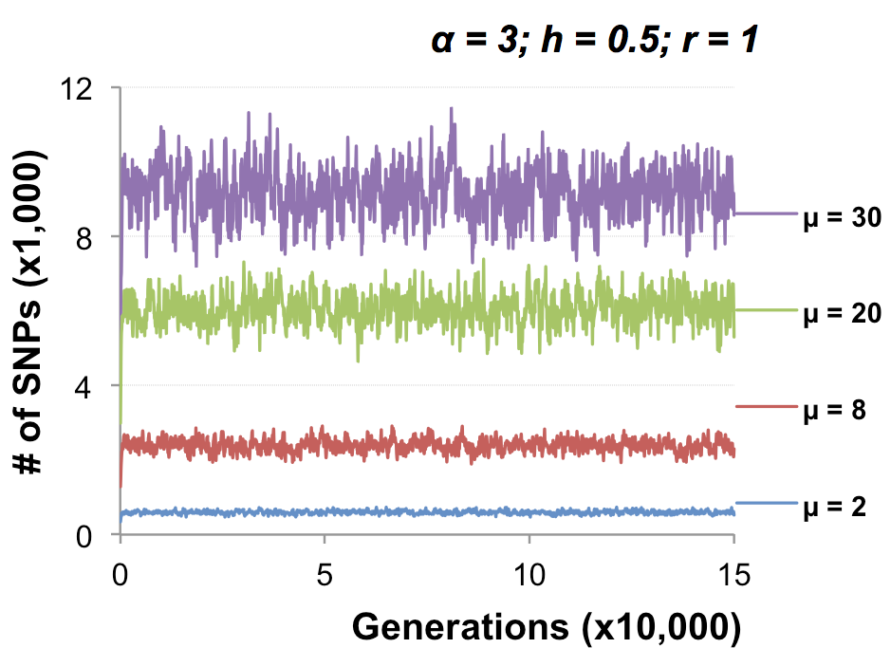
MAGE modeling number of SNPs in population

Slide 45
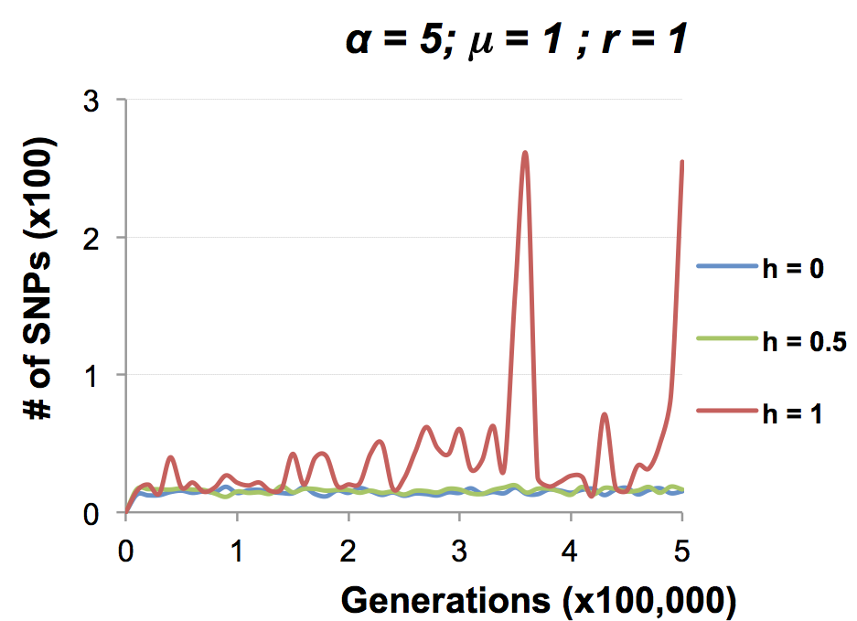
MAGE modeling number of SNPs in population

Slide 46
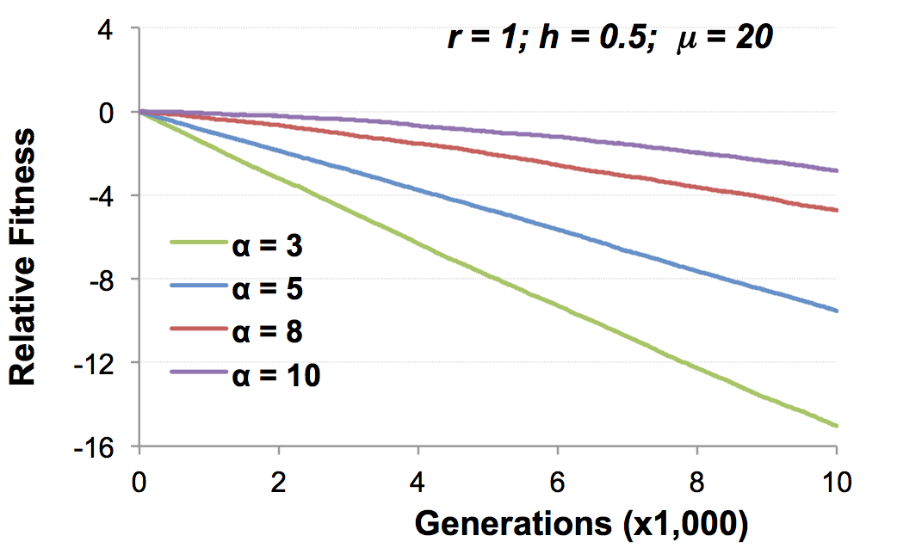
Change of population fitness in generations when deleterious mutations overwhelm beneficial ones

Slide 47
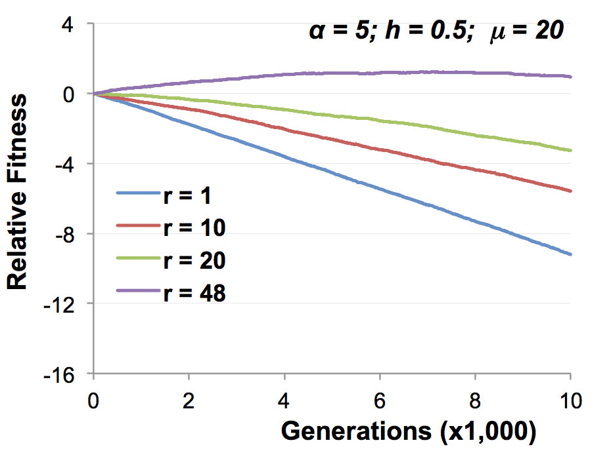
Change of population fitness in generations when deleterious mutations overwhelm beneficial ones

Slide 48
Major Conclusion
Computer modeling with MAGE has demonstrated that the number of meiotic recombination events per gamete is among the most crucial factors influencing population fitness.
In humans, these recombinations create a gamete genome consisting on an average of 48 pieces of corresponding parental chromosomes. Such highly mosaic gamete structure allows preserving fitness of population under the intense influx of novel mutations even when the number of mutations with deleterious effects is up to ten times more abundant than those with beneficial effects.
Our formula for healthy population r ≥μ

Slide 49
How haplotypes look like in MAGE modeling?

Slide 50
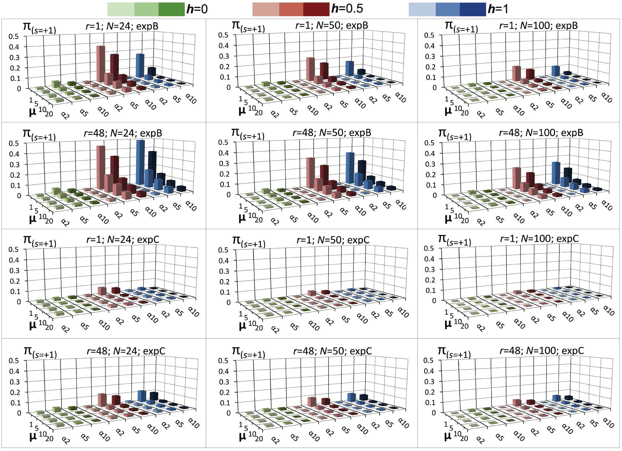
Probability of fixation of a mutation with s = +1

Slide 51
MAGE outcome on the probability of fixation of a mutation with selection coefficient s
For a specific set of parameters, probability of fixation of neutral mutation significantly deviates from 1/2N. For example, for (α =10, h=0, r=1, D=expC, µ=1, N=50) it is 2.1 times higher.
A common view that the probability of ultimate fixation of a beneficial mutation (π) should be proportional to s (π ≅ 2s) and not depend on the population size (Patwa and Wahl 2008). Our MAGE results demonstrate that the probability of fixation of a beneficial mutation π also depends on the combination of the six aforementioned parameters (N, μ, r, h, α, D). This phenomenon can be explained by the linkage of deleterious, beneficial, and neutral mutations within haplotypes and selecting them as whole units.

Slide 52

Mating Schemes with random pairs
Scheme1: True family values
Scheme2: Promiscuity
Random assigned male and female
Random assigned
repeat
Random match
Random match
Each couple has the same number of offspring
The random mating continues until equal number of offspring are born.
Constant mating pairs
Temporary mating pairs

Slide 53
Mating Schemes sorted by fitness
Scheme 4: Artificial scheme
Best-to-Least fit
Scheme 3: Best-to-Best fit
Random assigned
Random assigned
Best fit matches each other
Best fit matches the least fit
Each couple has the same number of offspring
Each couple has the same number of offspring

Slide 54
Mating Schemes sorted by fitness & variable offspring numbers
Scheme 5: Male fitness ->
Number of offspring
Scheme 6: Couple fitness ->
Number of offspring
Random assigned
Random assigned male and female
Best fit matches each other
Random match
The number of offspring is based on the male fitness
The number of offspring is based on the couple fitness

Slide 55

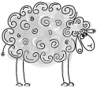
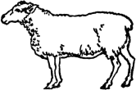




Mating Schemes: Herd – Only the Best male is reproduced
Same number of the offspring
Scheme7
Random assigned
Only the best fit
male is left

Slide 57
Homework assignment
Read two reviews by Nei et al. 2010 and Wagner 2008.
List all arguments presented in these papers that support Neutralism.
List all arguments presented in these papers that support Selectionism.

