Slide 1
Verification of Systems Biology Research in the Age of Collaborative- Competition
Network Verification Challenge
Natalia Boukharov
NVC Ambassador
nboukharov.consultant@selventa.com
The sbv IMPROVER project and www.sbvimprover.com are part of a collaboration designed to enable scientists to learn about and contribute to the development of a new crowd sourcing method for verification of scientific data and results. The project team includes scientists from Philip Morris International’s (PMI) Research and Development department and IBM's Thomas J. Watson Research Center. The project is funded by PMI.

Slide 2
Outline
sbv IMPROVER at a glance
Need for sbv IMPROVER
Crowdsourcing
Diagnostic Signature Challenge
Species Translation Challenge
Network Verification Challenge
Grand Challenge
sbv IMPROVER stands for Systems Biology Verification combined with Industrial Methodology for Process Verification in Research.

Slide 3
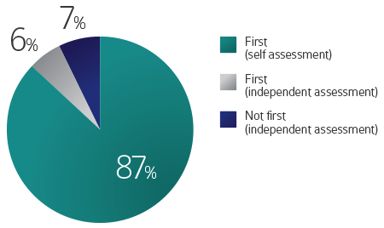
Why do we need sbv IMPROVER?
We are experiencing a data overload…
Genomic
Literature
Molecular
Profiles
Structures
But we lack the corresponding validation tools…
The self-assessment trap: can we all be better
than average?
Mol Syst Biol. 2011 Oct 11;7:537. doi: 10.1038/msb.2011.70.
Develop a robust methodology that verifies systems biology-based approaches
Notes:
Explosion of algorithms for Reverse Engineering (double every 2 years)
Complexity of algorithms

Slide 4
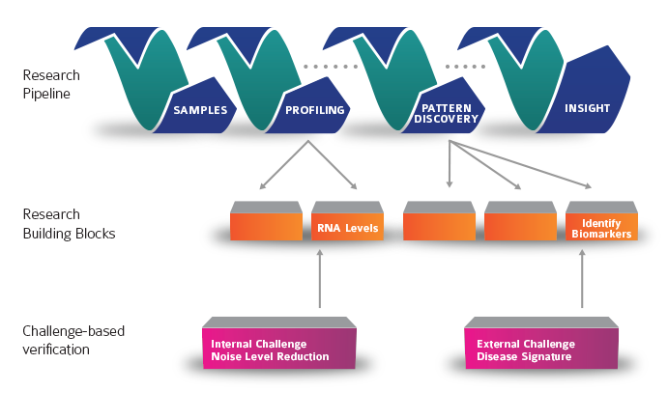
Divide a Research Workflow into Verifiable Building Blocks
Building blocks support each other towards a final goal
Each building block is verifiable by a challenge

Slide 5
Crowdsourcing advantages
Many contributors with independent methods / knowledge
Different solutions tackle various aspects of a complex problem
The combination of solutions often outperforms the best performing submissions and is extremely robust → “Wisdom of Crowds”
Nucleates a community around a given scientific problem
Allows for unbiased benchmarking
Establishes state-of-the-art technology and knowledge in a field
Complements the classical peer-review process
Notes:
Overwhelming to the reviewer the amount of data and complexity of methodology

Slide 6
Example of other crowdsourcing initiatives
Drug discovery: mutagenicity
Boehringer Ingelheim used the knowledge from online scientific community to help predict biological molecular response.
  Public data set with results for over 6000 molecules
    1,776 different structural characteristics ranging from molecular size and shape to chemical composition.
  Participants were asked to generate models that would predict mutagenic activity for new compounds.
    796 entrants, 8,841 entries
    26% improvement over previous accuracy benchmarks
http://www.kaggle.com/solutions/competitions
Notes:
Overwhelming to the reviewer the amount of data and complexity of methodology

Slide 7
Example of other crowdsourcing initiatives
Drug discovery: drug repurposing
NIH, pharma & academia collaborative project
  AbbVie, AstraZeneca, Bristol-Myers, Eli Lilly, GlaxoSmithKline, Janssen, Pfizer and Sanofi.
  58 proven safe compounds.
9 NIH funded projects
  The Efficacy and Safety of a Selective Estrogen Receptor Beta Agonist
  Fyn Inhibition by AZD0530 for Alzheimer’s Disease
  Medication Development of a Novel Therapeutic for Smoking Cessation
  A Novel Compound for Alcoholism Treatment: A Translational Strategy
  Partnering to Treat an Orphan Disease: Duchenne Muscular Dystrophy
  Reuse of ZD4054 for Patients with Symptomatic Peripheral Artery Disease
  Therapeutic Strategy for Lymphangioleiomyomatosis
  Therapeutic Strategy to Slow Progression of Calcific Aortic Valve Stenosis
  Translational Neuroscience Optimization of GlyT1 Inhibitor
Notes:
Overwhelming to the reviewer the amount of data and complexity of methodology

Slide 8
sbv IMPROVER Challenges
  Diagnostic Signature Challenge
    Best analytic approaches to predict phenotype from gene expression data
  Species Translation Challenge
    accuracy and limitations of rodent models for human diseases
  Network Verification Challenge
    Verify and enhance pulmonary biological network models
  Grand COPD Challenge
    COPD Biomarkers
Notes:
8

Slide 9
Extract disease-
related signal
Diagnostic Signature Challenge
(completed)
www.sbvimprover.com

Slide 10
Diagnostic Signature Challenge
Assess and verify computational approaches that classify clinical samples across four disease areas: psoriasis, multiple sclerosis, chronic obstructive pulmonary disease and lung cancer.
Publically-available training datatsets and an independent test set to predict which samples came from someone with the disease and which samples came from a control.
Fifty-five teams participated. Submissions were scored by the IBM Computational Biology Centre and independently reviewed by the IMPROVER Scoring Review Panel.
Combinations of different approaches performed better then each individual method

Slide 11
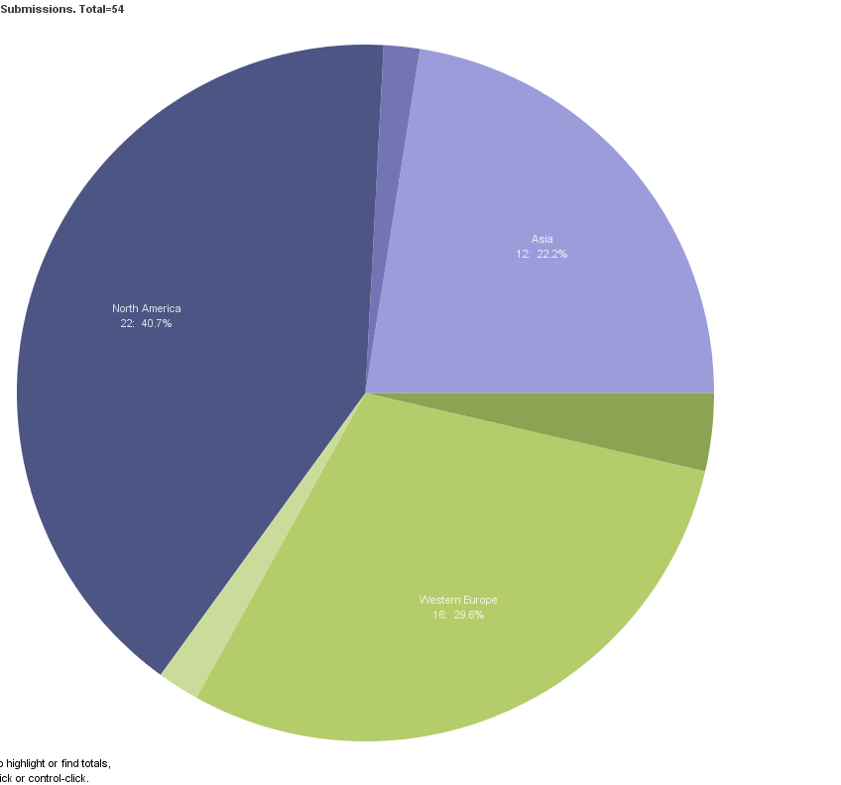
Diagnostic Signature Challenge: overall participation
Eastern Europe
1: 2%
Asia
12: 22%
54 Teams from around the world participated
North America
22: 41%
Other / Undefined
2: 4%
Western Europe
15: 30%
South America
1: 2%
Notes:
11

Slide 12
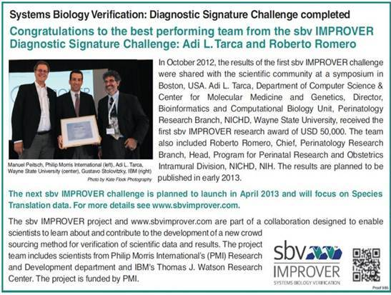
Diagnostic Signature Challenge: Results
Symposium 2012 (2-3 October 2012 in Boston, MA, USA)
  Announced the best performing teams
  Discussed and shared experiences on sbv IMPROVER and the Diagnostic Signature Challenge
  Keynotes Speakers from Systems Biology Community
Nature, 24 Jan. 2013, page 565

Slide 13

Species Translation Challenge
From Rat To Human: Understanding the Limits of Animal Models for Human Biology
Species translation formula
www.sbvimprover.com

Slide 14
Species Translation Challenge: Background
and Goal
Concept of « Translatabillity »
Goal: Verify the translation of biological effects of perturbations in one species given information about the same perturbations in another species.
Notes:
assumption of translatability
Not many studies
We want to see the limitations/scope of such translatability

Slide 15
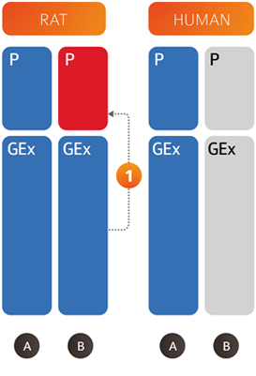
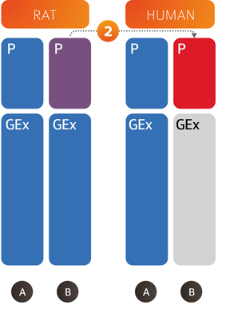
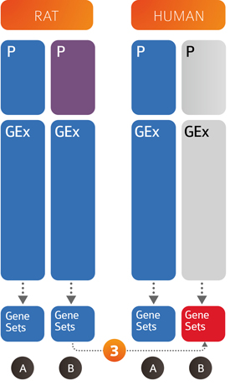
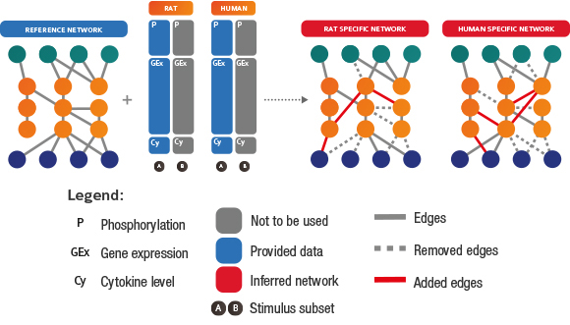
  Species Translation Challenge
Rat Training Subset A: Gene Expression (GEx) and Protein Phosphorylation (P). Rat Test Subset B: predict P using GEx
Rat and Human Training Subset A: GEx and P. Human Test Subset B: predict Human P using Rat P.
Rat Training Subset B: Gex, P and Gene Sets. Human Test Subset B: predict Human Gene Sets.
infer human and rat networks given phosphoprotein, gene expression and cytokine data and a reference network provided as prior knowledge

Slide 16
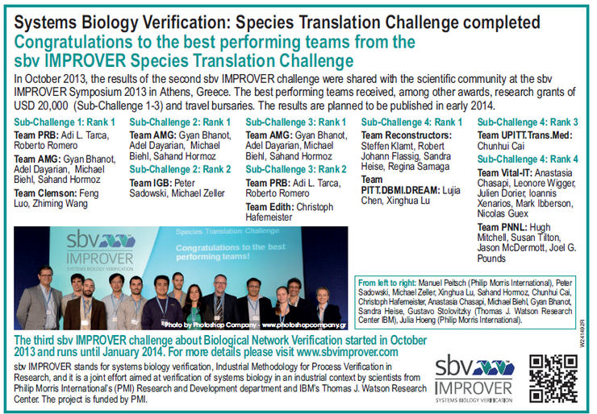
Species Translation Challenge: Results

Slide 17
Network Verification Challenge
COPD
network
www.sbvimprover.com

Slide 18
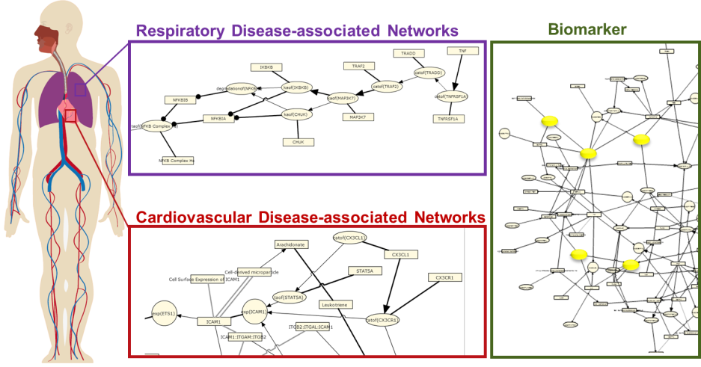
Network Verification Challenge
The disparate information on molecular mechanisms of the respiratory system has been organized and captured within a coherent collection of network models.
The purpose of the Network Verification Challenge is to engage the scientific community to review, challenge, and make corrections to the conventional wisdom
The verified network will be used in the “COPD Grand Challenge”
Network Biology for Systems Toxicology and Biomarker Discovery

Slide 19
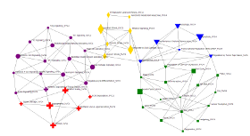
Networks
Represent important biological processes implicated in human lung physiology and specific processes related to COPD.
Cell death (blue, triangle nodes)
Cell proliferation (green, squares)
Cell stress (yellow, diamond)
Inflammation (purple, circle)
Tissue repair and angiogenesis (red, cross)

Slide 20
Context
Species: Primarily human, although mouse and rat evidence was included when supporting literature from human context was not available.
Tissue: Primarily non-diseased respiratory tissue biology.
Disease: Healthy tissue augmented with chronic obstructive pulmonary disease biology only (e.g. lung cancer context was excluded).

Slide 21
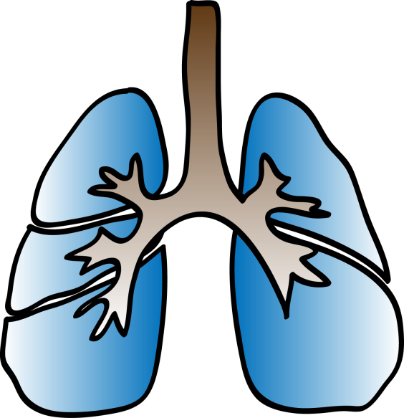
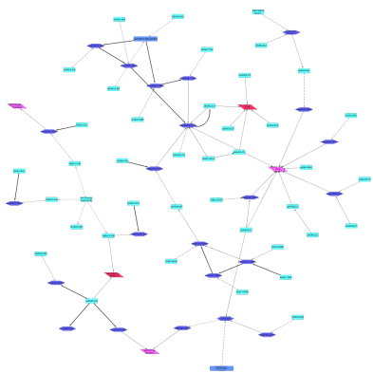
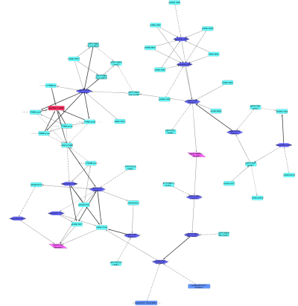
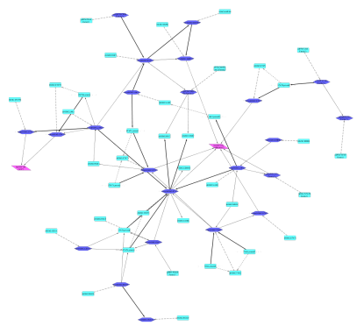
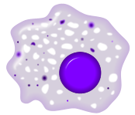

Network Models
Represent important biological processes implicated in
human lung physiology and specific processes related to COPD
Cell-specific Signaling
Example: Macrophage Signaling Network
Canonical Signaling
Example: MAPK Network
Physiologic Signaling
Example: Oxidative Stress
Raf
ROS
MEK
MAPK
Notes:
In this challenge, you will have the opportunity to view and improve 50 biological networks that cover a wide range of pathways and processes relevant to lung biology. Each network describes the molecular mechanisms underlying a particular pathway, from cell type-specific pathways such as macrophage signaling, to physiological pathways such as oxidative stress, to canonical signaling pathways such as MAPK signaling.
Macrophage image- wikipedia commons

Slide 22


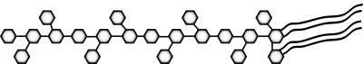

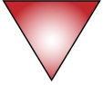



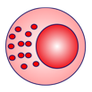


Networks were Built Using Literature and Human Transcriptomic Data
Data Set
Tissue
Stimulus
LPS
GSE 18341
Whole lung
PubMed
T-cells
IL4
IFNG
Th2
Th1
LPS
Dendritic cells
GSE 22886
Macrophage
Cell culture induced differentiation
NK cell
IL15
GSE 2322
Lung neutrophil
Endotoxin
22

Slide 23
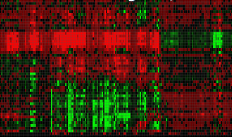
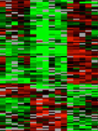
Transcriptomic Data Serves as the Input that Drives RCR
Data:
 r(Gene 1)
r(Gene 2)
 r(Gene 3)
 r(Gene 4)
Differentially expressed genes

Slide 24


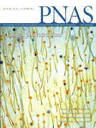
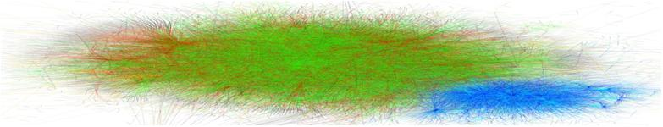

Knowledge Encoded in BEL Is a Substrate for RCR
Knowledgebase
A collection of cause-and-effect relationships
Knowledgebase:
tscript(Protein A)
r(Gene 1)
r(Gene 2)
r(Gene 3)
r(Gene 4)
Data:
 r(Gene 1)
r(Gene 2)
 r(Gene 3)
 r(Gene 4)
Differentially expressed genes

Slide 25
Knowledge Encoded in BEL Is a Substrate for RCR and Identifies Mechanistic Causes of the Data
Knowledgebase + Data
→ Inferred mechanism
Identification of mechanistic causes leading to differential gene expression changes
 tscript(Protein A)
 r(Gene 1)
r(Gene 2)
 r(Gene 3)
 r(Gene 4)
Reverse Causal Reasoning
Knowledgebase
A collection of cause-and-effect relationships
Knowledgebase:
tscript(Protein A)
r(Gene 1)
r(Gene 2)
r(Gene 3)
r(Gene 4)
Data:
 r(Gene 1)
r(Gene 2)
 r(Gene 3)
 r(Gene 4)
Differentially expressed genes

Slide 26
Knowledge Encoded in BEL Is a Substrate for RCR and Identifies Mechanistic Causes of the Data
(e.g. Increase in TNF)
Knowledgebase + Data
→ Inferred mechanism
Identification of mechanistic causes leading to differential gene expression changes
 tscript(Protein A)
 r(Gene 1)
r(Gene 2)
 r(Gene 3)
 r(Gene 4)
Reverse Causal Reasoning
RCR identifies the changes in signaling pathways (increase in the transcriptional activity of Protein A) that caused the changes in the data in response to a perturbation
Knowledgebase
A collection of cause-and-effect relationships
Prediction of active mechanisms is based on two statistics:
Richness: Based on Hypergeometric Distribution Over-representation of State Changes downstream mechanism based on total possible State Changes
Concordance: Based on Binomial Distribution Measures degree to which State Changes consistently support a direction for the mechanism
Differentially expressed genes
Notes:
Compiled from 45,762 publications and 619,375 statements
Is updated daily
Includes data from Homologene, KEGG, ChemID Plus and COSMIC
Captures detailed biological information to harness current ‘omics technologies (e.g., SNPs, mutations, RNA/Proteins, activities, modifications)

Slide 27
Knowledge Encoded in BEL Is a Substrate for RCR and Identifies Mechanistic Causes of the Data
(e.g. Increase in TNF)
Knowledgebase + Data
→ Inferred mechanism
Identification of mechanistic causes leading to differential gene expression changes
 tscript(Protein A)
 r(Gene 1)
r(Gene 2)
 r(Gene 3)
 r(Gene 4)
Reverse Causal Reasoning
RCR was used to enhance networks and can also be used to understand signaling in a data set in the context of biological networks
Knowledgebase
A collection of cause-and-effect relationships
Differentially expressed genes
Notes:
Compiled from 45,762 publications and 619,375 statements
Is updated daily
Includes data from Homologene, KEGG, ChemID Plus and COSMIC
Captures detailed biological information to harness current ‘omics technologies (e.g., SNPs, mutations, RNA/Proteins, activities, modifications)

Slide 28

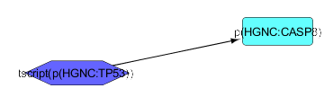
Biological Statements Coded into Network Models using BEL
PubMed
  Transcriptional activity of the TP53 protein increases level of CASP8.
Subject | Relationship | Object
tscript(p(HGNC:TP53)) | increases | p(HGNC:CASP8)
Notes:
In the Network Verification Challenge, biological networks are represented using the BEL language. Statements from peer-reviewed publications containing precise biological relationships may be scripted in the BEL language and used to construct a network representing a biological pathway(s).

Slide 29
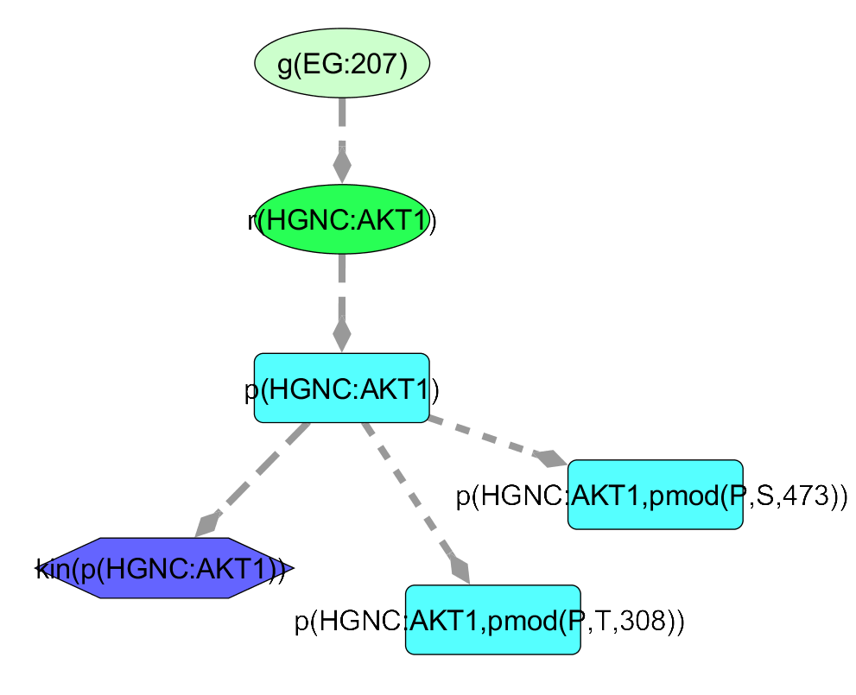
BEL Functions
function(namespace:Entity)
Types of functions:
  Abundances
  Modifications of abundances
  Processes
  Activities
  Transformations
BEL Functions enable representation of different aspects of a value
  e.g. AKT1 (EGID:207) may be represented in multiple ways
gene
RNA
protein
activity
modifications

Slide 30

BEL Portal
http://www.openbel.org/
http://wiki.openbel.org/display/BLD/BEL+Language+Documentation+v1.0+-+Current

Slide 31



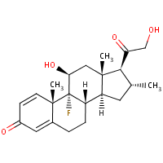
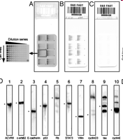
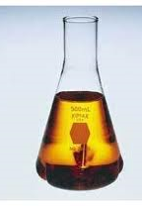

BEL Captures Scientific Findings in a Computable Language
“RNA expression of RBL2 is directly mediated via activation of the FOXO3 transcription factor”
Scientific Literature
tscript(p(HGNC:FOXO3)) => r(HGNC:RBL2)
J Biol Chem 2002 Nov 22 277(47) 45276-84
“LY294002 inhibits the activity of the PI3K alpha catalytic subunit”
Original Research
a(CHEBI:LY294002) -| kin(p(HGNC:PIK3CA))
XYZ Corp Document 12345

Slide 32
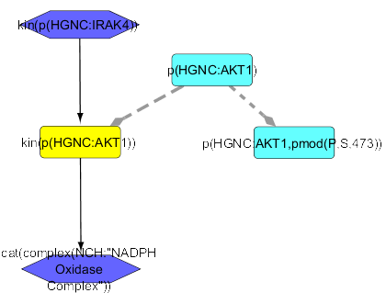
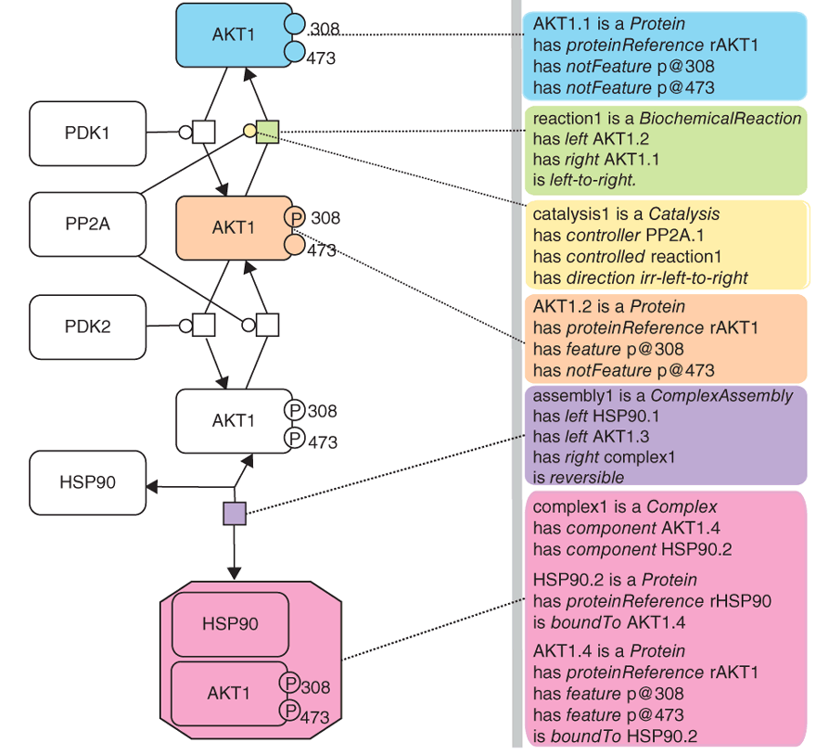

BEL Language vs. BioPAX Level 3
BEL captures pathway information similarly to BioPAX, but also includes causal relationships backed by discrete scientific findings with specific context information
BEL
BioPAX
In BEL, a causal edge is supported by a publication and annotated with context information
Subject | Relationship | Object
kin(p(HGNC:IRAK4)) | increases | kin(p(HGNC:AKT1)
Species: Mouse; Cell type: Neutrophil
BEL Evidence
Demir, et al Nature Biotechnology 28, 935–942 (2010)
PMID: 17475888
In BioPAX, whole pathways can be annotated but not specific statements within a pathway

Slide 33
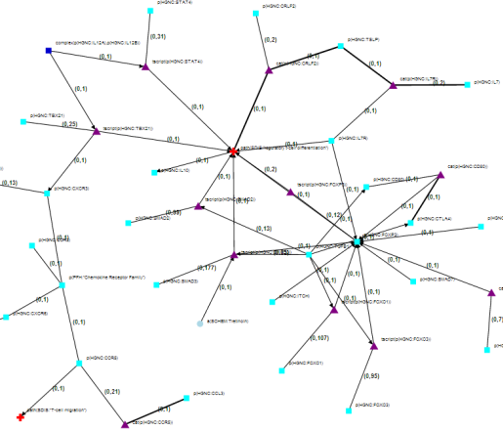
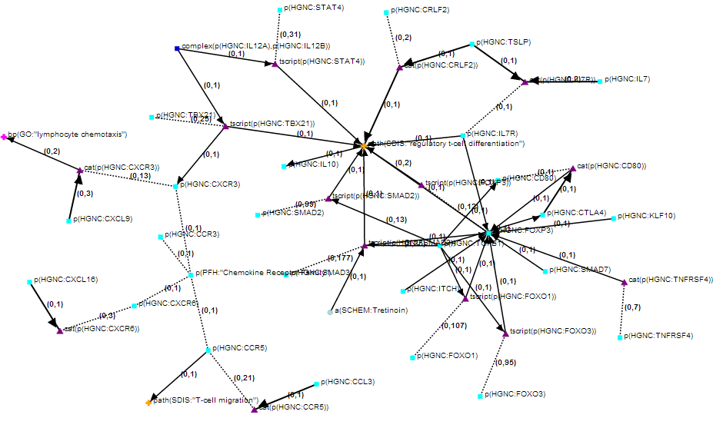
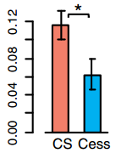
Network Models Can Be Used for Drug Discovery, Biomarker and Toxicity Applications
Identify biomarker candidates
Identify novel mechanisms
Confirm known mechanisms
Compare/contrast mechanisms
Quantitative toxicity testing
Pulmonary Inflammation
Drug A Drug B
Notes:
33

Slide 34


Reverse Causal Reasoning Is Used to Infer Active Mechanisms from Transcriptomic Data
Stimulus
RCR – Reverse Causal Reasoning
Mechanisms are inferred from gene expression changes using a knowledgebase of literature-supported relationships
Protein A
Kinase activity B
Transcriptional activity C
Data-enhanced network
A data set relevant to a network was used to enhance the network -
mechanisms active in the data set were predicted using RCR
RCR can also be used in conjunction with the networks to understand and compare biology in data sets
Notes:
Mechanisms, including proteins and activities of proteins, are inferred from gene expression changes using a knowledgebase of literature-supported relationships and integrated into the network

Slide 35

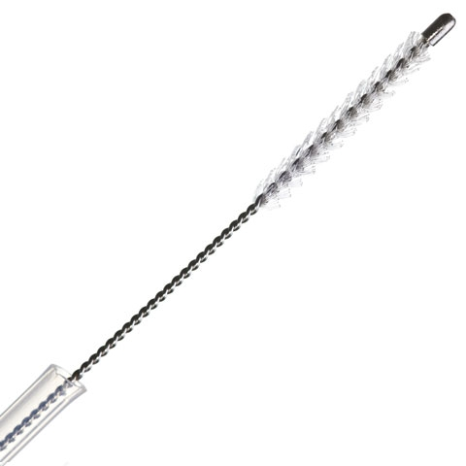


Lung Injury
Bleomycin
  Transcriptomic analysis of mouse lungs instilled with bleomycin
  Data set available at GEO: GSE18800, PMID: 19966781
Experimental Design
  Data collected 14 day after bleomycin instillation
  Other measurements
    Increased TGFB and immune cells measured at day 7 and 21
    Increased hydroxyproline at day 21
Mechanical injury
  Transcriptomic analysis of human lung after large airway brushing injury
  Data set available at GEO: GSE5372, PMID: 17164391
Experimental Design
  Data collected 7 day after large airway brushing
  Other measurements
    Injured area completely covered by partially redifferentiated epithelial layer after 7d
    Less than 1% of cells were inflammatory, indicating inflammation had subsided by 7d
Bleomycin
Comparing these data sets in the context of network models will help clarify which tissue repair processes are specific to bleomycin, mechanical injury and shared by both
35

Slide 36
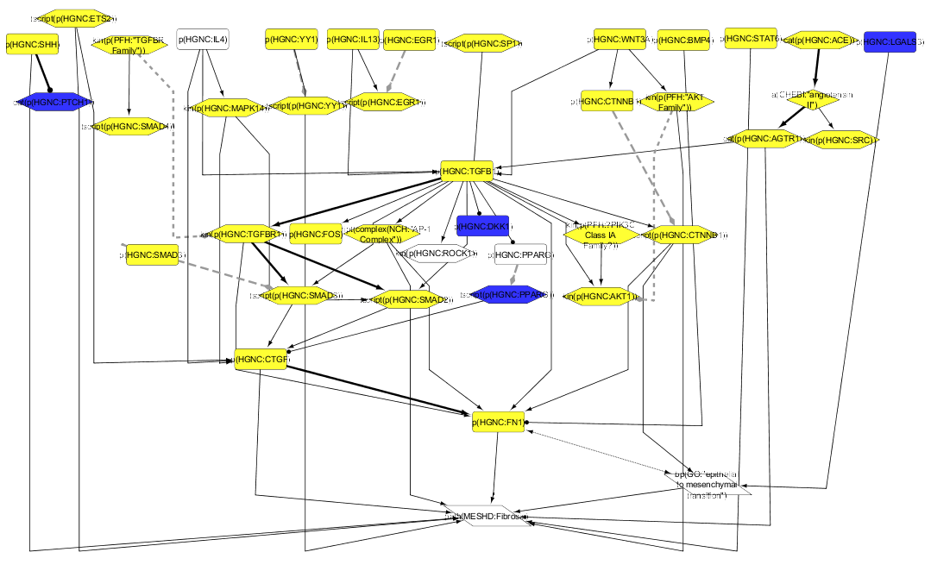
Bleomycin Induces Many Fibrosis Mechanisms Including TGFB
Bleomycin Mechanisms Predicted in Fibrosis Network
Consistent with increased process
Consistent with decreased process
  Note: A subset of the network is shown
As a well-known model of fibrosis, bleomycin induces many fibrosis mechanisms
Mechanisms predicted by RCR match findings from the literature, including increased TGFB, measured increased in the data set
  Increased beta catenin, angiotensin, PI3K and TGFB, and decreased PPARG can drive bleomycin-induced fibrosis
    PMIDs: 21212602, 14694243, 19520917, 17883846, 19714649
Fibrosis mechanisms predicted by RCR not studied in literature offer novel mechanistic detail
  Hedgehog signalling and specific beta-catenin family members have not been specifically studied in bleomycin literature

Slide 37
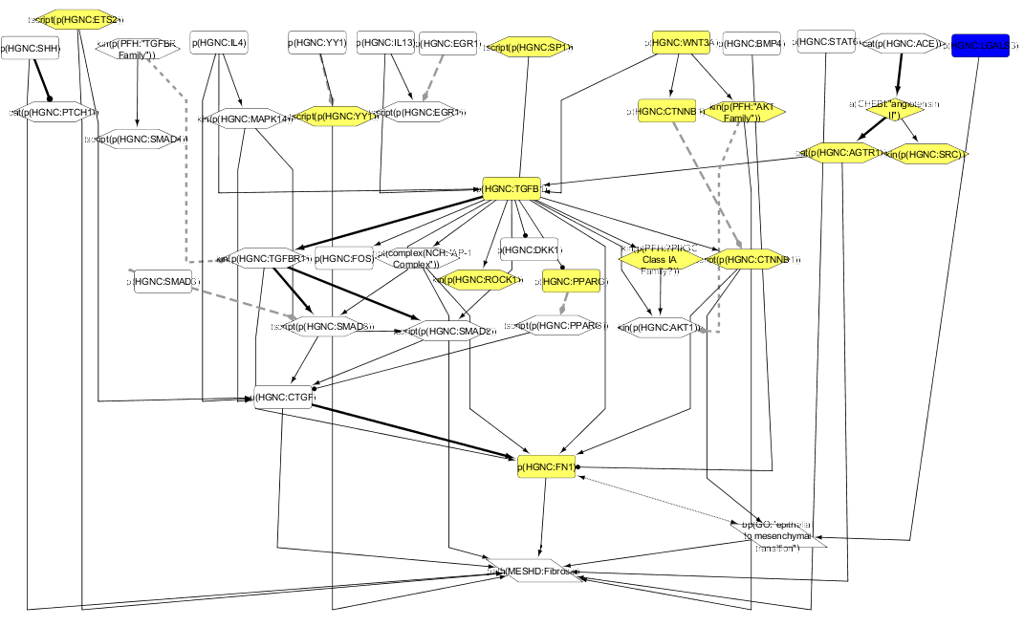
Mechanical Injury Induces Wound Healing Response Resulting in ECM Secretion
Mechanical Injury Mechanisms Predicted in Fibrosis Network
Consistent with increased process
Consistent with decreased process
  Note: A subset of the network is shown
PI3K, angiotensin, beta-catenin and Collagen type I are predicted, indicating mechanical injury induces ECM secretion
Lack of strong TGFB signaling and increased PPARG indicates a resolution of wound healing rather than fibrosis is occurring
  TGF-driven fibrosis is not strongly predicted and increased PPARG is predicted, a TGFB1 inhibitor
  PPARG is upregulated in response to wounding (PMIDs: 19562688, 18356564)

Slide 38
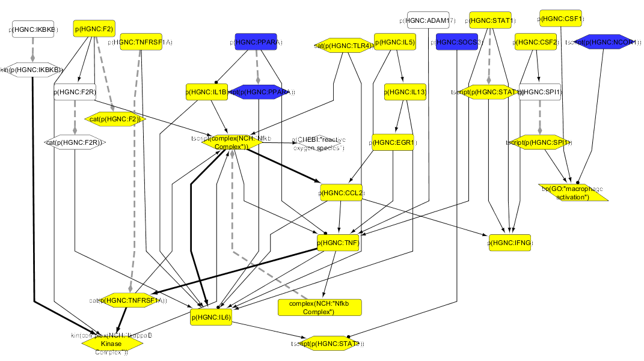
Bleomycin Induces NFKB Signaling as Expected
Bleomycin Mechanisms Predicted in Immune Tissue Repair Network
Consistent with increased process
Consistent with decreased process
  Note: A subset of the network is shown
Bleomycin is known to induce an inflammatory response, and the GSE18800 study measures an increase in macrophages at Days 7 and 21
  Increased NFKB, IL6/STAT3 and Th2 signaling and decreased PPARA regulates a bleomycin-induced immune response
    PMIDs: 12408953, 22684844, 20298567
Predicted mechanisms match findings from the literature, including increased NFKB signaling and macrophage activation

Slide 39
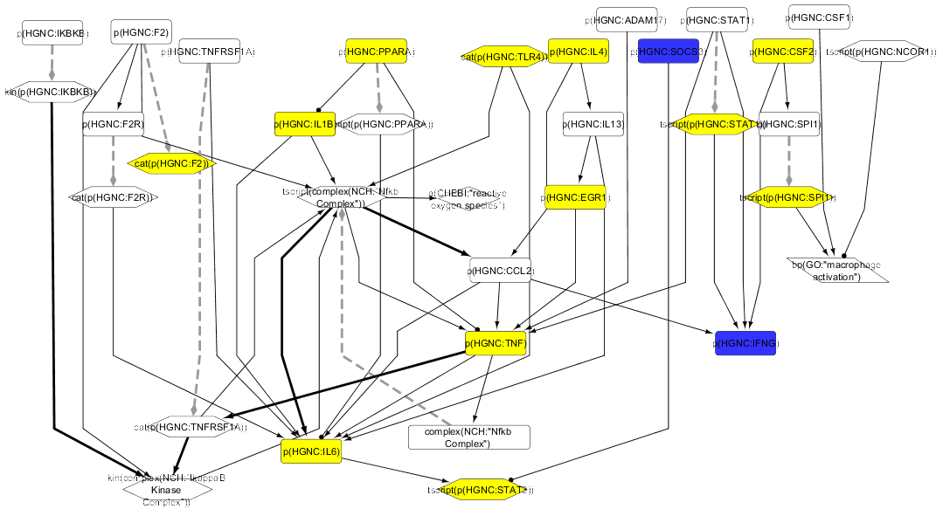
Mechanical Injury Induces Wound Healing Response Through Th2
Mechanical Injury Mechanisms Predicted in Immune Tissue Repair Network
Consistent with increased process
Consistent with decreased process
  Note: A subset of the network is shown
Mechanical injury shows a lack of NFKB signaling and a general decrease in predicted inflammatory HYPs compared to the bleomycin data set
In the mechanical injury data set, less than 1% of the sample consisted of inflammatory cells, suggesting inflammation had subsided by Day 7
Increased IL4 and decreased IFNG HYPs support a Th2 wound healing response that may lead to suppression of an inflammatory response
  PMIDs: 10950124, 21050944, 1501575

Slide 40
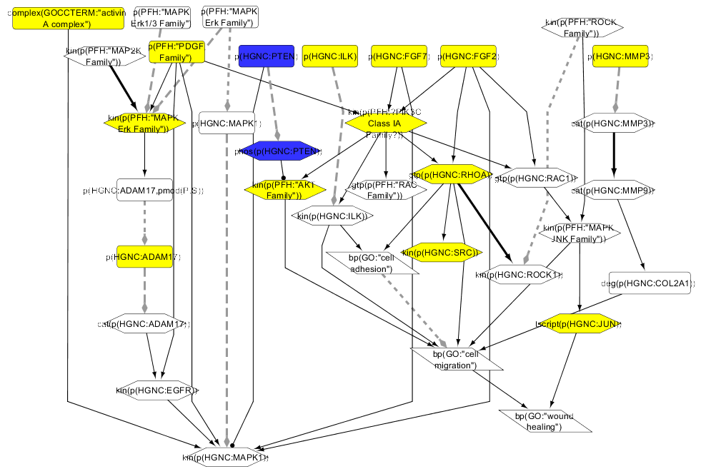
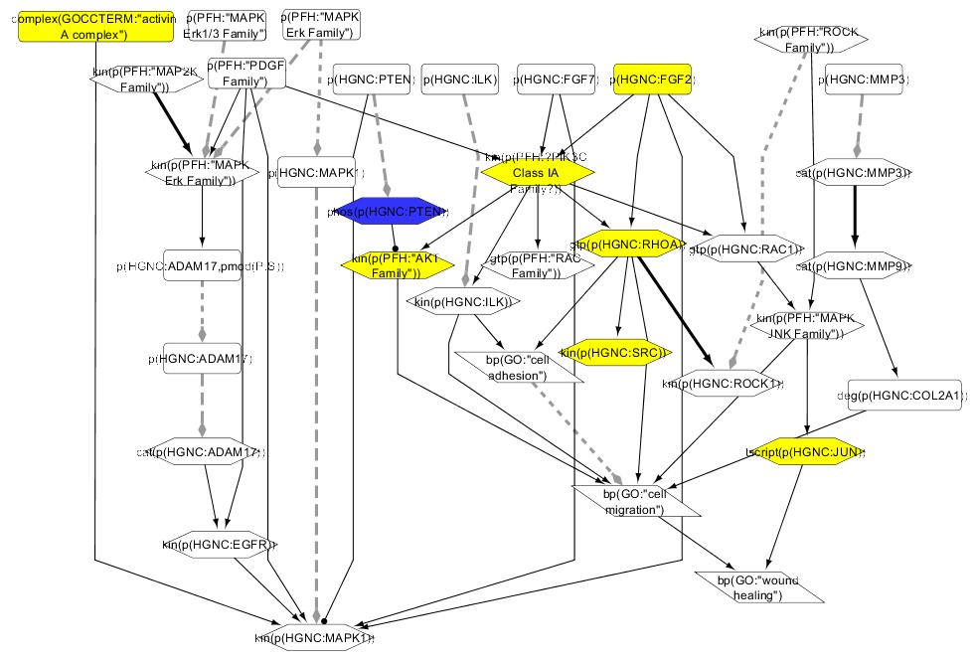
More Cellular Migration-specific Mechanisms Are Predicted in the Bleomycin Data Set
Bleomycin Mechanical injury
In the bleomycin data set, ADAM17 and MMP3 are predicted and known in literature to be induced by bleomycin
  PMIDs: 22687607, 21871427
PI3K and Rho signaling are predicted for both data sets, but these mechanisms can also regulate a variety of other biological processes
Lack of specific migration mechanisms in the mechanical injury data set is in line with endpoints, indicating that cell migration has already taken place
  Fully covered epithelium by day 7

Slide 41
Network Models in Translational Research
The fundamental mechanisms that initiate and propagate the lung injury have not been completely defined
Human studies have provided important descriptive information about the onset and evolution of the physiological and inflammatory changes in the lungs.
This information has led to hypotheses about mechanisms of injury, but for the most part, these hypotheses have been difficult to test in humans
Animal models provide a bridge between patients and the laboratory bench.
Animal model studies are most helpful if the characteristics of the model are directly relevant to humans.
Network models can help understand the strength and limitations of different animal models

Slide 42
Network Verification Challenge in a nutshell

Slide 43
The “Grand Challenge”
Extract disease-
Network Verification
Challenge
related signal
COPD
network
Diagnostic Signature Challenge
COPD
Biomarkers
Species translation formula
COPD clinical data
Species Translation Challenge
Emphysema mouse model
data
Notes:
We have already the puzzle pieces (from previous challenges) we need to build the puzzle

Slide 44
What do we want to address in the Grand Challenge?
We will have:
all the previously developed “puzzle” pieces
newly collected clinical data
newly collected rodent data
We want to:
identify biomarkers for onset of COPD
develop a comprehensive model of COPD onset

Slide 45
COPD Biomarker Identification Study
Controls
COPD
FEV1/FVC ≥ 70%
FEV1 ≥ 80%
60
+ smoking history matched
60
Current Smokers
(≥ 10 pack-year smoking history)
GOLD stage I or IIa*
FEV1/FVC ≤ 70% FEV₁ ≥ 50%
FEV1/FVC ≥ 70%
FEV1 ≥ 80%
* Following GOLD guidelines
60
Former Smokers
Signed consent
Males and females
40-70 years old
BMI 18-35 kg/m2
Ability to perform spirometry
Ability to produce 0.1g sputum
Age and gender- matched
FEV1/FVC ≥ 70%
FEV1 ≥ 80%
60
Never Smokers
Non-interventional, observational case-control design study conducted in the United Kingdom, and has been approved by the UK National Health Service (NHS) Ethics Committee
Notes:
The FEV1/FVC ratio, also called Tiffeneau-Pinell index, represents the persons vital capacity
The Global Initiative for Obstructive Lung Disease (GOLD)
FVC
Forced vital capacity: the determination of the vital capacity from a maximally forced expiratory effort
FEV₁
Volume that has been exhaled at the end of the first second of forced expiration

Slide 46
Study Design and Measured Endpoints in Emphysema Mouse Model
Exposure duration (months)
Inflammation:
BALF** analysis
Circulating whole blood cell count differential
Pulmonary function
- Flow-volume loops
- FEV0.1 ***
- Resistance, Compliance
- Elastance
Lung histopathology and morphometry
Genomics and Transcriptomics (lung, nasal epithelium, aortic arch, liver, blood)
Lipidomics (lung, liver, aorta, blood)
1
2
3
4
5
6
7
Sham
Reference cigarette 3R4F
“Cessation”
** BALF: bronchoalveolar lavage fluid
*** FEV0.1 forced expiratory volume in 0.1s
Notes:
Lipidomics is the large-scale study of pathways and networks of cellular lipids in biological systems
It is a subset of the "metabolome”
Lipids also regulate protein function and gene transcription as part of a dynamic "interactome" within the cell.

Slide 47
Grand Challenge Summary
Probable launch date in Q2 2014
Leverage the “wisdom of crowds” to develop methodologies for predicting the prognostic impact of different stimuli on COPD.
Network information verified by the Network Verification Challenge will be included as one of the inputs
From this and the preceding challenges, we as a scientific community will better understand the biology that underlies COPD.

Slide 48
Thank you for your Attention
The sbv IMPROVER project and www.sbvimprover.com are part of a collaboration designed to enable scientists to learn about and contribute to the development of a new crowd sourcing method for verification of scientific data and results. The project team includes scientists from Philip Morris International’s (PMI) Research and Development department and IBM's Thomas J. Watson Research Center. The project is funded by PMI.

Slide 49
BACK UP SLIDES

Slide 50
Abundance Functions
function(namespace:Entity)
Specifies the presence of an individual RNA or protein entity, the symbol of which is derived from an associated namespace
The “complex” function is used to combine multiple abundance values to signify a molecular complex
Short Form | Long Form | Example | Example Description
a() | abundance() | a(CHEBI:water) | the abundance of water
p() | proteinAbundance() | p(HGNC:IL6) | the abundance of human IL6 protein
complex() | complexAbundance() | complex(NCH:"AP-1 Complex") | the abundance of the AP-1 complex
 |  | complex(p(MGI:Fos), p(MGI:Jun)) | the abundance of the complex comprised of mouse Fos and Jun proteins
g() | geneAbundance() | g(HGNC:ERBB2) | the abundance of the ERBB2 gene (DNA)
m() | microRNAabundance() | m(MGI:Mir21) | the abundance of mouse Mir21 microRNA
r() | rnaAbundance() | r(HGNC:IL6) | the abundance of human IL6 RNA

Slide 51
Activity Functions
function(namespace:Entity)
Applied to protein and complex abundances to specify the molecular activity of the abundance
Short Form | Long Form | Example | Example Description
cat() | catalyticActivity() | cat(p(RGD:Sod1)) | the catalytic activity of rat Sod1 protein
chap() | chaperoneActivity() | chap(p(HGNC:CANX)) | the events in which the human CANX (Calnexin) protein functions as a chaperone to aid the folding of other proteins
gtp() | gtpBoundActivity() | gtp(p(PFH:"RAS Family")) | the GTP-bound activity of RAS Family protein
kin() | kinaseActivity() | kin(complex(NCH:"AMP-activated protein kinase complex")) | the kinase activity of the AMP-activated protein kinase complex
act() | molecularActivity() | act(p(HGNC:TLR4)) | the ligand-bound activity of the human non-catalytic receptor protein TLR4; a more specific activity function is not applicable to TLR4 protein
pep() | peptidaseActivity() | pep(p(RGD:Ace)) | the peptidase activity of the Rat angiotensin converting enzyme (ACE)
phos() | phosphataseActivity() | phos(p(HGNC:DUSP1)) | the phosphatase activity of human DUSP1 protein
ribo() | ribosylationActivity() | ribo(p(HGNC:PARP1)) | the ribosylation activity of human PARP1 protein
tscript() | transcriptionalActivity() | tscript(p(MGI:Trp53)) | the transcriptional activity of mouse TRP53 (p53) protein
tport() | transportActivity() | tport(complex(NCH:"ENaC Complex")) | the frequency of ion transport events mediated by the epithelial sodium channel (ENaC) complex

Slide 52
Modification Functions
function(namespace:Entity)
Modifications are functions used as arguments within abundance functions
  Post-translational modifications
  Sequence variants (mutations, polymorphisms)
Short Form | Long Form | Example | Example Description
pmod() | proteinModification() | p(HGNC:AKT1, pmod(P)) | the abundance of human AKT1 protein modified by phosphorylation
 |  | p(MGI:Rela, pmod(A, K)) | the abundance of mouse Rela protein acetylated at an unspecified lysine
 |  | p(HGNC:HIF1A, pmod(H, N, 803)) | the abundance of human HIF1A protein hydroxylated at asparagine 803
sub() | substitution() | p(HGNC:PIK3CA, sub(E, 545, K)) | the abundance of the human PIK3CA protein in which glutamic acid 545 has been substituted with lysine
trunc() | truncation() | p(HGNC:ABCA1, trunc(1851)) | the abundance of human ABCA1 protein that has been truncated at amino acid residue 1851 via introduction of a stop codon
fus() | fusion() | p(HGNC:BCR, fus(HGNC:JAK2, 1875, 2626)) | the abundance of a fusion protein of the 5' partner BCR and 3' partner JAK2, with the breakpoint for BCR at 1875 and JAK2 at 2626
 |  | p(HGNC:BCR, fus(HGNC:JAK2)) | the abundance of a fusion protein of the 5' partner BCR and 3' partner JAK2

Slide 53
Process Functions
function(namespace:Entity)
Processes include biological phenomena that occur at the level of the cell or organism
Short Form | Long Form | Example | Example Description
bp() | biologicalProcess() | bp(GO:"cellular senescence") | the biological process cellular senescence
path() | pathology() | path(MESHD:"Pulmonary Disease, Chronic Obstructive") | the pathology COPD

Slide 54
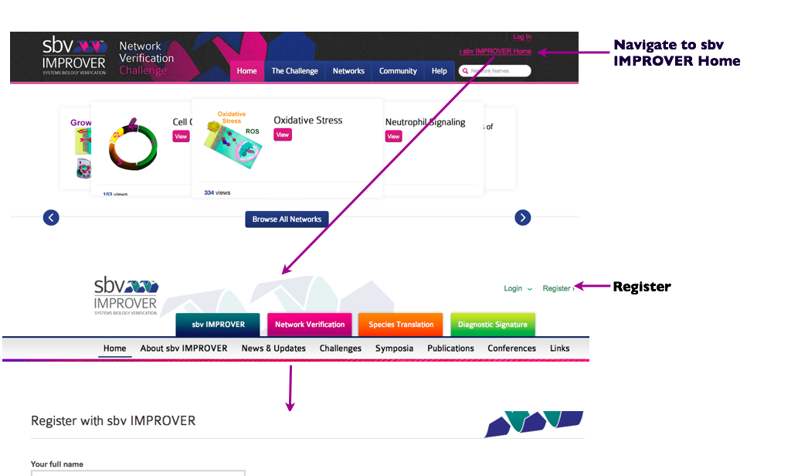
Registering: https://bionet.sbvimprover.com/
Follow the link in the e-mail (check spam if you don’t see e-mail from the Improver
Return back to the Network verification challenge page (bionet) and Log in)

Slide 55
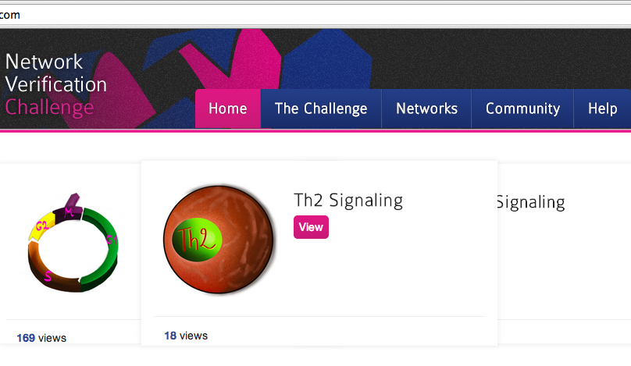


HELP
HELP
VIDEOS
More Help can be found by navigating
To sbv IMPROVER home and selecting
Network Verification tab

